Slide 2



Three habits
Wonder why
Be real
Hope together
Listen to others’ stories and see the world through their eyes.
Encounter others with authenticity and confidence.
Find hope and opportunity in the places where we long to see changes.

Slide 3
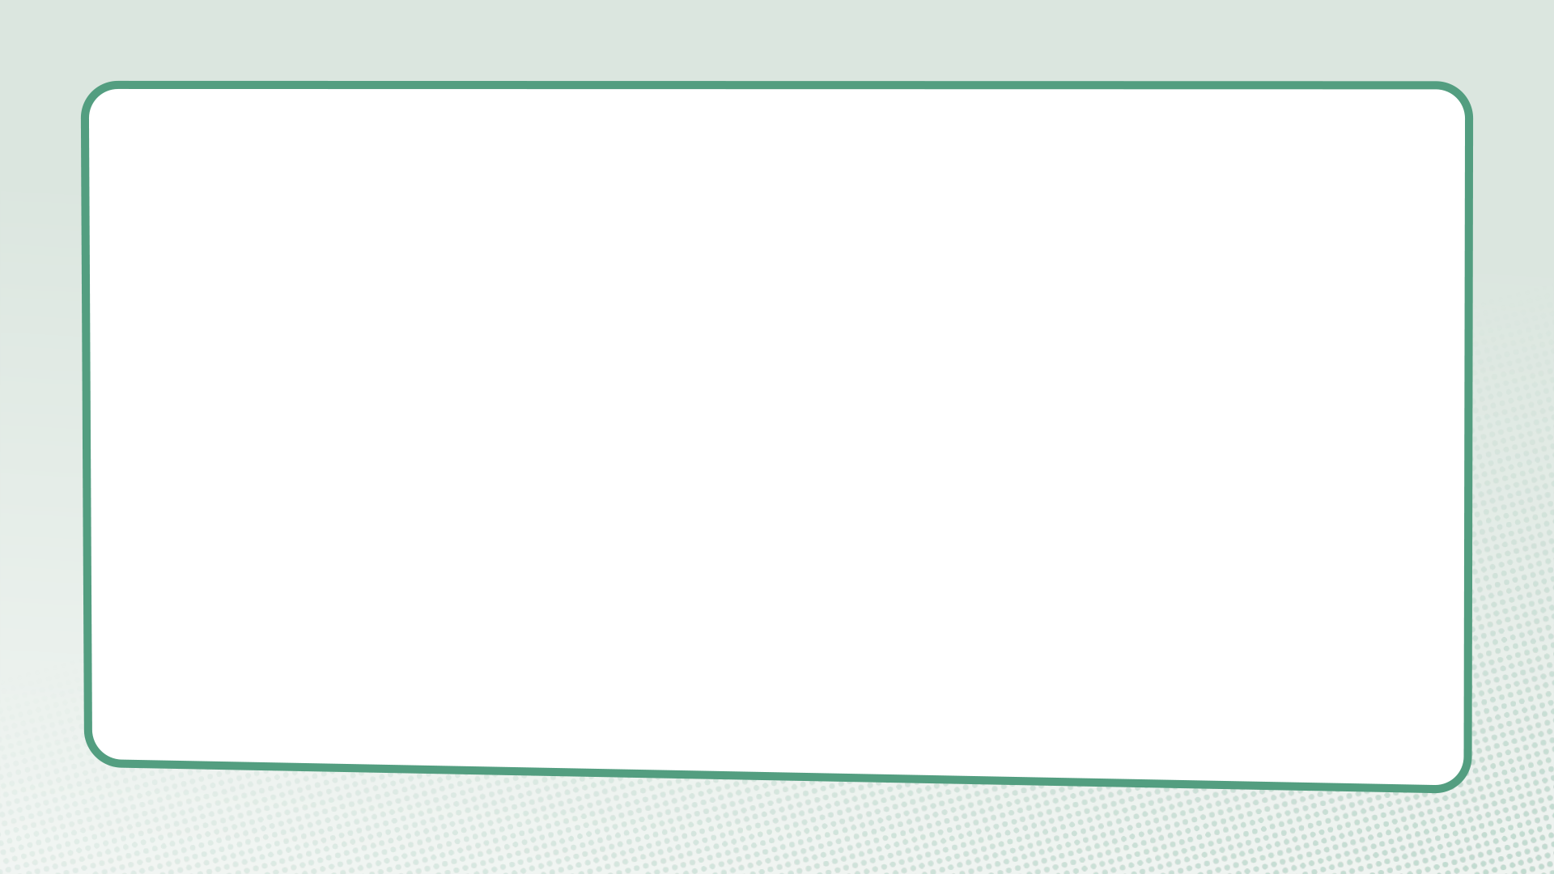
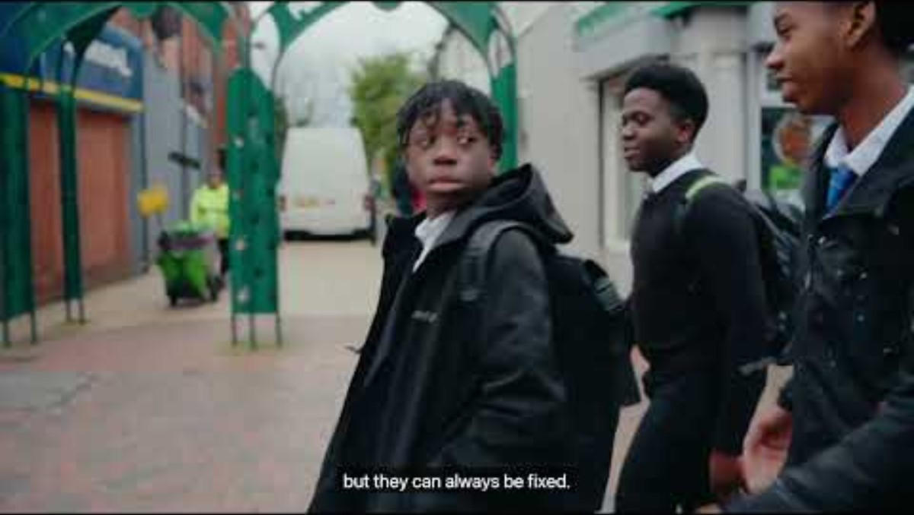

Slide 4
Can you think of an example of difference, division or disagreement which matters to young people and which you’ve been aware of in the last month?

Slide 5
John 10:10b
“I have come in order that you might have life – life in all its fullness.”

Slide 6
Questions for discussion
What is needed for everyone to flourish and live life in all its fullness?
How do our relationships with others impact this?

Slide 7
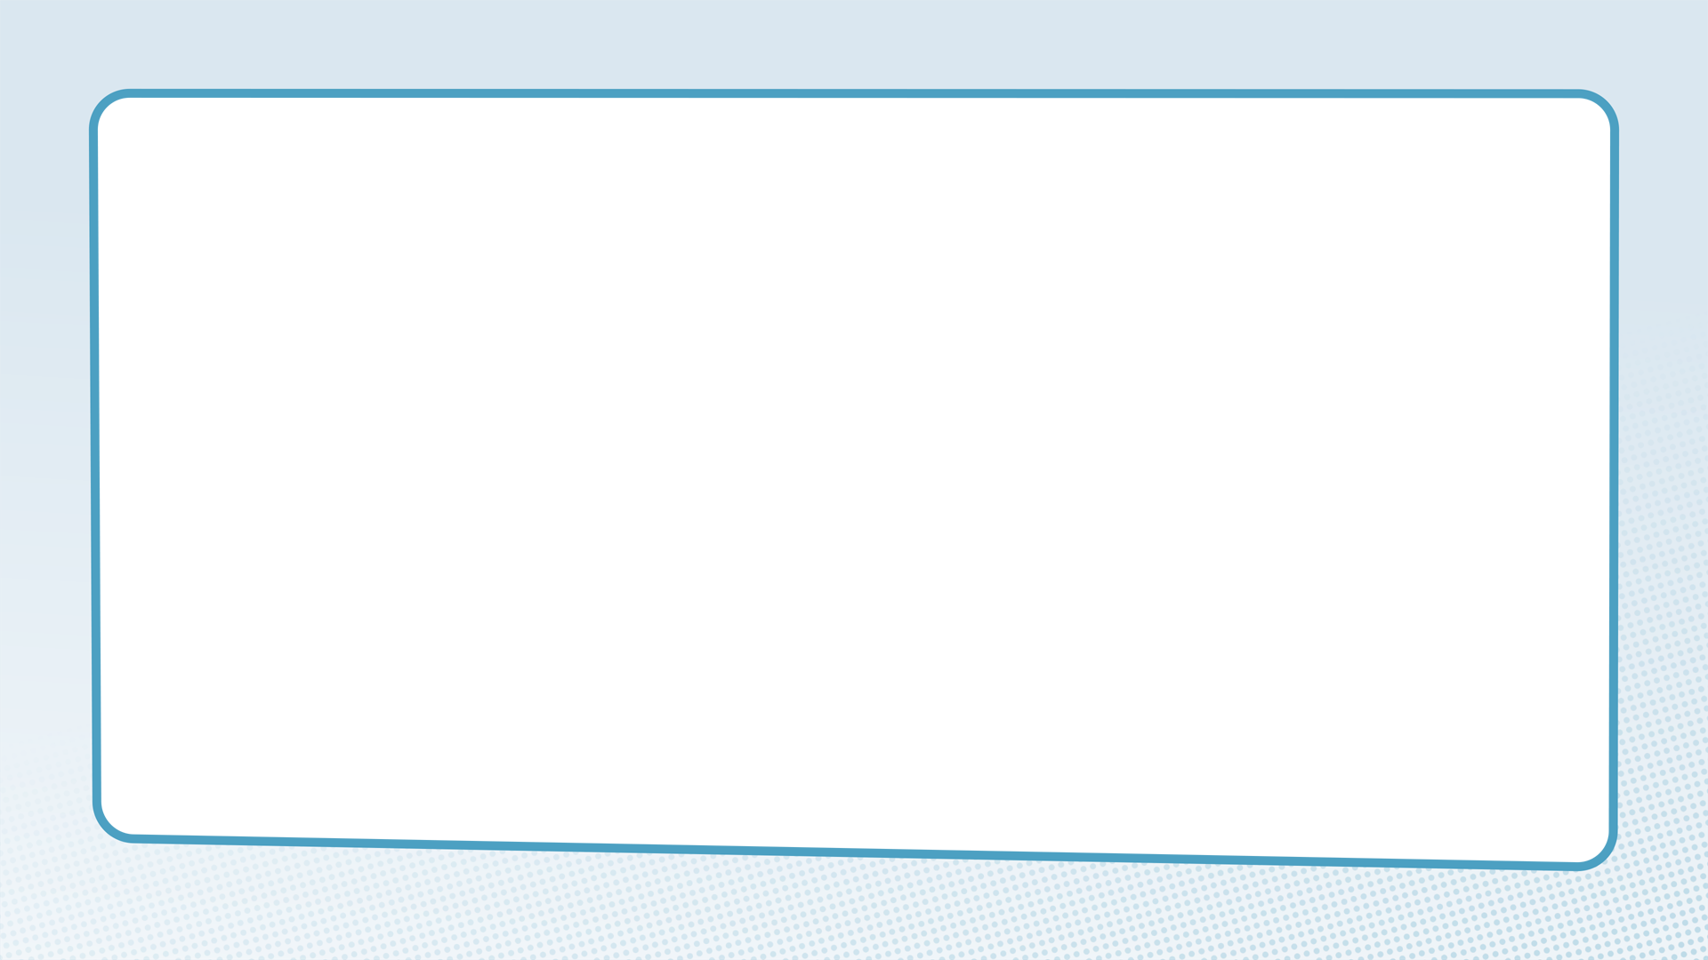
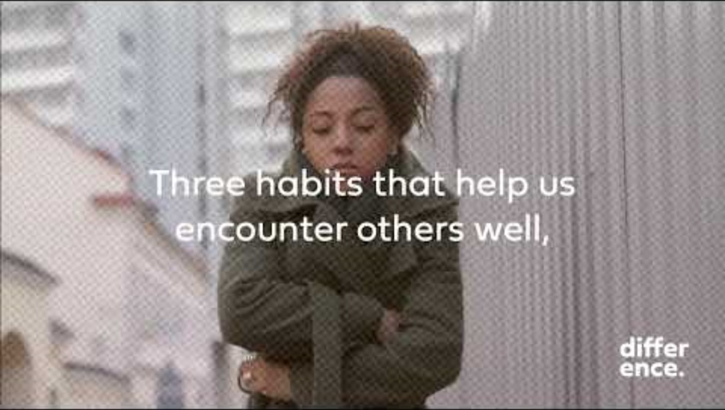

Slide 8
Be Curious:
Against the clock!

Slide 9
Be Present:
Take the register

Slide 10
Reimagine:
Reimagining monsters

Slide 11
Walk

Slide 12
Group guidelines

Slide 13
Explore some guidelines
Ask a respectful question if you hear something you disagree with.
Avoid judging others.
Listen carefully in order to understand others’ perspectives.
Try to stay engaged and avoid distraction.
Be honest.
Don’t interrupt people.
Notice the thoughts and feelings you have during conversations.
Be prepared for others to surprise you.
Don’t treat other people as a spokesperson for their culture
or community.
Remember that God is present in our conversations.

Slide 14
Closing prayer
Loving God, as we begin the Difference course together, inspire us to be curious, to be present and to reimagine as we seek a world where everyone can flourish.
In Jesus’ name. Amen

