Slide 2



Three habits
Wonder why
Be real
Hope together
Listen to others’ stories and see the world through their eyes.
Encounter others with authenticity and confidence.
Find hope and opportunity in the places where we long to see changes.

Slide 3
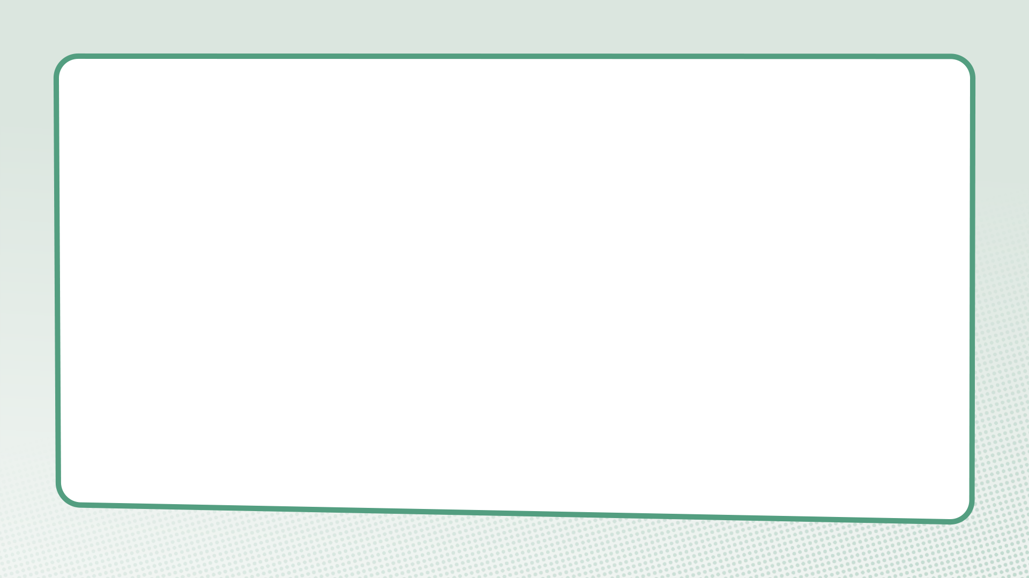
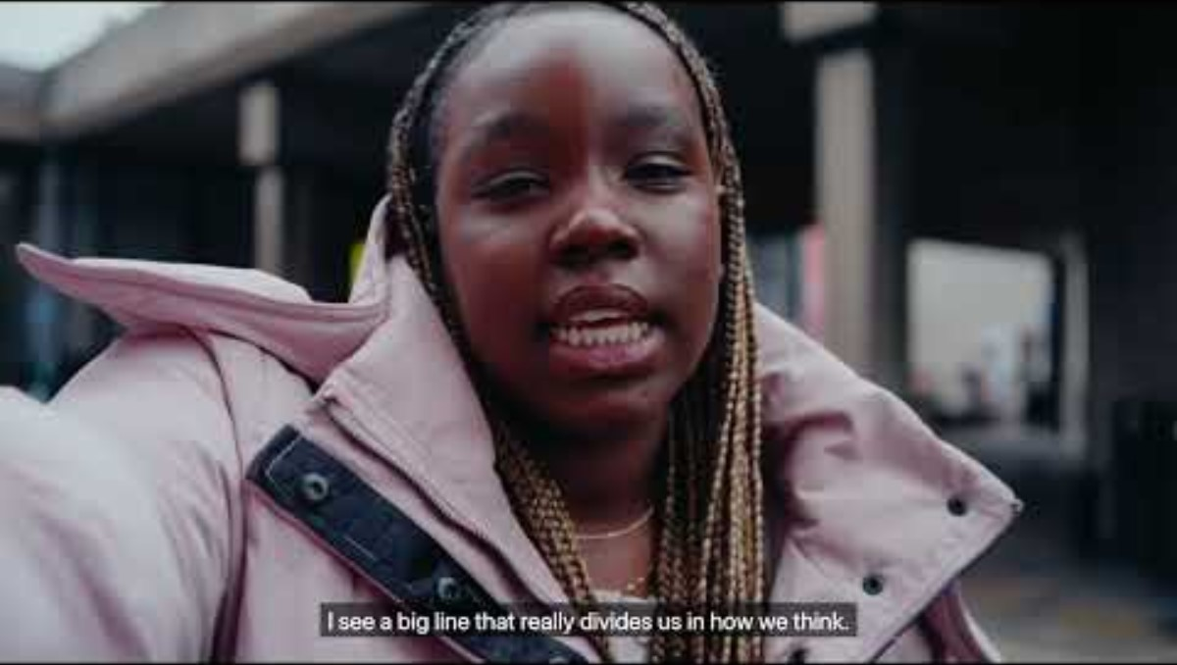

Slide 4
What do we learn about crossing divides in this film?

Slide 5
The woman at the well
John 4:3-42

Slide 6
Questions for discussion
What was the first thing Jesus did when he met the woman in the story?
Why was it unusual for Jesus and the woman to have a conversation?
What questions did Jesus and the Samaritan woman ask each other? Could they have had such a long conversation without asking questions?

Slide 7
Genesis 1:26a
“So God created human beings, making them to be like himself.”

Slide 8
Questions for discussion
Why is this important in our relationships with people who are different from us?
Where do you see similar principles and values in other faiths, worldviews or cultures and community traditions?

Slide 9
Discovering our walls

Slide 10
Thoughts, feelings, responses

Slide 11
What action did you think of to encounter the person on the other side of your ‘wall’?

Slide 12
What is something you want to remember from this session?

Slide 13
Prayer and reflection
Loving God, fill us with your Spirit now.
We think about what we have learnt about asking questions and wondering about another person’s experiences.
Help us to be curious about others’ stories – listening as often as we speak.

Slide 14
We think about the stories we have heard about encountering others different from ourselves.
Give us the courage to be present – showing up and sticking around.
We think about the things we have learned about crossing divides in this session.
Inspire us to reimagine what’s possible – finding hope, knowing that you can transform all things.
In Jesus’ name. Amen

