Slide 2



Three habits
Wonder why
Be real
Hope together
Listen to others’ stories and see the world through their eyes.
Encounter others with authenticity and confidence.
Find hope and opportunity in the places where we long to see changes.

Slide 3
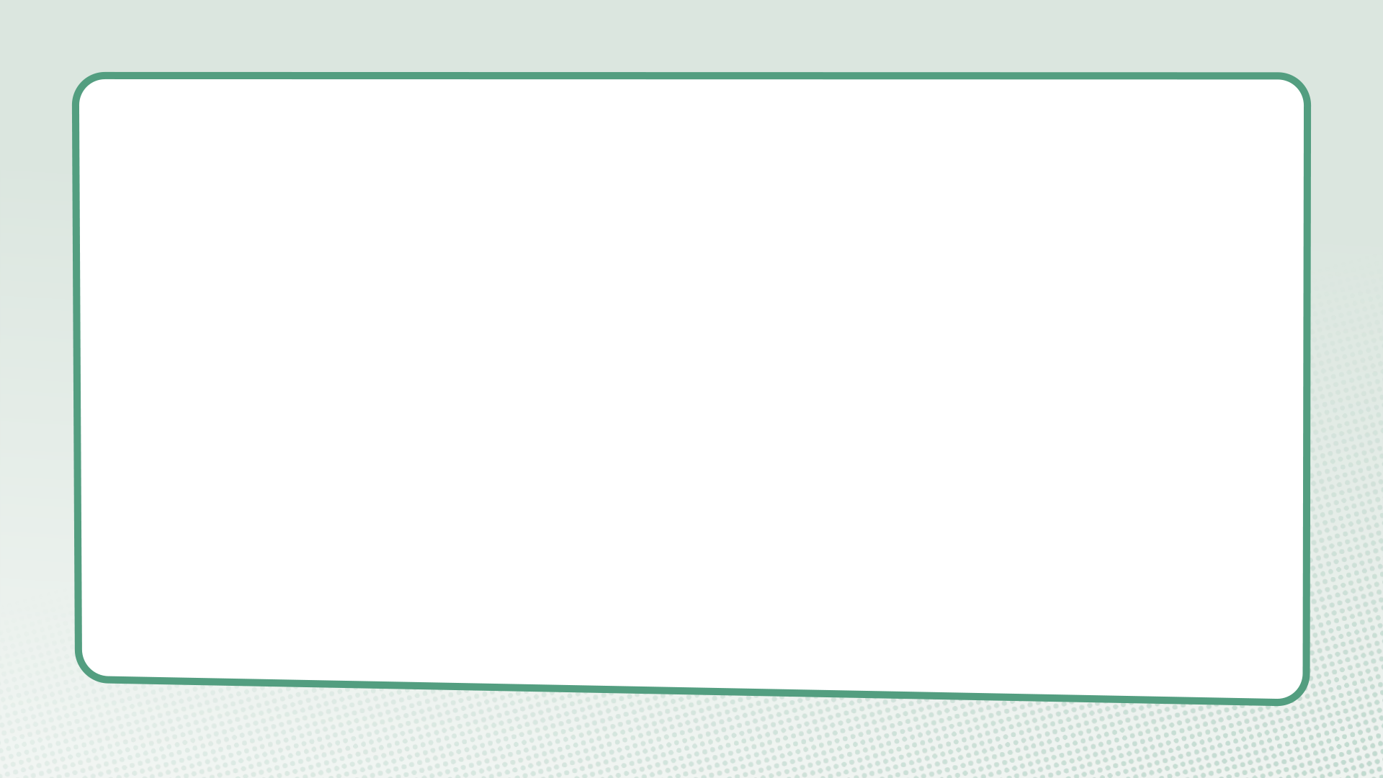
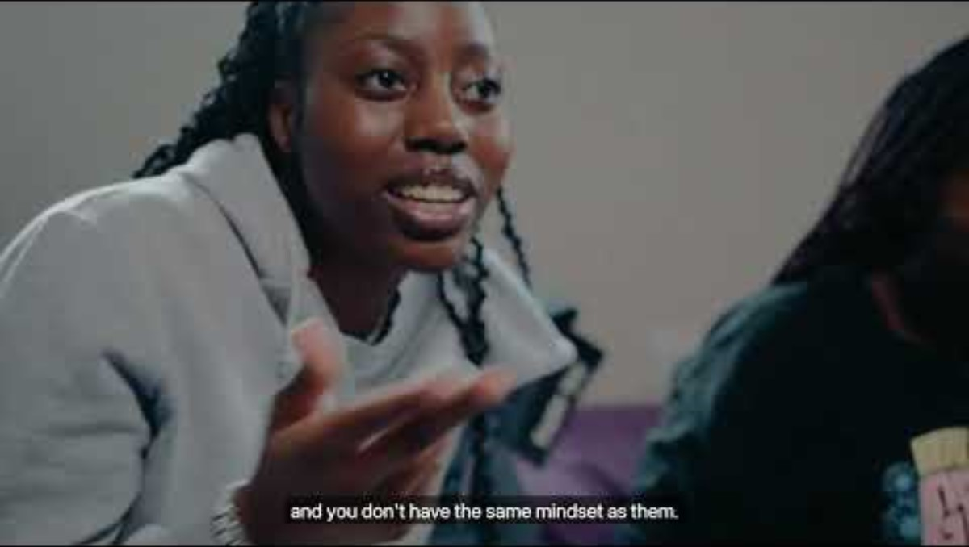

Slide 4
What do we learn about navigating disagreement in this film?

Slide 5
Jesus and the woman at the well
John 4:3-42

Slide 6
Questions for discussion
Did Jesus and the woman avoid difficult topics or express their different opinions and experiences?
What helped them have a good conversation even though they had different views?
How would applying the lessons we learn from Jesus and the Samaritan women help us when we have disagreements?

Slide 7
Luke 6:31
“Do to others as you would have them do to you.”

Slide 8
Questions for discussion
How would applying this help us when we have disagreements?
Where do you see similar principles and values in other faiths, worldviews or cultures and community traditions?

Slide 9
Agree or disagree?

Slide 10
Blind spots

Slide 11
Cancel culture

Slide 12
“Cancelling people pushes them away and makes them more likely to find spaces where bad views are the norm... Cancel culture, as I see it, involves the shutting down of different perspectives” – Matt Haig
“Being called out has made me a better person. Not being cancelled has enabled me to be accountable, learn from my mistakes, and go on to share those lessons with others and do good with my privilege” – Jameela Jamil
“[Cancel culture creates a] culture of accountability which... needed to come into being.” – Lisa Nakamura

Slide 13
What are the things we can see?
What things might be happening that are harder to see?

Slide 14
What is something you want to remember from this session?

Slide 15
Prayer and reflection
Loving God, fill us with your Spirit now.
We think about what we have learnt about empathising with the person we disagree with.
Help us to be curious about others’ stories – listening as often as we speak.

Slide 16
We think about someone who we often disagree with and what we have learn about building good relationships even when we disagree.
Give us the courage to be present – showing up and sticking around.
We think about the things we have learned about navigating disagreement in this session.
Inspire us to reimagine what’s possible – finding hope, knowing that you can transform all things.
In Jesus’ name. Amen

