Slide 2



Three habits
Wonder why
Be real
Hope together
Listen to others’ stories and see the world through their eyes.
Encounter others with authenticity and confidence.
Find hope and opportunity in the places where we long to see changes.

Slide 3

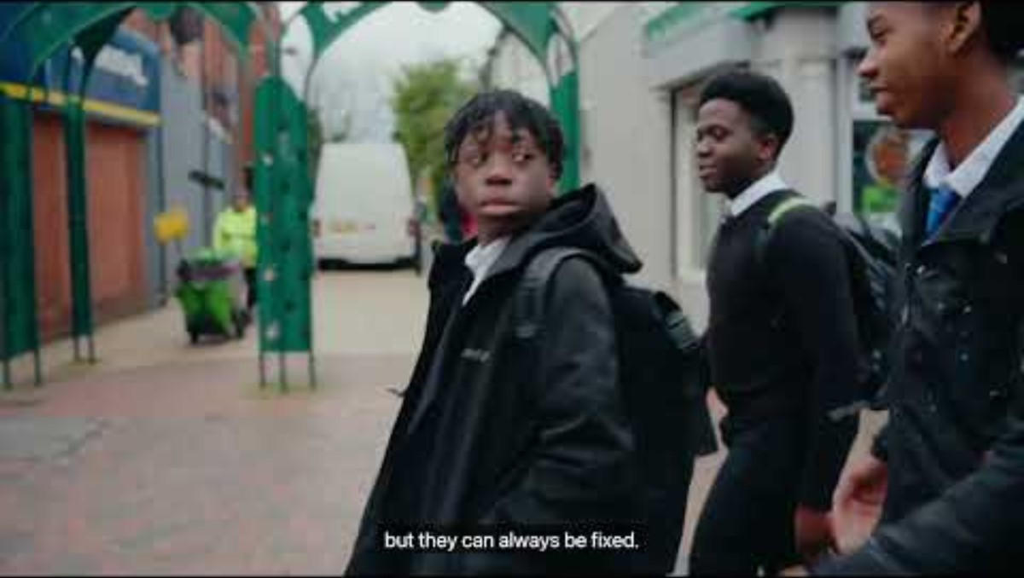


Slide 4
What do we learn about being a peacemaker in this film?

Slide 5
Matthew 5:1-12
When Jesus saw the crowds, he went up the mountain, and after he sat down, his disciples came to him. And he began to speak and taught them, saying:

Slide 6
“Blessed are the poor in spirit, for theirs is the kingdom of heaven.
Blessed are those who mourn, for they will be comforted.
Blessed are the meek, for they will inherit the earth.
Blessed are those who hunger and thirst for righteousness, for they will be filled.
Blessed are the merciful, for they will receive mercy.
Blessed are the pure in heart, for they will see God.

Slide 7
Blessed are the peacemakers, for they will be called children of God.
Blessed are those who are persecuted for the sake of righteousness, for theirs is the kingdom of heaven.
Blessed are you when people revile you and persecute you and utter all kinds of evil against you falsely on my account. Rejoice and be glad, for your reward is great in heaven, for in the same way they persecuted the prophets who were before you.”

Slide 8
Questions for discussion
What is surprising or unexpected in what Jesus says here?
Were there any words or ideas that were difficult to understand?
What is a peacemaker? What’s the difference between making peace and ‘keeping the peace’?

Slide 9
Questions for discussion
Why do you think Jesus talks about peacemakers being blessed?
What is the point Jesus is making in this passage?
Where do you see the need for peace?
If you put this passage into action, how would it change the way you live?

Slide 10
Matthew 5:9
“Blessed are the peacemakers, for they will be called children of God.”

Slide 11
Questions for discussion
Why do you think Jesus talks about peacemakers being blessed?
What is a peacemaker? What’s the difference between making peace and ‘keeping the peace’?

Slide 12
The big picture

Slide 13
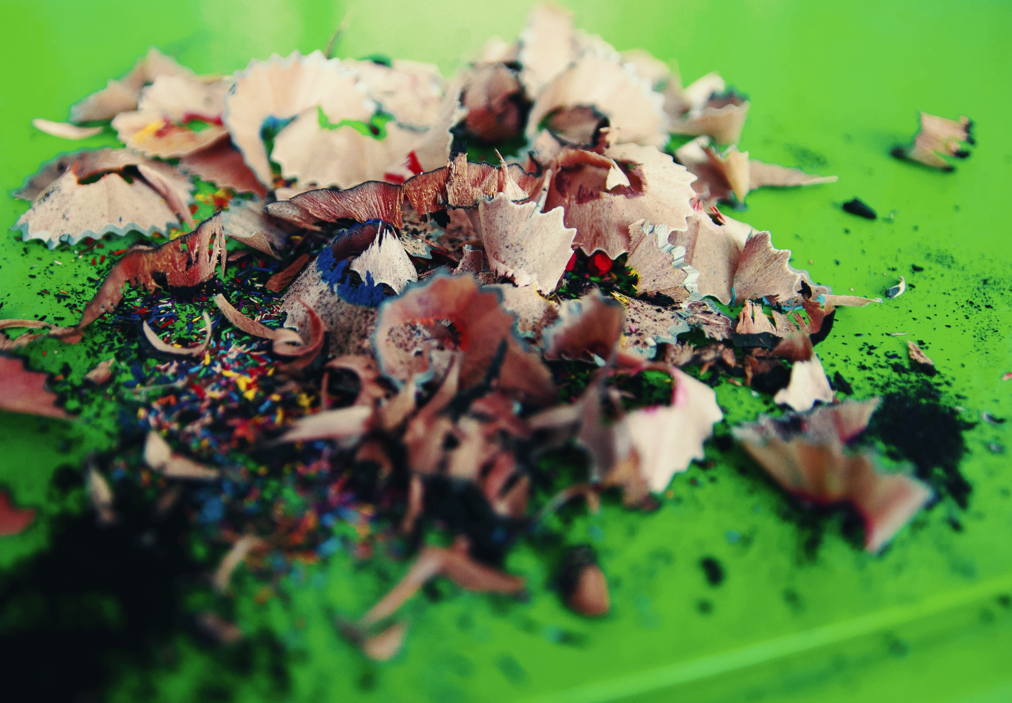

Slide 15
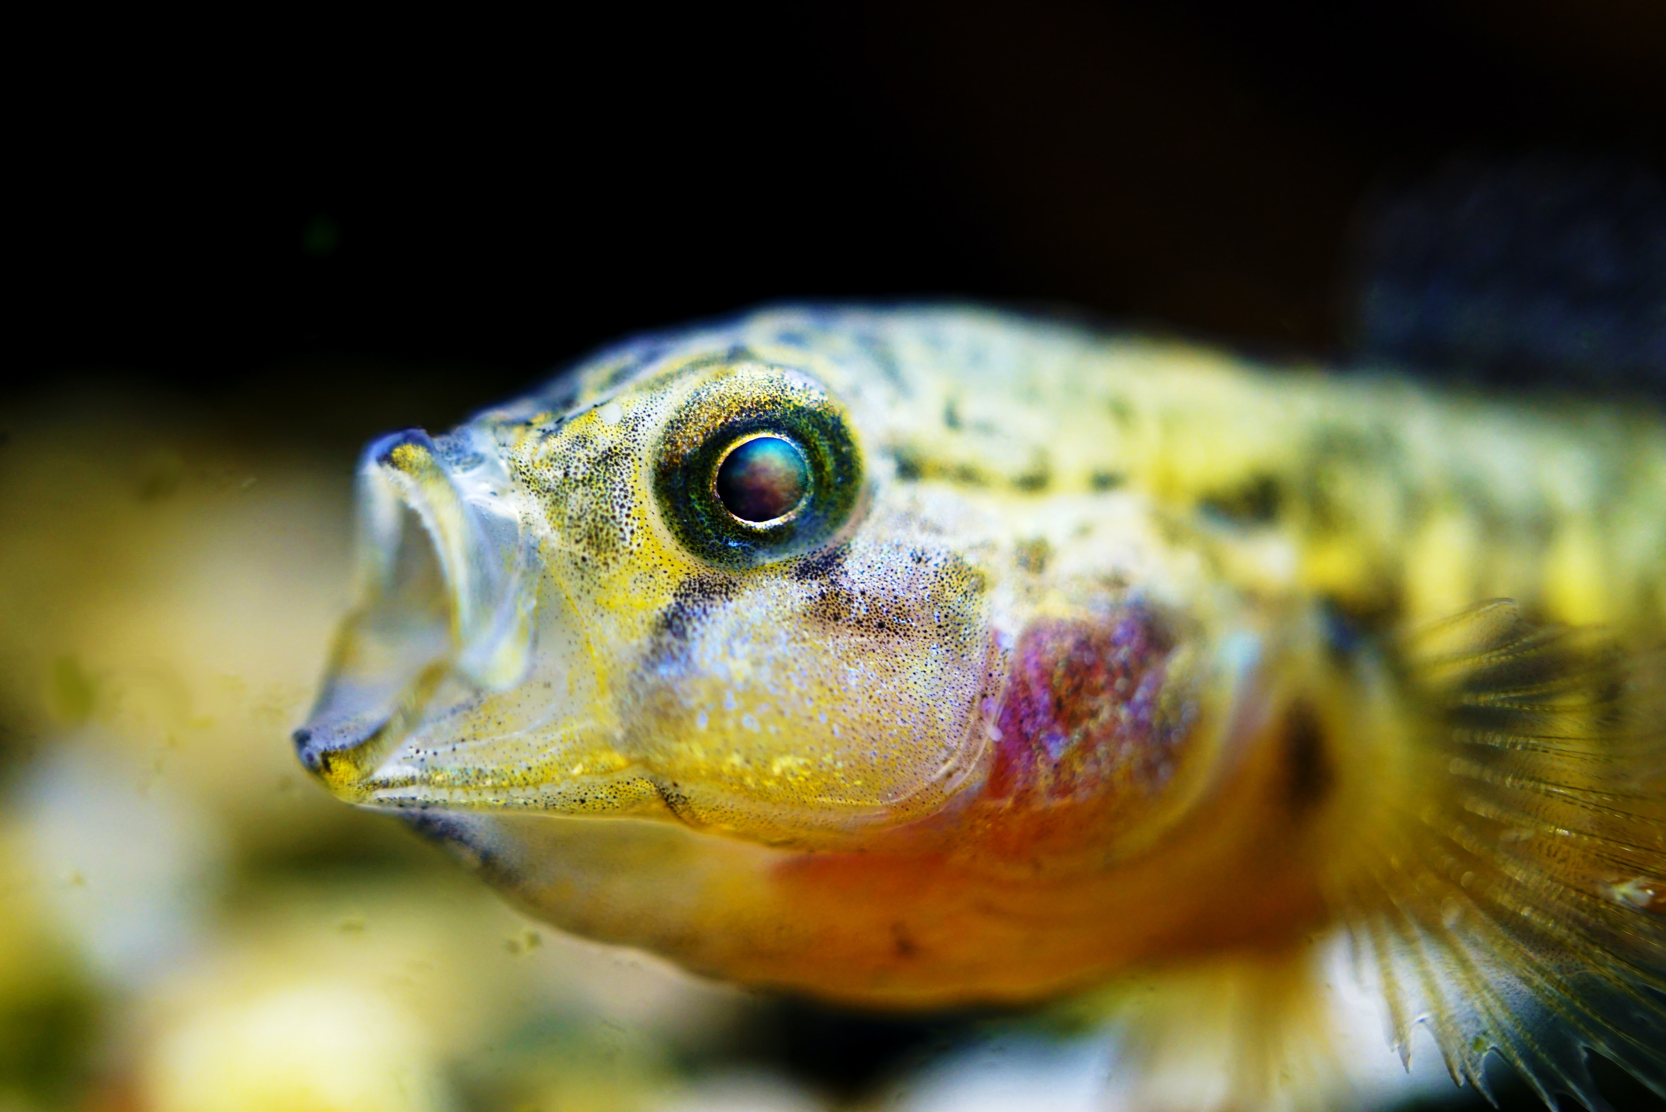

Slide 17


Slide 19
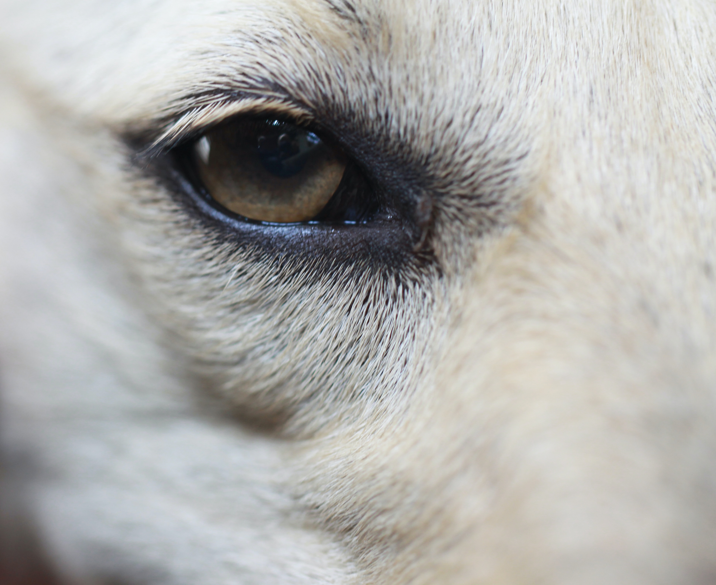

Slide 21
What’s a peacemaker?

Slide 22

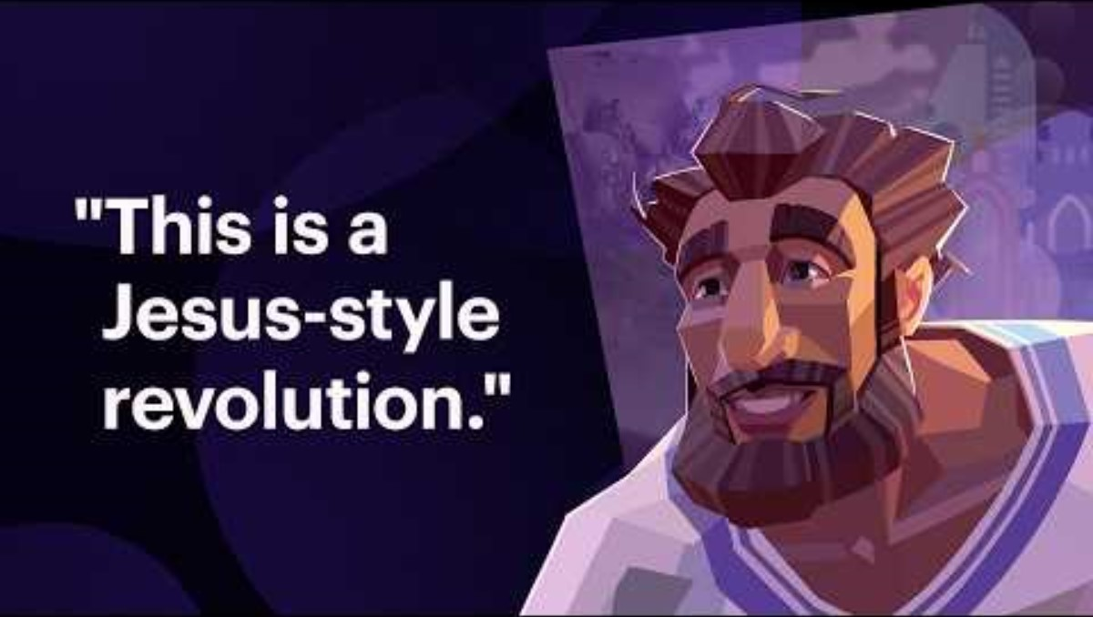

Slide 23
What’s a peacemaker?

Slide 24
The walk

Slide 25
Reflect on each of us being invited to be part of God’s story of peace and reconciliation in this world

Slide 26
What is something you want to remember from this session?

Slide 27
Prayer and reflection
Loving God, fill us with your Spirit now.
We think about what we have learnt about your story of reconciliation in the world.
Help us to be curious about others’ stories – listening as often as we speak.

Slide 28
We think about the things we have learned about peace and how we can pursue it.
Give us the courage to be present – showing up and sticking around.
We think about your invitation to join with you by becoming peacemakers.
Inspire us to reimagine what’s possible – finding hope, knowing that you can transform all things.
In Jesus’ name. Amen

