Slide 2



Three habits
Wonder why
Be real
Hope together
Listen to others’ stories and see the world through their eyes.
Encounter others with authenticity and confidence.
Find hope and opportunity in the places where we long to see changes.

Slide 3
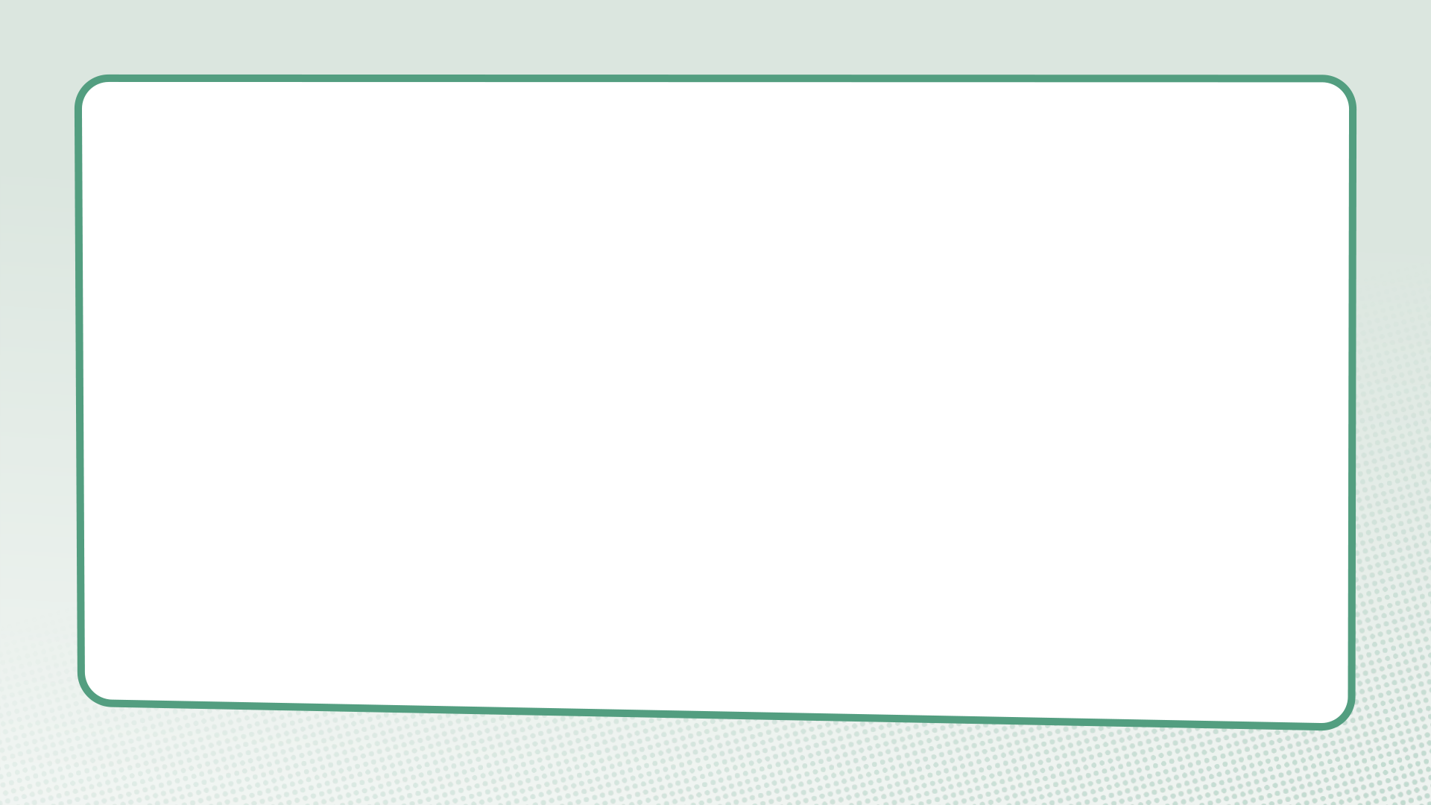
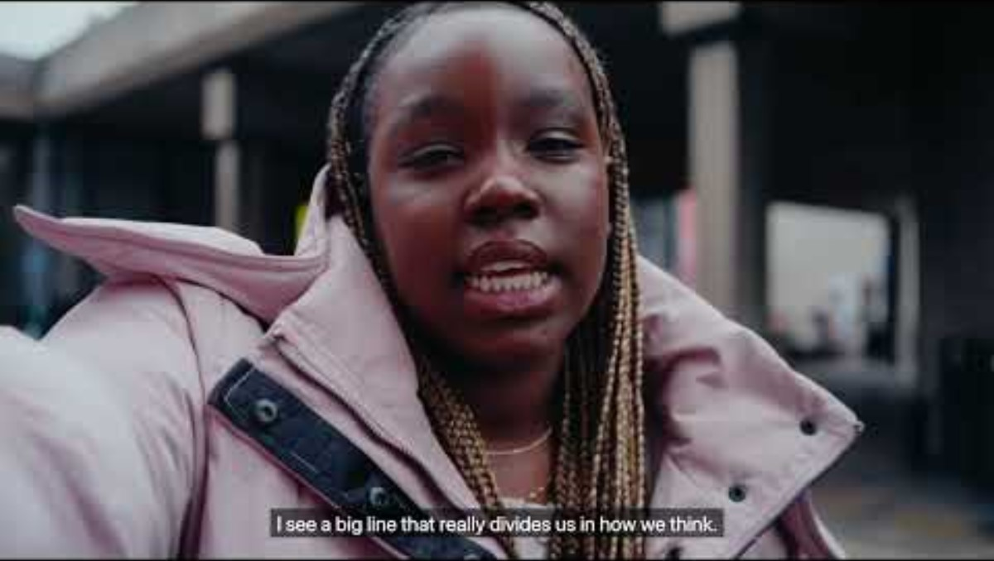

Slide 4
What do we learn about crossing divides in this film?

Slide 5
Jesus and the woman at the well
John 4:3-42

Slide 6
Questions for discussion
What was the first thing Jesus did when he met the woman in the story?
What divides or differences do you notice in this passage?
Why was it unusual for Jesus and the woman to have a conversation? What questions did Jesus and the Samaritan woman ask each other? Could they have had such a long conversation without asking questions?

Slide 7
Questions for discussion
It was unusual for men to talk to women they weren’t related to, and it was unusual for Jews (like Jesus) to talk to people from Samaria. What do you think Jesus is doing here?
What do we learn about crossing divides in this story? Is there anything that could help us cross divides in our own lives?

Slide 8
Genesis 1:26a
“So God created human beings, making them to be like himself.”

Slide 9
Questions for discussion
What does this verse teach us about one another?
Why is this important in our relationships with people who are different from us?
Think about people who are your ‘enemies’. What does it mean to treat them as someone made in God’s image?

Slide 10
Discovering our walls

Slide 11
Dismantling our walls

Slide 12
Behind the wall

Slide 13
What action did you think of to encounter the person on the other side of your ‘wall’?

Slide 14
What is something you want to remember from this session?

Slide 15
Prayer and reflection
Loving God, fill us with your Spirit now.
We think about what we have learnt about asking questions and wondering about another person’s experiences.
Help us to be curious about others’ stories – listening as often as we speak.

Slide 16
We think about the stories we have heard about encountering others different from ourselves.
Give us the courage to be present – showing up and sticking around.
We think about the things we have learned about crossing divides in this session.
Inspire us to reimagine what’s possible – finding hope, knowing that you can transform all things.
In Jesus’ name. Amen

