Slide 2



Three habits
Wonder why
Be real
Hope together
Listen to others’ stories and see the world through their eyes.
Encounter others with authenticity and confidence.
Find hope and opportunity in the places where we long to see changes.

Slide 3
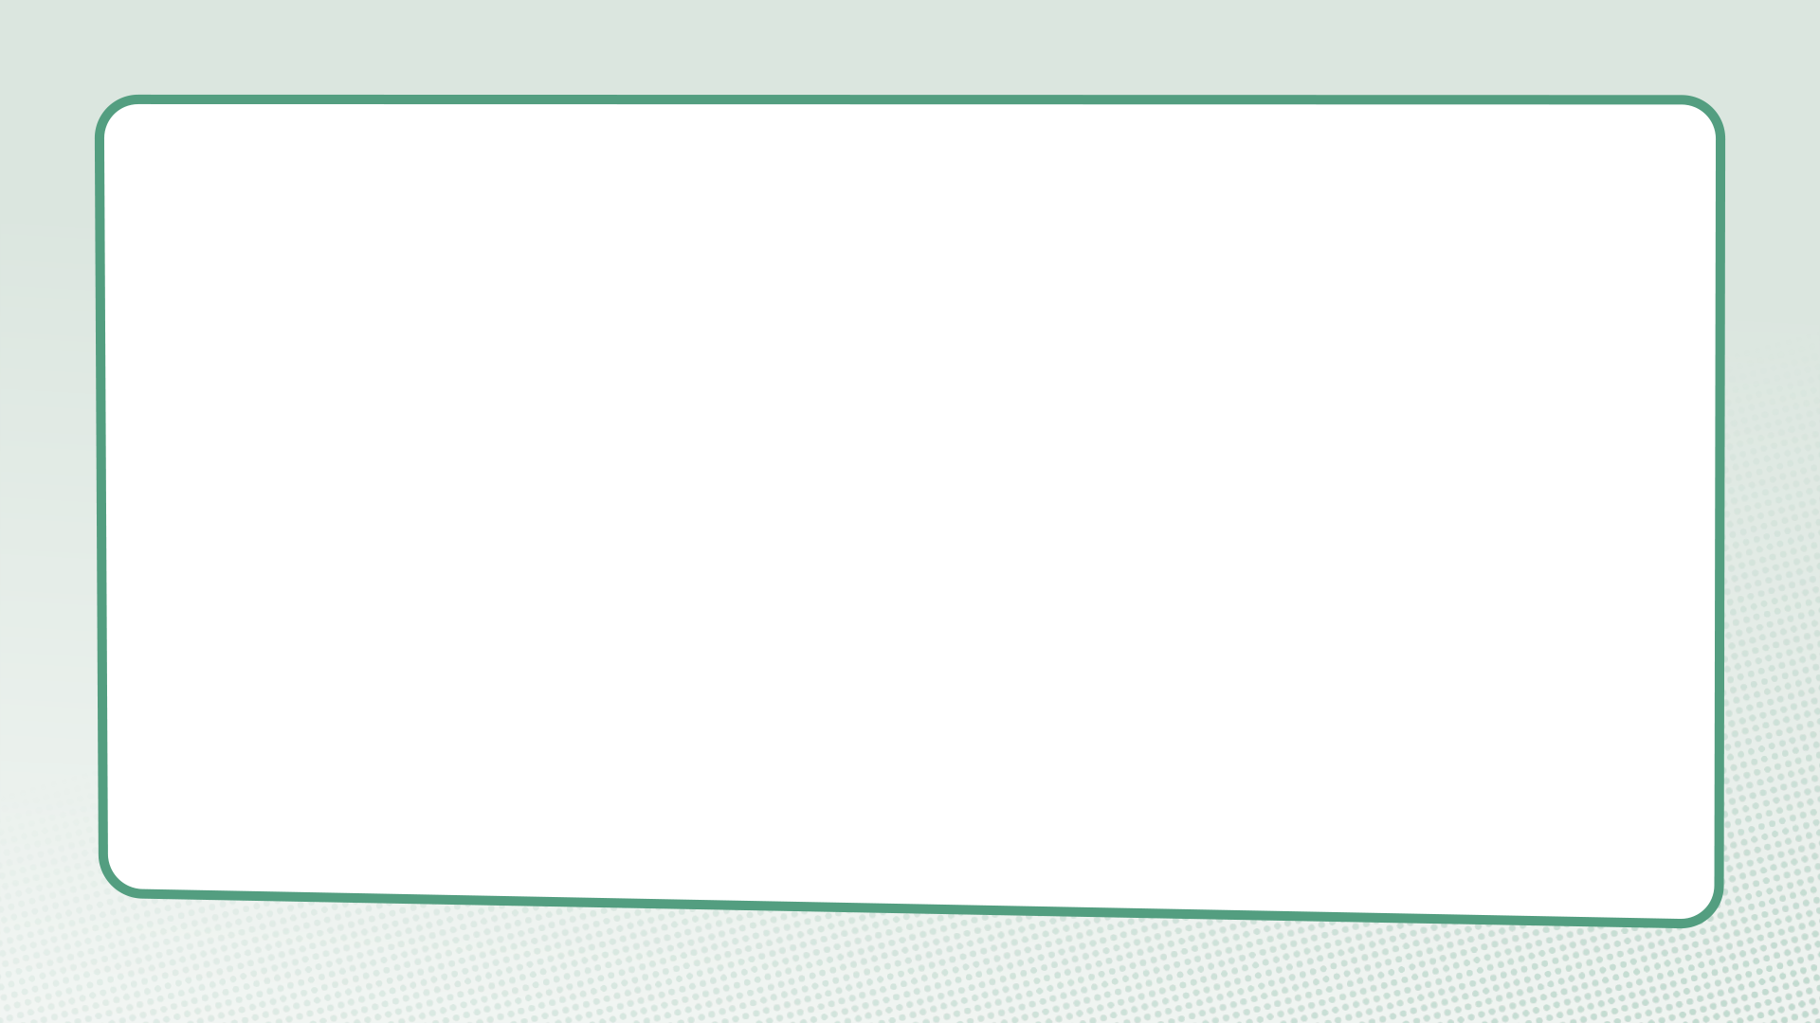
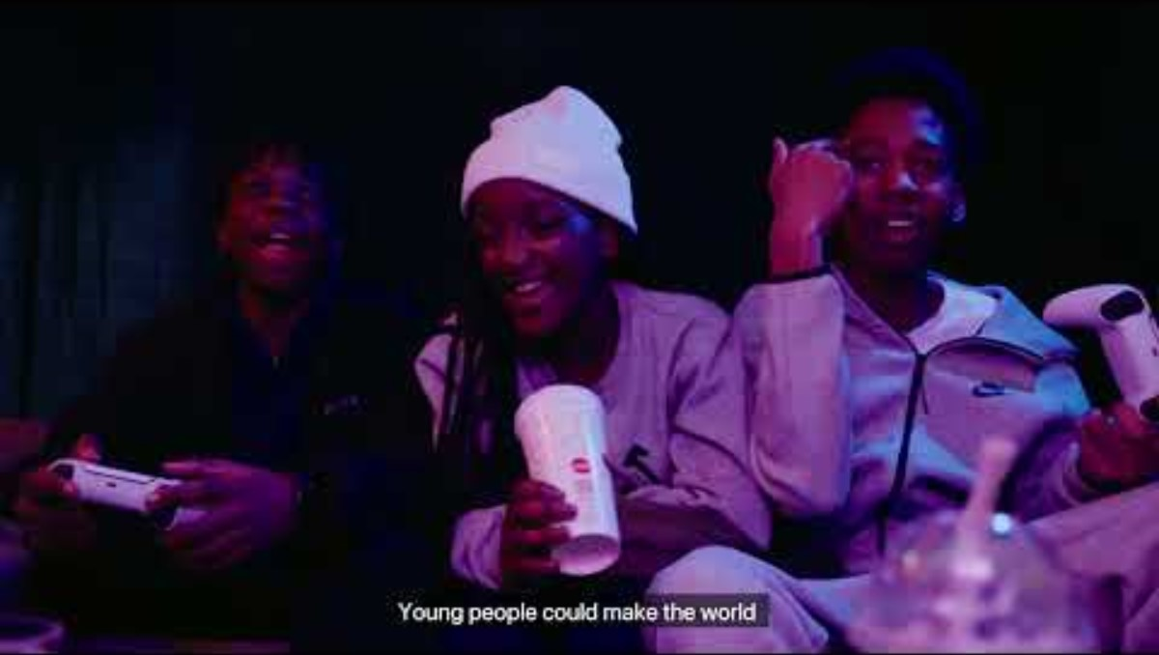

Slide 4
What do we learn about justice in this film?

Slide 5
Jesus and Zacchaeus
Luke 19:1-10

Slide 6
Questions for discussion
In what ways had Zacchaeus contributed to injustice?
Zacchaeus gives half his money to the poor and repays those he’s cheated four times as much. Is this a fair response? Why is making amends an important part of justice?

Slide 7
Questions for discussion
How do you think Jesus’ actions help Zacchaeus to change his behaviour?
Who had power or influence in this story?
What does this story have to say about situations in your own life?

Slide 8
Micah 6:8
“[W]hat does the Lord require of you but to do justice, and to love kindness, and to walk humbly with your God?”

Slide 9
Questions for discussion
What do you think it means to ‘do justice’?
Why is this important for us to ‘do justice’?
What have kindness and humility got to do with justice?

Slide 10
You be the judge

Slide 11
What would you do?

Slide 12
You visit your gran’s house and scoff down a massive doughnut you find in the fridge. You then discover from your mum that your gran has been saving it for her tea.
Do you:
Own up immediately?
Say nothing and hope she doesn’t notice?
Leave the wrapper and a smear of cream in the dog’s bowl and try to blame Rover?
Buy your gran another doughnut and try to put it in her fridge without her seeing?

Slide 13
Your mate brings a new player to football club. You think he says that her name is Dani, but when you call her that, she looks at you weirdly. Then you realise that your mate might have said ‘Sammy’ or even ‘Jenny’.
Do you:
Never speak to her, pass the ball to her or even acknowledge her existence?
Ask her what her name is and then apologise if you got it wrong.
Think of a nickname for her and attempt to get everyone to call her it?
Sneak up to your mate and ask her what her name is and then write it on your hand so you don’t forget?

Slide 14
You go shopping and get a load of new clothes for not very much money. Then you see a video on social media about the collapse of a factory in Cambodia, a factory which made garments from the shop where you bought your new clothes.
Do you:
Take the clothes back and ask to speak to the manager?
Do nothing – Cambodia is thousands of miles away and you don’t know anyone who lives there.
Do nothing, but feel guilty about it?
Find out about the supply chain of the shop and what their policy is about workers’ rights and modern-day slavery?

Slide 15
Your mate gets stopped leaving a shop by a security guard, who asks to see their receipt for what they’ve got in their bag. They look humiliated and outside the shop they tell you that this is the third time this has happened to them this month, even though they’ve never stolen anything in their life.
Do you:
Work together to start a campaign about the discrimination your friend has experienced?
Tell them they’re making it up – it’s never happened to you?
Tell them to forget about it. If they’ve never stolen anything, they’ve got nothing to worry about?
Go back to the shop and demand an explanation from the security guard?

Slide 16
Questions for discussion
If you could see there was an option that seemed the right thing to do, was it easy to choose that option?
Did you think of other ways to act in each situation?
What would you have done differently?
What stops us from challenging injustice in the world, especially if we are part of the problem?

Slide 17
Newspapers

Slide 18
“We can change the world and make it a better place. It is in our hands to make a difference.”
– Nelson Mandela

Slide 19
Complete the sentence:
‘I long for a world where…’

Slide 20
What is something you want to remember from this session?

Slide 21
Prayer and reflection
Loving God, fill us with your Spirit now.
We think about the stories we have heard about the transformation of injustice.
Help us to be curious about others’ stories – listening as often as we speak.

Slide 22
We think about what we have learnt about recognising the injustice experienced by many.
Give us the courage to be present – showing up and sticking around.
We think about the things we have learned about pursuing justice in this session.
Inspire us to reimagine what’s possible – finding hope, knowing that you can transform all things.
In Jesus’ name. Amen

