Slide 2



Three habits
Wonder why
Be real
Hope together
Listen to others’ stories and see the world through their eyes.
Encounter others with authenticity and confidence.
Find hope and opportunity in the places where we long to see changes.

Slide 3
Holding on

Slide 4

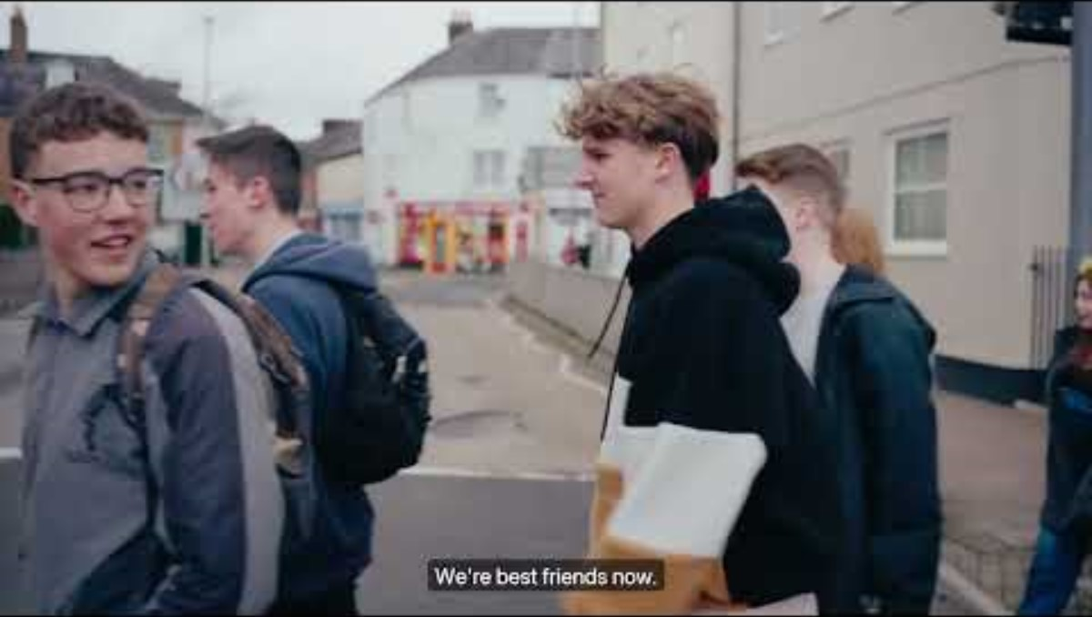

Slide 5
What do we learn about forgiveness in this film?

Slide 6
Jesus and Peter on the beach
John 21:1-19

Slide 7
Questions for discussion
How do you think Peter felt at the start of the story?
Have you ever felt like Peter?
Where do you see forgiveness in the story?
How does Jesus give Peter a new perspective and a new way forward?

Slide 8
The prodigal son
Luke 15:11-32

Slide 9
Questions for discussion
Where do you see forgiveness in the story?
Which character do you find it easiest to understand or identify with?
We don’t know if the older brother forgave his younger brother in the end or not. What do you think would have made it easier for him to forgive and make a fresh start with his brother?

Slide 10
Ephesians 4:32
“Be kind and compassionate to one another, forgiving each other, just as in Christ God forgave you.”

Slide 11
Questions for discussion
Is forgiveness important in friendships? Why/why not?
What do you think about the idea that God forgives? What does that mean?

Slide 12
Stepping into the story

Slide 13
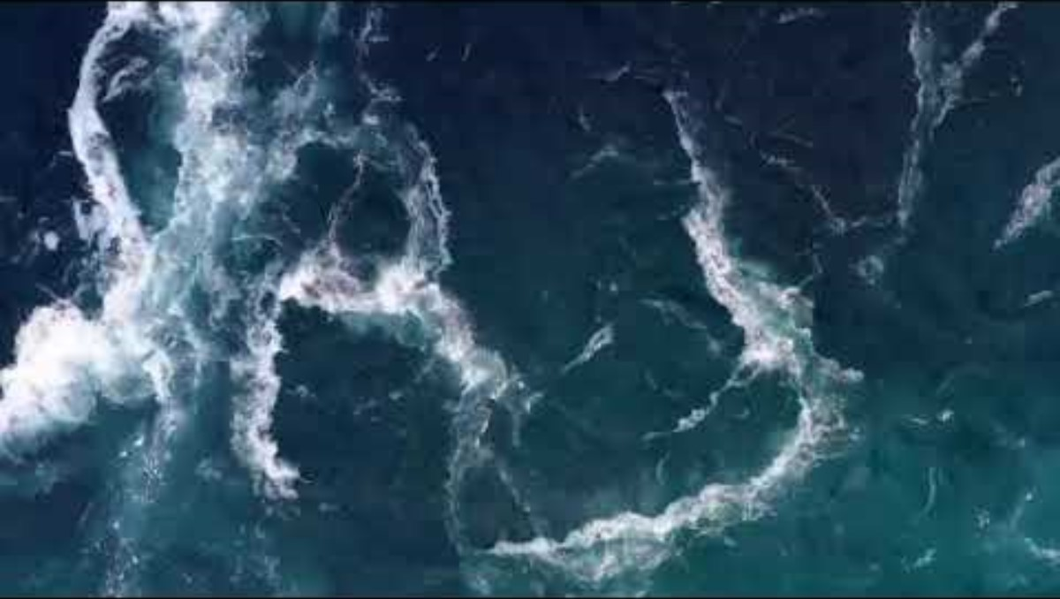


Slide 14
Questions for reflection
How do you feel as you move through the water towards Jesus?
What does it mean for you to eat breakfast with Jesus on this beach?
How do you know that Jesus has forgiven you?
How does this moment change the way you see yourself? What about the way you see your relationship with Jesus? What about the way you see your relationship with others when they let you down?

Slide 15
Letting go

Slide 16
Myth-busting

Slide 17
Complete the sentences
Forgiveness is not [____], it takes [____] and [____________].
Forgiveness is not [________], it takes [_____] and [_____].
Forgiveness is not the same as letting someone off a [___________], but it does mean not seeking [______].
Forgiveness is not [_________]. We can only [____] of the past if we bravely [_________] it.
Forgiveness is not [______], it can take [________________].
hard work
quick
punishment
a long time
determination
easy
courage
remember
strength
weakness
revenge
forgetting
let go

Slide 18
Forgiveness is not [easy], it takes [hard work] and [determination].
Forgiveness is not [weakness], it takes [courage] and [strength].
Forgiveness is not the same as letting someone off a [punishment], but it does mean not seeking [revenge].
Forgiveness is not [forgetting]. We can only [let go] of the past if we bravely [remember] it.
Forgiveness is not [quick], it can take [a long time].

Slide 19
Would you forgive?

Slide 20
Would you forgive? (scenarios)

Slide 21
A good friend accidentally breaks something that belongs to you. The thing they broke was really special to you and your friend is very sorry.

Slide 22
Someone you don’t know very well at school loses their temper with you; they are not sorry.
Later you find out that a member of their family is unwell.

Slide 23
Your boyfriend/girlfriend was seen holding hands with someone else.
They denied it at first but have now said sorry.

Slide 24
Your two-year-old younger brother was sick on your favourite shirt – it is stained and ruined.

Slide 25
You and your best friend have fallen out.
You have both done things wrong but neither wants to say sorry first.

Slide 26
You are very badly injured in a car accident. The driver whose fault it was died in the accident.

Slide 27
Your house is broken into, and a lot of your possessions are stolen. The burglars are never caught.

Slide 28
In an important cup match, someone on your team commits a foul.
The other team get a penalty and your team loses.

Slide 29
A family member has a big birthday coming up.
You had planned to get them a present, but you carelessly spent all your money on yourself. Now you feel really guilty.

Slide 30
Is there anyone that you would like to say sorry to?
Is there anyone that you would like to forgive?

Slide 31
What is something you want to remember from this session?

Slide 32
Prayer and reflection
Loving God, fill us with your Spirit now.
We think about the stories we have heard about forgiveness.
Help us to be curious about others’ stories – listening as often as we speak.

Slide 33
We think about what we have learnt about recognising a hurt.
Give us the courage to be present – showing up and sticking around.
We think about the things we have learned about forgiving and seeking forgiveness.
Inspire us to reimagine what’s possible – finding hope, knowing that you can transform all things.
In Jesus’ name. Amen

