Slide 2



Three habits
Wonder why
Be real
Hope together
Listen to others’ stories and see the world through their eyes.
Encounter others with authenticity and confidence.
Find hope and opportunity in the places where we long to see changes.

Slide 3
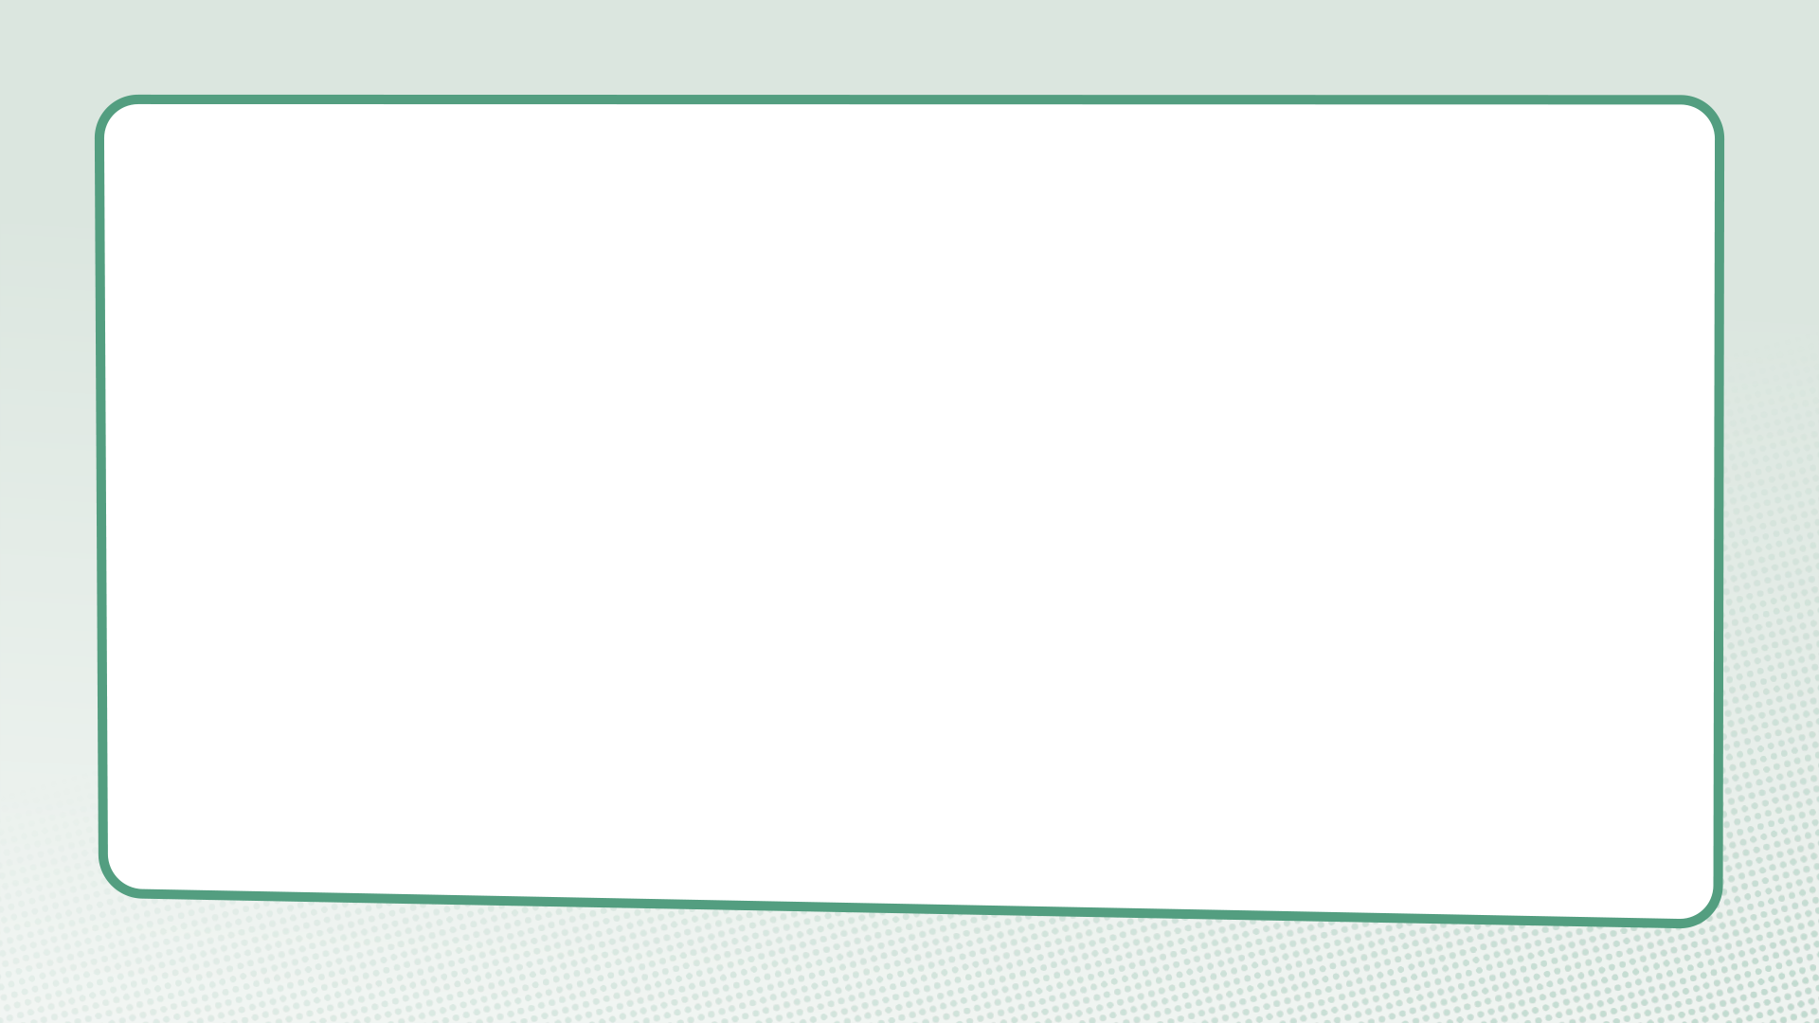
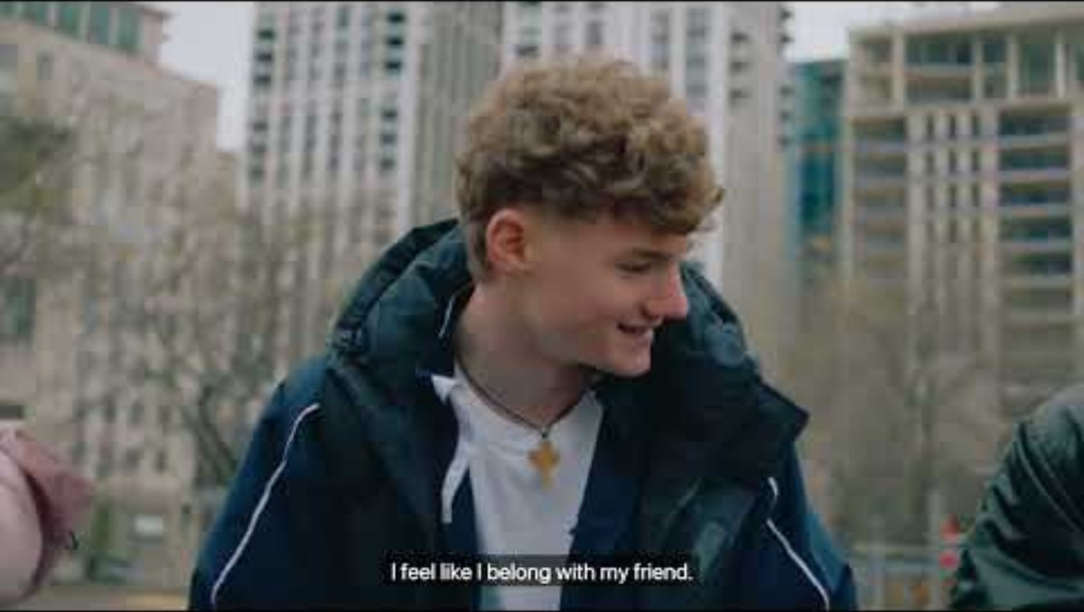

Slide 4
What do we learn about belonging in this film?

Slide 5
1 Corinthians 12:15-22, 26
Suppose the foot says, “I am not a hand. So I don’t belong to the body.” By saying this, it cannot stop being part of the body. And suppose the ear says, “I am not an eye. So I don’t belong to the body.” By saying this, it cannot stop being part of the body. If the whole body were an eye, how could it hear? If the whole body were an ear, how could it smell?

Slide 6
God has placed each part in the body just as he wanted it to be.
If all the parts were the same, how could there be a body? As it is, there are many parts. But there is only one body. The eye can’t say to the hand, “I don’t need you!” The head can’t say to the feet, “I don’t need you!” In fact, it is just the opposite. The parts of the body that seem to be weaker are the ones we can’t do without...
If one part suffers, every part suffers with it. If one part is honoured, every part shares in its joy.”

Slide 7
Questions for discussion
What do you think the writer (St Paul) is trying to say here?
What do you think of the image of a body being used to describe a community?
What would change if we all recognised our need of one another?
Do you see similar principles and values in other faiths, worldviews or cultures and community traditions?

Slide 8
“Ubuntu speaks particularly about the fact that you can’t exist as a human being in isolation. It speaks about our interconnectedness…
I can be me only if you are fully you. I am because we are, for we are made for togetherness, for family. We are made for complementarity. We are created for a delicate network of relationships, of interdependence with our fellow human beings, with the rest of creation.
I have gifts that you don’t have, and you have gifts that I don’t have. We are different in order to know our need of each other. To be human is to be dependent.”
– Archbishop Desmond Tutu

Slide 9
“I am human because I belong, I participate, I share.”
– Archbishop Desmond Tutu

Slide 10
Interweaving stories

Slide 11
Belonging

Slide 12
“I am human because I belong, I participate, I share.” – Archbishop Desmond Tutu
“Today, if we have no peace, it is because we have forgotten that we belong to each other - that man, that woman, that child is my brother or my sister.” – Mother Teresa

Slide 13
“Ubuntu speaks particularly about the fact that you can’t exist as a human being in isolation. It speaks about our interconnectedness…
I can be me only if you are fully you. I am because we are, for we are made for togetherness, for family. We are made for complementarity. We are created for a delicate network of relationships, of interdependence with our fellow human beings, with the rest of creation.
I have gifts that you don’t have, and you have gifts that I don’t have. We are different in order to know our need of each other. To be human is to be dependent.”
– Archbishop Desmond Tutu

Slide 14
What is something you want to remember from this session?

Slide 15
What have you most valued from
doing this course?

Slide 16
Prayer and reflection
Loving God, fill us with your Spirit now.
We think about the fact that our stories are woven together.
Help us to be curious about others’ stories – listening as often as we speak.

Slide 17
We think about our need for one another if we are all to flourish.
Give us the courage to be present – showing up and sticking around.
We thank you for weaving us into your story and inviting us to join together in your work in this world.
Inspire us to reimagine what’s possible – finding hope, knowing that you can transform all things.
In Jesus’ name. Amen

