Slide 1
Instructions
There are a selection of slides for you to use to share about the course with your youth group, school or organisation
Use the template to add in the details about your course – including the dates, location and contact information for the course host.
There’s also slide options with space for a QR code too if your organisation uses them
Your slides will look best using a font called ‘Outfit’ – download for free here: https://fonts.google.com/specimen/Outfit

Slide 2
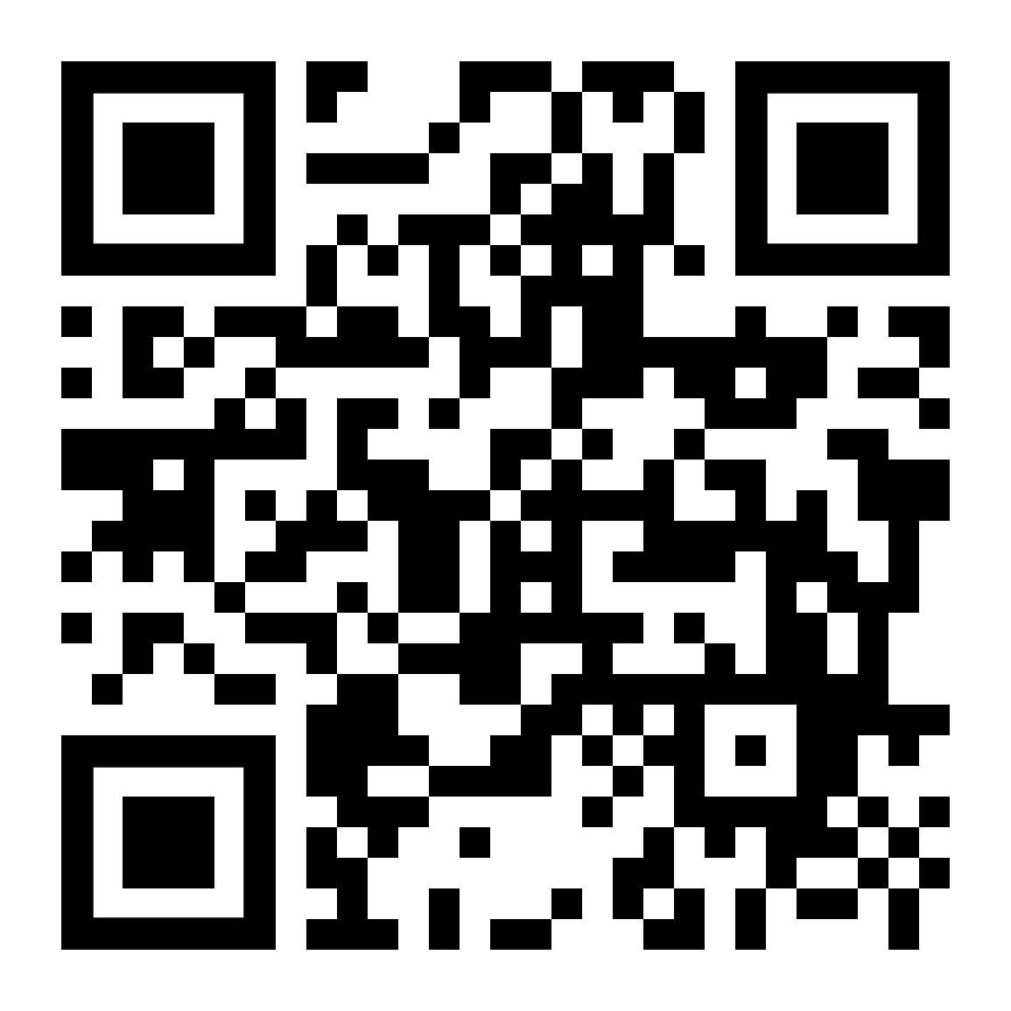
The Difference course
Wednesday evenings, 7-9pm
Starting on Wednesday 5 March
Venue name
Street, Town AB1 2CD
Got questions?
contact@emailaddress.com
01234 567890

Slide 3
The Difference course
Wednesday evenings, 7-9pm
Starting on Wednesday 5 March
Venue name
Street, Town AB1 2CD
Got questions?
contact@emailaddress.com
01234 567890

Slide 4
The Difference course
In a world that is messy, hurting and divided, Difference equips us with skills to cross divides, navigate disagreement, practise forgiveness and pursue a just and flourishing world as we seek to follow Jesus
Wednesday evenings, 7-9pm
Venue name
Street, Town AB1 2CD
Got questions?
contact@emailaddress.com
01234 567890

Slide 5
The Difference course
In a world that is messy, hurting and divided, Difference equips us with skills to cross divides, navigate disagreement, practise forgiveness and pursue a just and flourishing world as we seek to follow Jesus
Wednesday evenings, 7-9pm
Venue name
Street, Town AB1 2CD
Got questions?
contact@emailaddress.com
01234 567890

Slide 6
The Difference course
Wednesday lunchtimes at 1pm
Starting on Wednesday 5 March
Room name
Got questions?
contact@emailaddress.com

Slide 7
The Difference course
Wednesday lunchtimes at 1pm
Starting on Wednesday 5 March
Room name
Got questions?
contact@emailaddress.com

Slide 8
The Difference course
In a conflicted and divided world, Difference is a six-session resource that equips students with skills to cross divides, navigate disagreement and build welcoming school communities
Wednesday lunchtimes at 1pm
Room name
Got questions?
contact@emailaddress.com

Slide 9
The Difference course
In a conflicted and divided world, Difference is a six-session resource that equips students with skills to cross divides, navigate disagreement and build welcoming school communities
Wednesday lunchtimes at 1pm
Room name
Got questions?

