Slide 1
Instructions
There are a selection of slides for you to use to share about the course with your church, small group or organisation
Use the template to add in the details about your course – including the dates, location and contact information for the course host.
There’s also slide options with space for a QR code too if your organisation uses them
Your slides will look best using a font called ‘Outfit’ – download for free here: https://fonts.google.com/specimen/Outfit

Slide 2
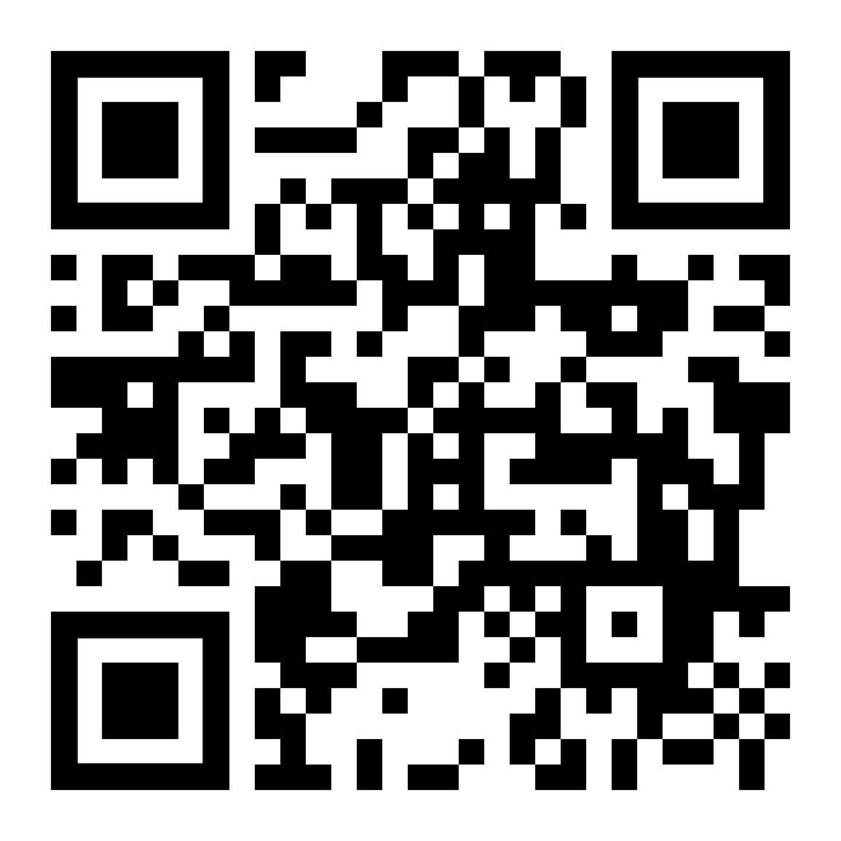
Join the Difference course!
Wednesday evenings, 7-9pm
Starting on Wednesday 5 March
Venue name
Street, Town AB1 2CD
Contact us
contact@emailaddress.com
01234 567890

Slide 3
Join the Difference course!
Wednesday evenings, 7-9pm
Starting on Wednesday 5 March
Venue name
Street, Town AB1 2CD
Contact us
contact@emailaddress.com
01234 567890

Slide 4
Join the Difference course
A five-session course for exploring how we can follow Jesus in a conflicted and divided world
Wednesday evenings, 7-9pm
Venue name
Street, Town AB1 2CD
Contact us
contact@emailaddress.com
01234 567890

Slide 5
Join the Difference course
A five-session course for exploring how we can follow Jesus in a conflicted and divided world
Wednesday evenings, 7-9pm
Venue name
Street, Town AB1 2CD
Contact us
contact@emailaddress.com
01234 567890

Slide 6
Join the Difference course!
Wednesday evenings, 7-9pm
Starting on Wednesday 5 March
Venue name
Street, Town AB1 2CD
Contact us
contact@emailaddress.com
01234 567890

Slide 7
Join the Difference course!
Wednesday evenings, 7-9pm
Starting on Wednesday 5 March
Venue name
Street, Town AB1 2CD
Contact us
contact@emailaddress.com
01234 567890

Slide 8
Join the Difference course
A five-session course for exploring how we can follow Jesus in a conflicted and divided world
Wednesday evenings, 7-9pm
Venue name
Street, Town AB1 2CD
Contact us
contact@emailaddress.com
01234 567890

Slide 9
Join the Difference course
A five-session course for exploring how we can follow Jesus in a conflicted and divided world
Wednesday evenings, 7-9pm
Venue name
Street, Town AB1 2CD
Contact us
contact@emailaddress.com
01234 567890

