Slide 3




Three habits
Community
Embrace
Power
Listen to others’ stories and see the world through their eyes.
Encounter others with authenticity and confidence.
Find hope and opportunity in the places where we long to see changes.

Slide 4
I wonder…
How can our differences make us stronger?

Slide 5

Difference habits EYFS
Coming soon…

Slide 6
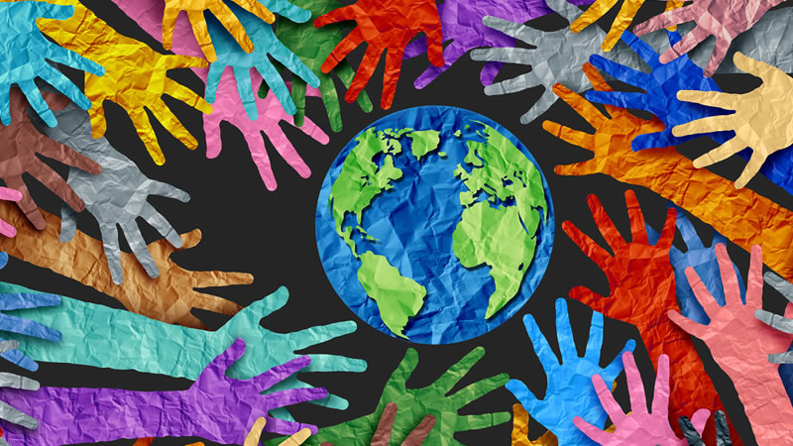
What does the word community mean?

Slide 7
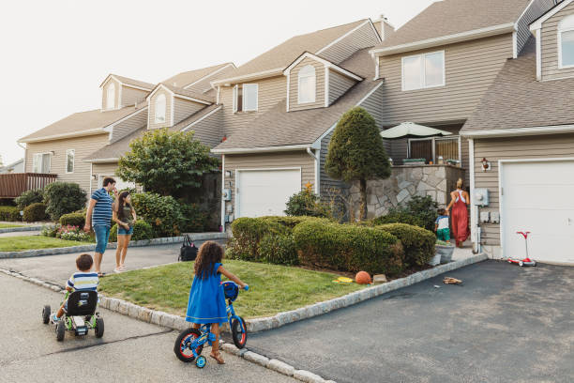
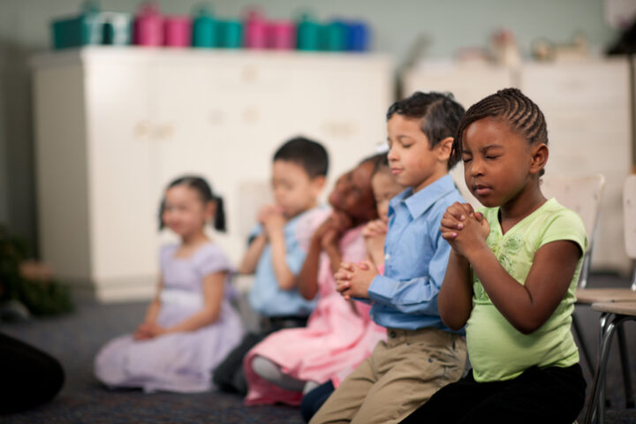
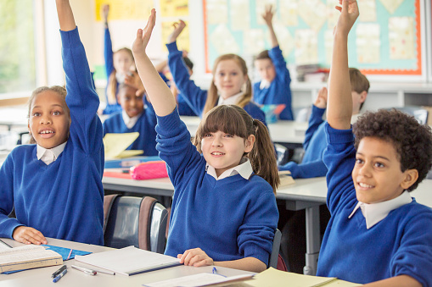
What communities do you belong to?

Slide 8
Is everyone in our community the same or different?

Slide 9
Cheeky Pandas – The Custard Monsters

Slide 10
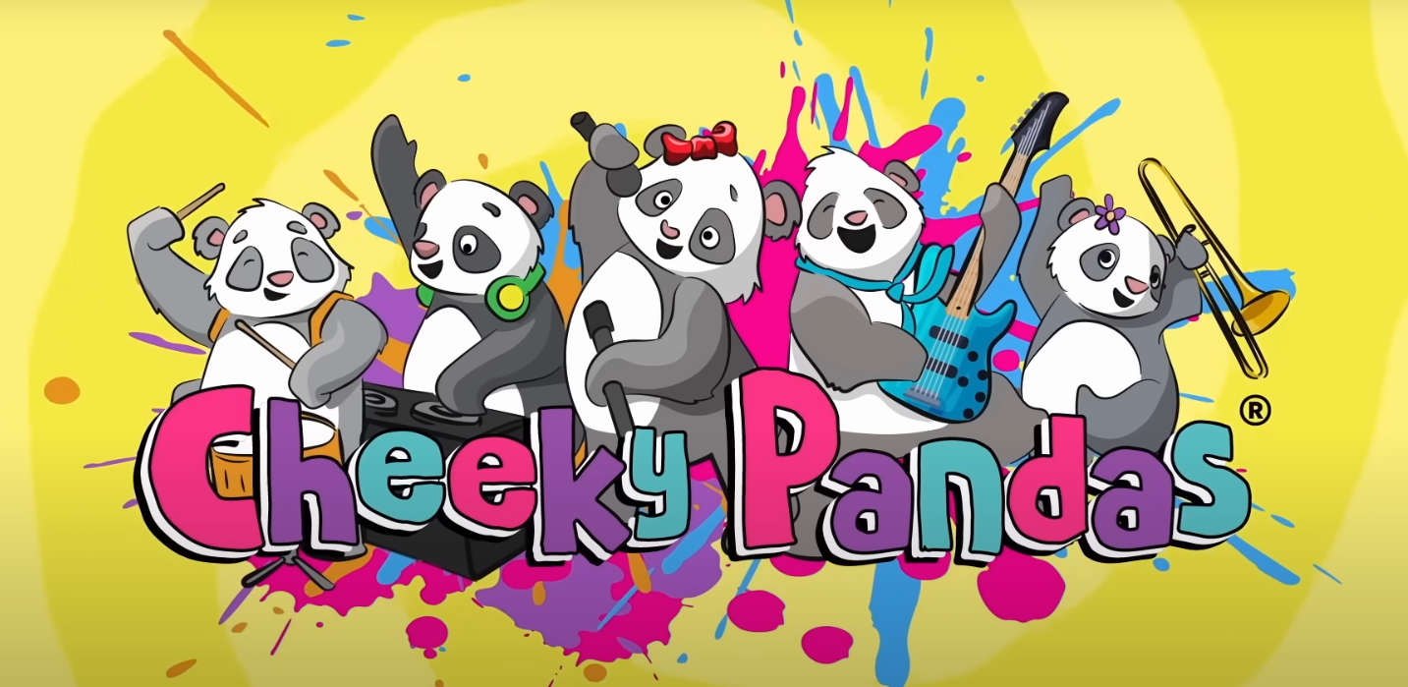

Cheeky Pandas The Custard Monster: A Story About Goodness

Slide 11
Key questions:
How do you think Milo felt when he got the blame and felt left out?
What helped the Pandas realise they had made a mistake?
How did they show goodness and include him again?

Slide 12
Have you ever felt left out? What helped you feel included?
How can we be a community where no one feels left out—even when mistakes happen?

Slide 13
Would you rather..

Slide 14
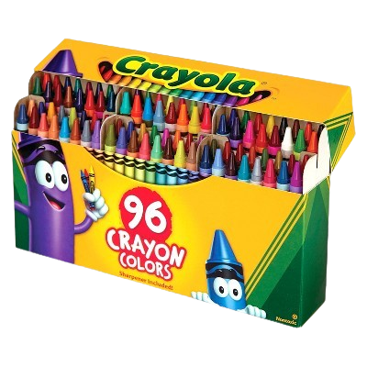
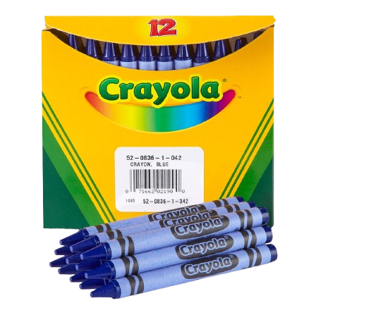
Would you rather use a box of blue crayons or a box full of different colour crayons?

Slide 15
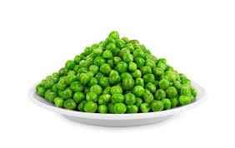
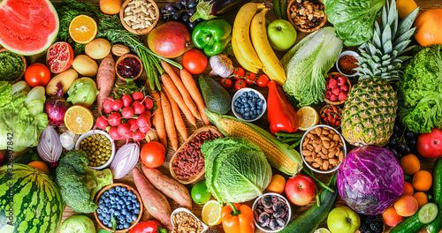
Would you rather eat a bowl of peas every day or eat lots of different fruit and vegetables every day?

Slide 16
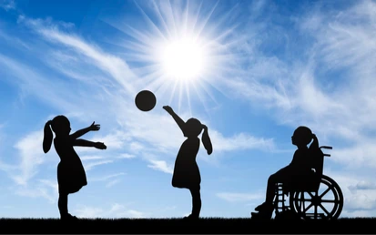
Would you rather play with your friend or try to include everyone?

Slide 17
How could we include everyone?

Slide 18
Romans 15:7
“Therefore, welcome others as Christ has welcomed you, for the glory of God.”

Slide 19
A community is like a big team where everyone matters.
We all belong to a community — like our class or family.
When someone is new or feeling left out, we can be kind and say, “Come and play!”. That’s how we make others feel welcome.
When we share, help each other and take turns everyone feels like they belong.
Let’s smile, share, and be good friends.
That’s how we make our community a happy place!

Slide 20
Dear God,
Thank You for my friends and my community.
Help me to be kind and welcome others.
Let everyone feel loved and that they belong.
Amen.

