Slide 3




Three habits
Community
Embrace
Power
Listen to others’ stories and see the world through their eyes.
Encounter others with authenticity and confidence.
Find hope and opportunity in the places where we long to see changes.

Slide 4
I wonder…
How can our differences make us stronger?

Slide 5
Can you remember some of our class promises from our last session?

Slide 6
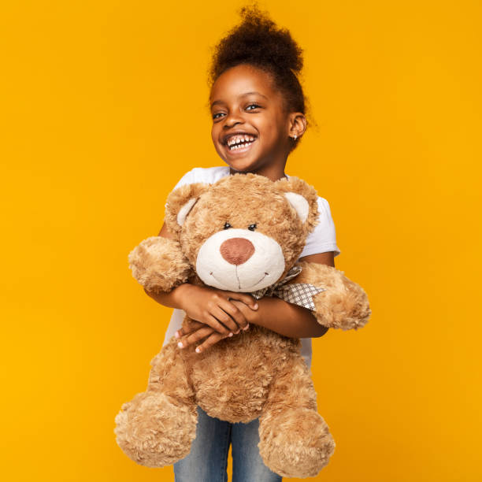
Talk Partners
What is special to you? (children bring in their special toy)
Why is it special?

Slide 7
Talk Partners
How do you show that it is special?
How would you feel if someone touched your special thing without asking?

Slide 8
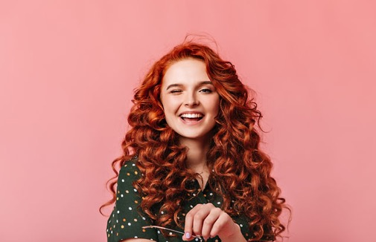
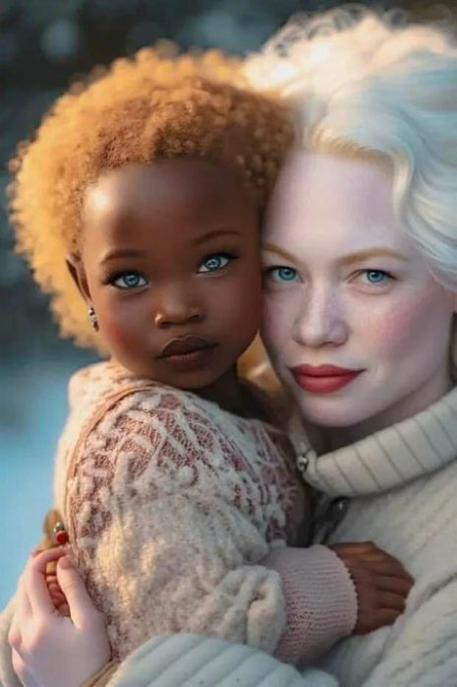
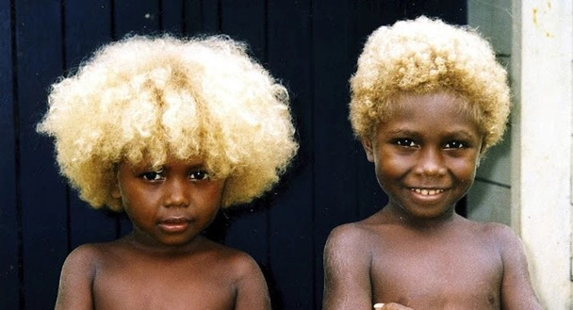
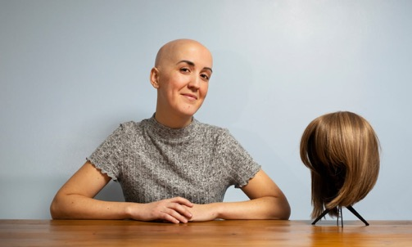
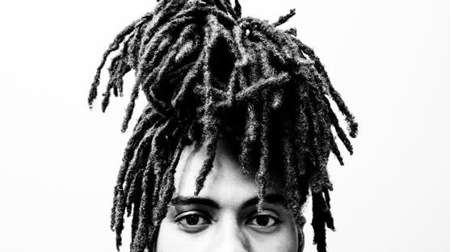
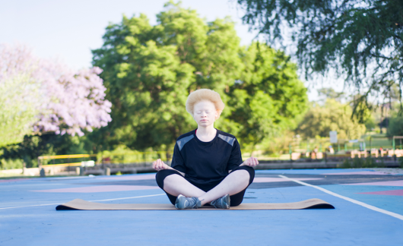
What can you see?
Talk Partners
Is anything surprising?
What do you think?

Slide 9
For some people, their hair is special to them. It makes them unique
Talk Partners
Do we all have the same hair?
If your hair is different to mine, is it less special/unique/important?

Slide 10
Talk Partners
How would you feel if you weren’t allowed to school if you had blonde/brown/red
/black/curly/straight/
afro hair?

Slide 12


Slide 13
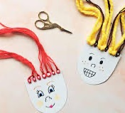
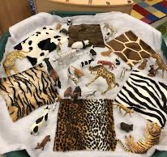
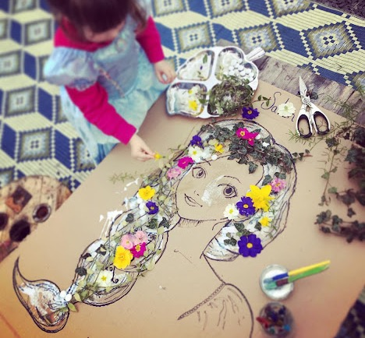
Continuous provision
Can you create your favourite hairstyle?
Why is their hair/skin important?
Can you use different resources to create a collage ?

Slide 14
Ephesians 2:10
"For we are God's masterpiece."

Slide 15
Isn't it great how everyone is different?
Some of us have curly hair, some straight, and we all like different things. It's like a garden with many colorful flowers, making our world more beautiful.
Think about your favorite storybook. The different characters make it exciting! Our differences make life fun, just like that.
Remember, being different is special. We each have unique gifts, and that's something to celebrate!

Slide 16
Dear God,
Thank You for making each of us special and unique. We love that we are all different, just like the many colors in a beautiful garden.
Help us to appreciate and love our friends for who they are. Teach us to be kind and celebrate our differences, knowing that You made us all perfect in Your eyes.
Amen.

