Slide 3




Three habits
Community
Embrace
Power
Listen to others’ stories and see the world through their eyes.
Encounter others with authenticity and confidence.
Find hope and opportunity in the places where we long to see changes.

Slide 4
I wonder…
How we can be kind to others?

Slide 5
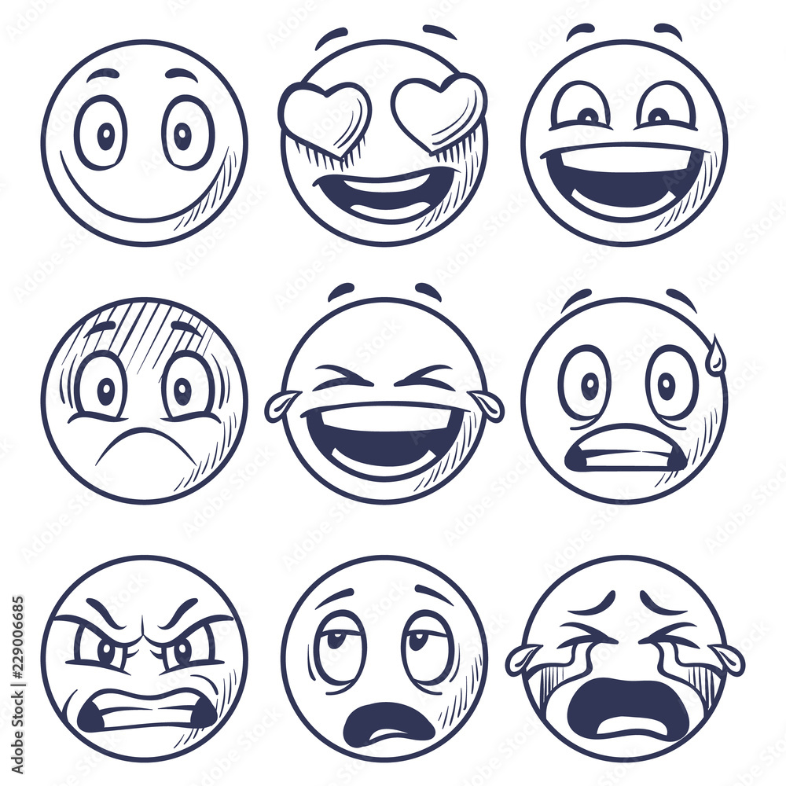
Talk Partners
What can you see?
What is different
What is the same?
What is the same?

Slide 7



Slide 8
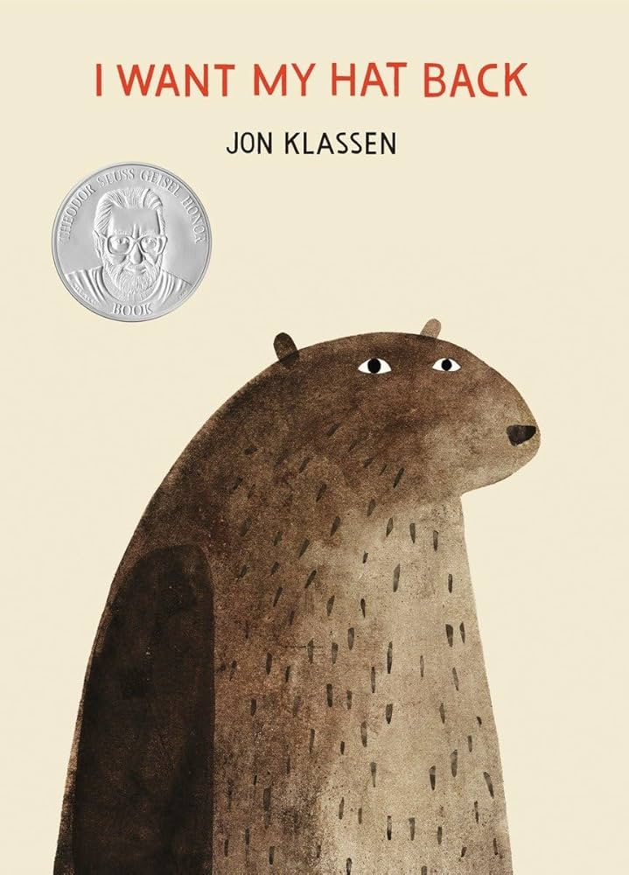
What do you think the bear's hat looks like?
What could you do to help bear?
How do you think the bear feels?

Slide 9
Continuous provision
Can you design bear's hat?
Can you play the how would you feel game?

Slide 10
Ephesians 4:32
"Be kind and loving to
each other.”

Slide 11
Kindness means being nice, sharing, and helping others.
When we do kind things, like sharing toys or saying kind words, it makes our friends happy and makes us feel good too!
We can show kindness every day by helping, listening, or giving hugs when someone is sad.
Even small acts of kindness can make a big difference!

Slide 12
Dear God,
Thank You for my friends and family.
Help me be kind and share with others.
Show me how to help when someone is sad or needs a friend.
Help me use kind words and show love every day.
Amen.

