Slide 3




Three habits
Community
Embrace
Power
Listen to others’ stories and see the world through their eyes.
Encounter others with authenticity and confidence.
Find hope and opportunity in the places where we long to see changes.

Slide 4
I wonder…
How can our differences make us stronger?

Slide 5
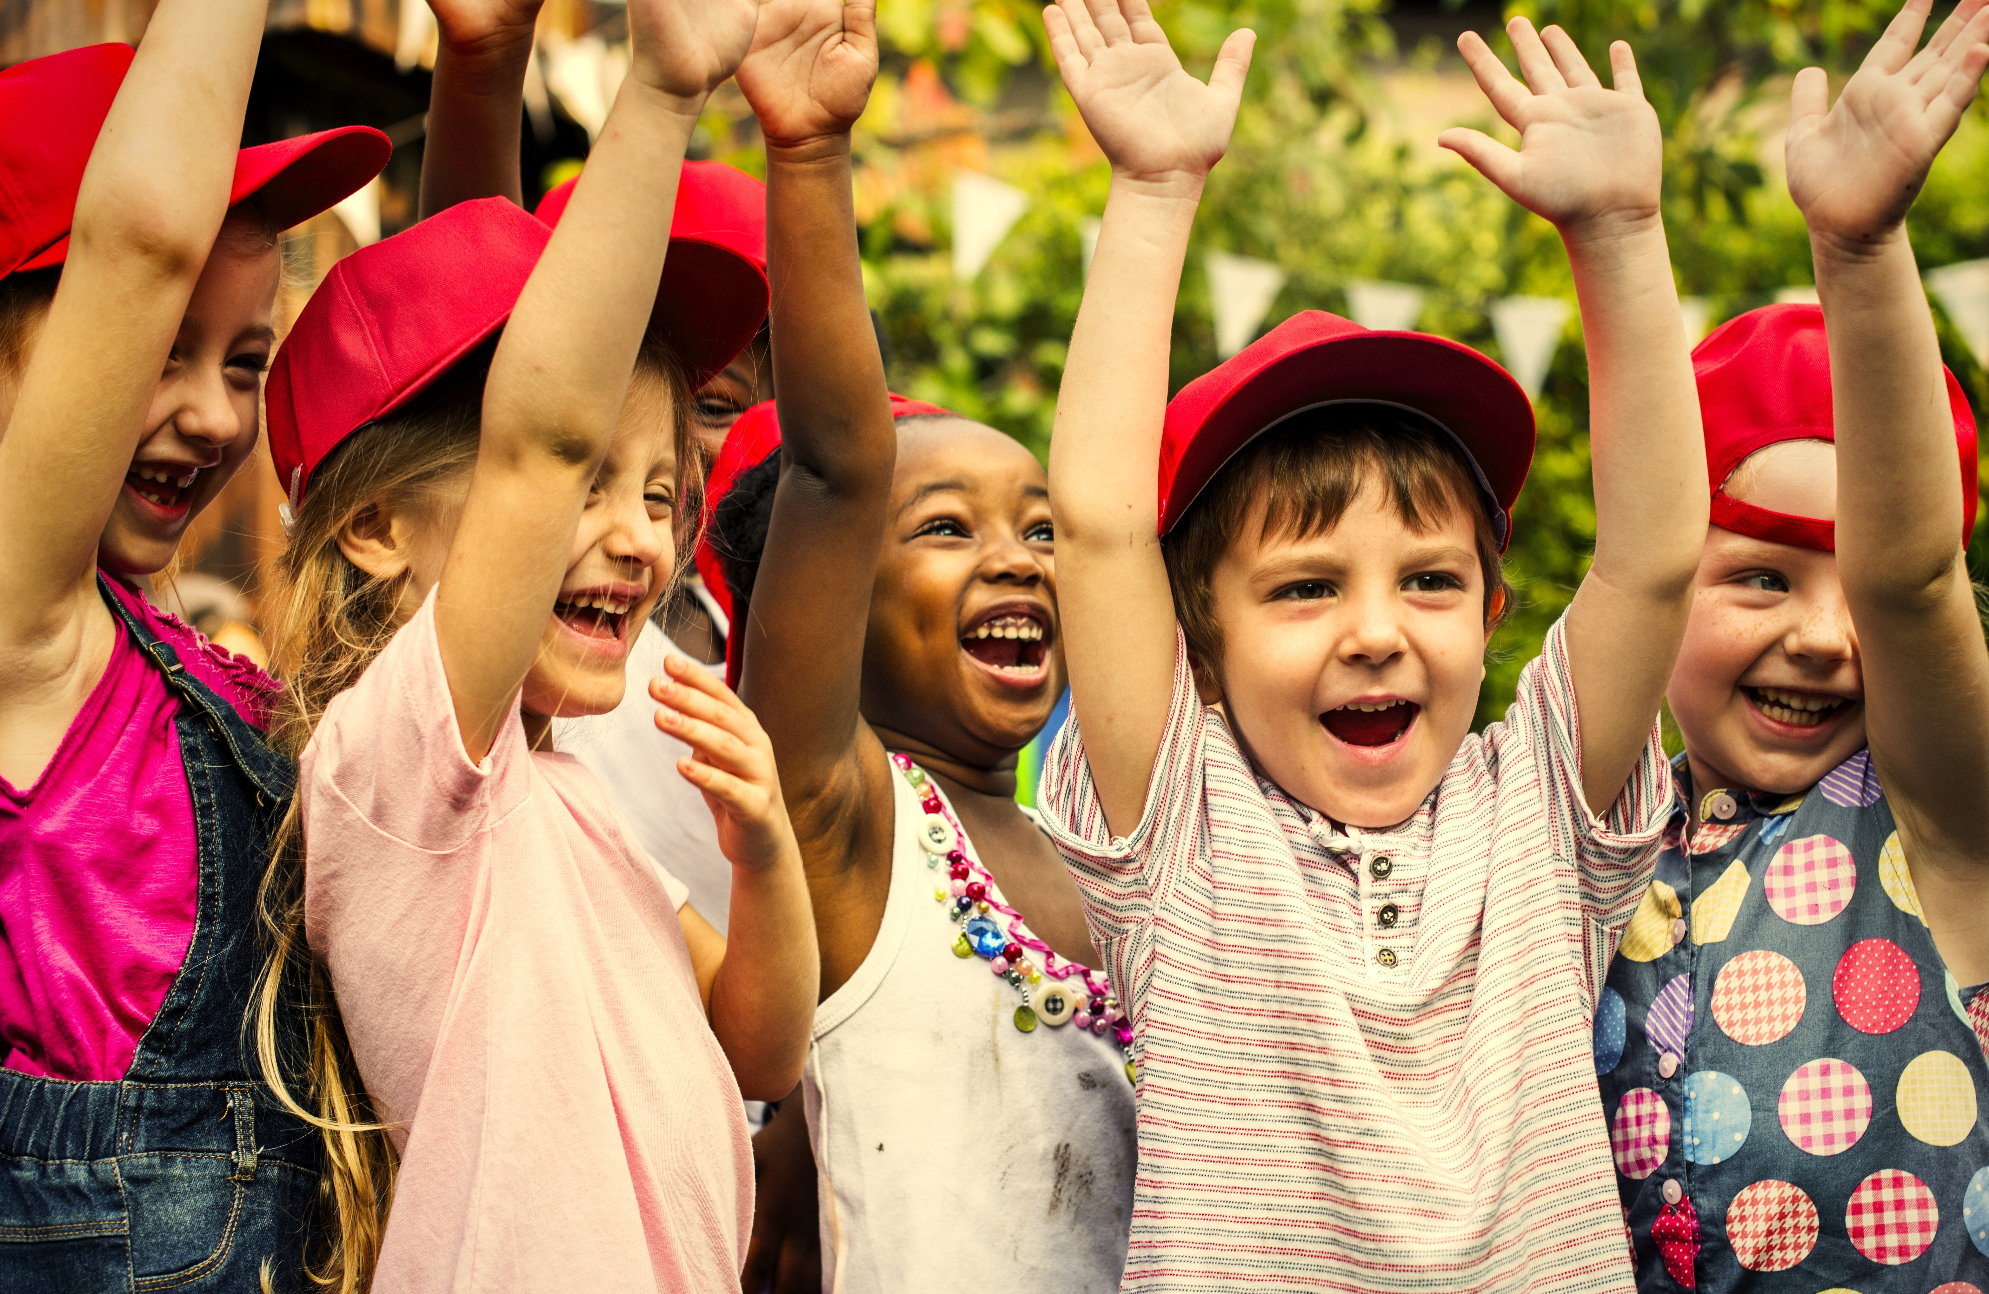

Just The Way You Are by iSingPop

Slide 6
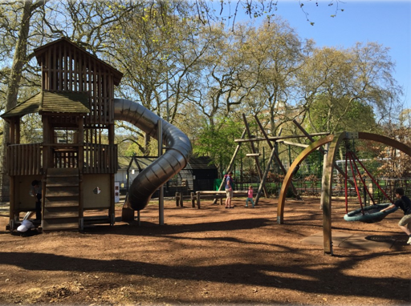
What can you see?
Have you been somewhere like this before?
Talk Partners
What is your favourite piece of equipment to explore?
What would you go on first?

Slide 8

Be Present Embrace

Slide 9
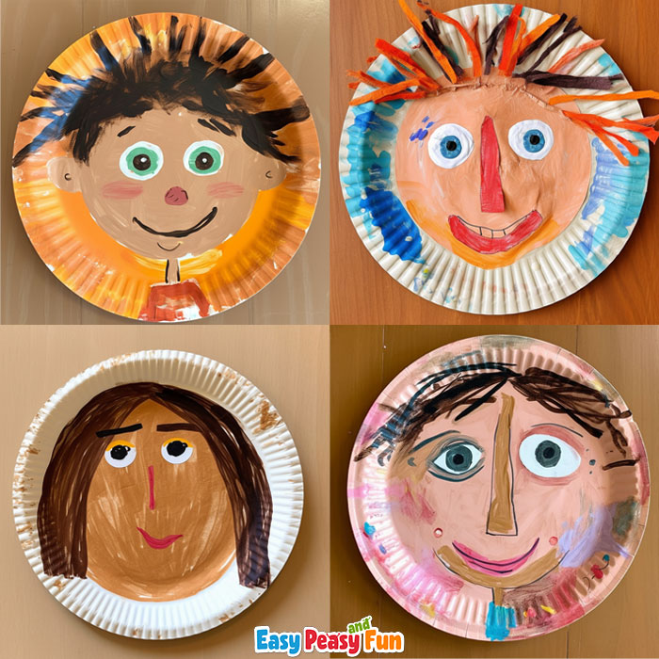
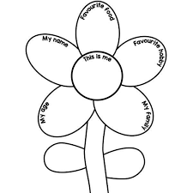
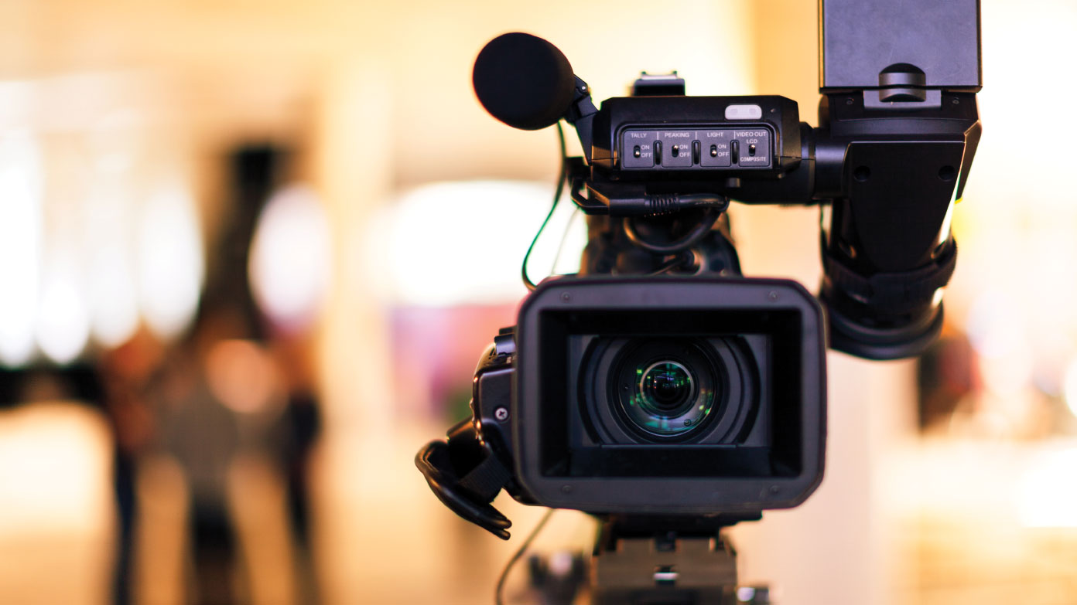
Continuous provision
Can you create a self portrait?
Can you make an 'all about me' flower?
Creating a video

Slide 10
Psalm 139:14
"I praise you because I am fearfully and wonderfully made; your works are wonderful, I know that full well".

Slide 11
Did you know that being different is amazing? Some of us are good at drawing, some at running, and others love singing or building. When we share our special talents, we have even more fun together!
Let us always be kind and enjoy our differences. We can all be friends, no matter what, because our differences make our friendships extra special! Isn't that awesome?

Slide 12
Dear God,
Thank you for making each of us special and unique. Even though we are all different, you made us so we can all be friends and learn from each other.
Help us remember that our differences make us stronger and better together.
Teach us to love and help one another, just like Jesus does.
Amen.

