Slide 3
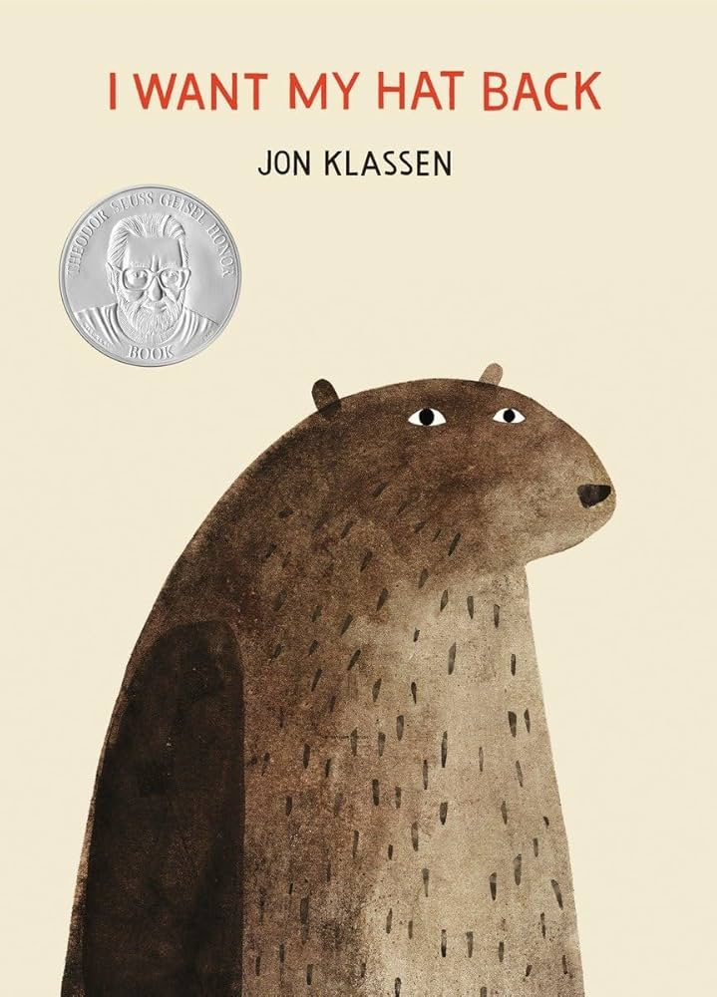
Gallery Walk of Bear's Hat

Slide 4




Three habits
Community
Embrace
Power
Listen to others’ stories and see the world through their eyes.
Encounter others with authenticity and confidence.
Find hope and opportunity in the places where we long to see changes.

Slide 5
I wonder…
How we can be kind to others?

Slide 6
Stand up, sit down

Slide 7


We are going to
play a game.
If you agree (or think I am right) stand up.
If you disagree (or think I am wrong sit down).

Slide 8
Bears hat is blue

Slide 9
Bears hat is red

Slide 10
Bear is sitting
on his hat

Slide 11
Bears doesn’t
have a hat

Slide 12
Chocolates are
nicer than sweets

Slide 13
Water taste better
than juice

Slide 14

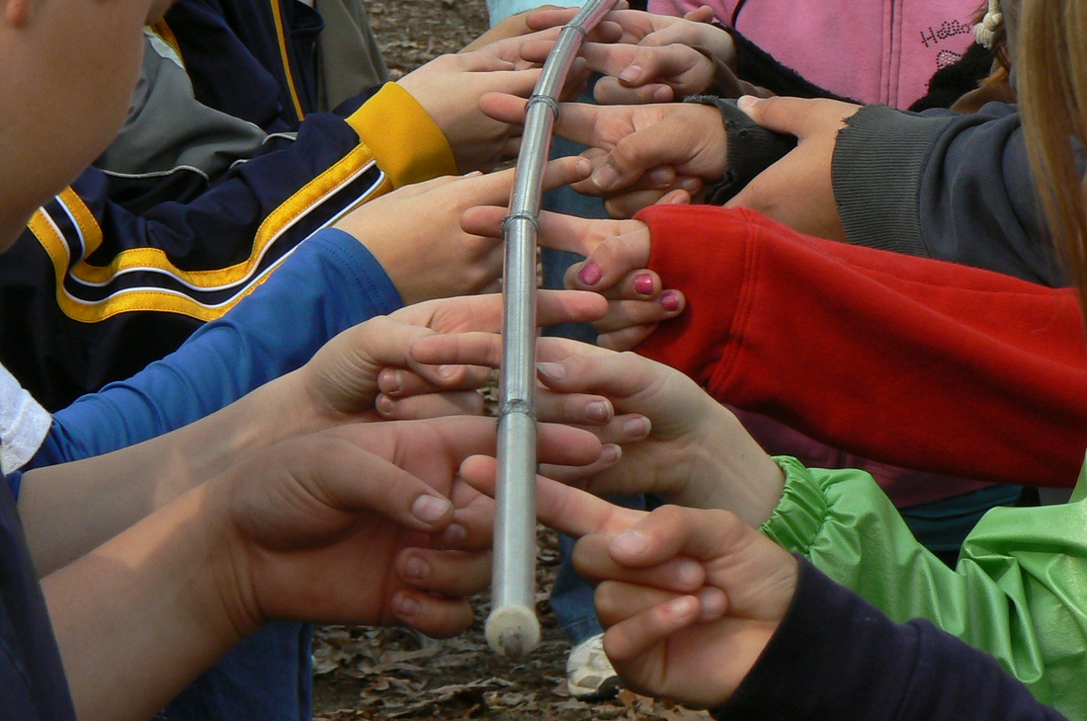
Continuous provision
Can you create a painted handprint?
Can you play the helium stick game?

Slide 15
John 13:34
“Love one another.”

Slide 16
Sometimes we don't agree.
We often think, feel or want different things and that’s ok!

Slide 17
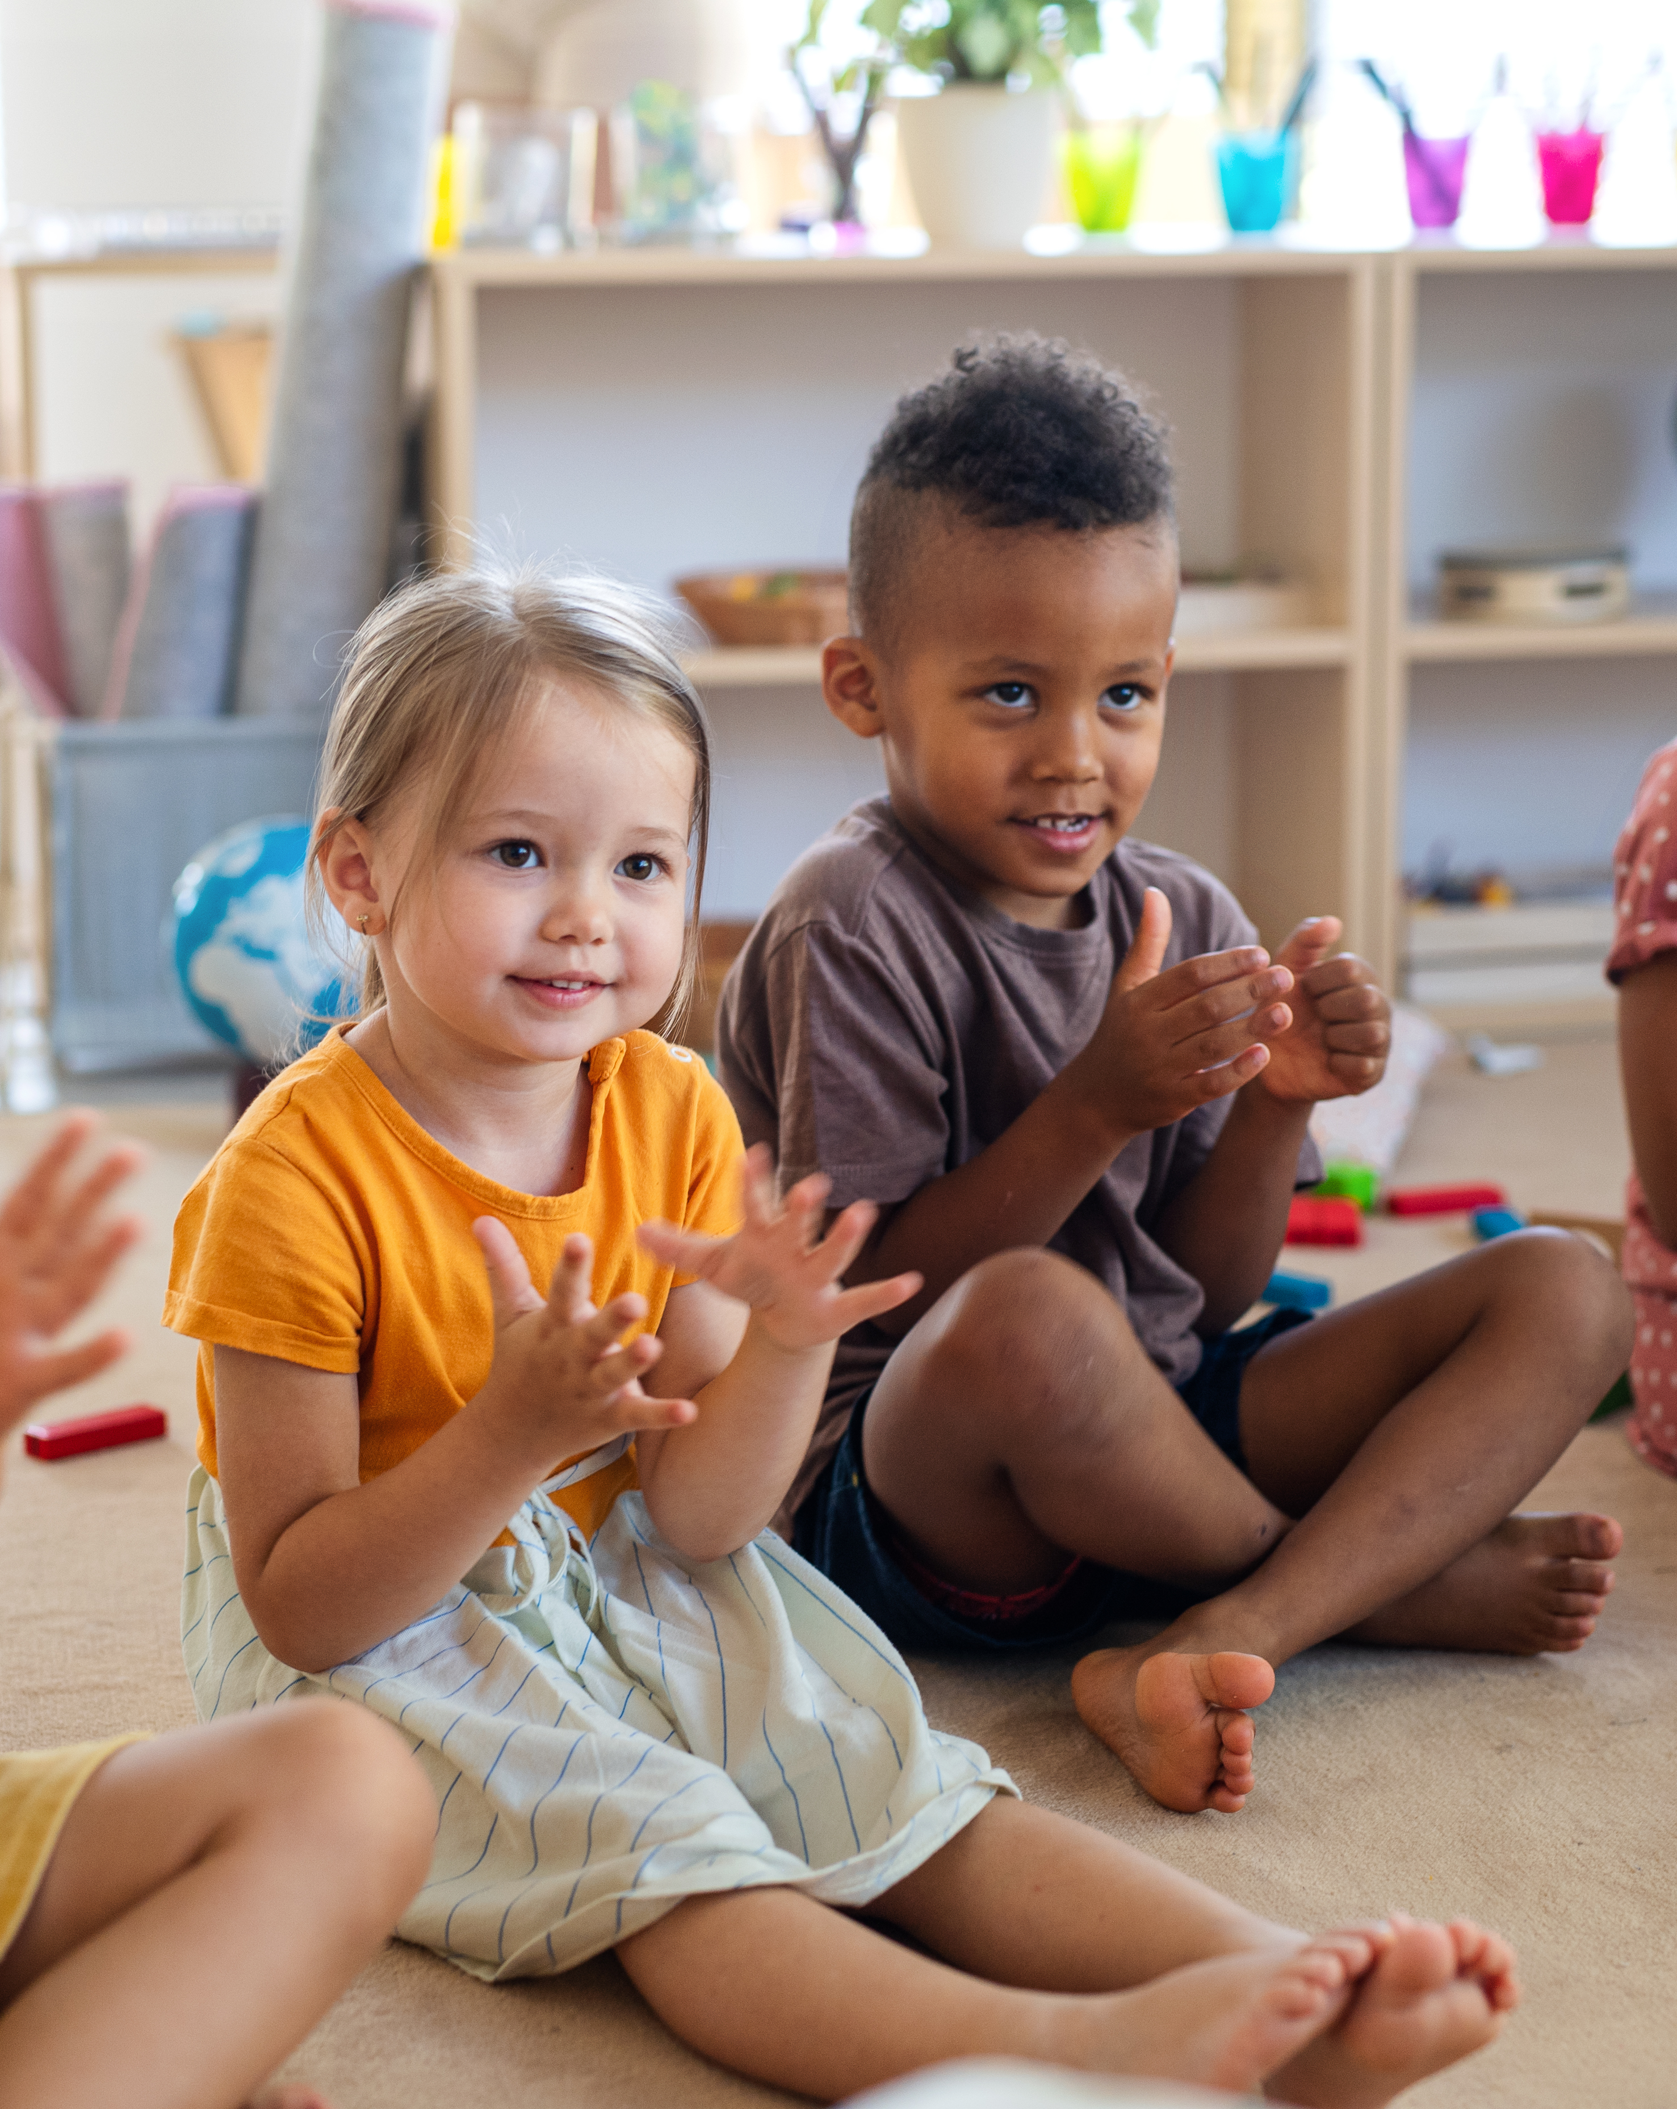
We can remember this rhyme...
When we don’t agree,
That’s okay, you see!
We stop, we talk, we share —
And show each other care

Slide 18
Sometimes we don’t agree with our friends. Maybe we both want the same toy or want to play different games. That can make us feel sad or even frustrated.
But when we stop, breathe, listen and use kind words, we can figure it out together.
That’s how we solve problems and stay good friends. That’s how we make everyone feel welcome.

Slide 19
Dear God,
Sometimes I get upset when I don't agree with my friends.
Help me to use kind words,
Help me listen and share.
Help me to make others feel welcome.
And love my friends like You love me.
Amen.

