Slide 3




Three habits
Community
Embrace
Power
Listen to others’ stories and see the world through their eyes.
Encounter others with authenticity and confidence.
Find hope and opportunity in the places where we long to see changes.

Slide 4
I wonder…
How can we be kind to others?

Slide 5
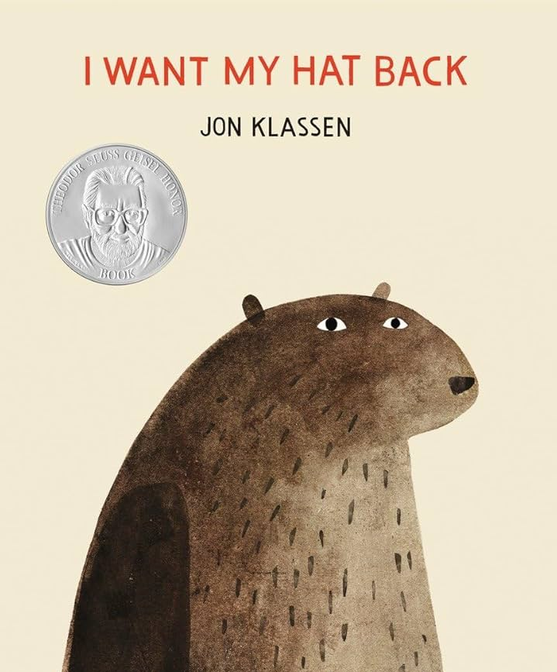
Let's read our story..
(stop at ‘you stole my hat’)

Slide 6
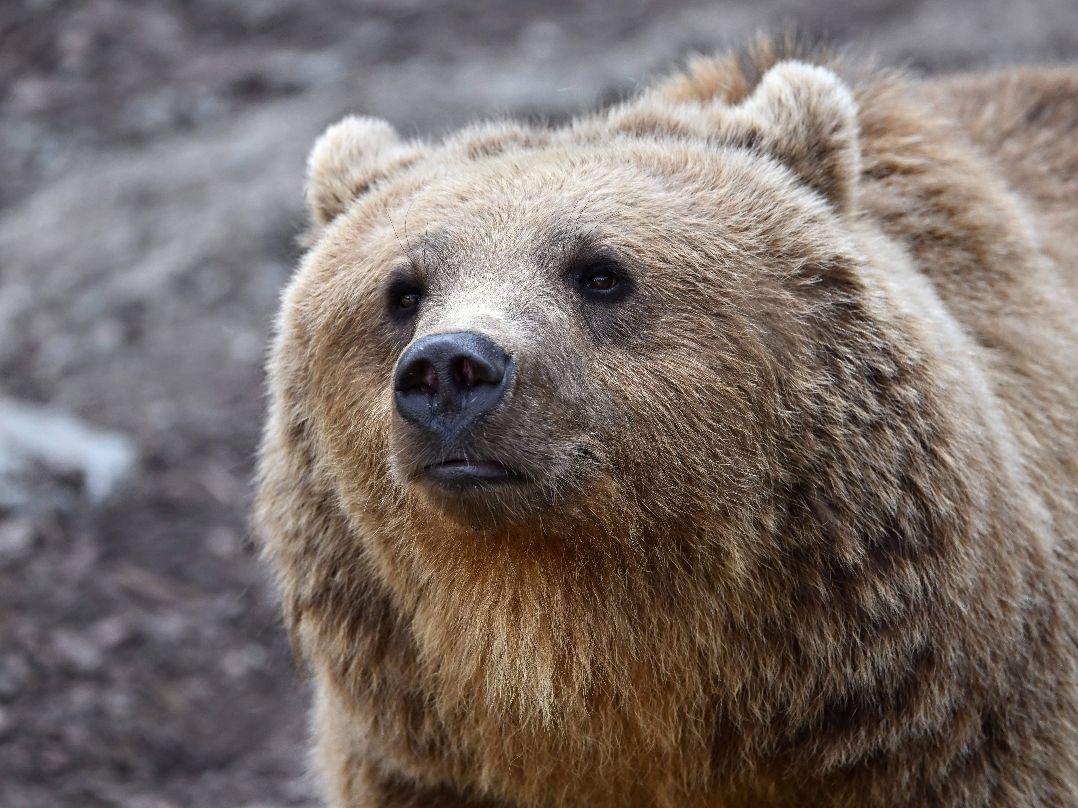
How do you think bear felt when he couldn’t find his hat?

Slide 7
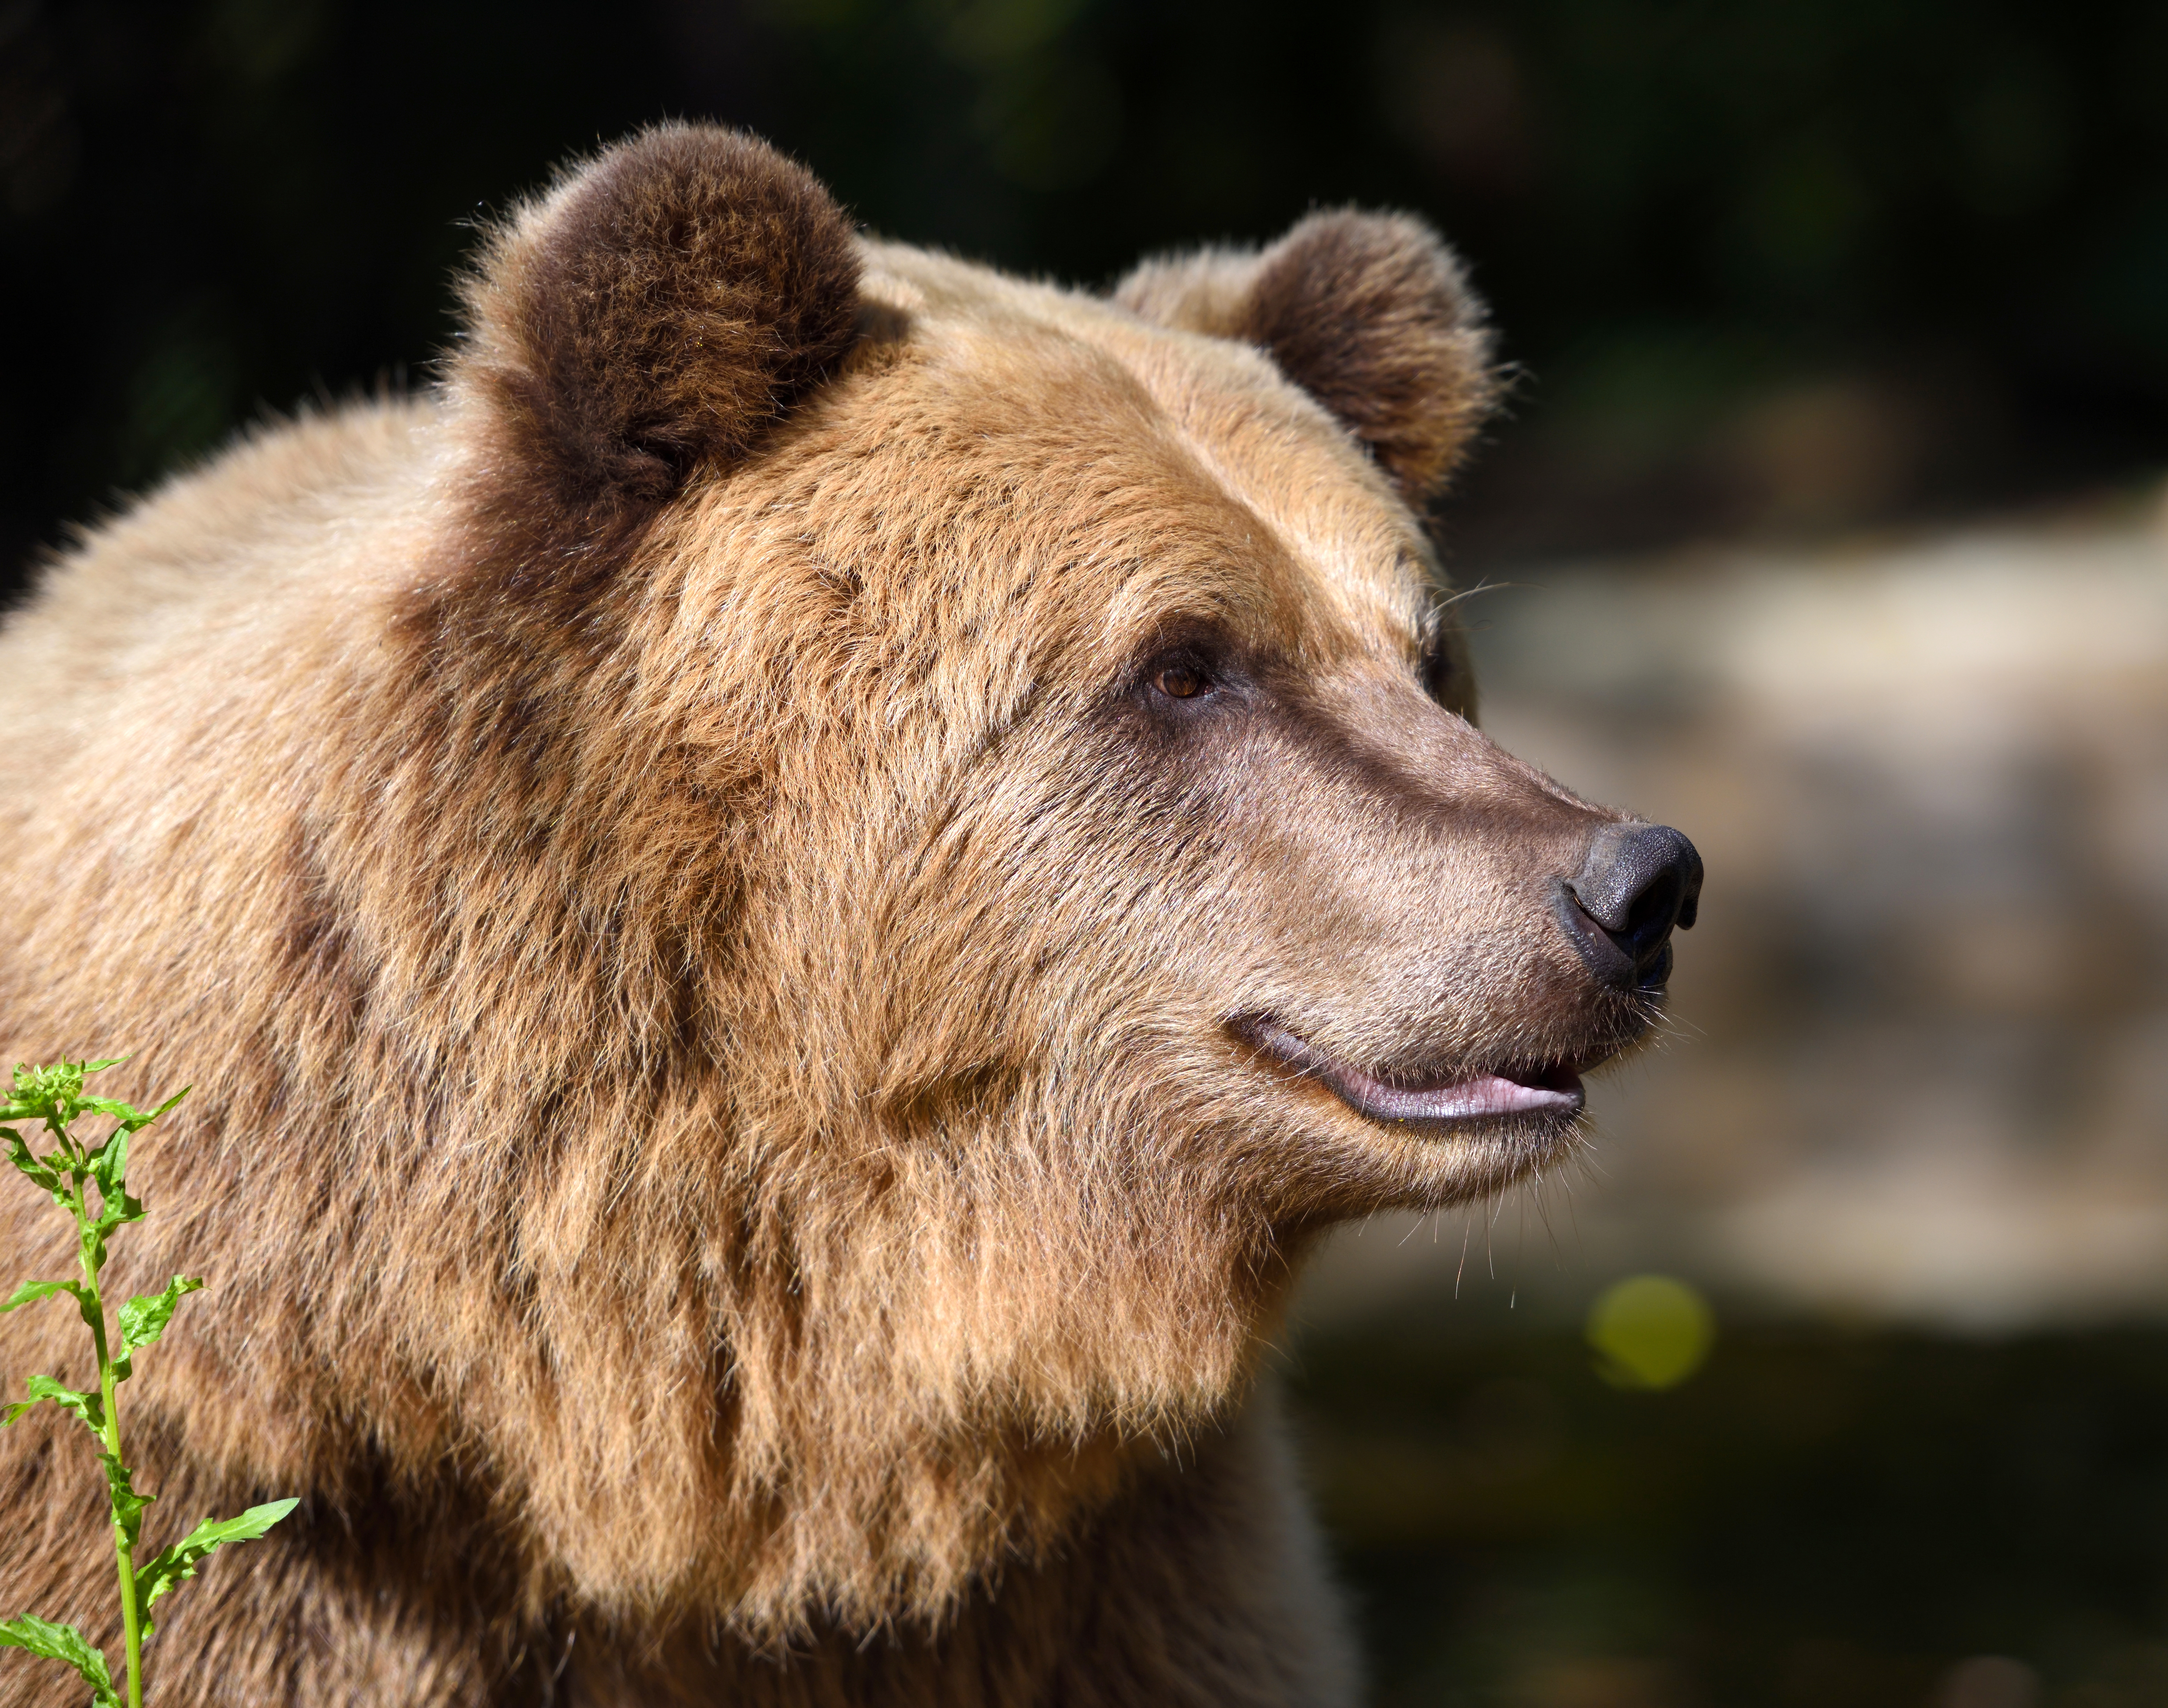
How do you think bear felt when he found his hat?
How do you think rabbit felt?

Slide 8
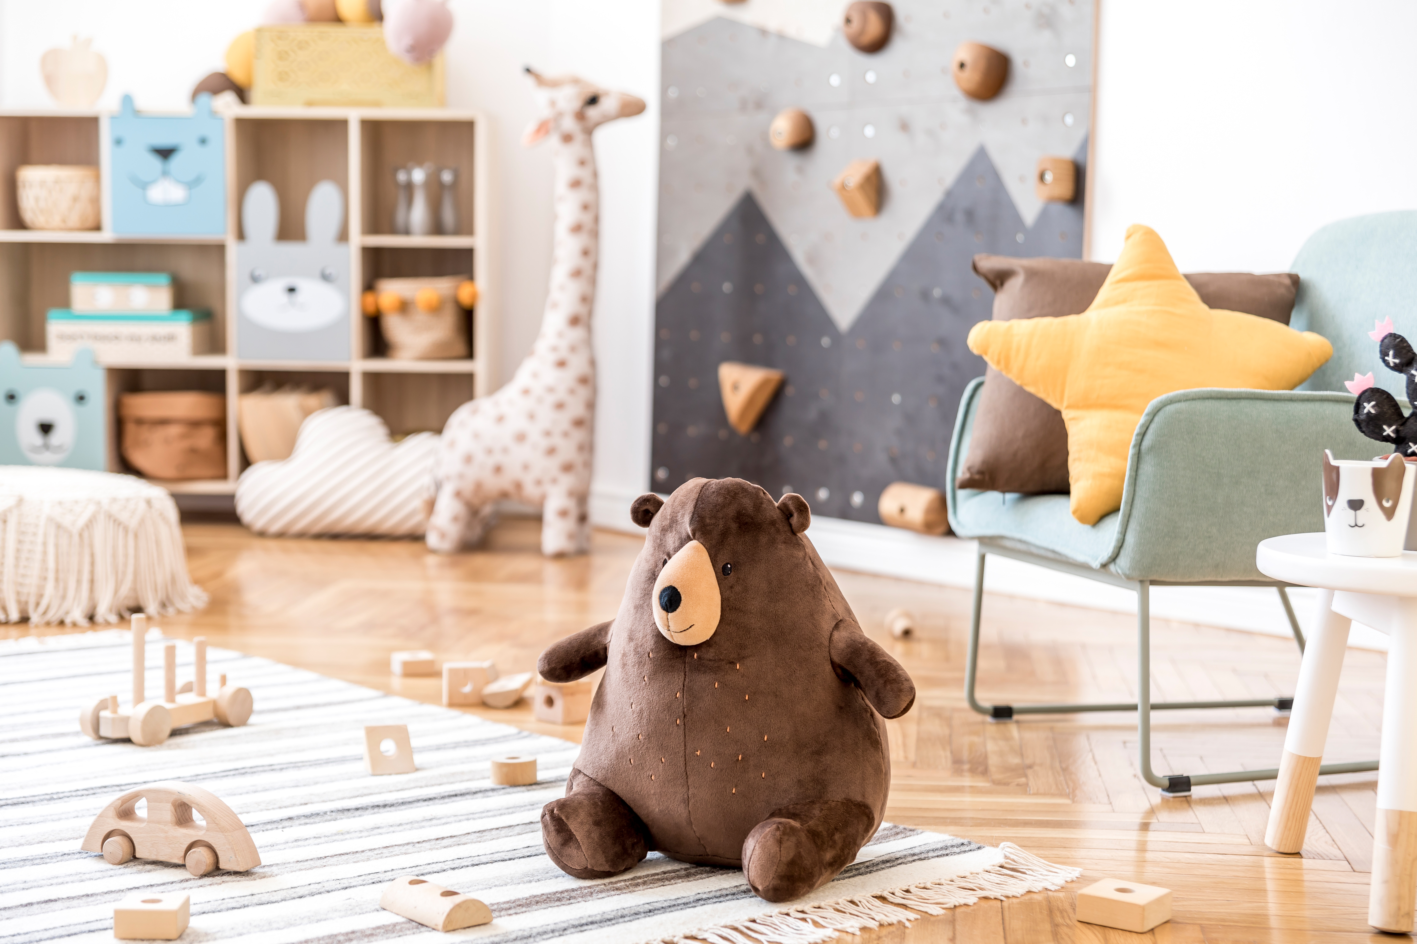
How could bears friends help?

Slide 9

They could be "peacemakers"
Kind, Listen, Share, Help

Slide 10
1 Corinthians 13:4
"Love is kind."

Slide 12
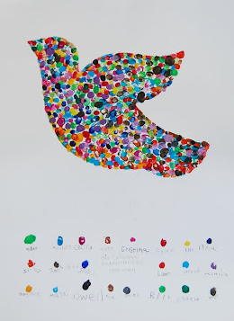
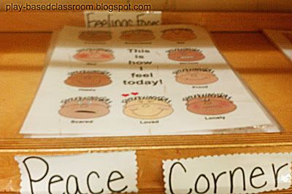
Continuous provision
Can we create a classroom peace (maker) dove?
Can we create a peace corner?

Slide 13
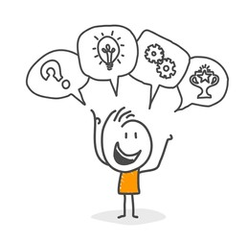
Let's reimagine the ending..​
Can we think of kind ways that our story could have ended?
Can we act them out?
What could bear have done instead of eating rabbit?

Slide 14
Sometimes people make mistakes and hurt our feelings.
When that happens, we can forgive them and be kind.
Being a peacekeeper means saying, "I forgive you," and helping everyone be friends again.
When we forgive and share love, we make our world a happier place!

Slide 15
Dear God,
Thank you for loving me.
Help me to forgive when someone is unkind.
Help me to share, love, and always be kind.
Make me a peacemaker just like you!
Amen

