Slide 3




Three habits
Community
Embrace
Power
Listen to others’ stories and see the world through their eyes.
Encounter others with authenticity and confidence.
Find hope and opportunity in the places where we long to see changes.

Slide 4
I wonder…
How can our differences make us stronger?

Slide 5

Think about your special things that you brought into our last session....
How would you feel if someone took it, without your permission?

Slide 6
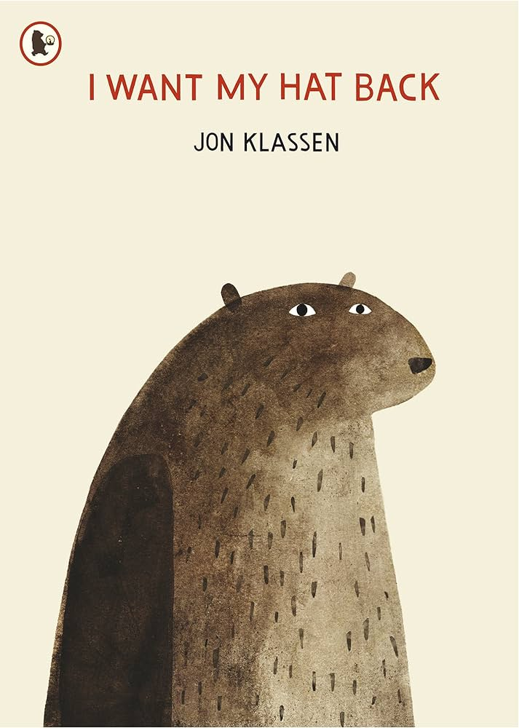

Slide 7
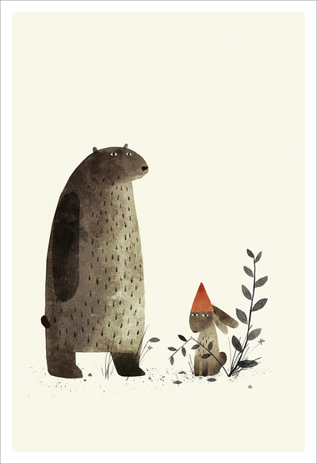
Talk Partners
Imagine if bear or rabbit were in our class...did they follow our class promises?
Why or why not?
What could bear or rabbit have done instead?

Slide 8
Ephesians 4:32 (NIV)
"Forgive one another."

Slide 9
Optional: Cheeky Pandas – The Missing Pizza

Slide 10
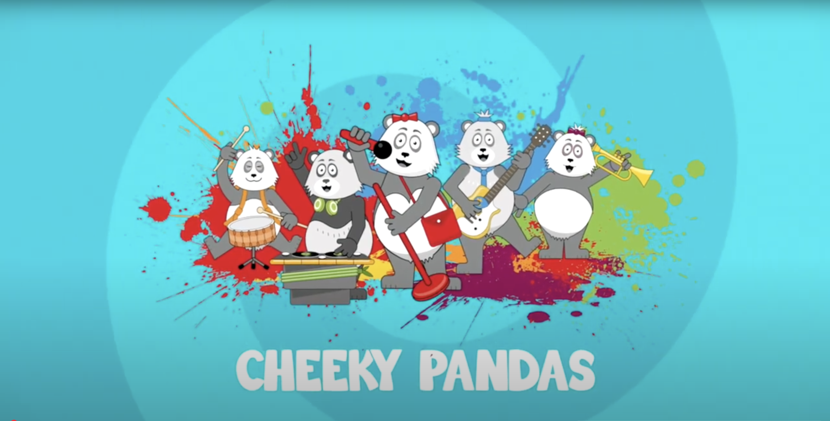

Remember, your words have power, saying sorry is not always easy but it is the right thing to say if we have hurt or upset our friends....
Also, we must forgive and let go of any upset feeling so that we can be happy and play together again...

Slide 11
Questions
How did the pandas feel when they thought their pizza had been taken?
What happened when they discovered the truth?
How did they show forgiveness in the end?

Slide 12
How do you think people feel when they’re forgiven after a mistake?
What can we do when someone says sorry to us?

Slide 13
Our Hearts

Slide 14
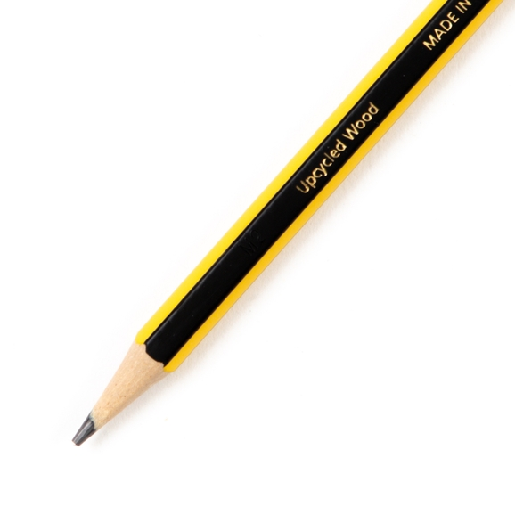
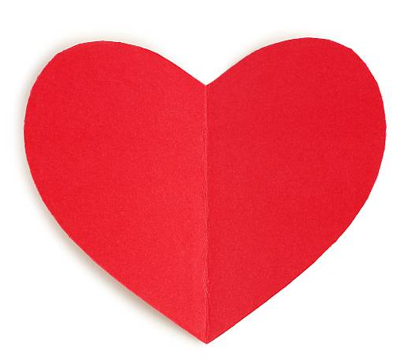
Look at the beautiful heart that you have in your hands.
It has lots of space to give and receive love and kindness from those around us.
Now think of a time someone has upset you with their words or actions....
Use a pencil to scribble on the heart...
Does your heart still have lots of space to give and receive love?
Why or why not?

Slide 15
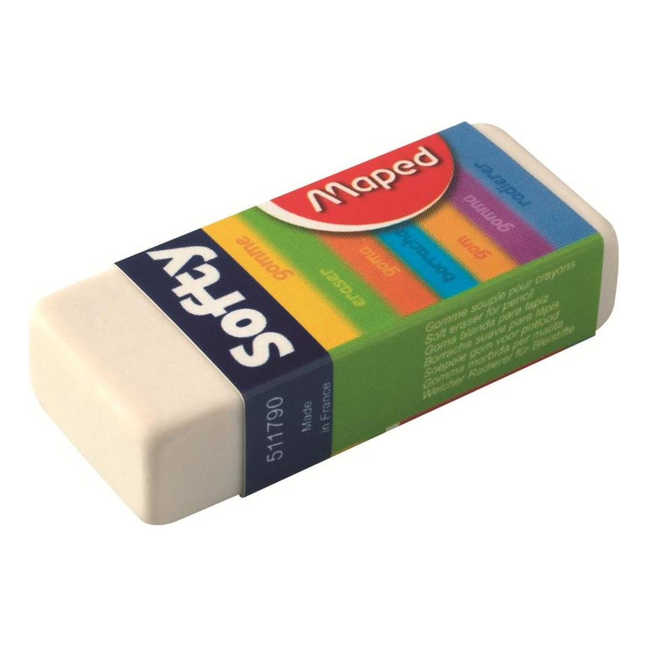
If someone upsets, you what can they do to make it right?
After each prompt encourage children to rub out some of the marks made....

Slide 16

Continuous provision
Can you clean/heal your heart?
Can you let it go?
(adult led)
Can you change the end of the story?
(role play)

Slide 17
When you say sorry and forgive, it’s like giving and receiving a big, warm hug. It makes everyone feel better, and it helps keep the fun going.
Remember, everyone makes mistakes sometimes, and that’s okay!
What is important is being kind, saying sorry when we need to, and forgiving others so we can all keep being happy together.

Slide 18
Dear God,
Thank you for loving us so much.
Help us to be kind and to forgive others when they hurt our feelings.
Teach us to say sorry when we do something wrong.
Please help our hearts to be filled with love, so that we can be good friends.
Thank you for forgiving us, and for always being there when we need you.
Amen.

