Slide 3




Three habits
Community
Embrace
Power
Listen to others’ stories and see the world through their eyes.
Encounter others with authenticity and confidence.
Find hope and opportunity in the places where we long to see changes.

Slide 4
I wonder…
How can our differences make us stronger?

Slide 5
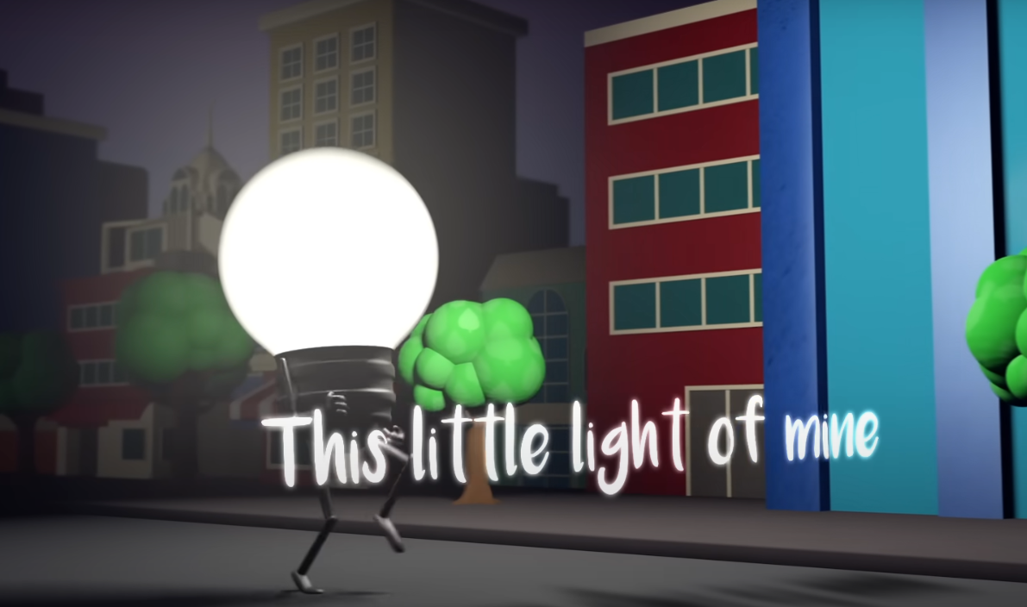

This Little Light Of Mine

Slide 6
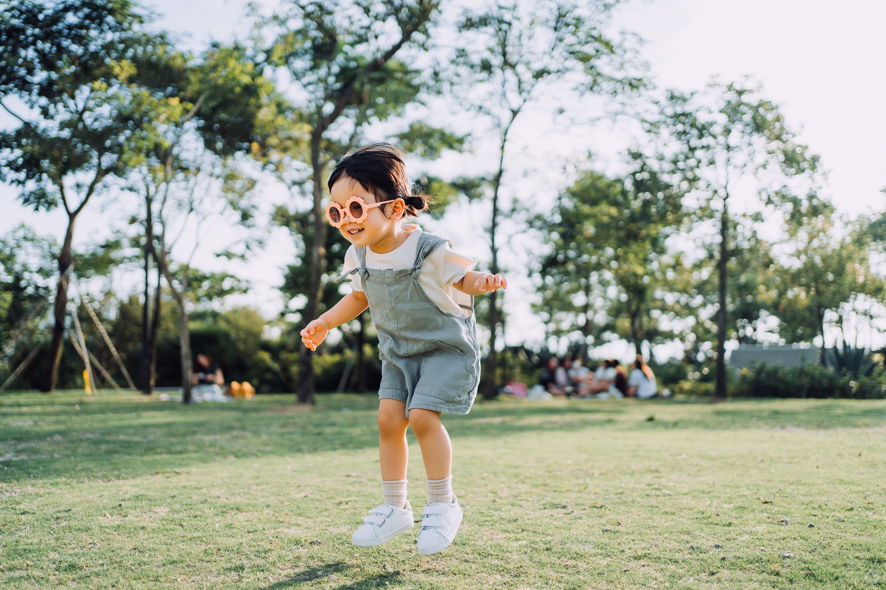
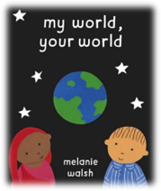
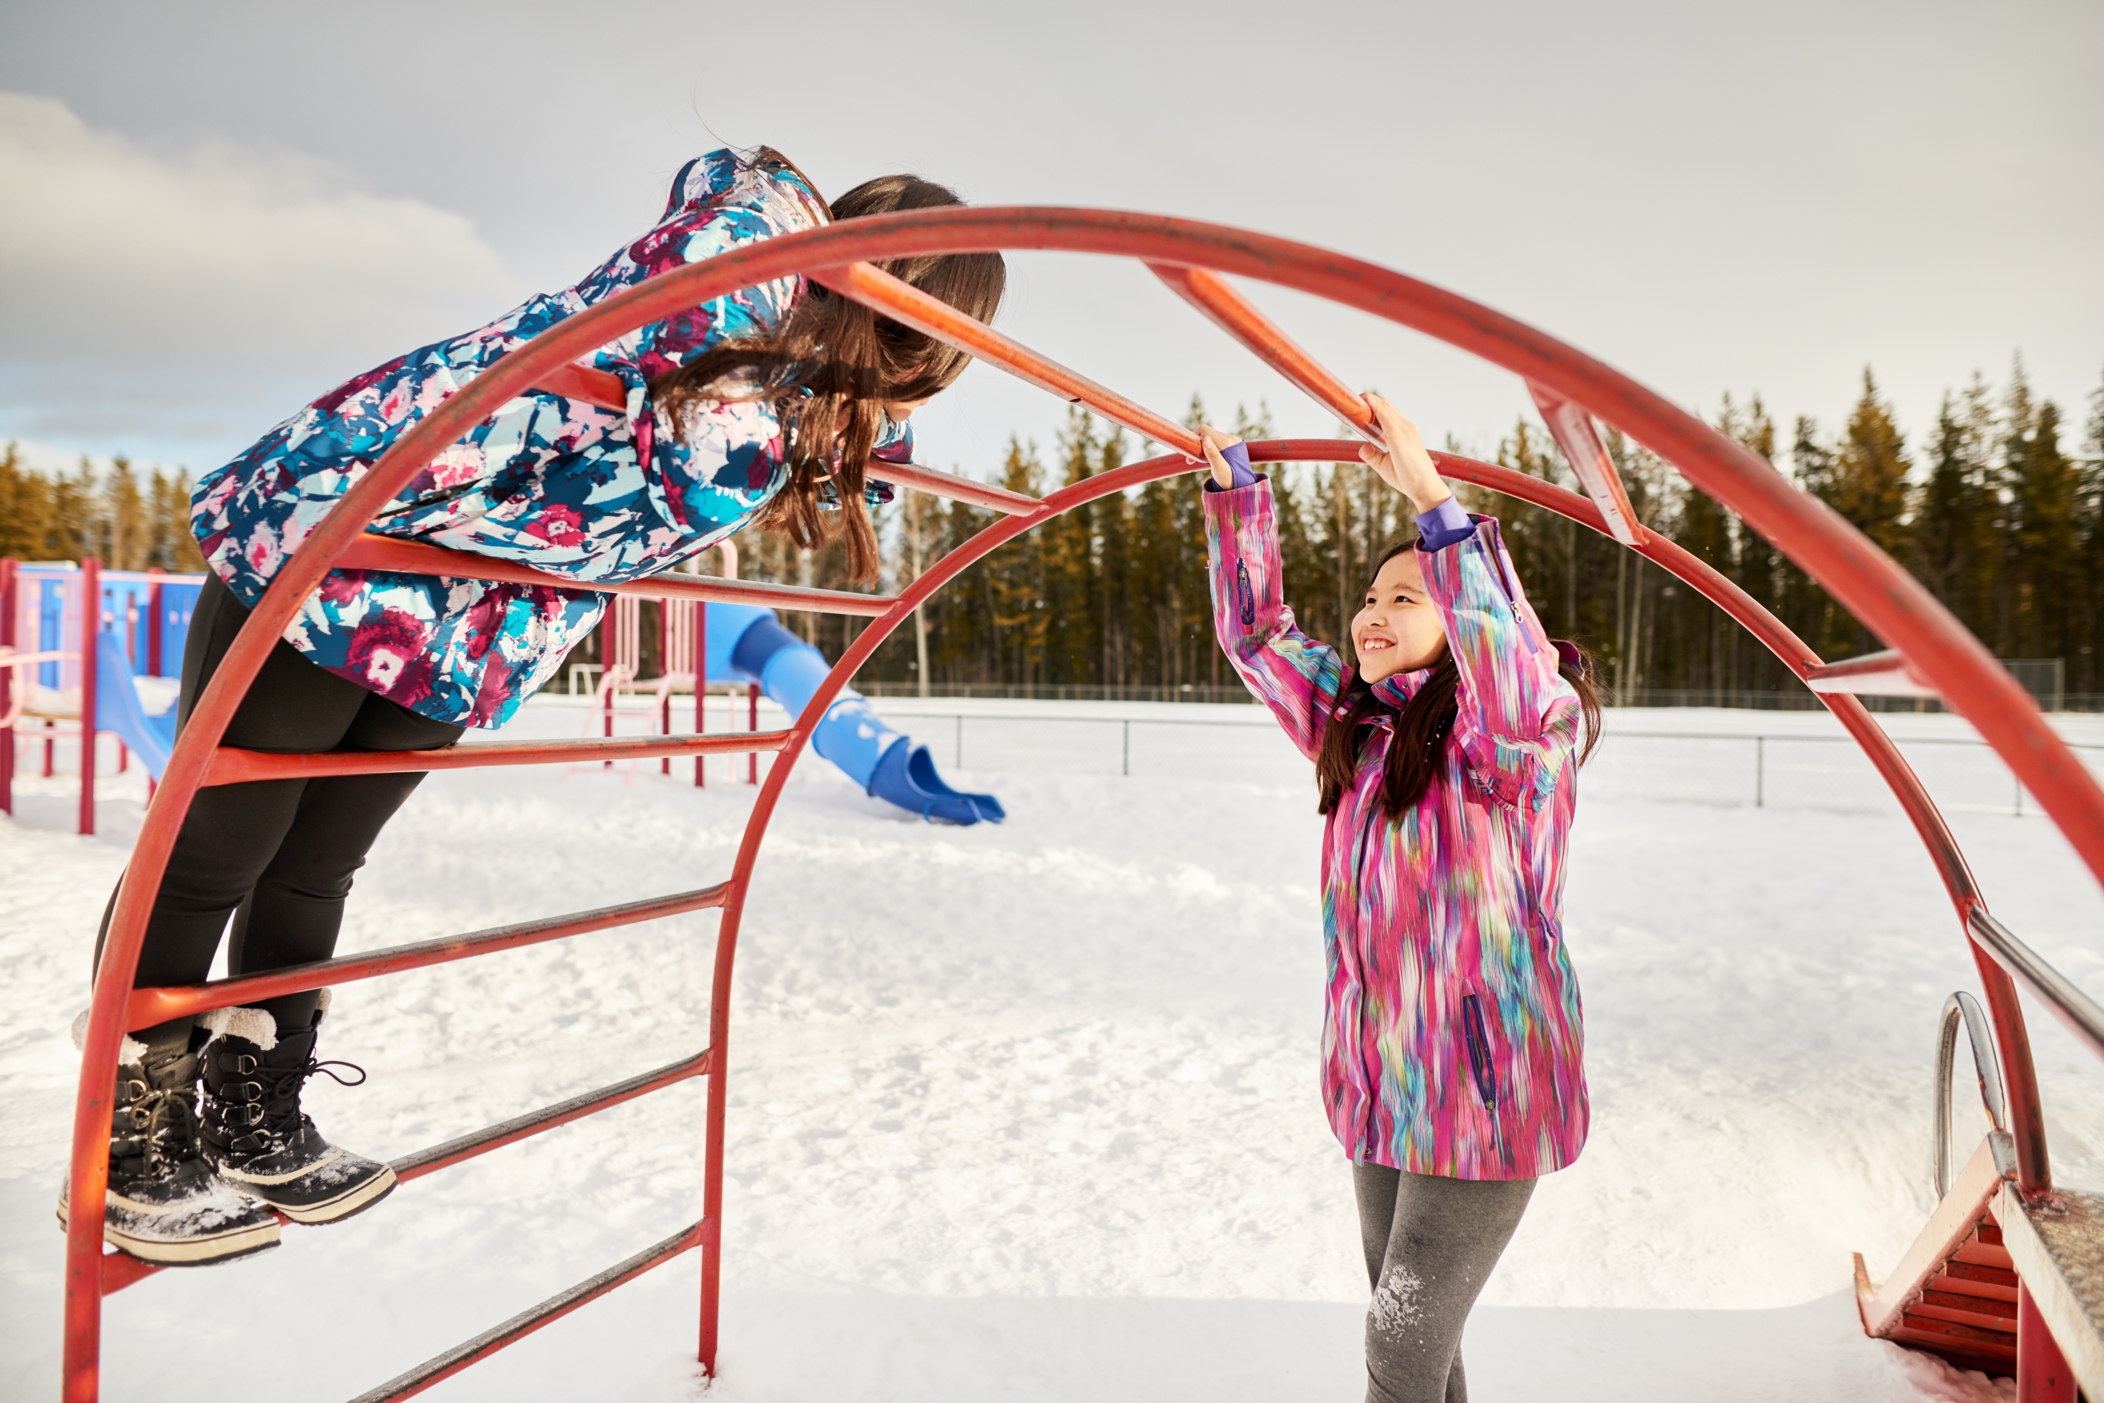
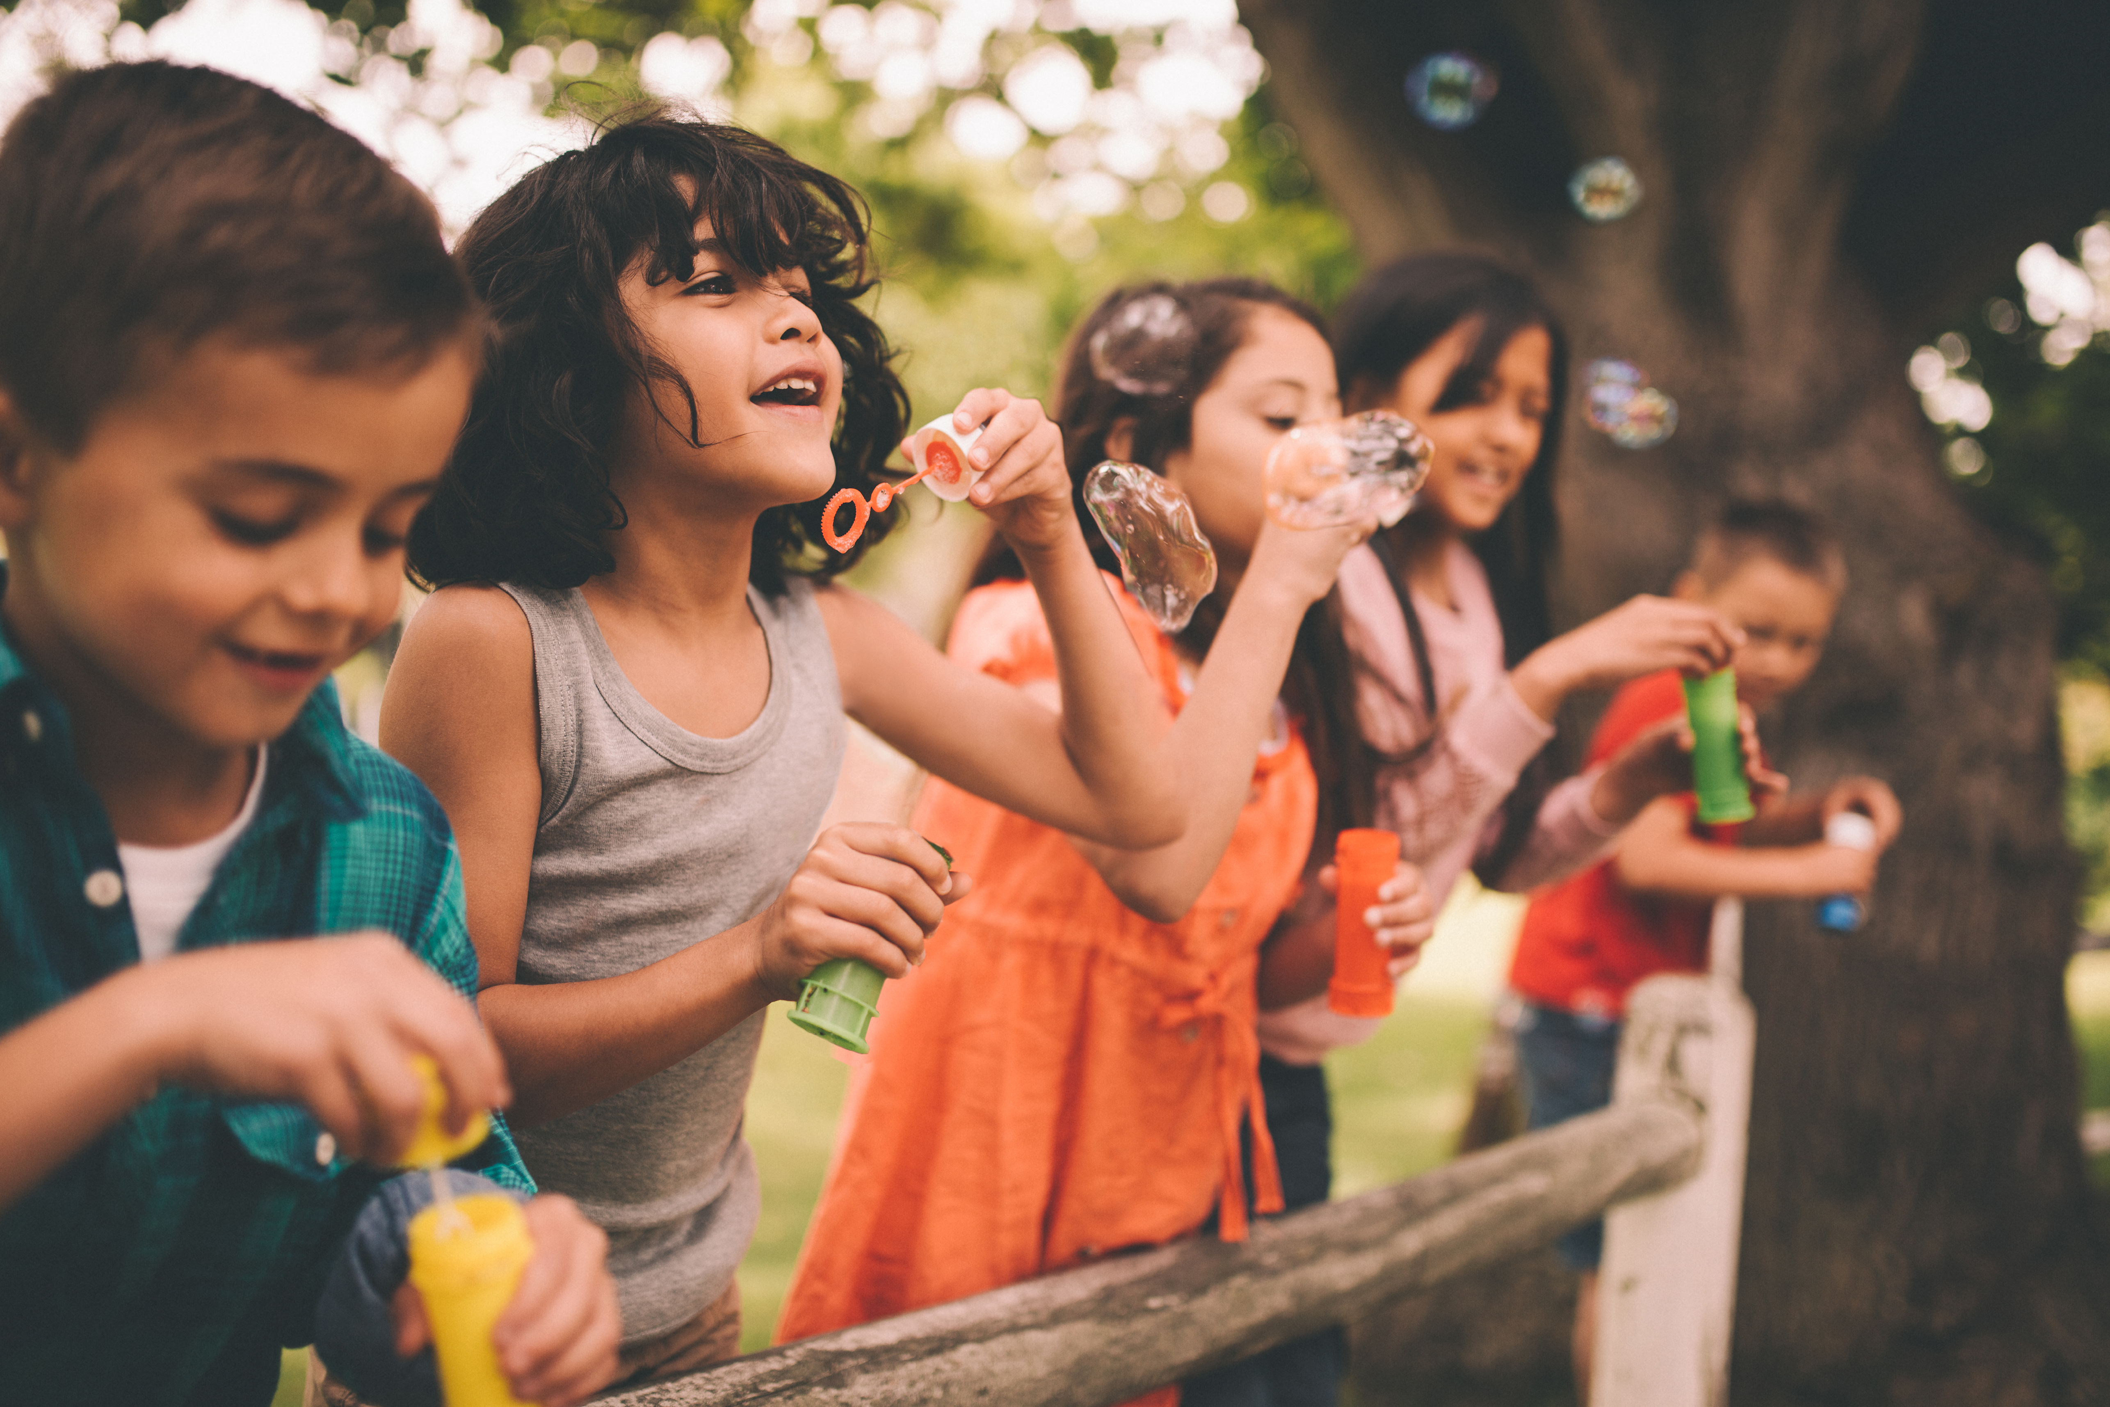
Be Curious Community
Recap
Re-read the story My World, Your World
What did you notice about the children in the story? How were they the same or different from you?
What is something you like about a friend that makes them special?
Can you think of something a friend does that makes you smile?

Slide 7
Be Curious Community
Talk Partners
What do you enjoy doing together, even if you do it in different ways?
What is something kind or helpful you’ve seen a friend do, like the children in the book?
How can we show respect and care for friends who do things differently from us?

Slide 9
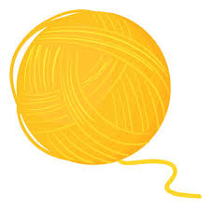
Let’s play a game
Option 1: I like…. Because….
Children identify why they like to play with another child in the class. Then they throw the ball of wool to that child while holding on to the string
e.g. “I like Stephanie because she lets me play football with her…”

Slide 10
Option 2: Same Here Game
Children say something they like to do/eat/play/wear etc. and children with similar interests say “Same here” child throws the ball of yarn to one of the children while holding on to the string.

Slide 11
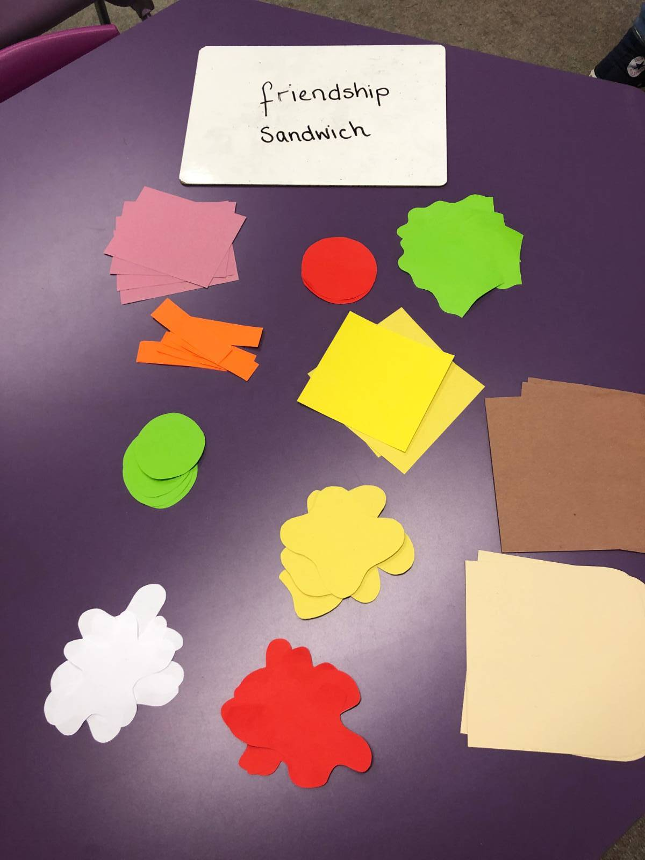
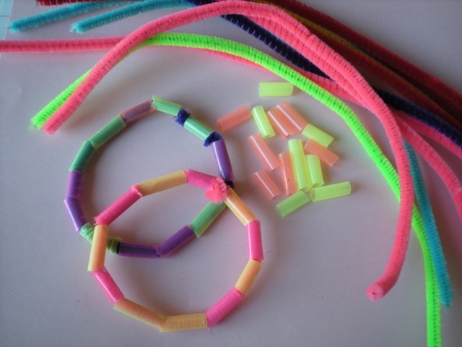
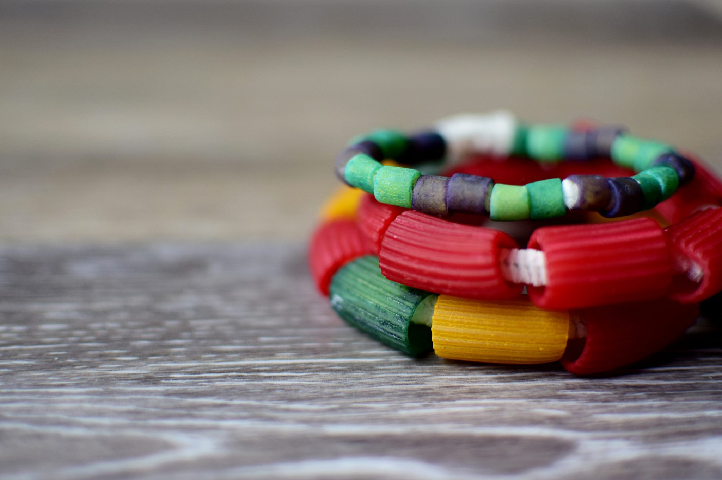
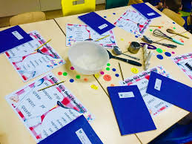
Continuous provision
Can you create a Friendship recipe or a friendship sandwich and talk about it?
Can you make a friendship bracelet and give it to your friend?

Slide 12
Romans 12:5
"So, in Christ we, though many, form one body, and each member belongs to all the others."

Slide 13
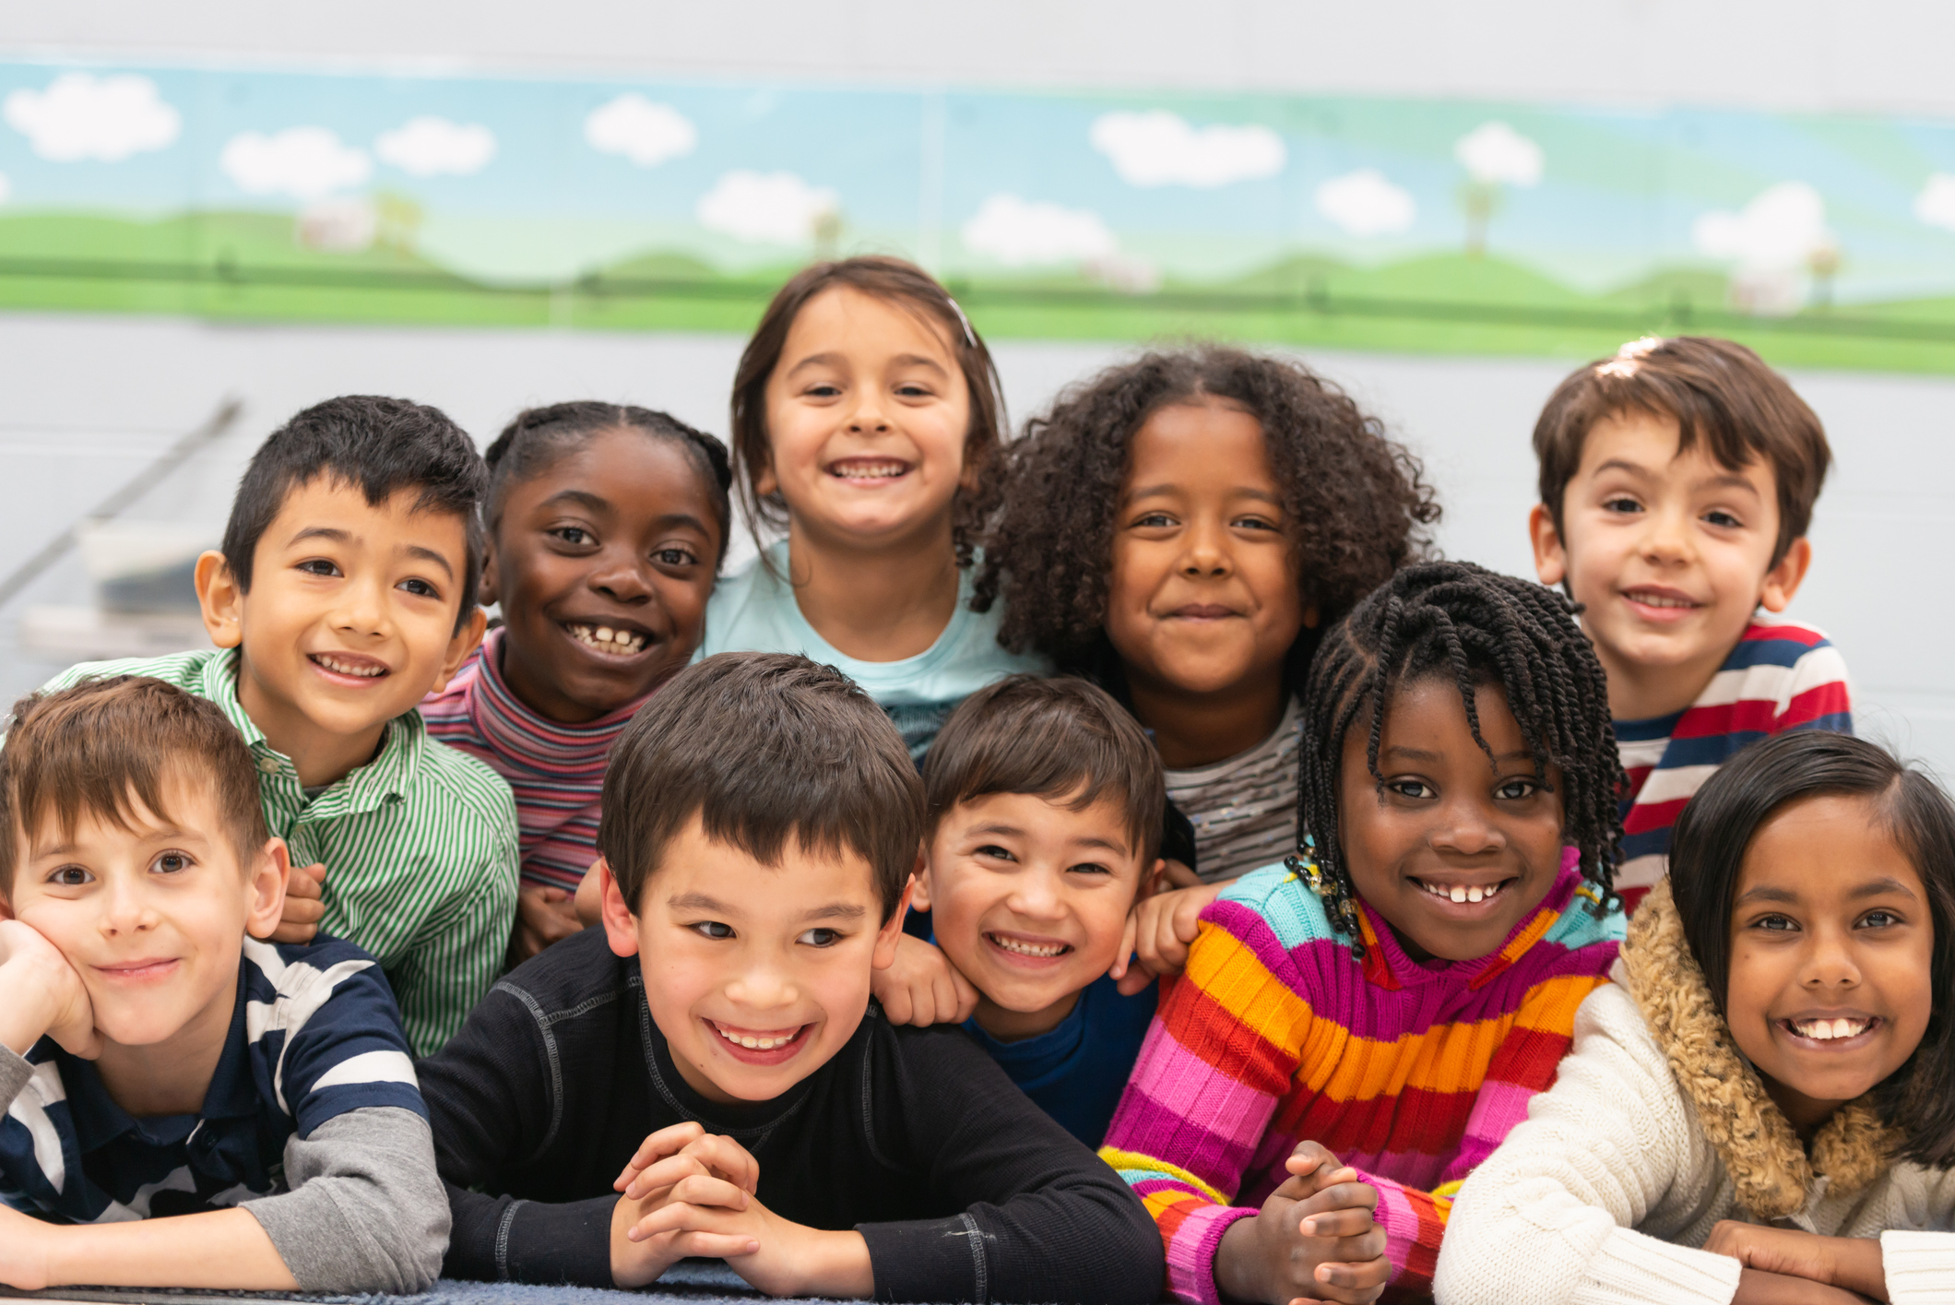
How can our differences make us stronger?
Sustainable Development Goals

Slide 14
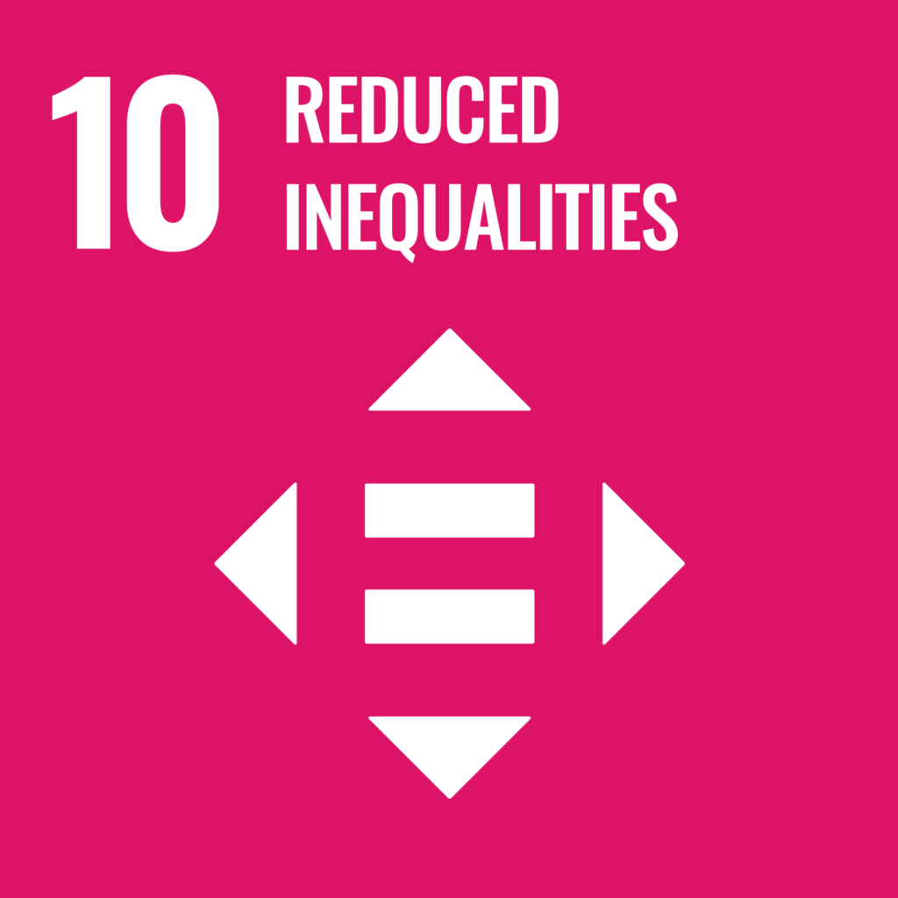
Sustainable Development Goals
Learning about how everybody is different and special.
Learning about different backgrounds.
Learning about how words can hurt.
Taking care of others.
Creating a world where everybody matters.
What makes us look or feel different?
What makes us crumple? (Words that hurt us)
Everybody is good at something – what are you good at?

Slide 15

Sustainable Development Goals
Exploring what makes us different.
What is a family? And who is in yours?
Everyone is special.
Creating a world where everyone can choose who they want to be.
Create your own family tree.
How we are different gallery.

Slide 16
Let’s take a moment to think about how we’re all different and why that’s so great.
Imagine we’re building a big tower with blocks. Some of us have tall blocks, some have short blocks, and some have colorful blocks. When we put all our blocks together, we can build a cool tower that’s strong and beautiful.
Just like the blocks, our differences help us build something amazing. So, let’s always remember to be kind and help our friends, because together, we are stronger and happier.

Slide 17
Dear God,
Thank You for all our friends and all the ways we are different, special and unique. Thank you for considering all of us as equally valuable and important to You and for giving us a place to belong.
Help us to remember that when we all come together, we can help each other and be even stronger.
Please help us to love and help one another every day.
Amen.

