Slide 1
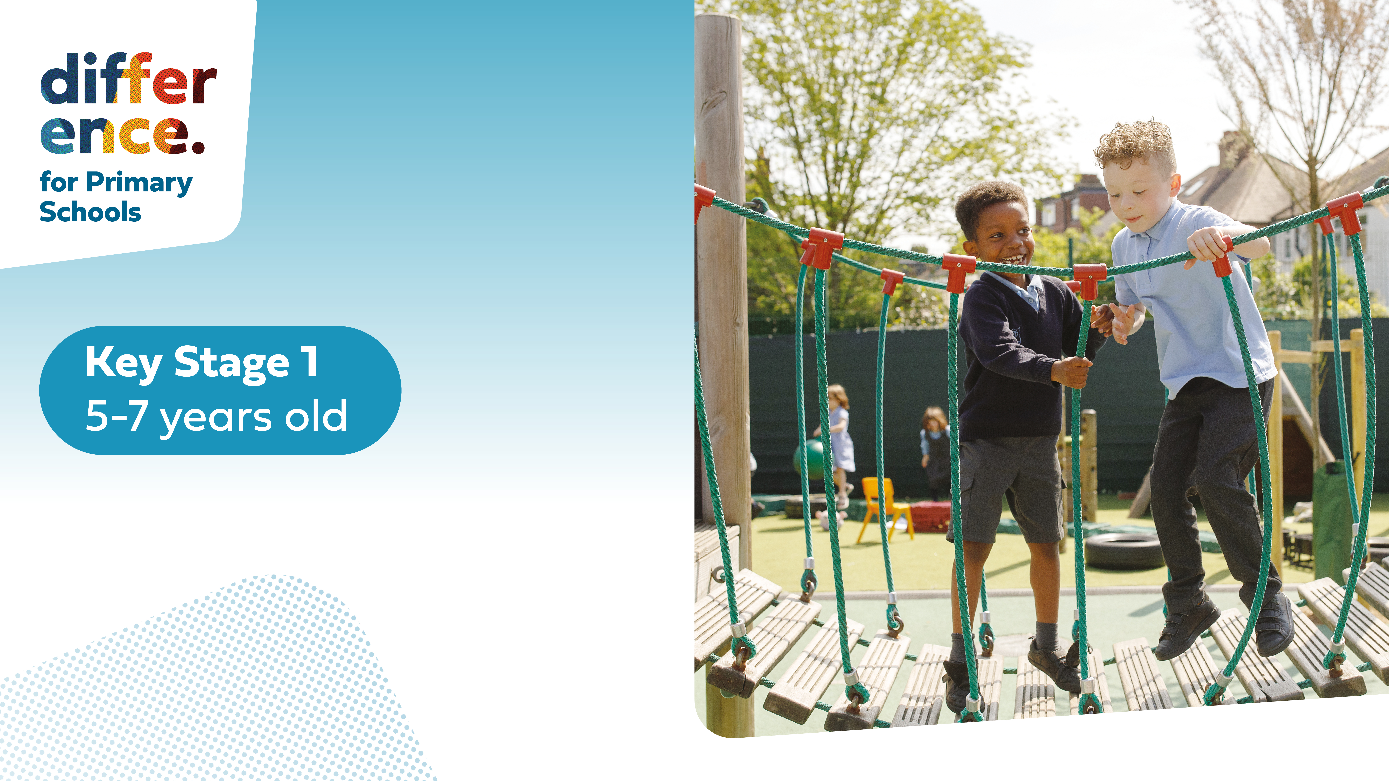

Slide 3




Three habits
Community
Embrace
Power
Listen to others’ stories and see the world through their eyes.
Encounter others with authenticity and confidence.
Find hope and opportunity in the places where we long to see changes.

Slide 4
I wonder…
Are we braver than we think?

Slide 5
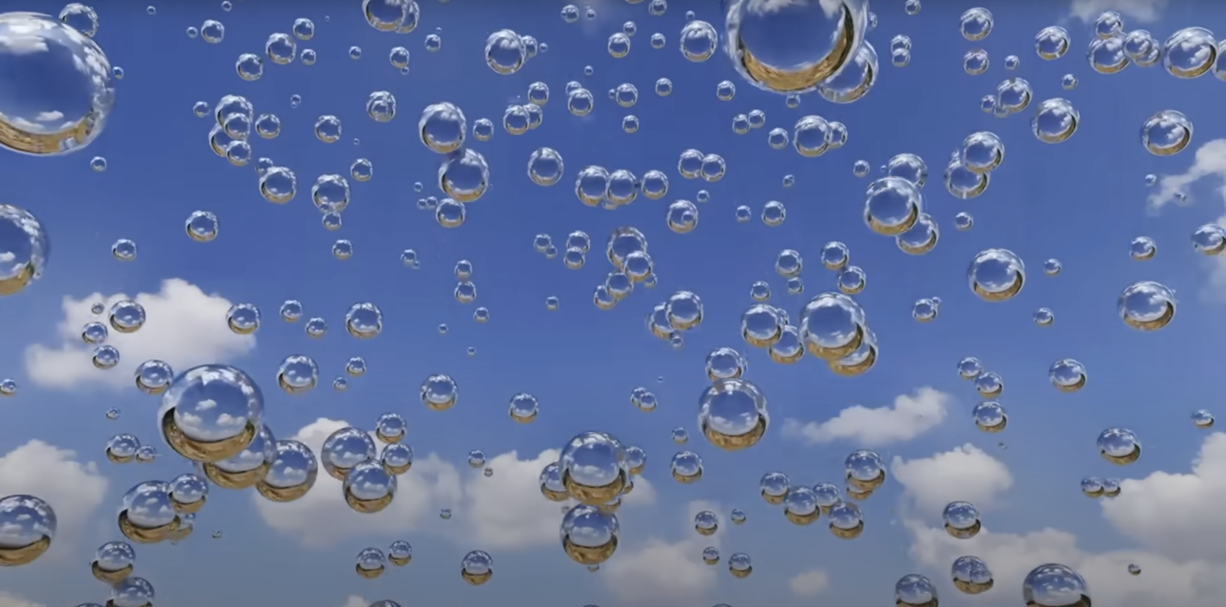

Calming Sensory Bubbles
Notes:
KS1 Difference Habits video needed

Slide 6

Difference habits KS1
Coming soon…
Notes:
KS1 Difference Habits video needed

Slide 7
What does hope mean?

Slide 8
Psalm 39:7
"And now, O Lord, for what do I wait? My hope is in you."

Slide 9
The Windmill Farmer

Slide 10
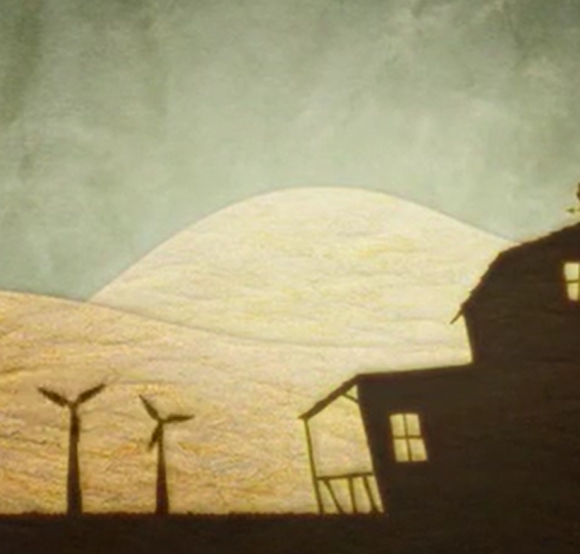
What do you see?
What do you think?
What do you know?
What do you want to know?

Slide 11
Watch and Discuss

Slide 12
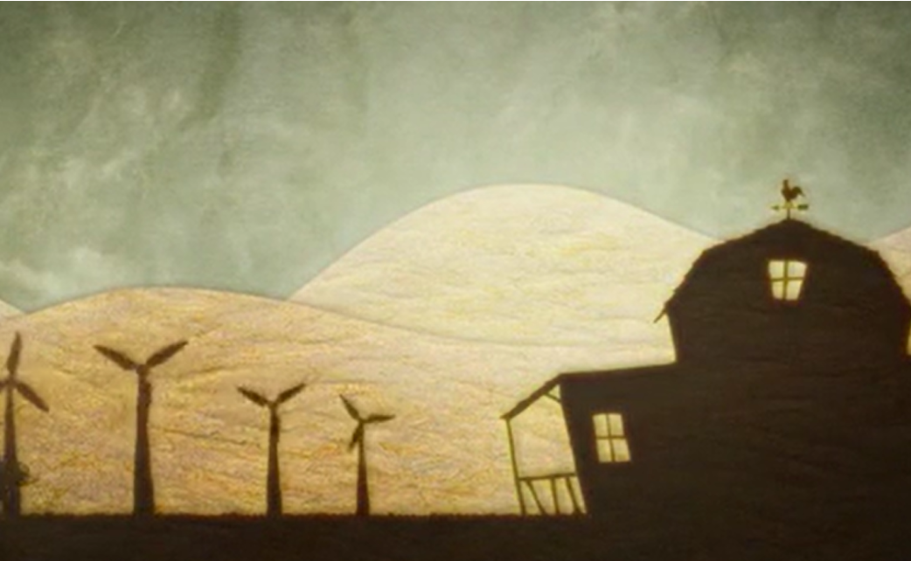
The Windmill Farmer

Slide 13
How did the farmer care for the windmill seeds?
How do you think he felt when the weather changed?
Do you think he should have hope? Why? Why not?

Slide 14
Guided Imagery Exercise

Slide 15
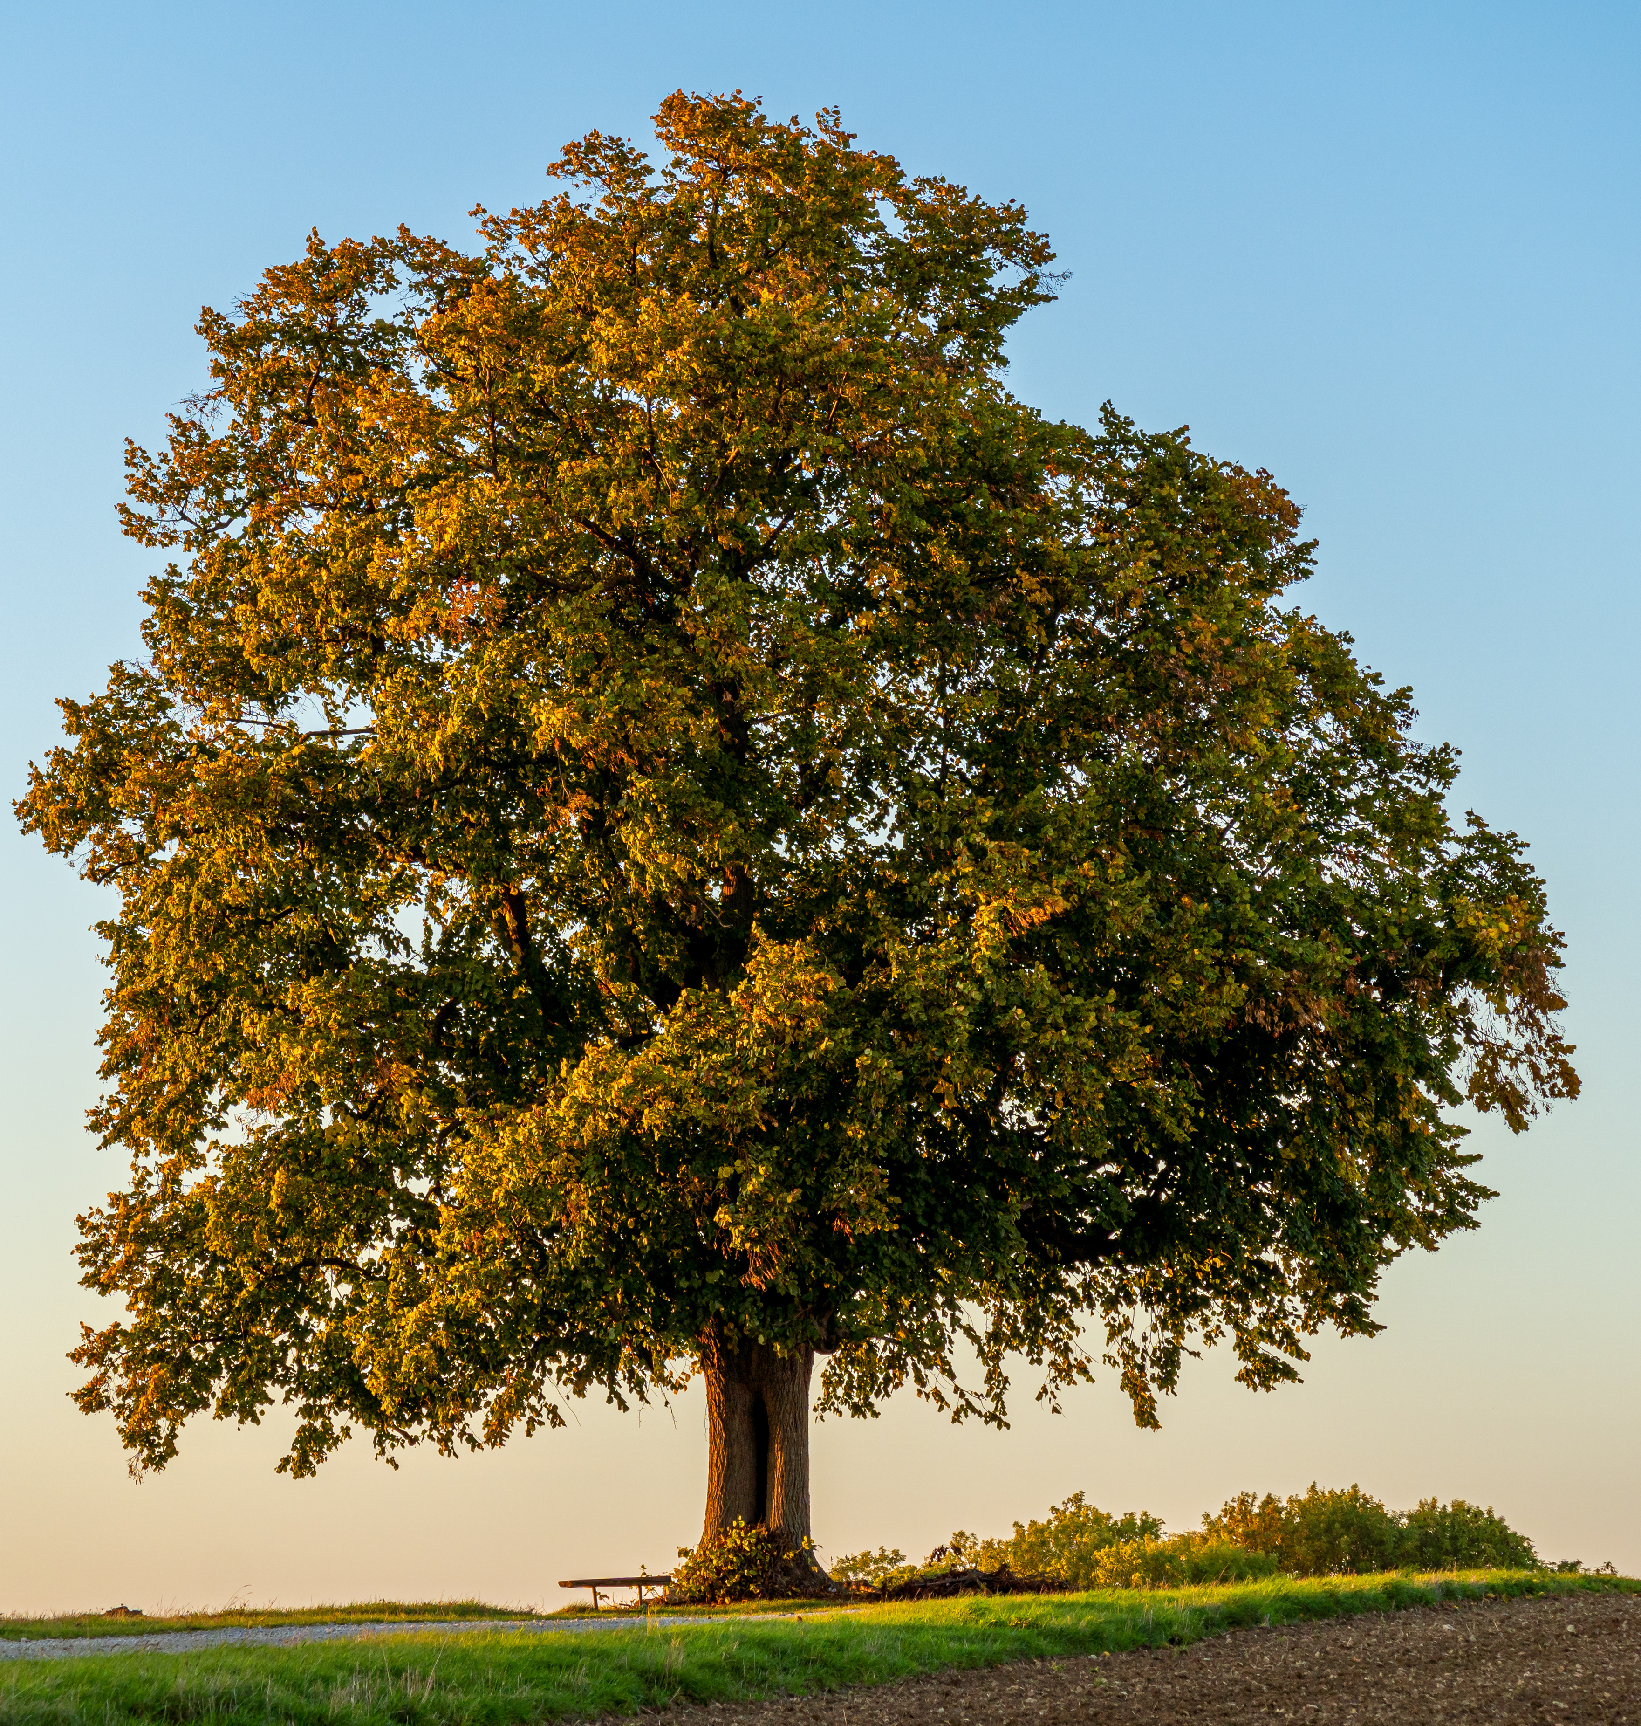
What did you feel when you were growing into a tree?
How can we use hope in our own lives when things feel hard?

Slide 16


Slide 17
Just like the farmer, there will be times when storms enter our lives. We must be hopeful that things will get better, and the storms will pass.
Having hope helps us think about all the good things that can go right.

Slide 18
Dear God,
Teach us to be patient and to have hope when things go wrong. We trust that you will guide us through difficult storms and into the light.
We put our faith in you.
Amen.

