Slide 1
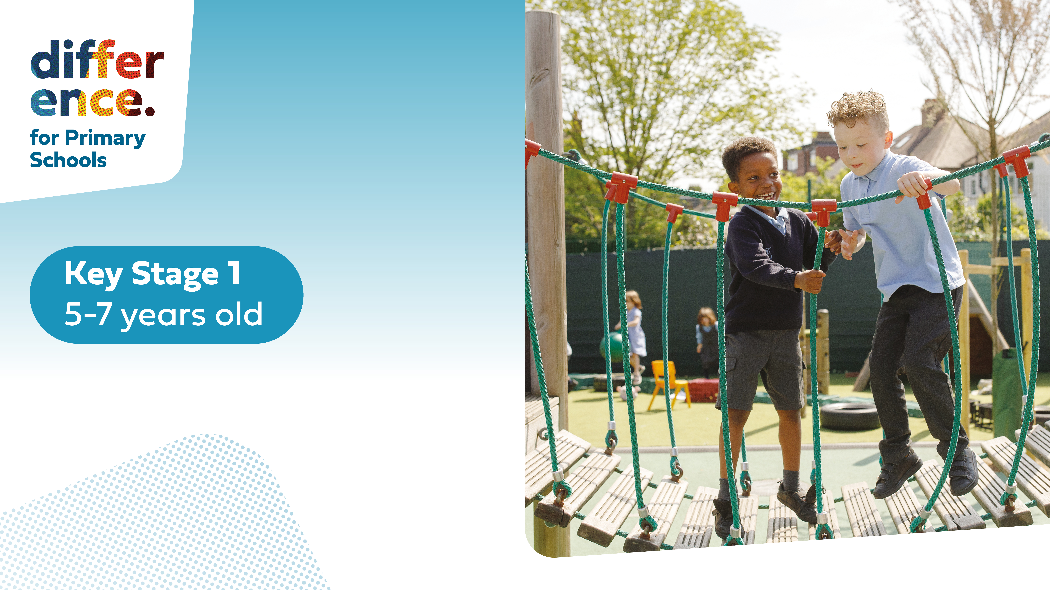

Slide 3




Three habits
Community
Embrace
Power
Listen to others’ stories and see the world through their eyes.
Encounter others with authenticity and confidence.
Find hope and opportunity in the places where we long to see changes.

Slide 4
I wonder…
Are we braver than we think?

Slide 5
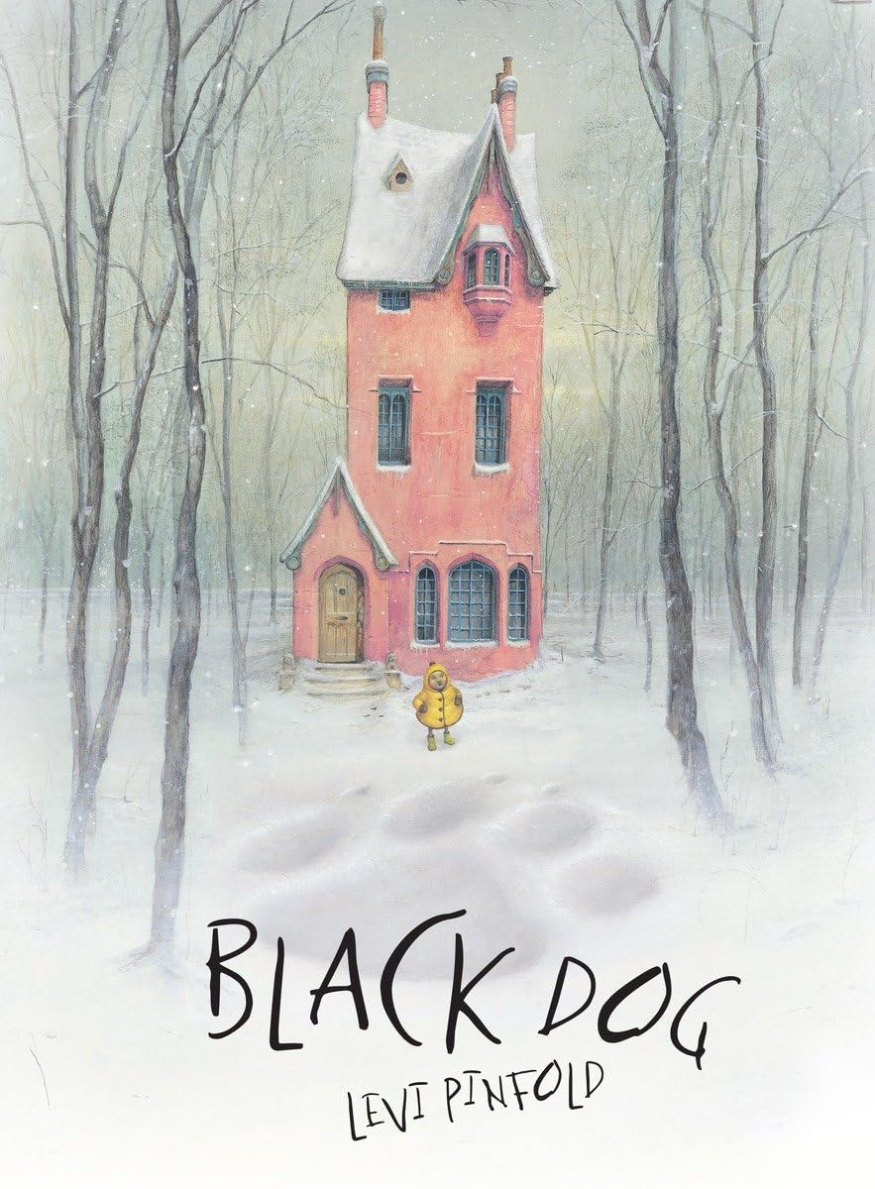

Slide 6
Read and Discuss

Slide 7
Why are the family scared?
What does it mean to hope?
How is Hope (Small) different from her family?

Slide 8
Can you think of a time when you felt scared?
Why was the dog compared to a tyrannosaurus rex?

Slide 9
Are there times we are afraid of things we can’t see?

Slide 10
Hope Against Fear

Slide 11
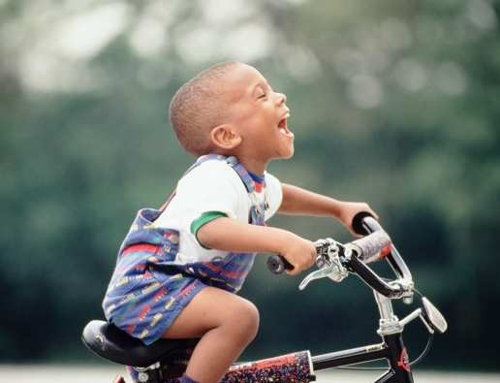
Making Hope Bigger than Fear
Imagine you want to learn to ride a bike, but you're so afraid of falling that you don’t even want to try. How will you ever learn to ride if you never get on the bike?
How can we make the hope bigger than the fear?

Slide 12
What would the world be like without hope?

Slide 13
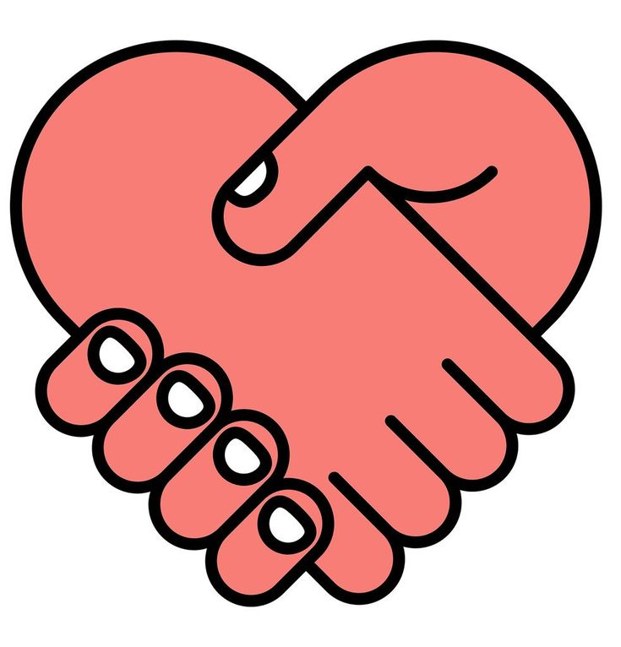
I hope that people in the world can be kinder
to each other.
How can hope help the world?

Slide 14
Psalms 31:24
"Be strong, and let your heart take courage."

Slide 15
What Are Your Hopes?
Take a cloud and write or draw something you hope or wish for to make the world a better place.
If you would like to share, tell us about your hopes and why you chose them.

Slide 16
Sometimes in life we can feel scared or frightened when things are new. Sometimes this can be when we see something that is different from what we are used to, such as a huge black dog!
But, if we are brave and show courage, we may be able to make our fear go away and find that the activity, thing or person we get to know might not be scary.

Slide 17
Dear God,
Thank you for teaching us how to be brave and how to have hope when we are faced with challenges.
Teach us to try our best, and to show courage when we need it. May we try to always find hope that things will go right and not focus on what can go wrong.
We ask this in your name.
Amen.

