Slide 1
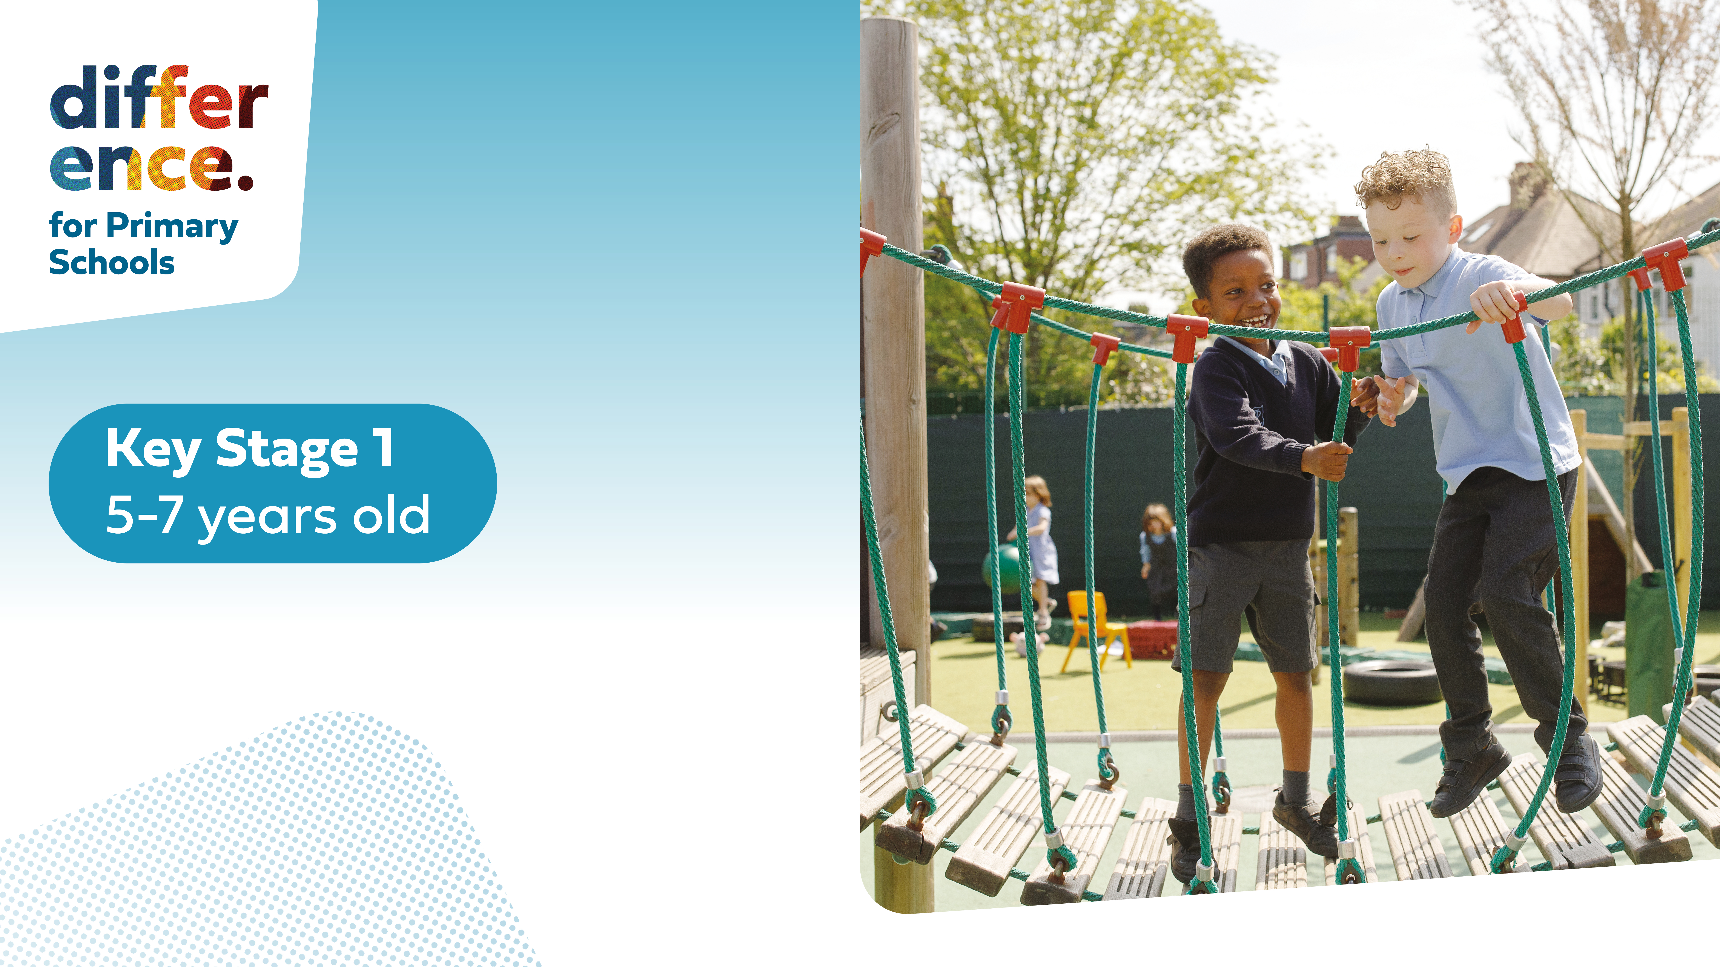

Slide 3




Three habits
Community
Embrace
Power
Listen to others’ stories and see the world through their eyes.
Encounter others with authenticity and confidence.
Find hope and opportunity in the places where we long to see changes.

Slide 4
I wonder…
Are we braver than we think?

Slide 5
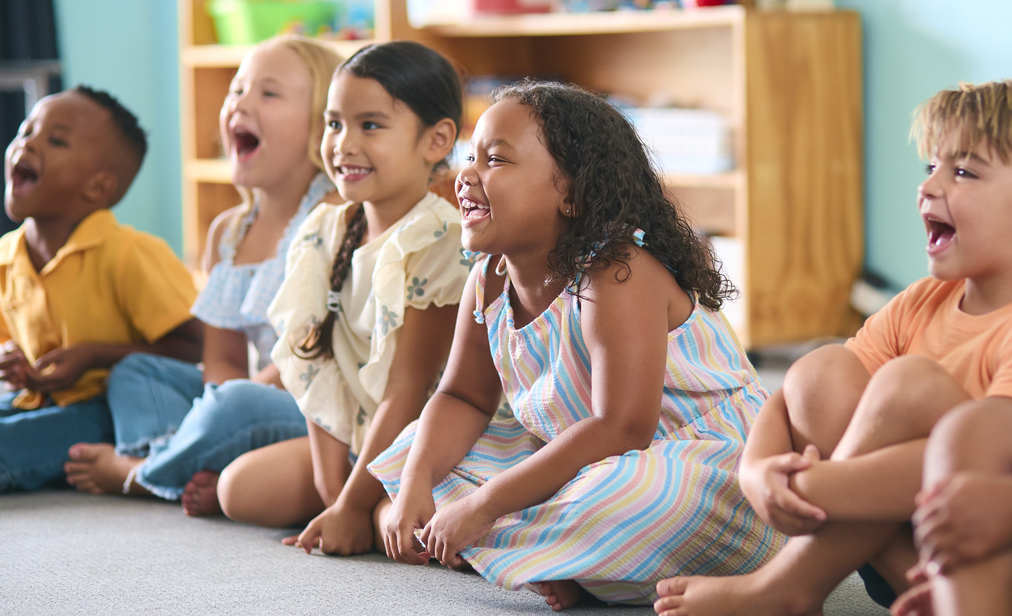

This is Our World by iSingPop

Slide 6

Let's Recap our Story...
Which characters thought the same as each other in Black Dog?
Which character thought differently from the others?

Slide 7
Let's Recap our Story...
How do we know?
Did they agree or disagree with one another?

Slide 8
Agree or Disagree?

Slide 9

What Do You Think?
Look around the classroom and you will see a 'thumbs up, thumbs in the middle or thumbs down'. These show when you agree, aren't sure or disagree.
When I say a statement, move to the part of the classroom that shows what you think.

Slide 10
What Do You Think?
Only boys should be able to play football at break times.

Slide 11
What Do You Think?
Chocolate should not be allowed at snack time.

Slide 12
What Do You Think?
No one should have to wear school uniform.

Slide 13
What Do You Think?
We should be friends with everyone.

Slide 14
Proverbs 15:1
"A kind answer soothes angry feelings, but harsh words stir them up."

Slide 15
How can we disagree kindly?

Slide 16
Some Steps…
Listen to what the other person is saying.
Respond kindly, e.g. "I disagree with Lucy because..."
Say why you disagree.
We don't need to argue when we disagree with someone!

Slide 17
Why do we not always agree?

Slide 18
Sometimes we don’t agree with people, we may think one thing and they may think something else. Sometimes we don’t agree with our friends and that’s okay!
We all have different experiences of the world and sometimes that means we don’t think the same, it's great we are all different otherwise the world would be boring!

Slide 19
Dear God,
Thank you for helping us to share our differences with others. Teach us to listen to each other, even when we don't agree. We know that our differences make us special.
We want to live in a world where we care about others, even when they think differently. May we still be kind and welcoming to them.
Amen.

