Slide 1
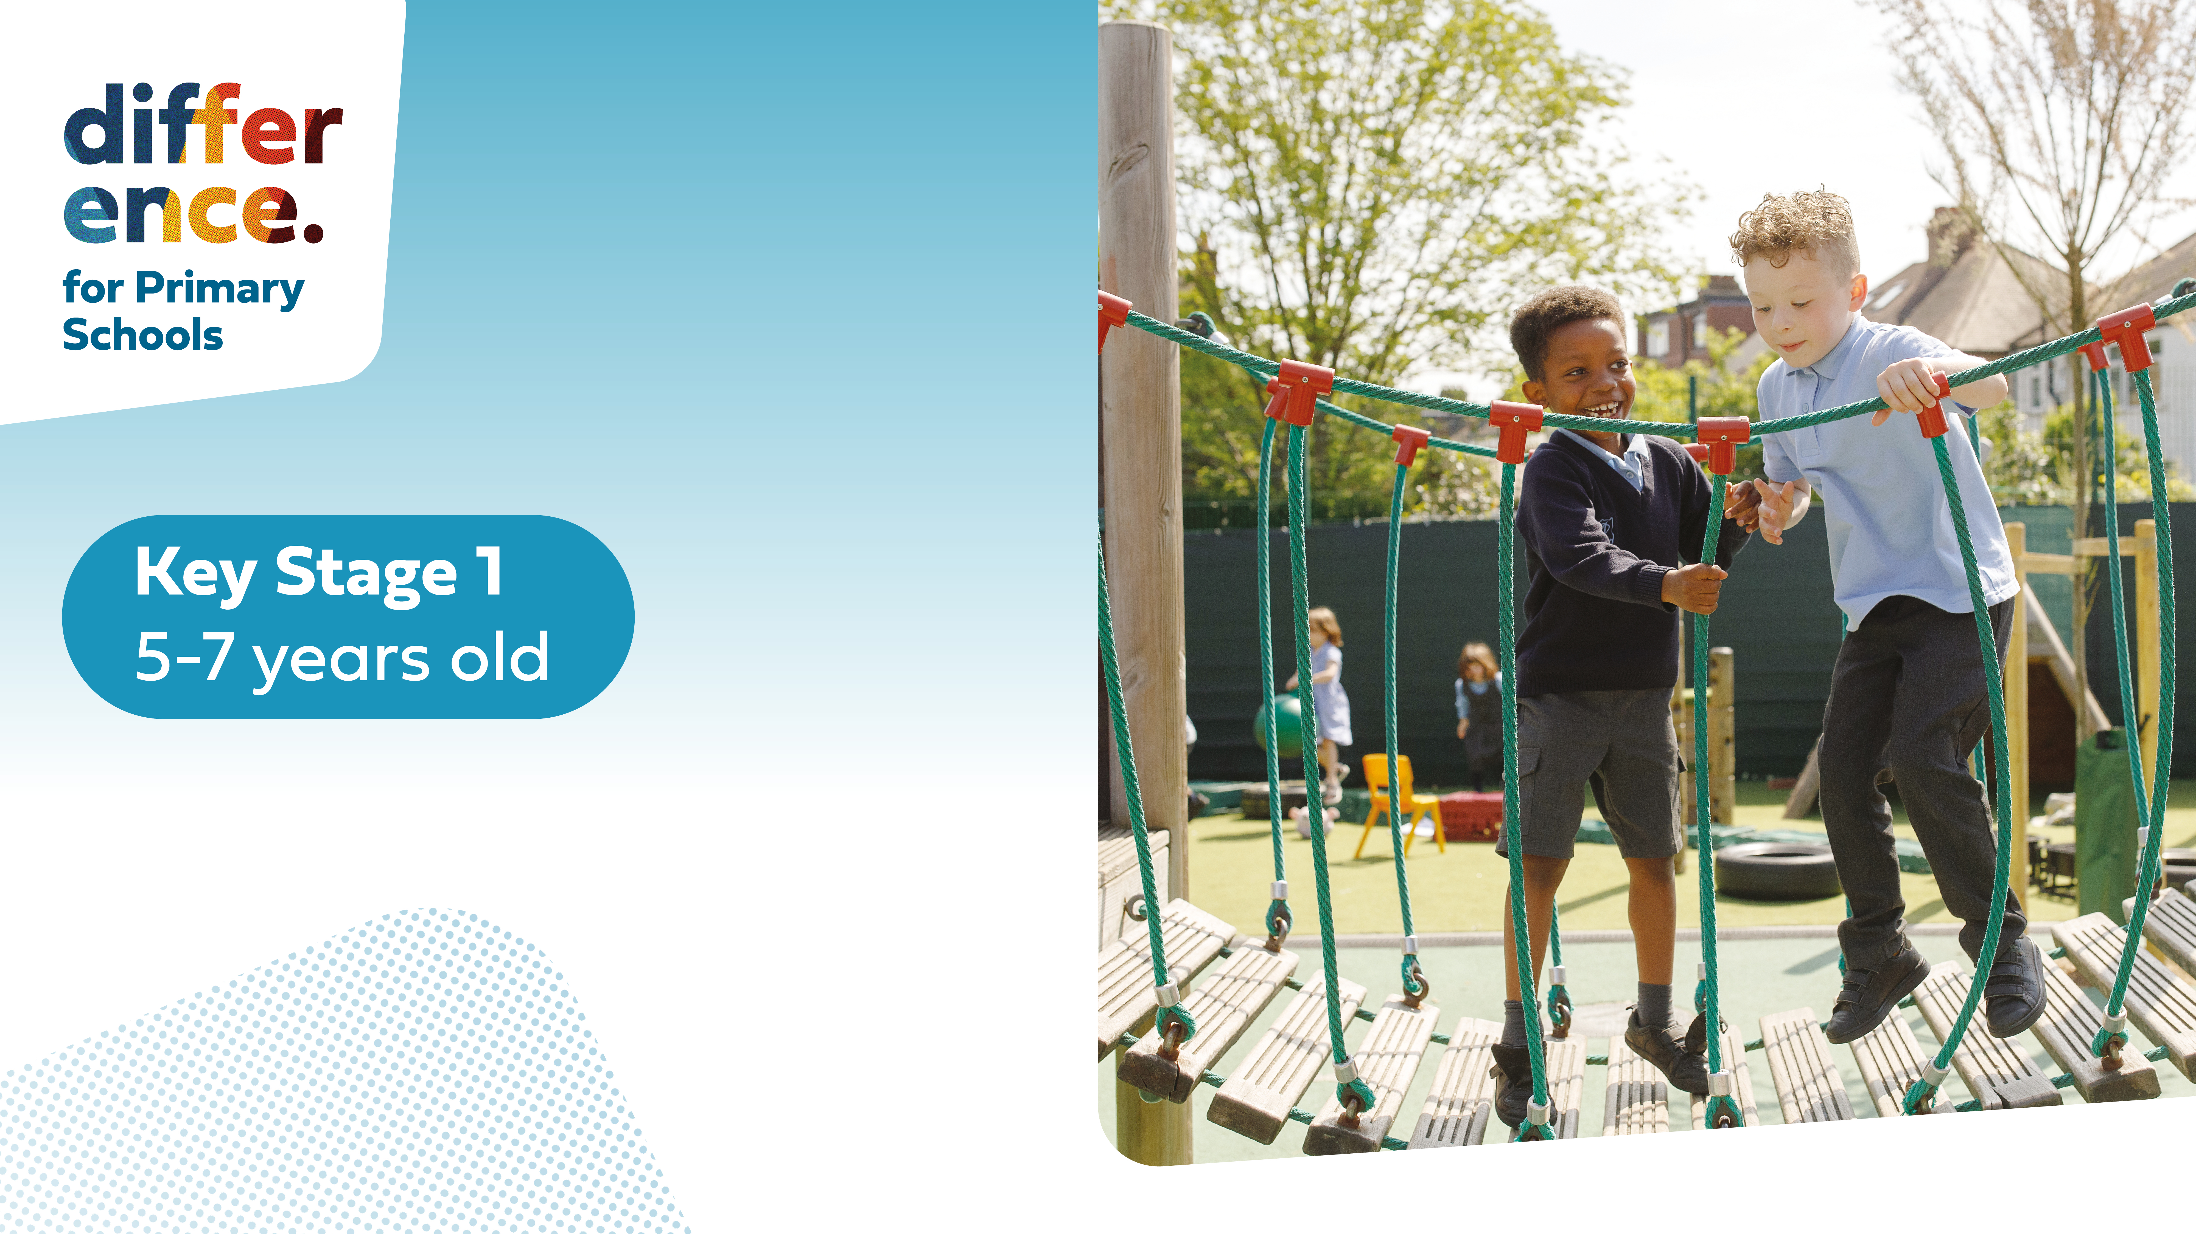

Slide 3




Three habits
Community
Embrace
Power
Listen to others’ stories and see the world through their eyes.
Encounter others with authenticity and confidence.
Find hope and opportunity in the places where we long to see changes.

Slide 4
I wonder…
Are we braver than we think?

Slide 5
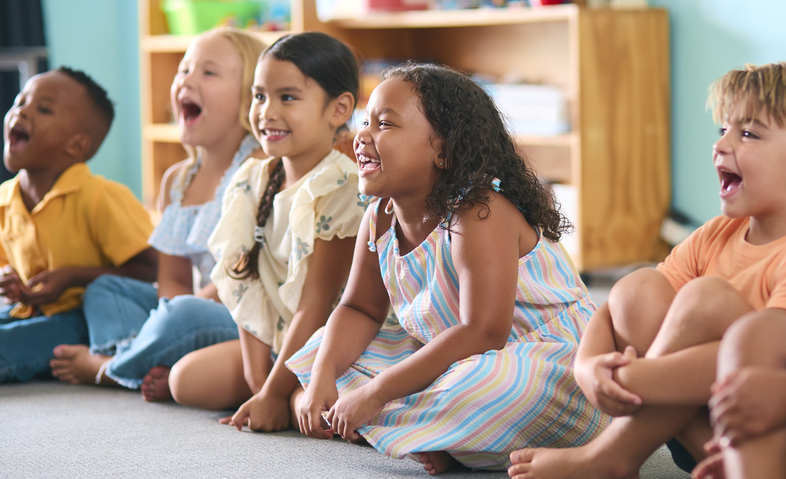

Love, Peace and Happiness

Slide 6

How Does Our Body Feel?
Today we are going to notice how our body feels at different points during this session.

Slide 7

Calming our Bodies
Notes:
KS1 Difference Habits video needed

Slide 8
How do you feel?

Slide 9
Lead Your Partner

Slide 10
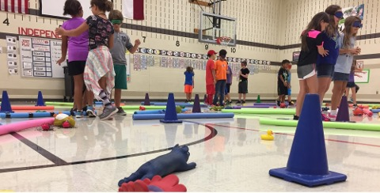
Lead Your Partner

Slide 11
Now For a Different Feeling!
We are going to cover our eyes and let a friend lead us through the obstacle course.
I want you to take notice about how you are feeling during this activity.

Slide 12
How Did You Feel?
What did you feel in your tummy?
What were you thinking?

Slide 13
How Did You Feel?
Did you notice anything else?
How did you feel letting your partner lead you?

Slide 14
Romans 12:18
"Do all you can to live in peace with everyone."

Slide 15
How can we live more peacefully?

Slide 16
Peace
When did you feel most at peace in this session?
Why is it important to feel calm and peaceful?
Why do we need peace in the world?

Slide 17
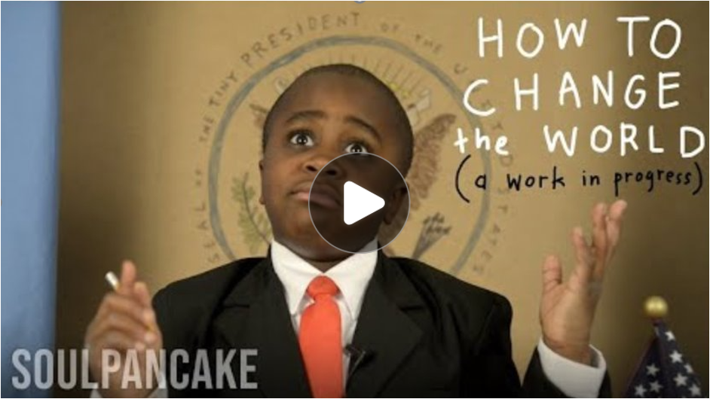
Message to the World

Slide 18
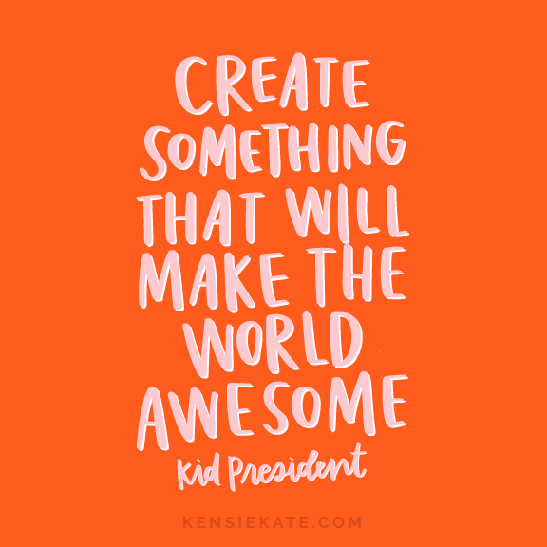
What can we do to make the world ‘more awesome’?
How would you make the world fairer?

Slide 19
It’s important for us to notice feelings in our bodies, as they give us important messages. Sometimes our bodies may tell us we are afraid, sometimes they may tell us we are calm.
When we feel less scared, our body starts to feel peace and we like this feeling! This means we are less likely to have arguments with other people and more likely to be kind to them. We want to look for more ways to live peacefully in our day to day lives.

Slide 20
Feeling peace inside our bodies also helps us to help others to be more amazing! We want to spread love so that other people can also feel happier in our world.

Slide 21
Dear God,
Thank you for helping us to listen to the feelings in our body and know the difference between feeling scared and feeling calm.
Help us to find peace and to pass this onto others in acts of kindness. We know that the world will thrive when everyone is able to live more peacefully with one another.
Amen

