Slide 1


Slide 3




Three habits
Community
Embrace
Power
Listen to others’ stories and see the world through their eyes.
Encounter others with authenticity and confidence.
Find hope and opportunity in the places where we long to see changes.

Slide 4
I wonder…
Are we braver than we think?

Slide 5


This is Our World by iSingPop

Slide 6
A Story About Self Control

Slide 7
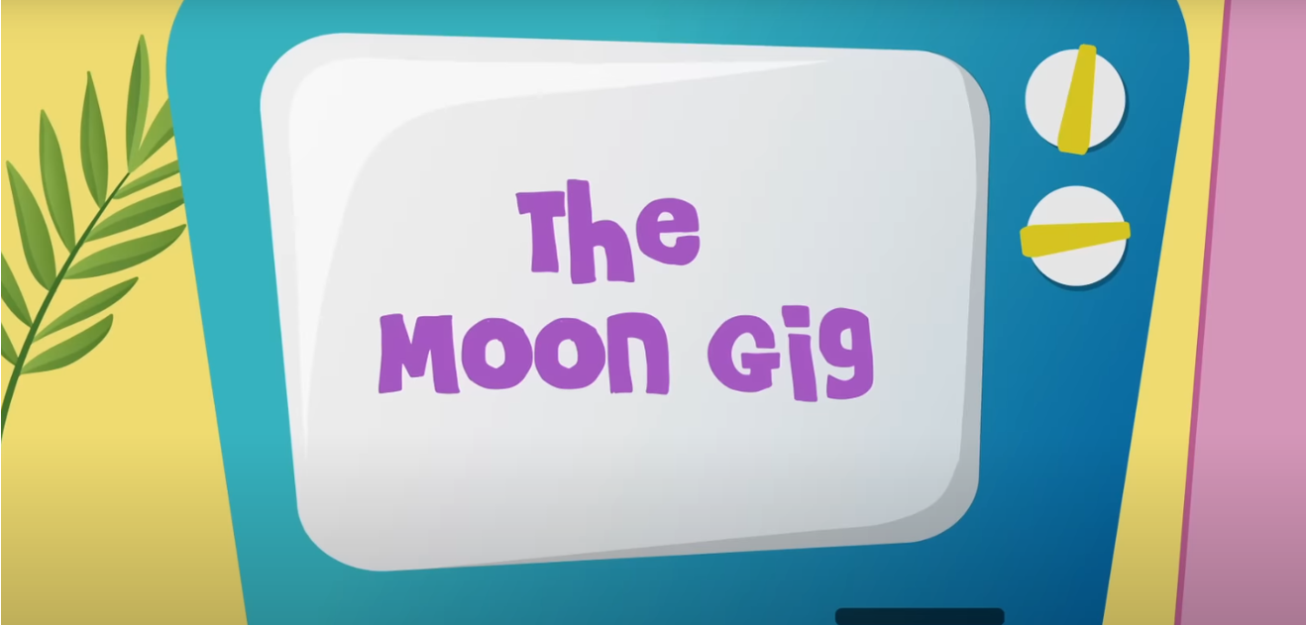
The Moon Gig
Notes:
KS1 Difference Habits video needed

Slide 8
Discussion
Why do you think CJ got so frustrated during the Moon Gig?
How did CJ’s feelings affect the rest of the Cheeky Pandas?

Slide 9
Discussion
What helped CJ calm down and think more clearly?
What can we do when we feel angry or overwhelmed, like CJ did?
Why is it important to use self-control, even when things don’t go our way?

Slide 10
Learning How to Forgive

Slide 11
Learning How to Forgive...
Hold your feather in your hand.
Think about a time when someone made you upset or angry.
Now think about how it felt when that person said sorry. How did you feel afterwards?
Now think about how it would feel if they hadn't have said sorry. How would that make you feel. Would it be harder to let go of your upset or anger?

Slide 12
Letting Go
Imagine that blow away your feather is the hurt you felt when someone upset you. When you blow your feather, imagine that the hurt is floating away.

Slide 13
Key Questions
What would happen if you were always angry?
Why is it important to forgive others?

Slide 14
Key Questions
How does your body feel when you gently blow away the feather?
What else could you do?

Slide 15
Practising Forgiveness

Slide 16
Ephesians 4:32
"Be kind and compassionate to one another, forgiving each other, just as in Christ, God forgave you."

Slide 17
Can you think of times when we may need to forgive our friends?

Slide 18
Sometimes people upset or hurt us, these people can include our friends or family. It's okay to feel hurt, upset or even angry. We don't want to get stuck being angry as it stops us enjoying the good things in life.
When we forgive, it can feel we are ‘blowing the hurt out of our heart' and it can help us to feel calm and enjoy our day; we don’t want to be angry all the time.

Slide 19
Dear God,
We know that sometimes people may do the wrong thing and make choices that may upset or anger us. Help us to let go of our anger so that we can find peace within ourselves.
May we continue to practise forgiveness and show more kindness to one another, making our world a better place.
Amen.

