Slide 1


Slide 3




Three habits
Community
Embrace
Power
Listen to others’ stories and see the world through their eyes.
Encounter others with authenticity and confidence.
Find hope and opportunity in the places where we long to see changes.

Slide 4
I wonder…
Are we braver than we think?

Slide 5
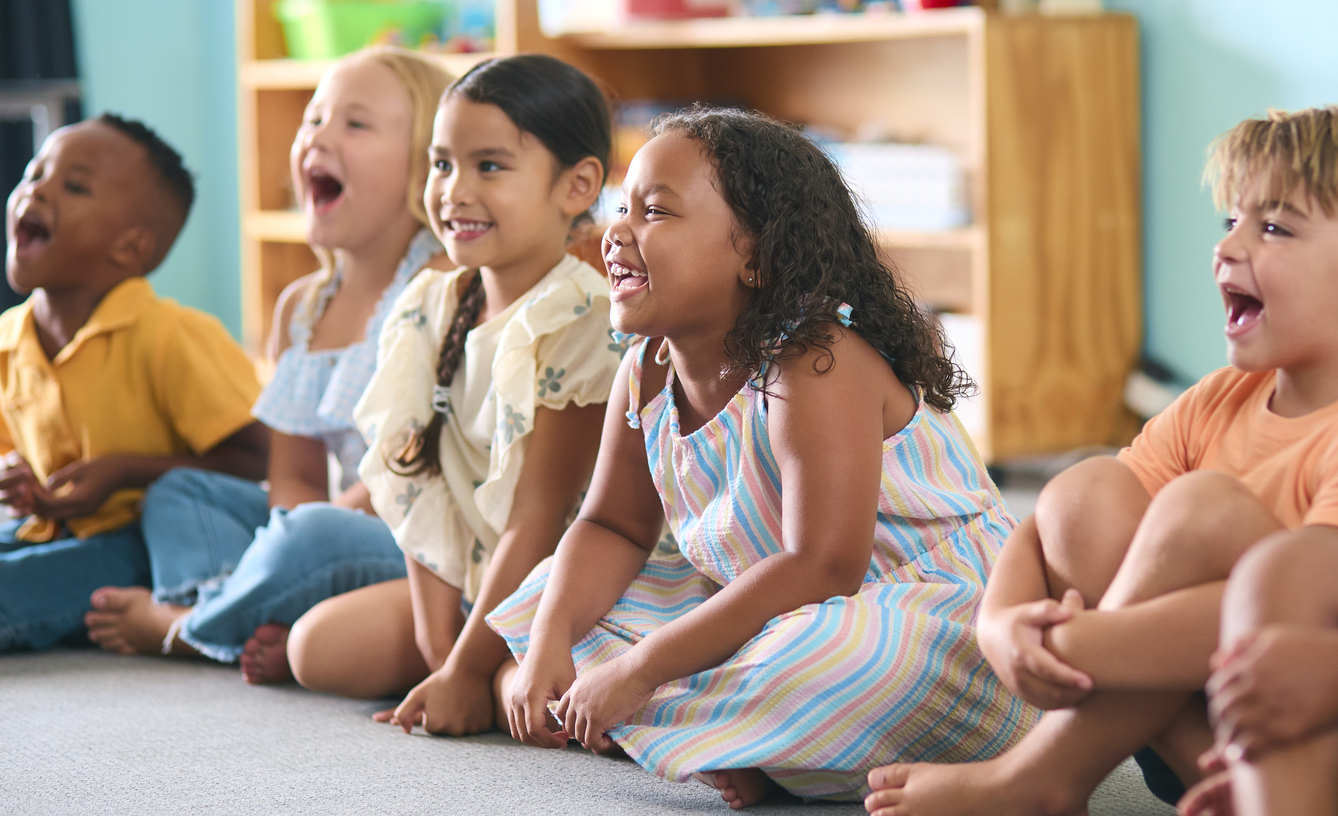

This is Our World by iSingPop

Slide 6
Story

Slide 7
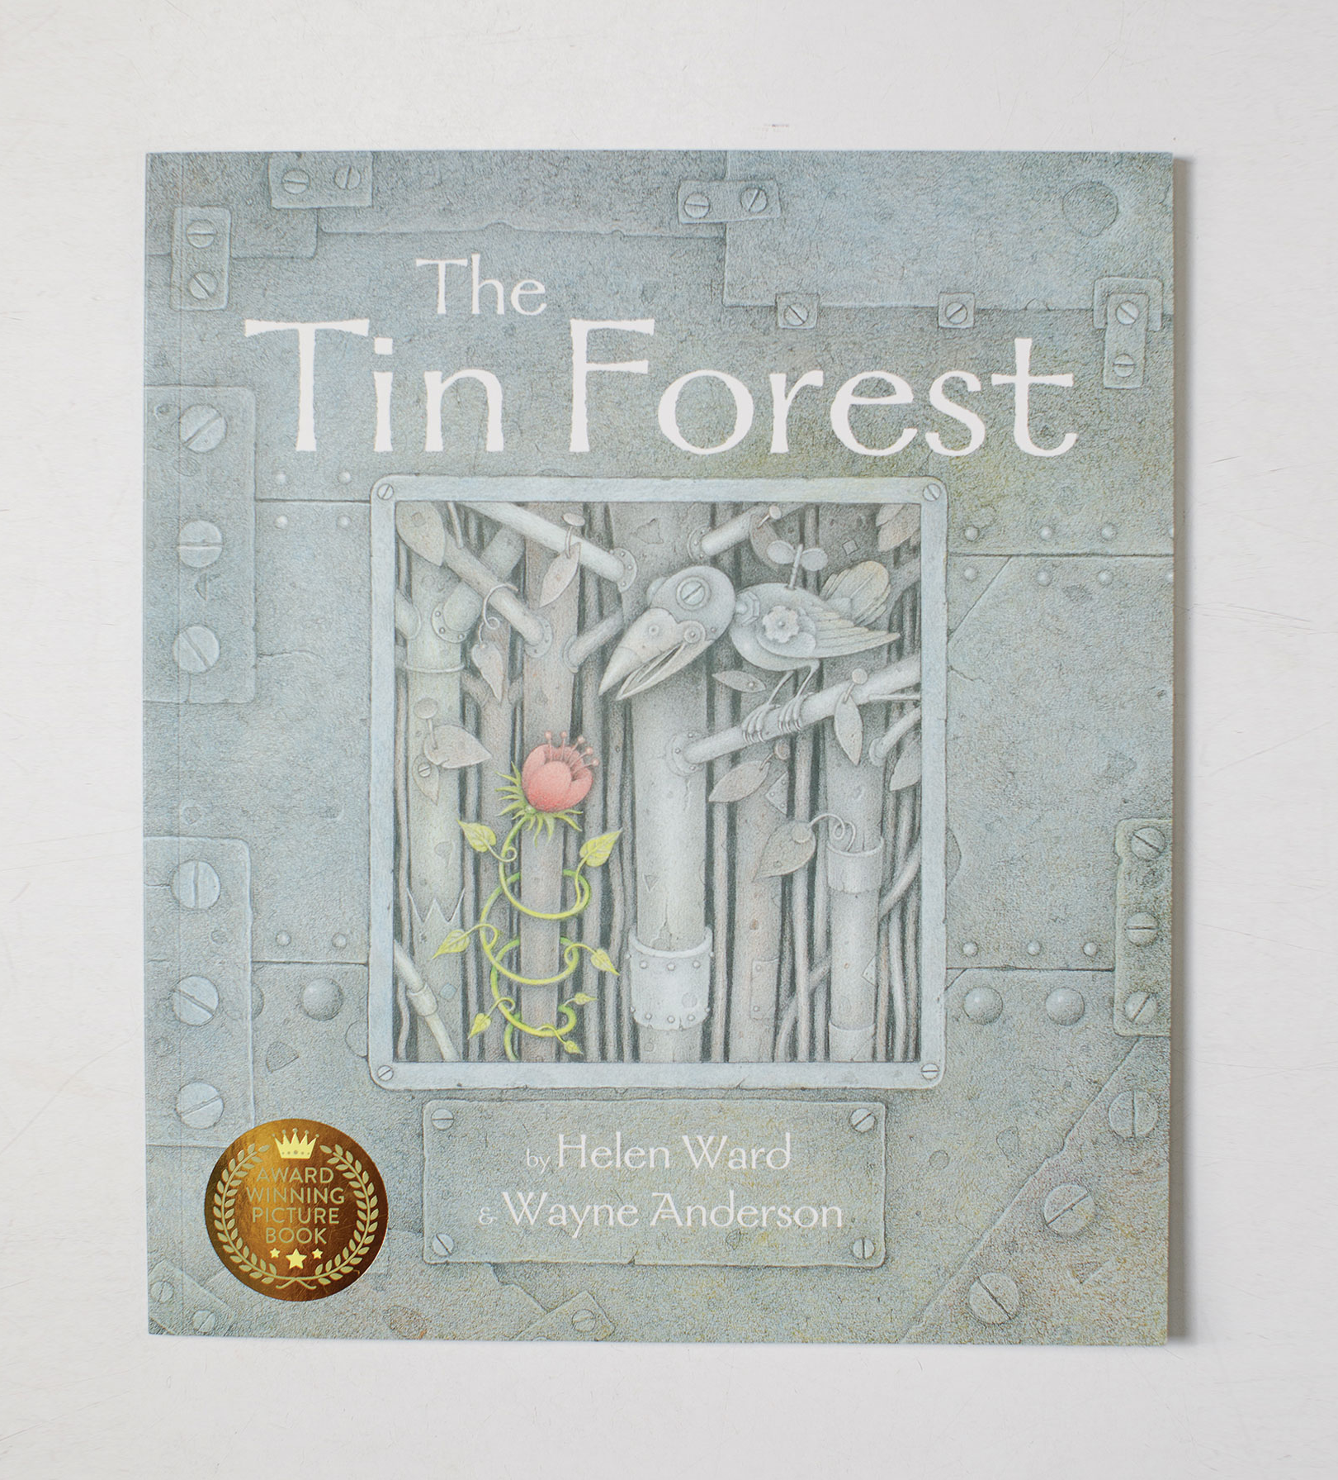
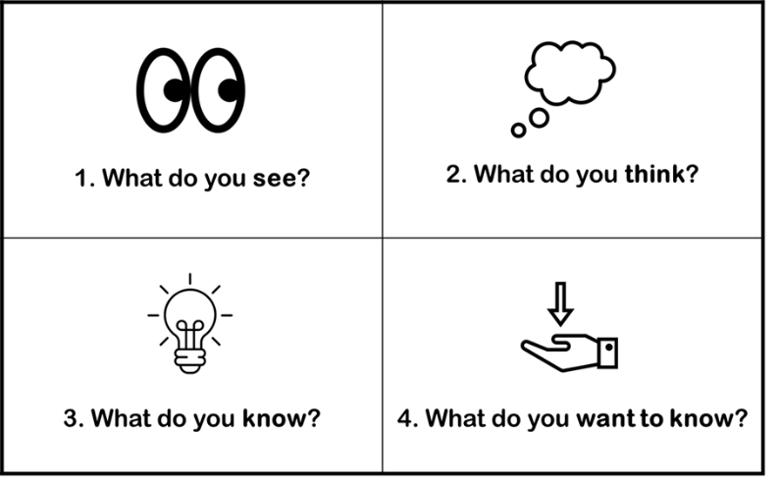
The Tin Forest

Slide 8
Discussion
How do you think the man felt at the beginning?
What does it mean to 'ache'?

Slide 9
Discussion
Why did he 'ache with emptiness'?
How did he feel at the end? What changed for him?

Slide 10
Discussion

Slide 11
Looking After Our World
How does the old man look after the world around him?
Why do you think the bird wanted to come?
Why do you think the bird wants to stay?

Slide 12
How can we make people feel welcome?
How can we look after everyone in our community?
How can we make them feel they want to stay?

Slide 13
Leviticus 19:33-34
"When a foreigner resides among you in your land, do not mistreat them."

Slide 14
How can we create beauty out of things which seem unwanted?

Slide 15
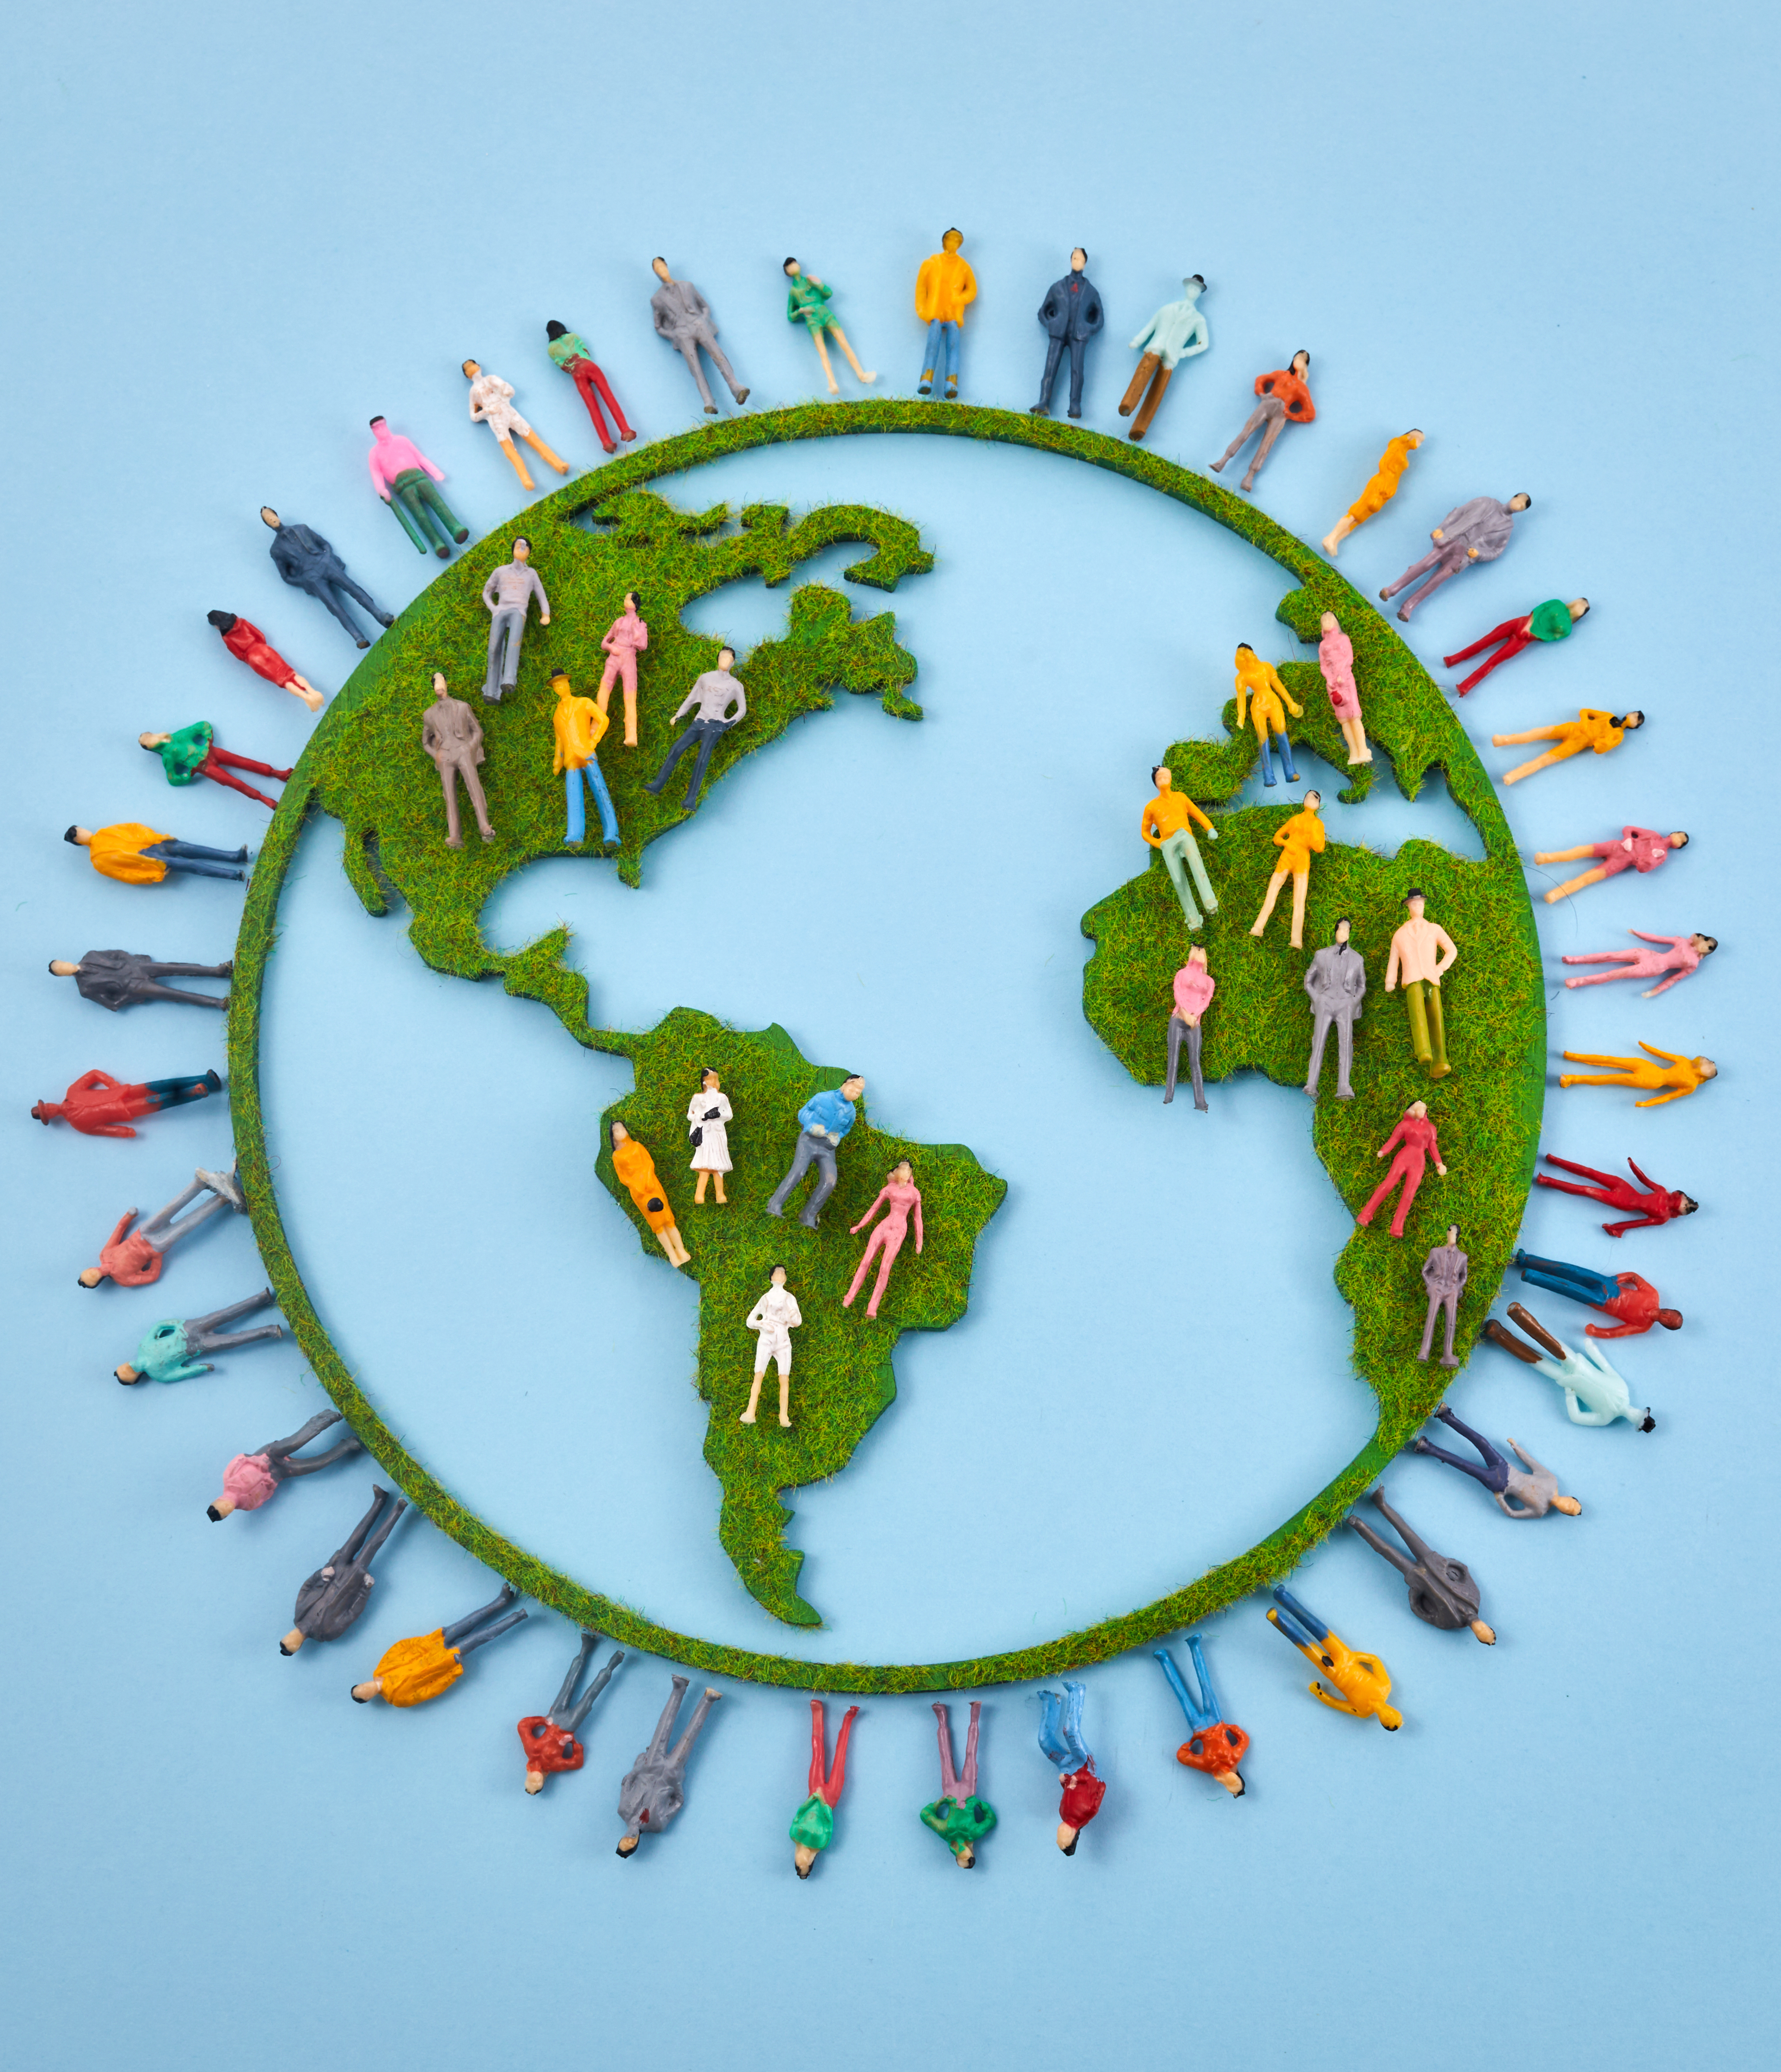
Discussion
What is a ‘foreigner’?
Who are the foreigners in the story?

Slide 16
Discussion
How do you think hearing the word, ‘foreigner’ might make some people feel?
Which words can we use instead to make other people welcome?

Slide 17
Creating Beauty

Slide 18
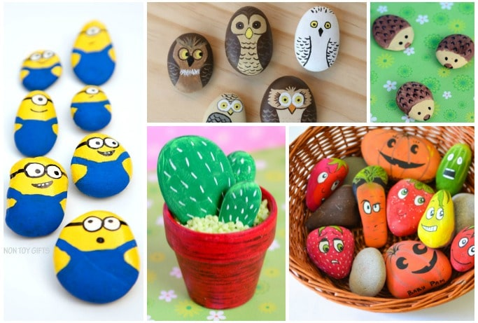
What Do You Think These Are Made Of?

Slide 19
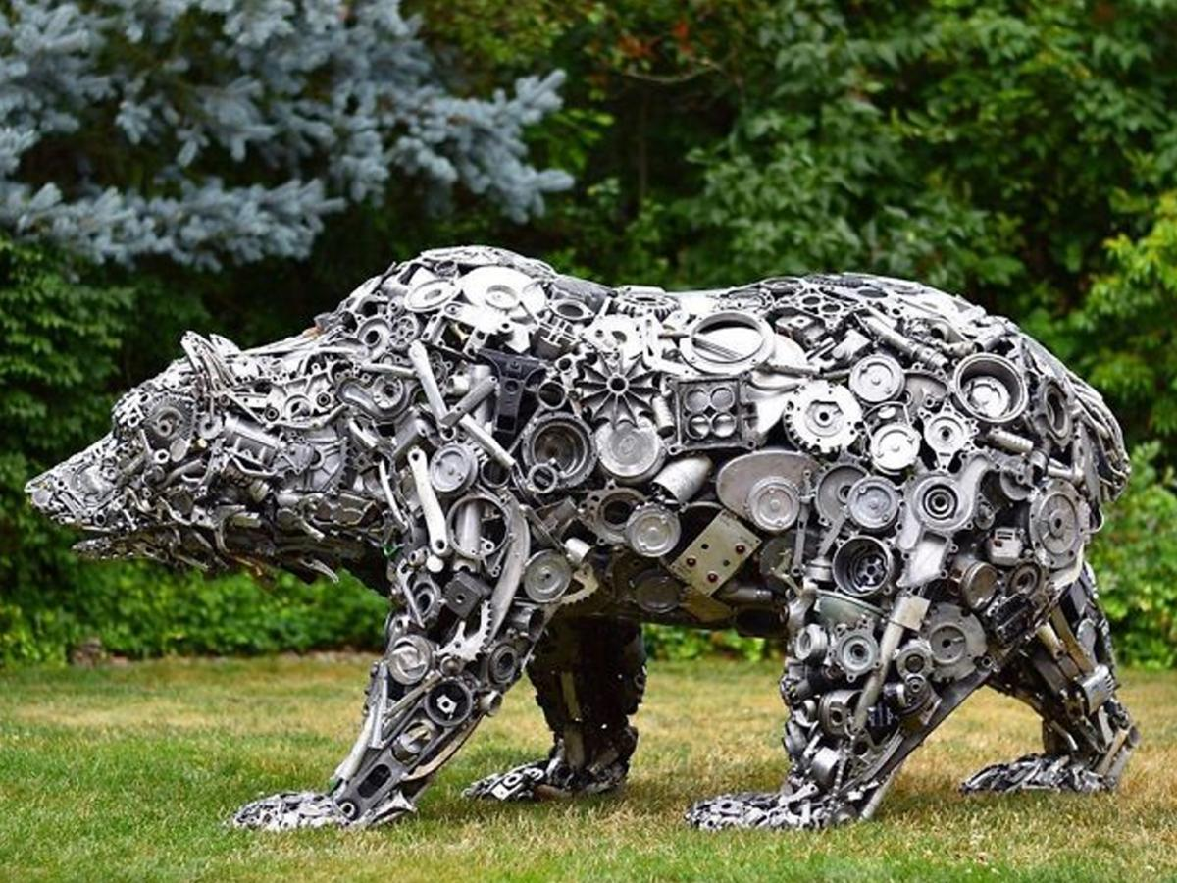
What Do You Think This Is Made Of?

Slide 20
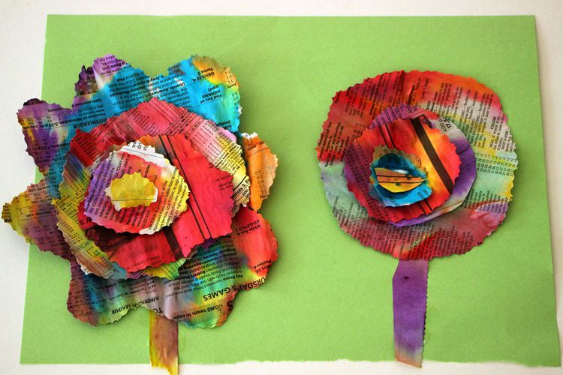
Newspaper Flowers
People threw away these newspapers.
How do they look now?
Let's make some for
our classroom!

Slide 21
It’s important to look after the world around us and welcome people into this world. Sometimes people may feel unwanted and unwelcome, but it's important to make them feel valued so they feel like they belong.
We want to welcome everyone into our class and into our community!

Slide 22
Dear God,
We want everyone in our world to feel as though they have a place. Help us to show kindness to others so that they know they are wanted in our community.
May we continue to feel peace in places where we belong and help others to feel the same.
We ask this in your name.
Amen

