Slide 3




Three habits
Community
Embrace
Power
Listen to others’ stories and see the world through their eyes.
Encounter others with authenticity and confidence.
Find hope and opportunity in the places where we long to see changes.

Slide 4
I wonder…
How can we define beauty?

Slide 5

Difference habits LKS2
Coming soon…

Slide 6
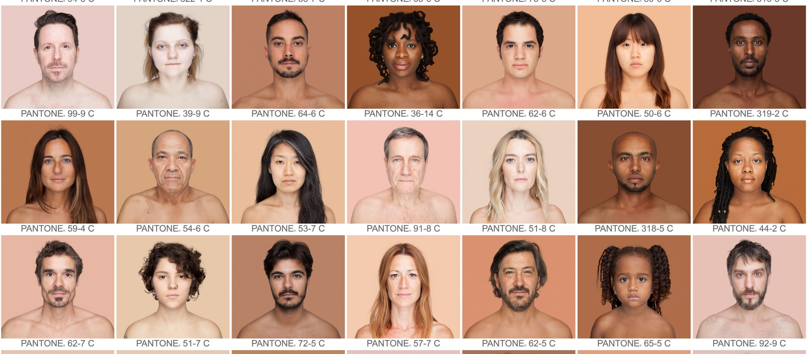

Slide 7
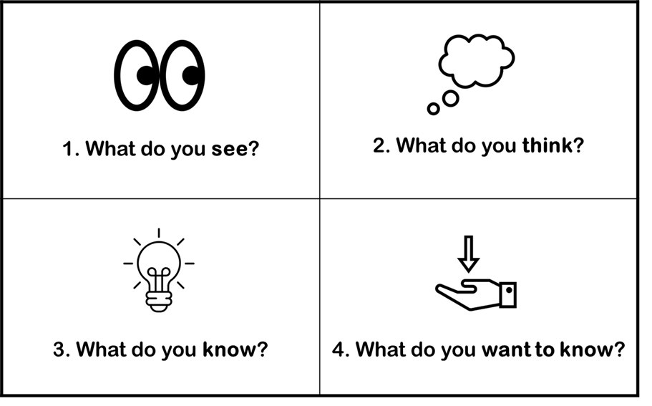

Slide 9
Guess the story!

Slide 10
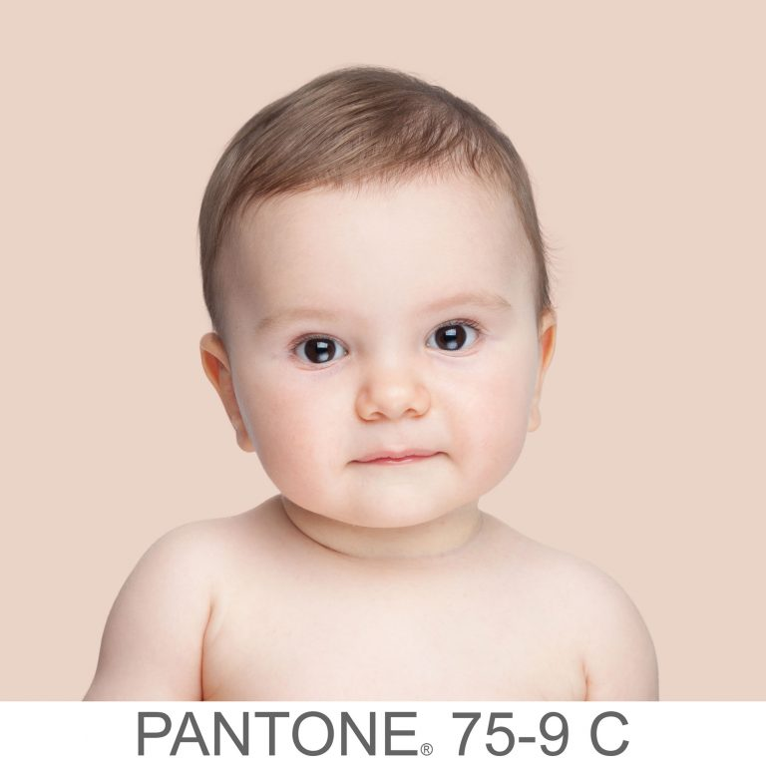
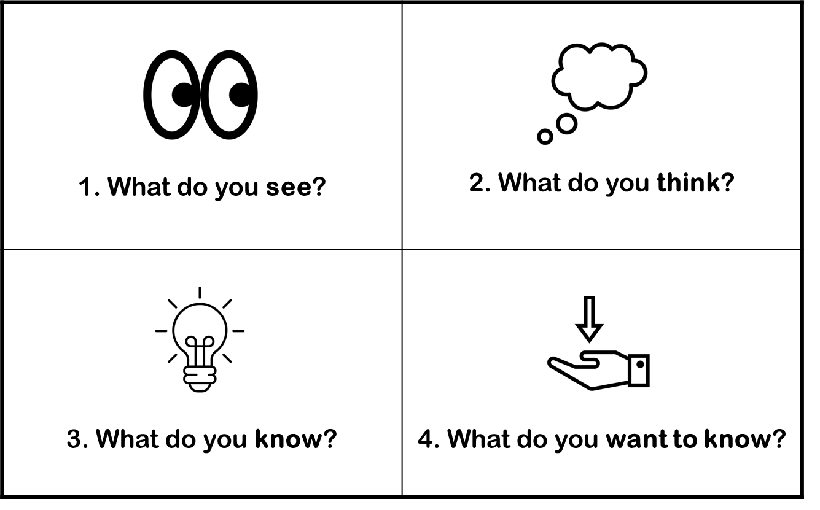
What could be the story of this person?
Is this person beautiful?

Slide 11
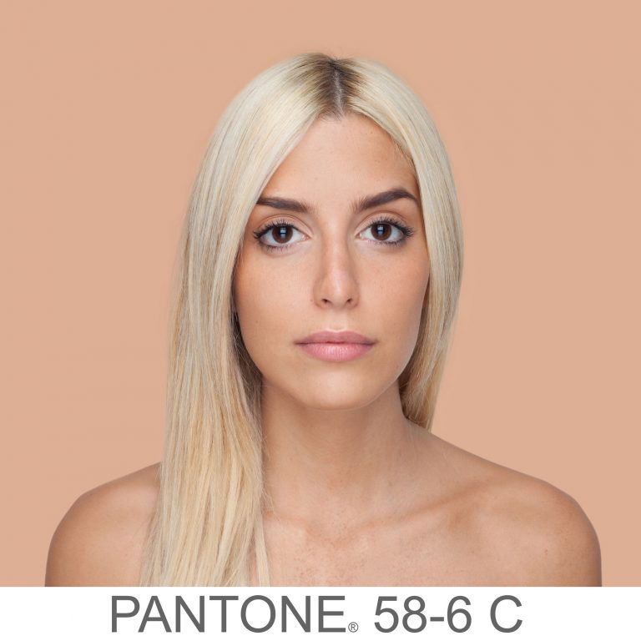
What could be the story of this person?
Is this person beautiful?

Slide 12
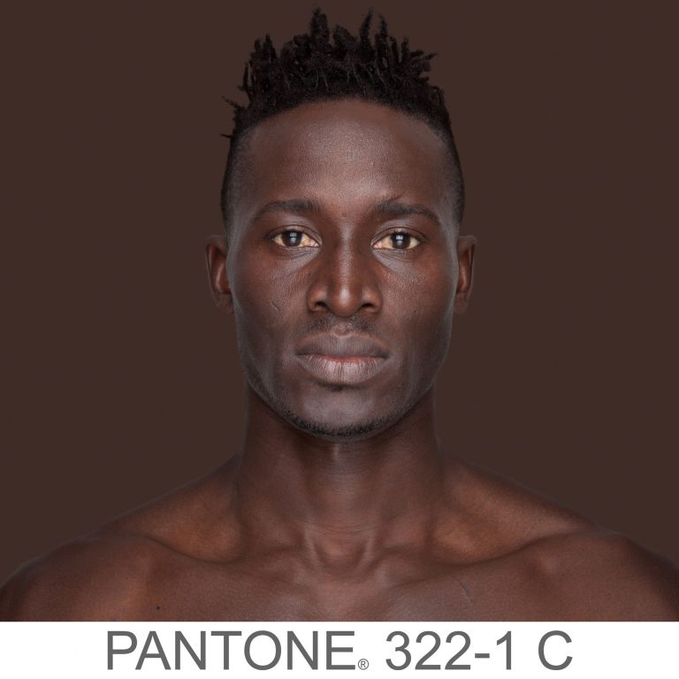
What could be the story of this person?
Is this person beautiful?

Slide 13
I wonder…
How can we define beauty?

Slide 14
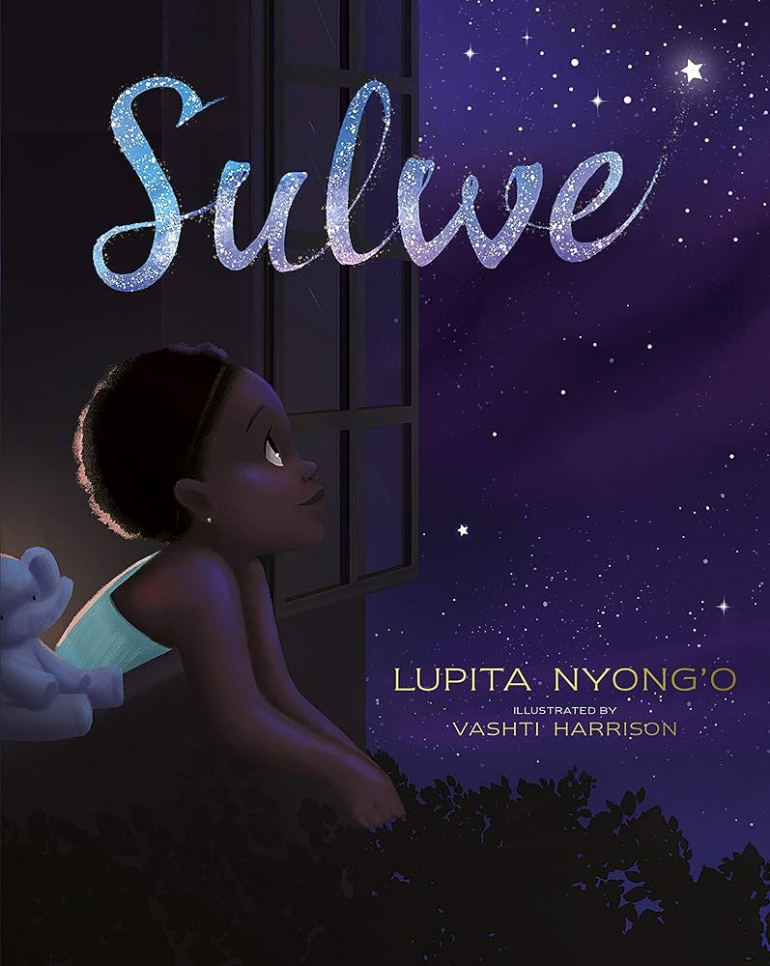
Read or Watch

Slide 15
Ephesians 2:10
"For we are God’s masterpiece…"

Slide 16
Sulwe felt sad because she didn’t look like the people around her.
Have you ever felt left out or different?
How would it feel to remember that you are God's masterpiece?
What can we do to help others feel like they are special too?

Slide 17
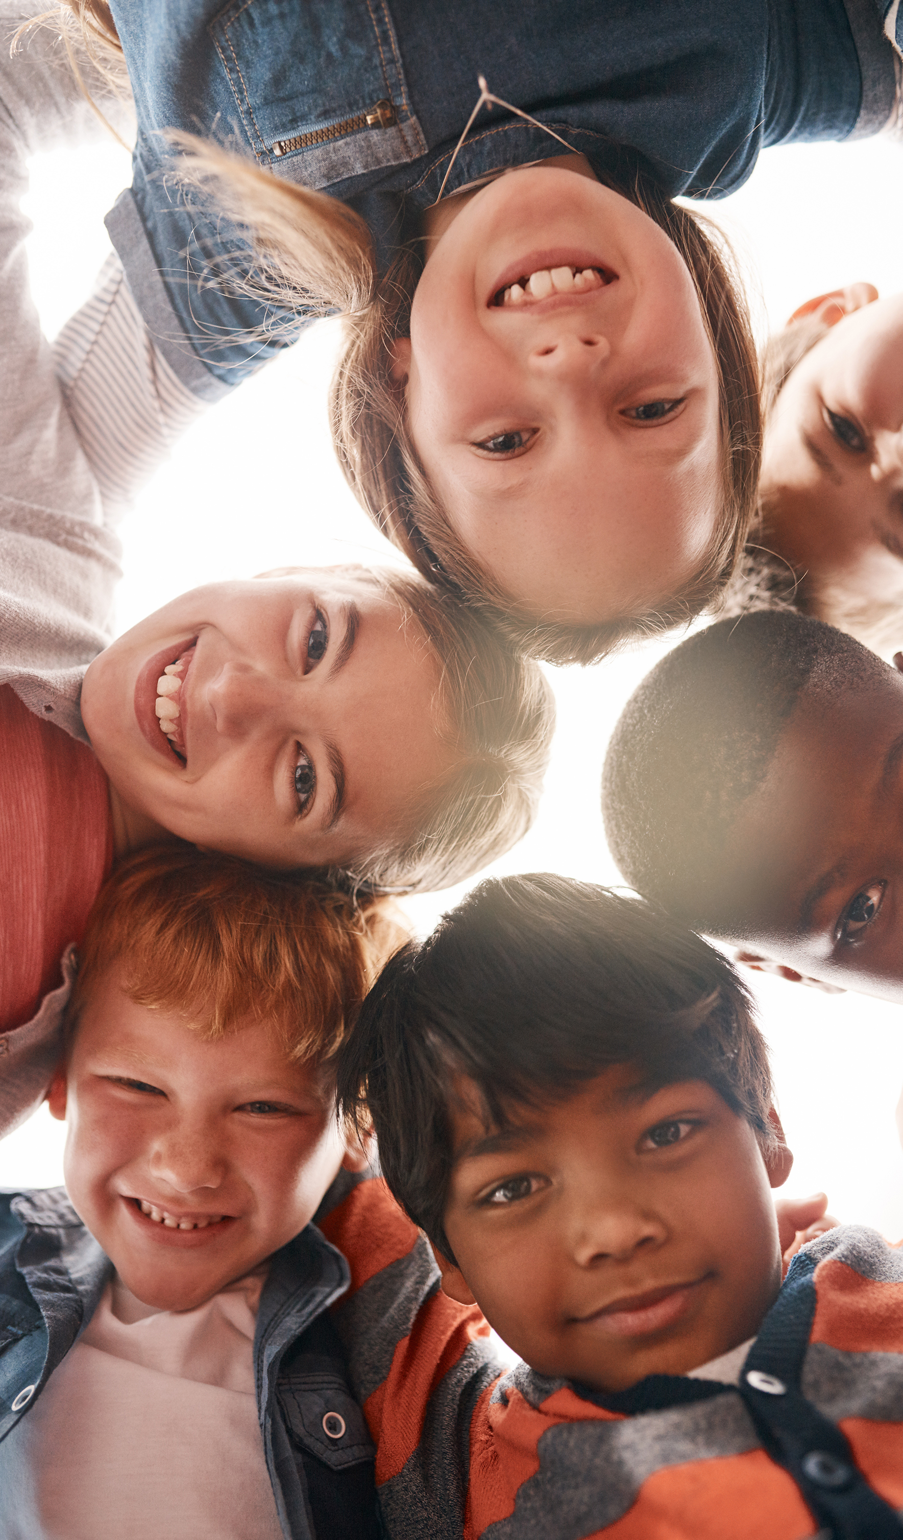
Imagine a garden with many different flowers. Some are red, some are blue, some are big, and some are small. Each flower is unique, and together they make the garden beautiful.

Slide 18
People are like these flowers. We come from different places, have different skin colours, speak different languages, and have different traditions. And just like the flowers, our differences make the world a more beautiful and interesting place.

Slide 19
When we meet someone who looks different from us or comes from a different country, it's like discovering a new and special flower. We can learn so much from each other! Maybe your new friend knows a cool game you've never played before or can teach you words in another language. Every person has something unique and wonderful to share.

Slide 20
Dear God,
Thank you for bringing us together today.
Help us to see the beauty in everything around us. Open our eyes to the wonders of nature, the colours of the flowers, the songs of the birds and our own inner beauty. Teach us to recognise the beauty in others.

Slide 21
Help us to see how special and unique each one of us is. Guide our hearts to appreciate kindness, friendship, and love, which are the most beautiful things of all.
Thank you for making our world so full of beauty.
Amen.

