Slide 3




Three habits
Community
Embrace
Power
Listen to others’ stories and see the world through their eyes.
Encounter others with authenticity and confidence.
Find hope and opportunity in the places where we long to see changes.

Slide 4
I wonder…
How can we define beauty?

Slide 5

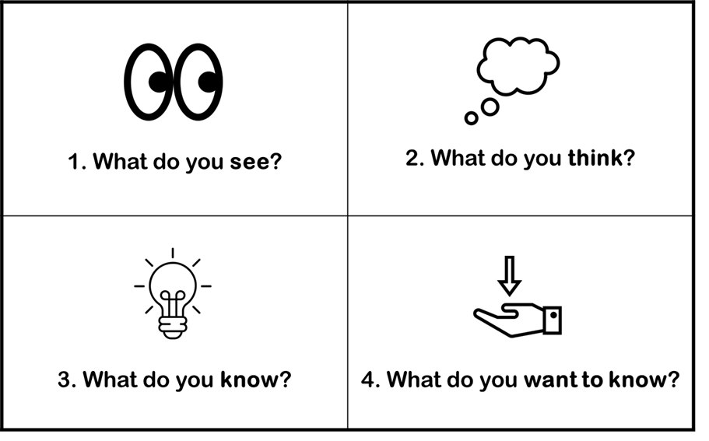

Slide 6
Explore Vocabulary
uniform
uni
"one"
form
"shape" or "likeness"
One Likeness

Slide 7
Explore Vocabulary
conform
con
"together"
form
"shape" or "likeness"
To be in likeness together

Slide 8
Explore Vocabulary
reform
re
"again"
form
"shape" or "likeness"
To be made into likeness again

Slide 9
What do we know about the girl on the front cover? How do you know?
Is she covering or hiding her face? Why is she doing this?
Why does she have one eye exposed?

Slide 10
What does she have wrapped around her hands and arms? Why?
Do you think she sees herself as beautiful?

Slide 11
What did others say about the rough-face girl?

Slide 12
Discussion!

Slide 13
What other influences are there?

Slide 14
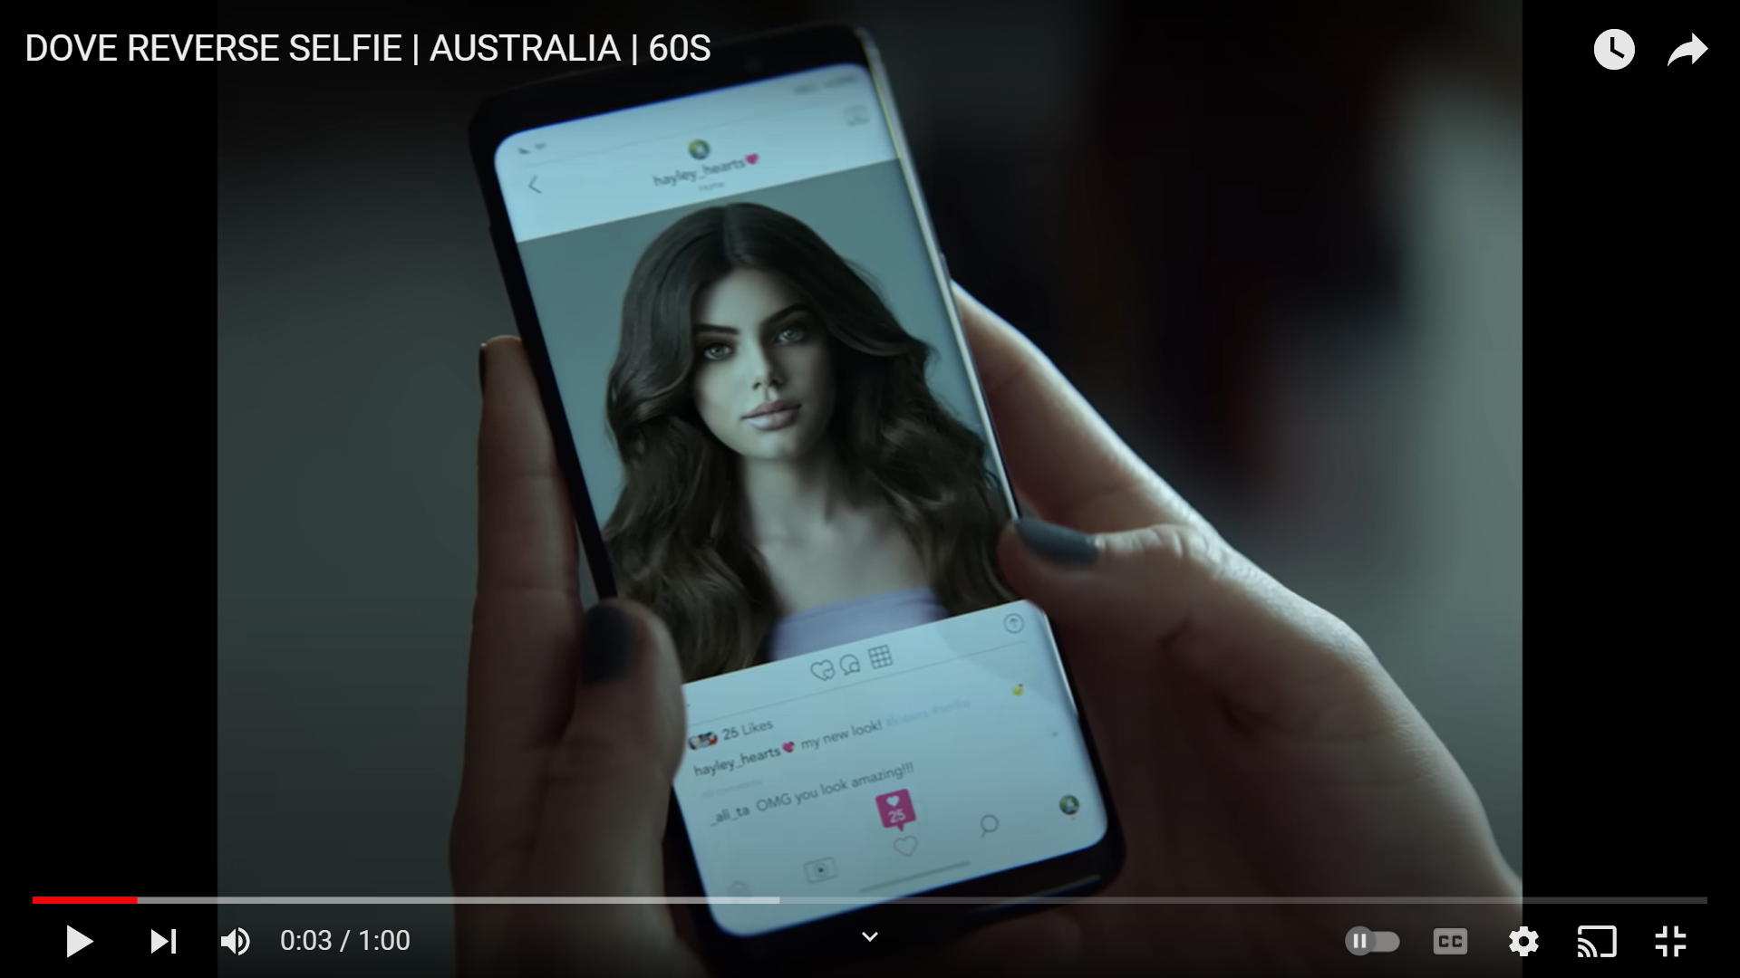

Dove Beauty Commercial

Slide 15
If you could speak to her, what would you say?
Why did she think she needed to do that?

Slide 16
Why might she have wanted to do that?
How do you think she looked at the end?

Slide 17

Imagine the Possibilities Commercial

Slide 18
If you could speak to those young girls, what would you say?
How do you think it felt for them to take on those roles?

Slide 19
Why might they have wanted to do that?
Do you consider their confidence and courage to be a form of beauty?

Slide 20
Discussion!

Slide 21
What does it mean to be manly?

Slide 22
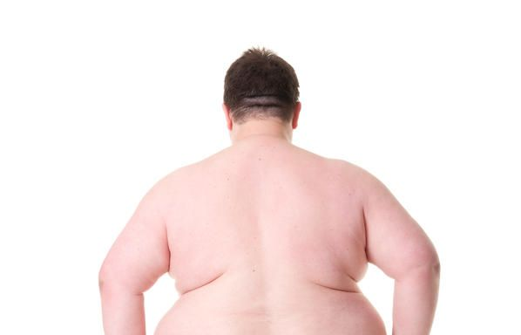
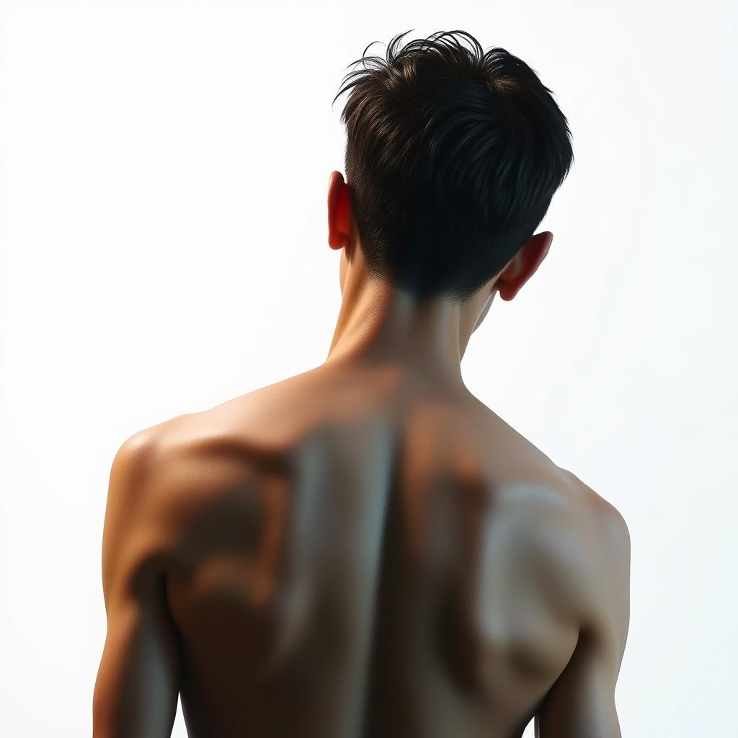
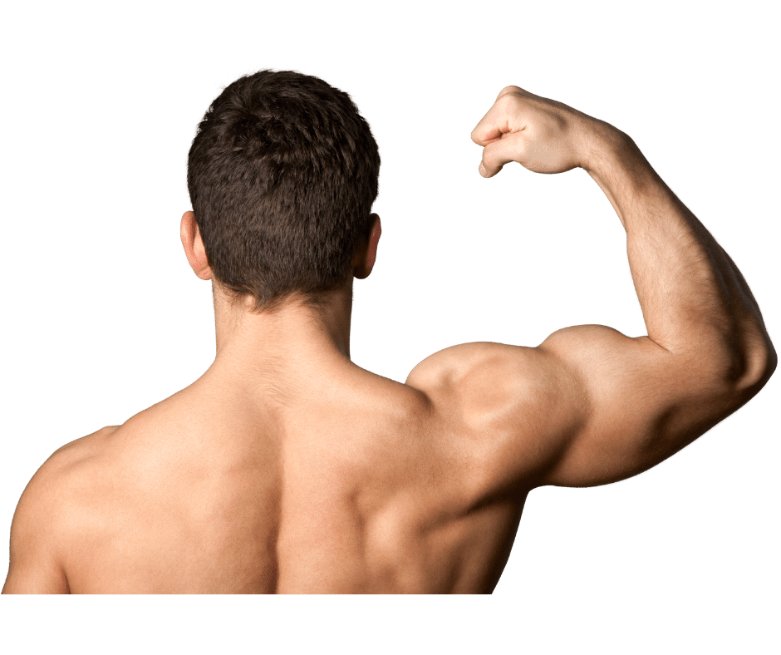
A
B
C

Slide 23
Which image do you think is most ‘manly’?
Does the size of your muscles define who you are?

Slide 24
A
What is similar or different on the slide below?
B
Do our similarities and differences change how beautiful each of us is?
C

Slide 25
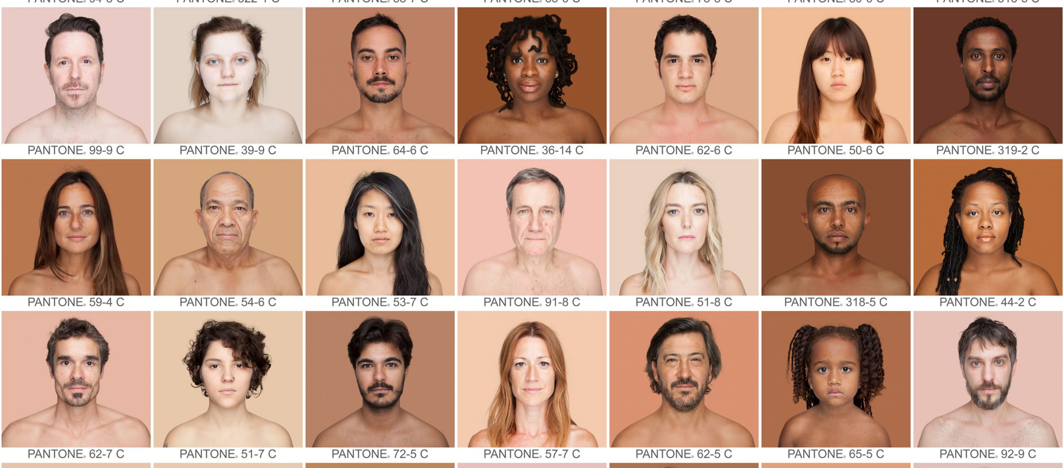

Slide 26
I wonder…
What defines beauty?

Slide 27
Romans 12:2
"Do not conform to the pattern of this world, but be transformed by the renewing of your mind."

Slide 28
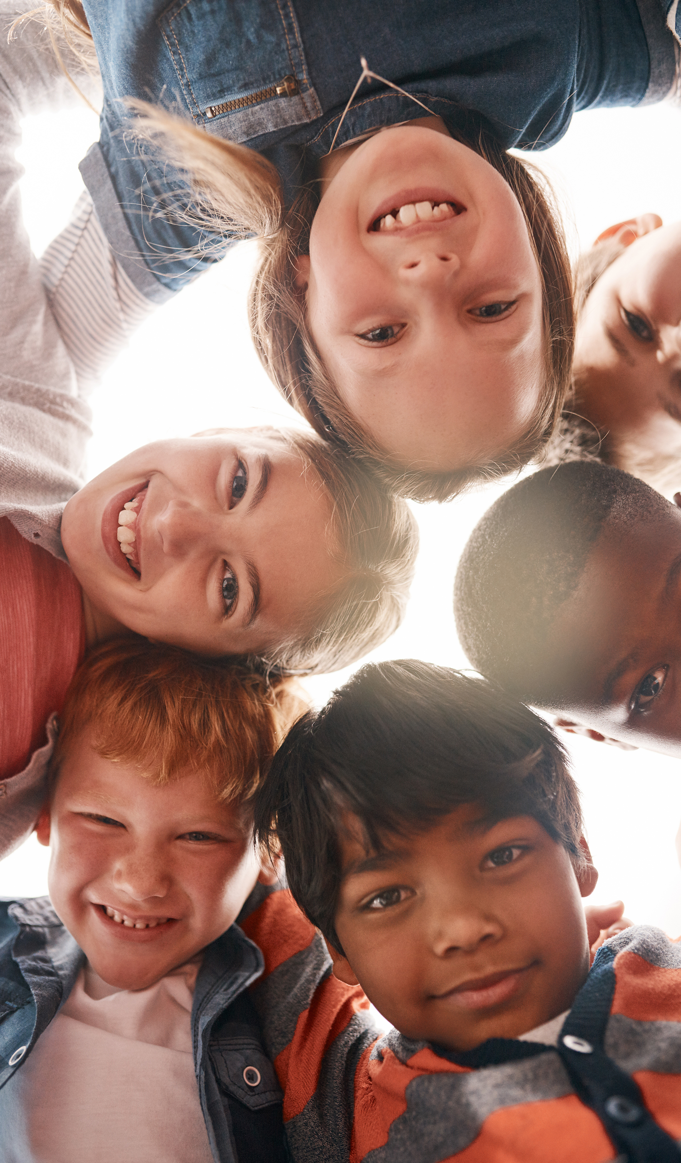
‘Comparison is the thief of joy.’
– Theodore Roosevelt
It can be easy to fall into the trap of measuring ourselves by the standards set by others.

Slide 29
Our friends, family, culture and even religion may dictate to us what is beautiful. However, the constant pull of society today is to get us to compare ourselves to others and this can strip us of our joy and gratitude. Take a moment to reflect on all that makes you who you are.

Slide 30
Dear God,
Sometimes we wish to be just like everyone else. We see others and think that being the same would make life easier.
Help us to understand that You made each of us unique and special for a reason. Remind us that our differences are what make us beautiful and important.

Slide 31
Give us the courage to embrace who we are, to celebrate our talents, and to appreciate our own special gifts. Help us to see that it's okay to be different, and that being ourselves is the best way to be.
Thank you for loving each of us exactly as we are.
Amen.

Slide 32
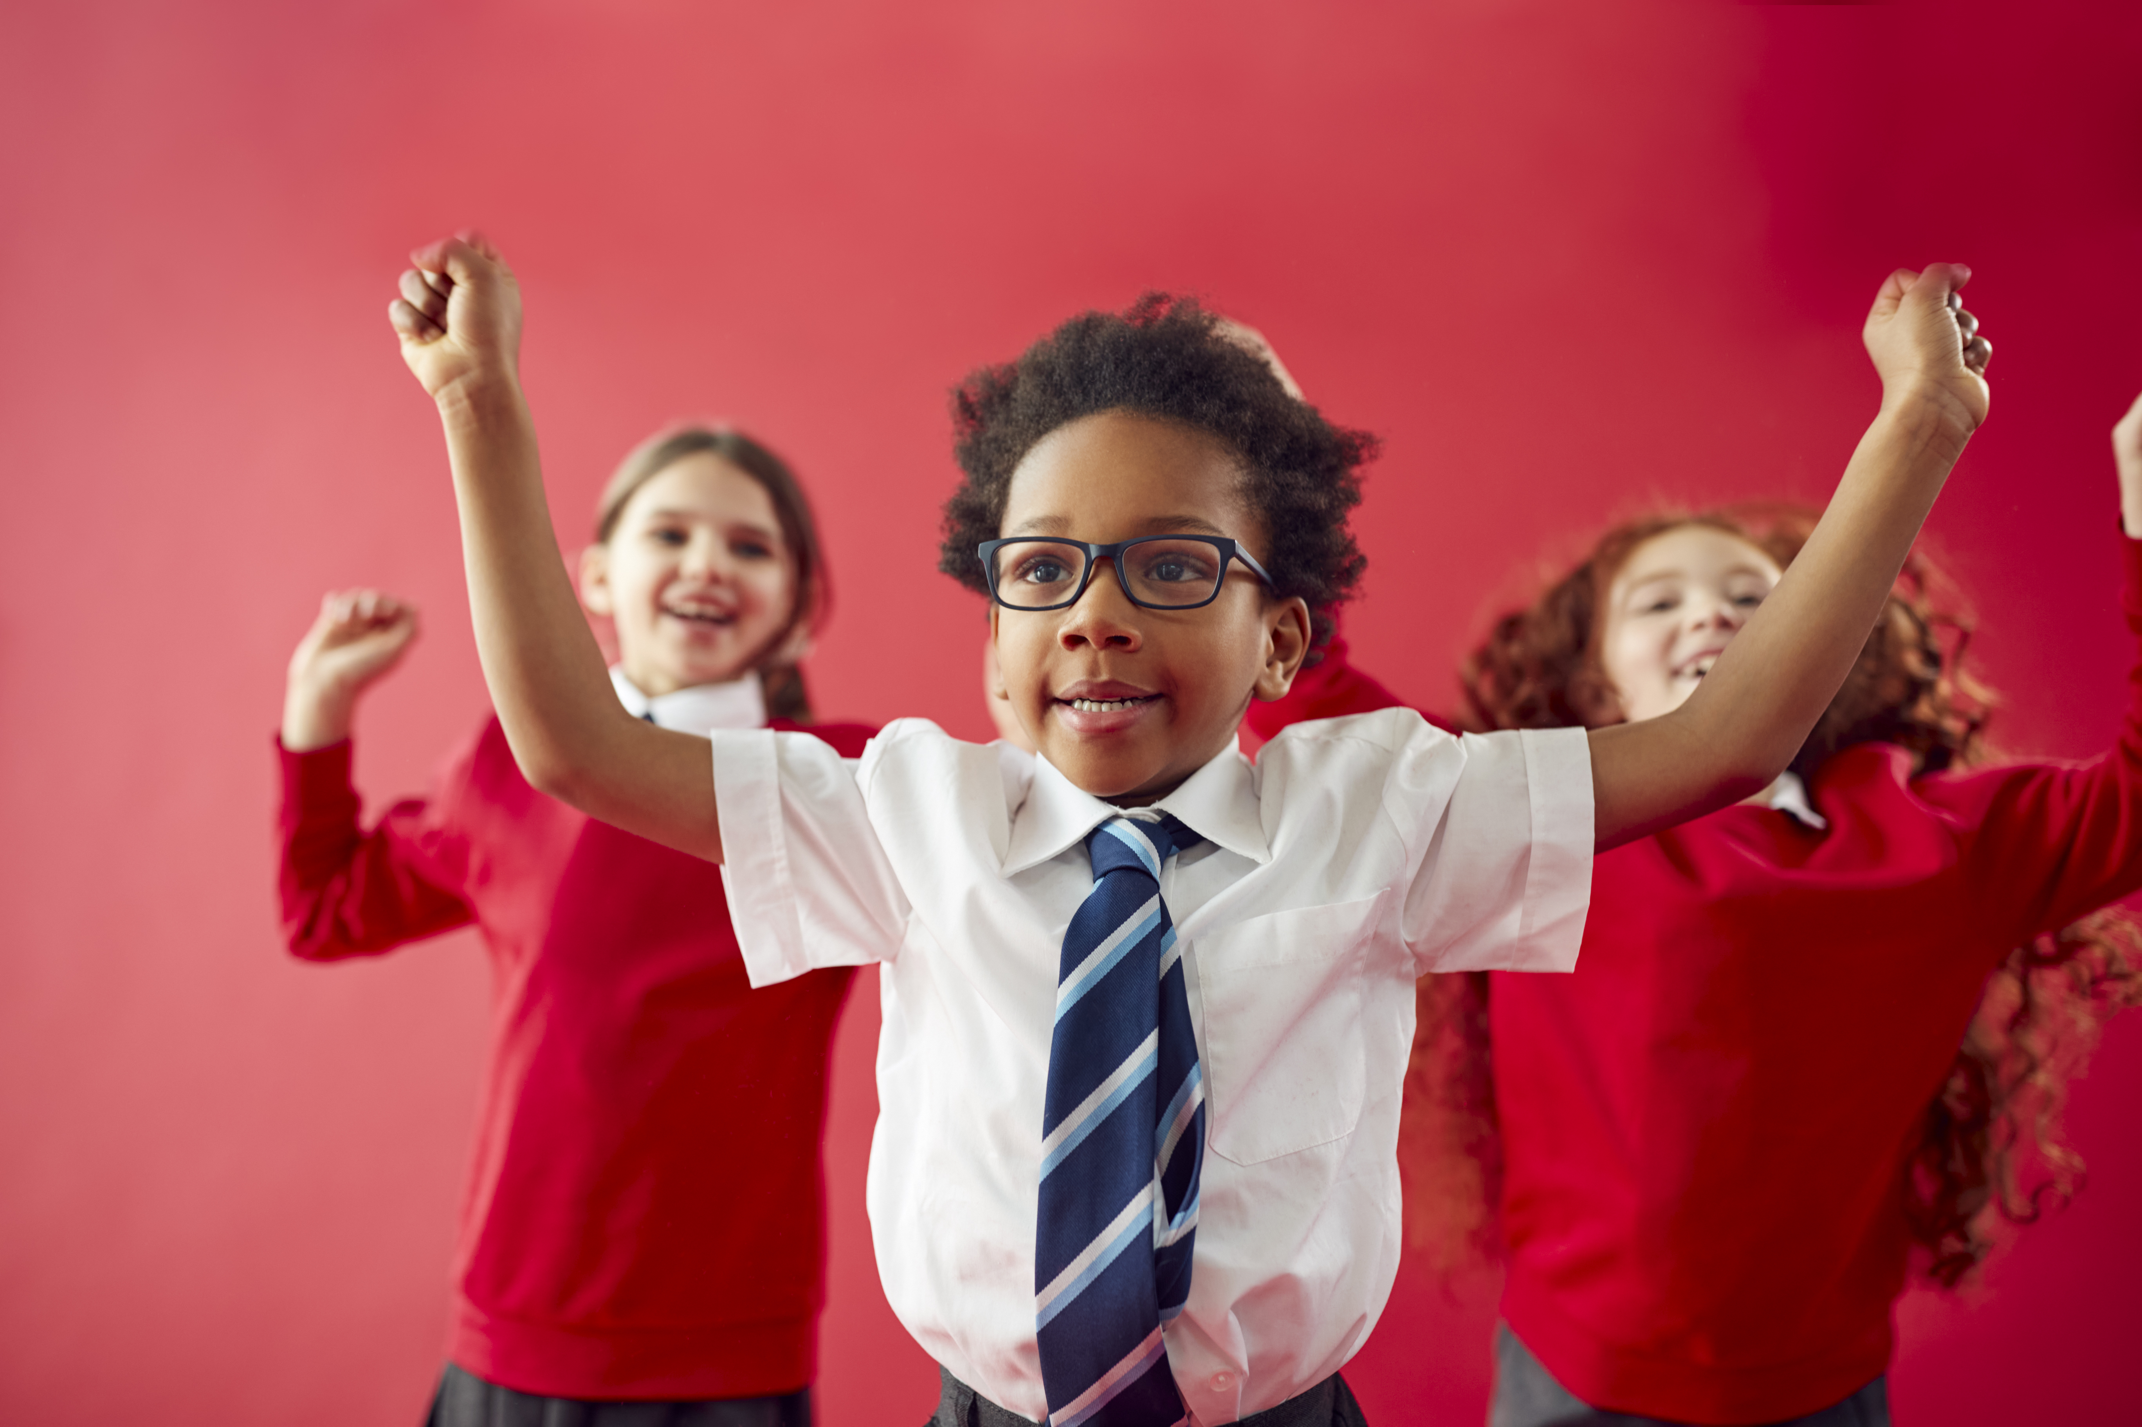
This is Our World by iSingPop

