Slide 3




Three habits
Community
Embrace
Power
Listen to others’ stories and see the world through their eyes.
Encounter others with authenticity and confidence.
Find hope and opportunity in the places where we long to see changes.

Slide 4
I wonder…
How can we define beauty?

Slide 5
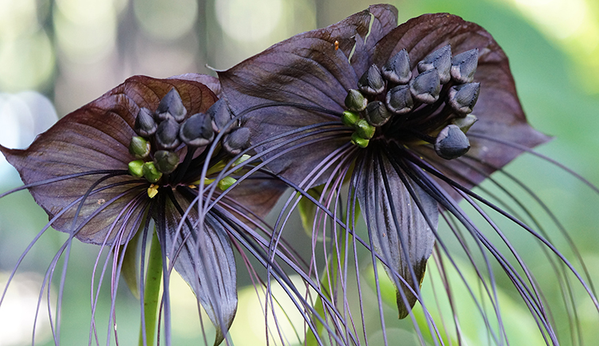
Explore Vocabulary: Wild, Strange

Slide 6
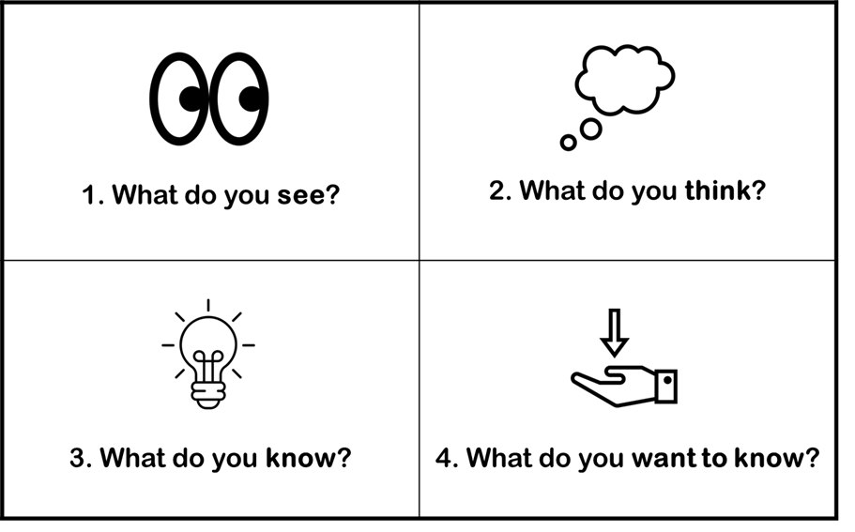
Explore Vocabulary: Wild, Strange
How would you describe this?

Slide 7
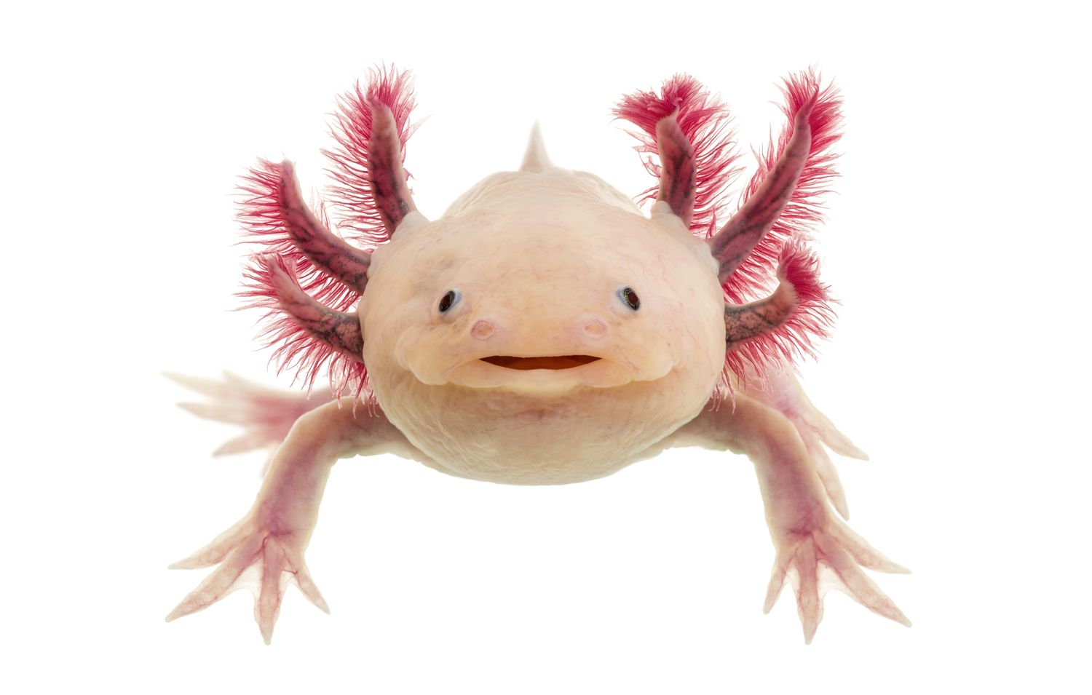
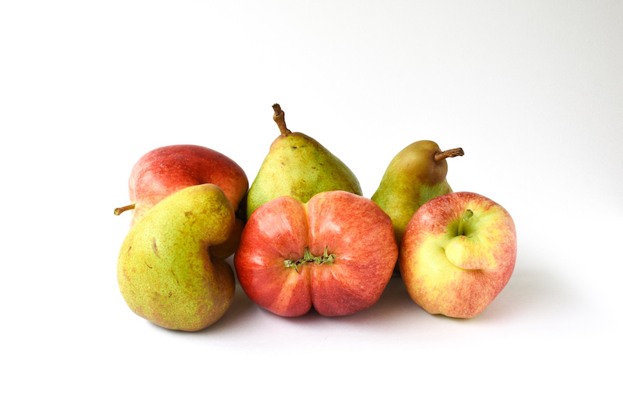
Explore synonyms and antonyms of the word ‘strange’
Axolotl (amphibian)
Wonky Fruit
Let's create a definition of the word 'strange'

Slide 8


Slide 9
‘They found her strange…’

Slide 10
Debate

Slide 11
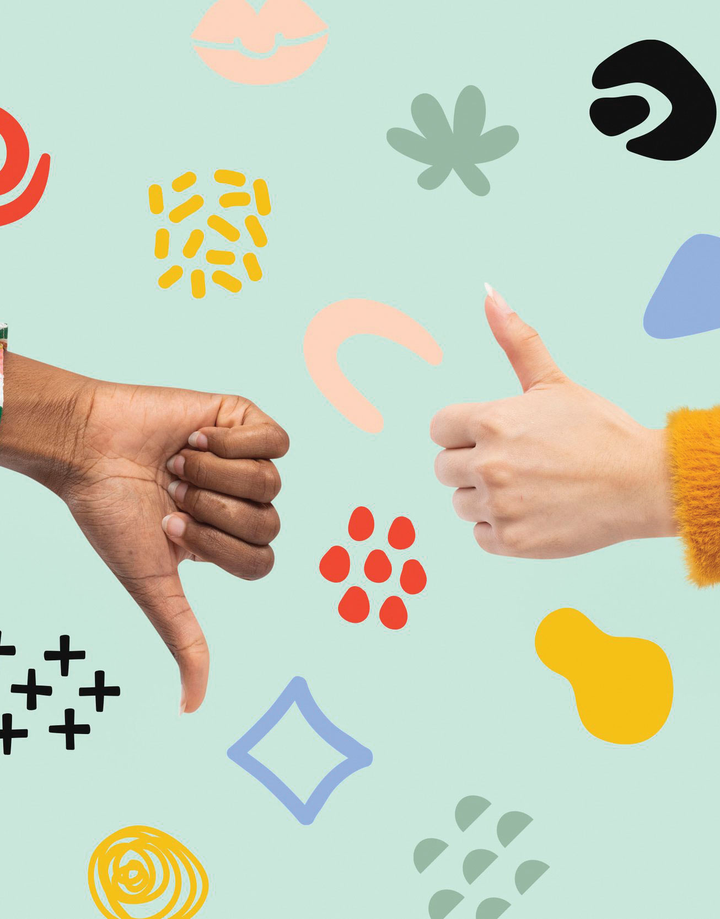
Motion: Being strange is a bad thing?
Team A: Agree/For
Team B: Disagree/Against

Slide 12
1 Corinthians 12:12
"For just as the body is one and has many members, and all the members of the body, though many, are one body, so it is with Christ."

Slide 13
There is beauty in diversity.

Slide 14
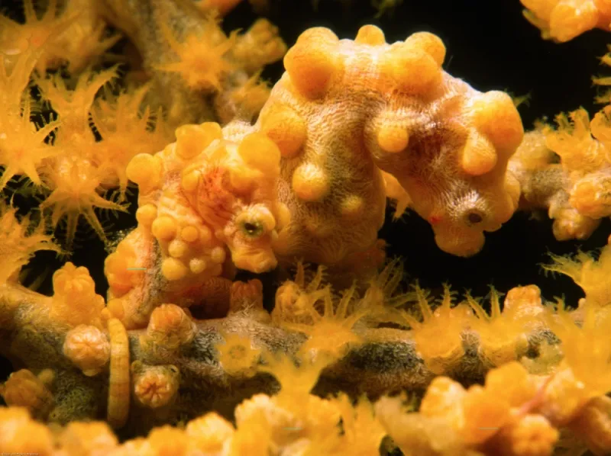
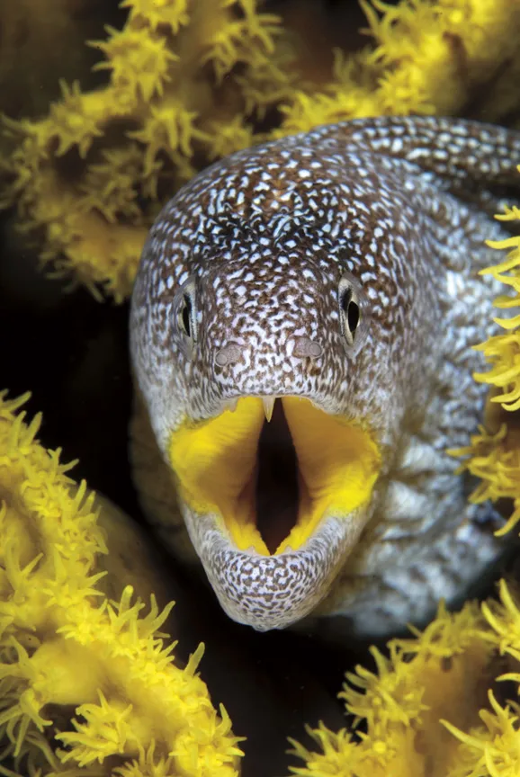
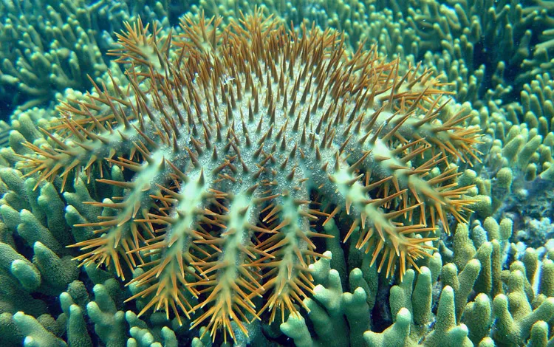
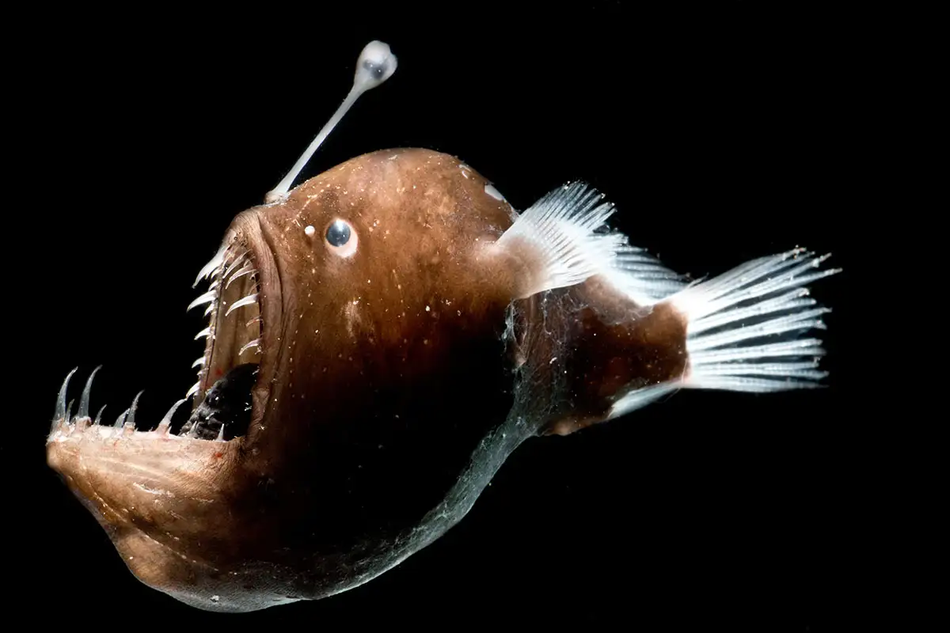
Coral Reef: Bio-diversity

Slide 15
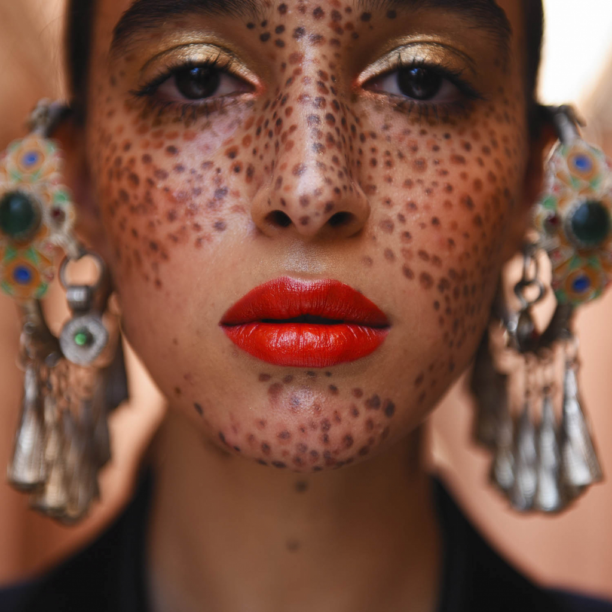
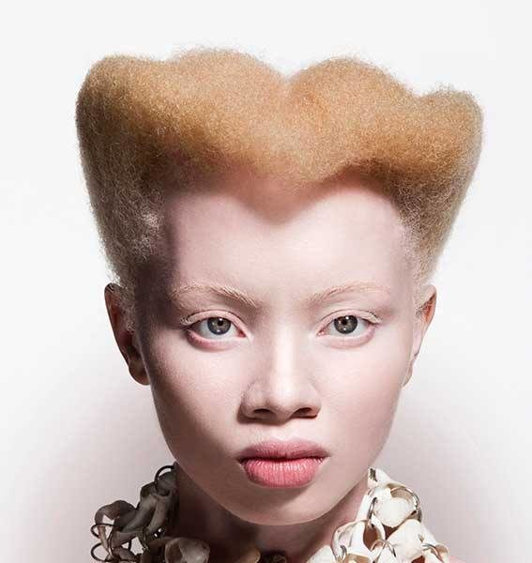
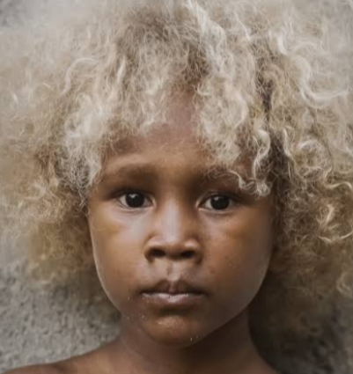
Human-beings

Slide 16
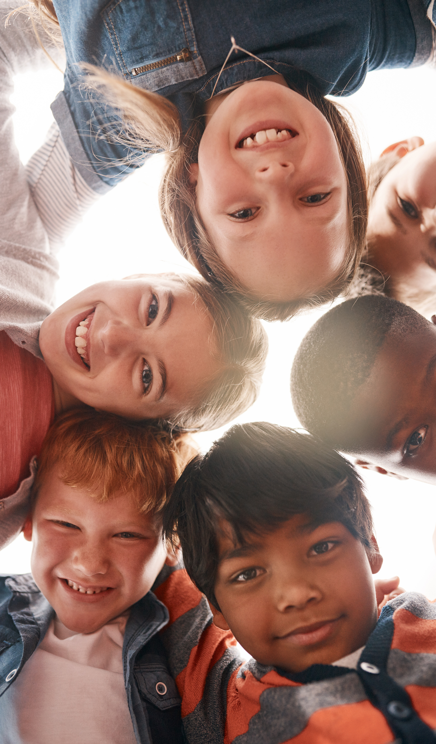
‘There is no beauty without some strangeness.’
– Edgar Allan Poe
Every living thing possess traits that make it both beautiful and strange. In fact, our very beauty is rooted in strangeness.

Slide 17
What if we reimagined and replaced ‘strangeness’ with ‘difference’?
How would the quote by Edgar Allan Poe be read?

Slide 18
Suppose you had a new member of the class arrive one day and they looked and spoke differently to the rest of the class. How would you view them? How would you treat them?

Slide 19
Dear God,
Help us to understand that we are fearfully and wonderfully made. We are your handiwork and you have created us in your image and likeness. Help us to appreciate the things that we struggle to see as beautiful, and to see the beauty in others.
Amen.

