Slide 3




Three habits
Community
Embrace
Power
Listen to others’ stories and see the world through their eyes.
Encounter others with authenticity and confidence.
Find hope and opportunity in the places where we long to see changes.

Slide 4
I wonder…
How can we define beauty?

Slide 5
What is Justice?

Slide 6
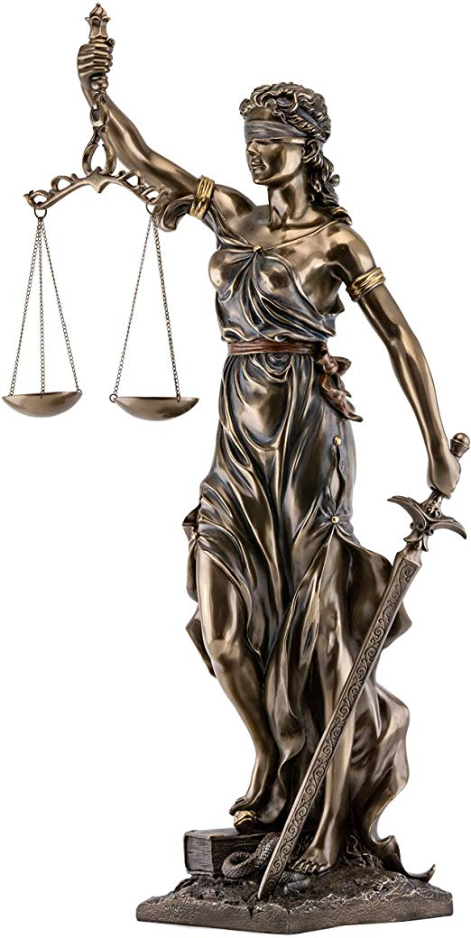
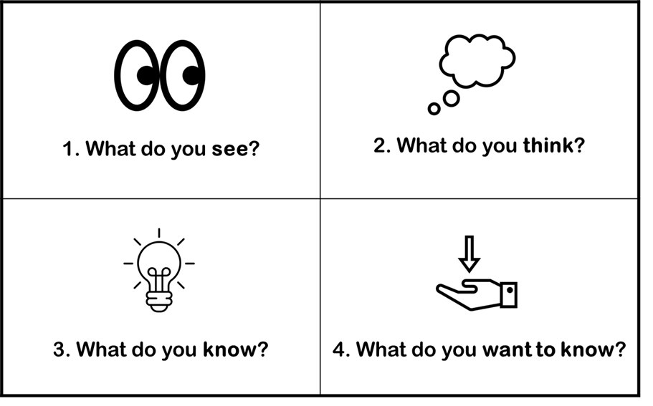

Slide 7
Blindfold
Scales
Sword

Slide 8
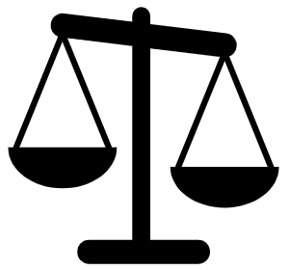
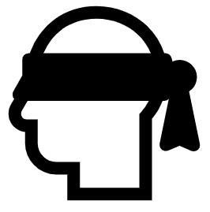
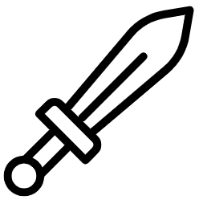
Scales
Blindfold
Sword
power, protection, authority, strength, and courage.
balance, equality, justice, and harmony.
fairness

Slide 9
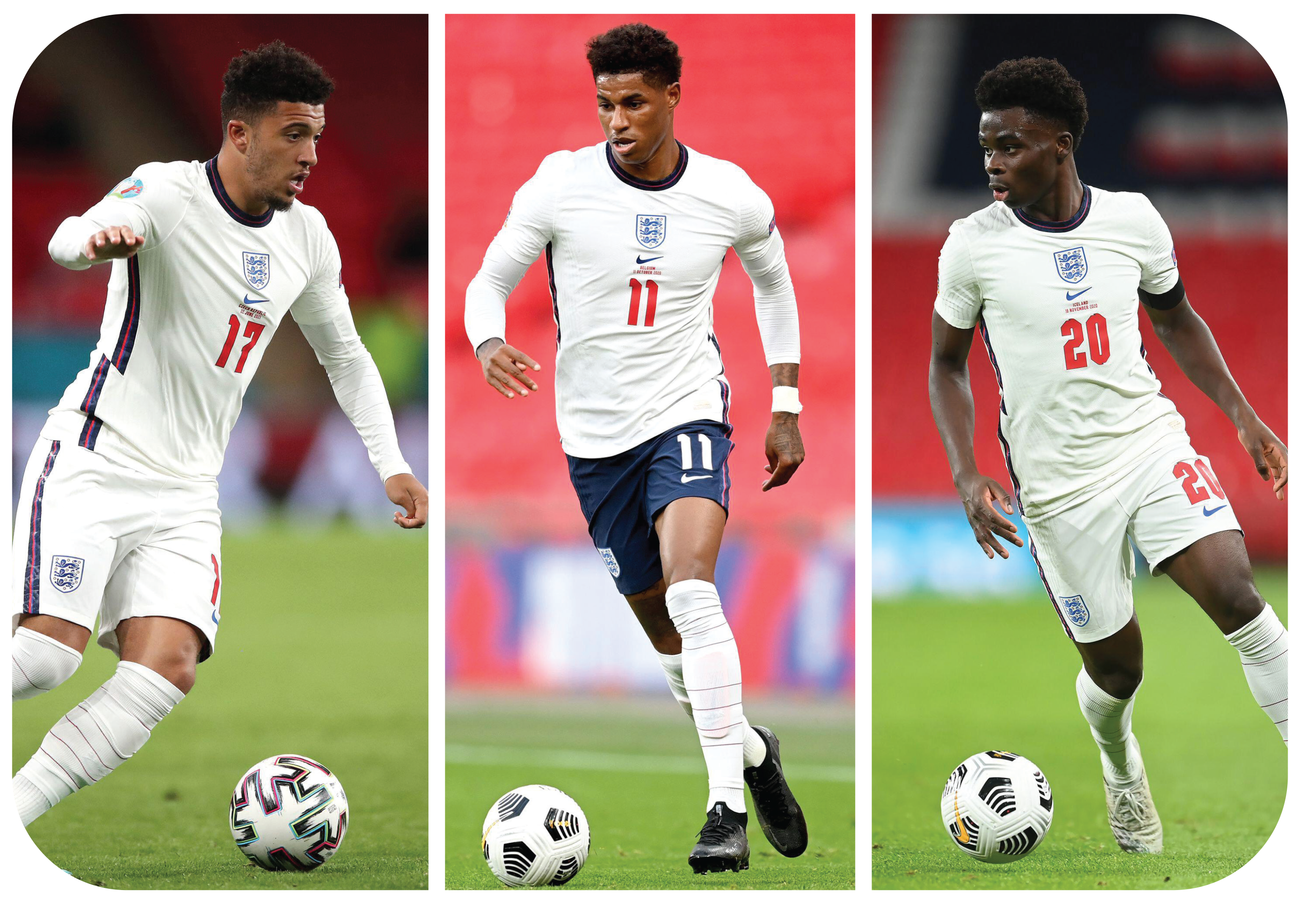
Case Study

Slide 10
What would you say to the three players at this time?

Slide 11
Promises

Slide 12
"I can help others feel safe by __________."

Slide 13
"When I see someone being treated unfairly, I will __________."

Slide 14
"I can make a difference by __________."

Slide 15
"I feel proud when I stand up for __________."

Slide 16
"I show fairness by __________."

Slide 17
"When something is not right, I will __________."

Slide 18
"I will treat everyone with respect by __________."

Slide 19
"I can be a good friend by __________."

Slide 20
"I will use my voice to __________."

Slide 21
"I believe everyone deserves __________, so I will __________."

Slide 22
Proverbs 16:24
"Gracious words are a honeycomb, sweet to the soul and healing to the bones."

Slide 23
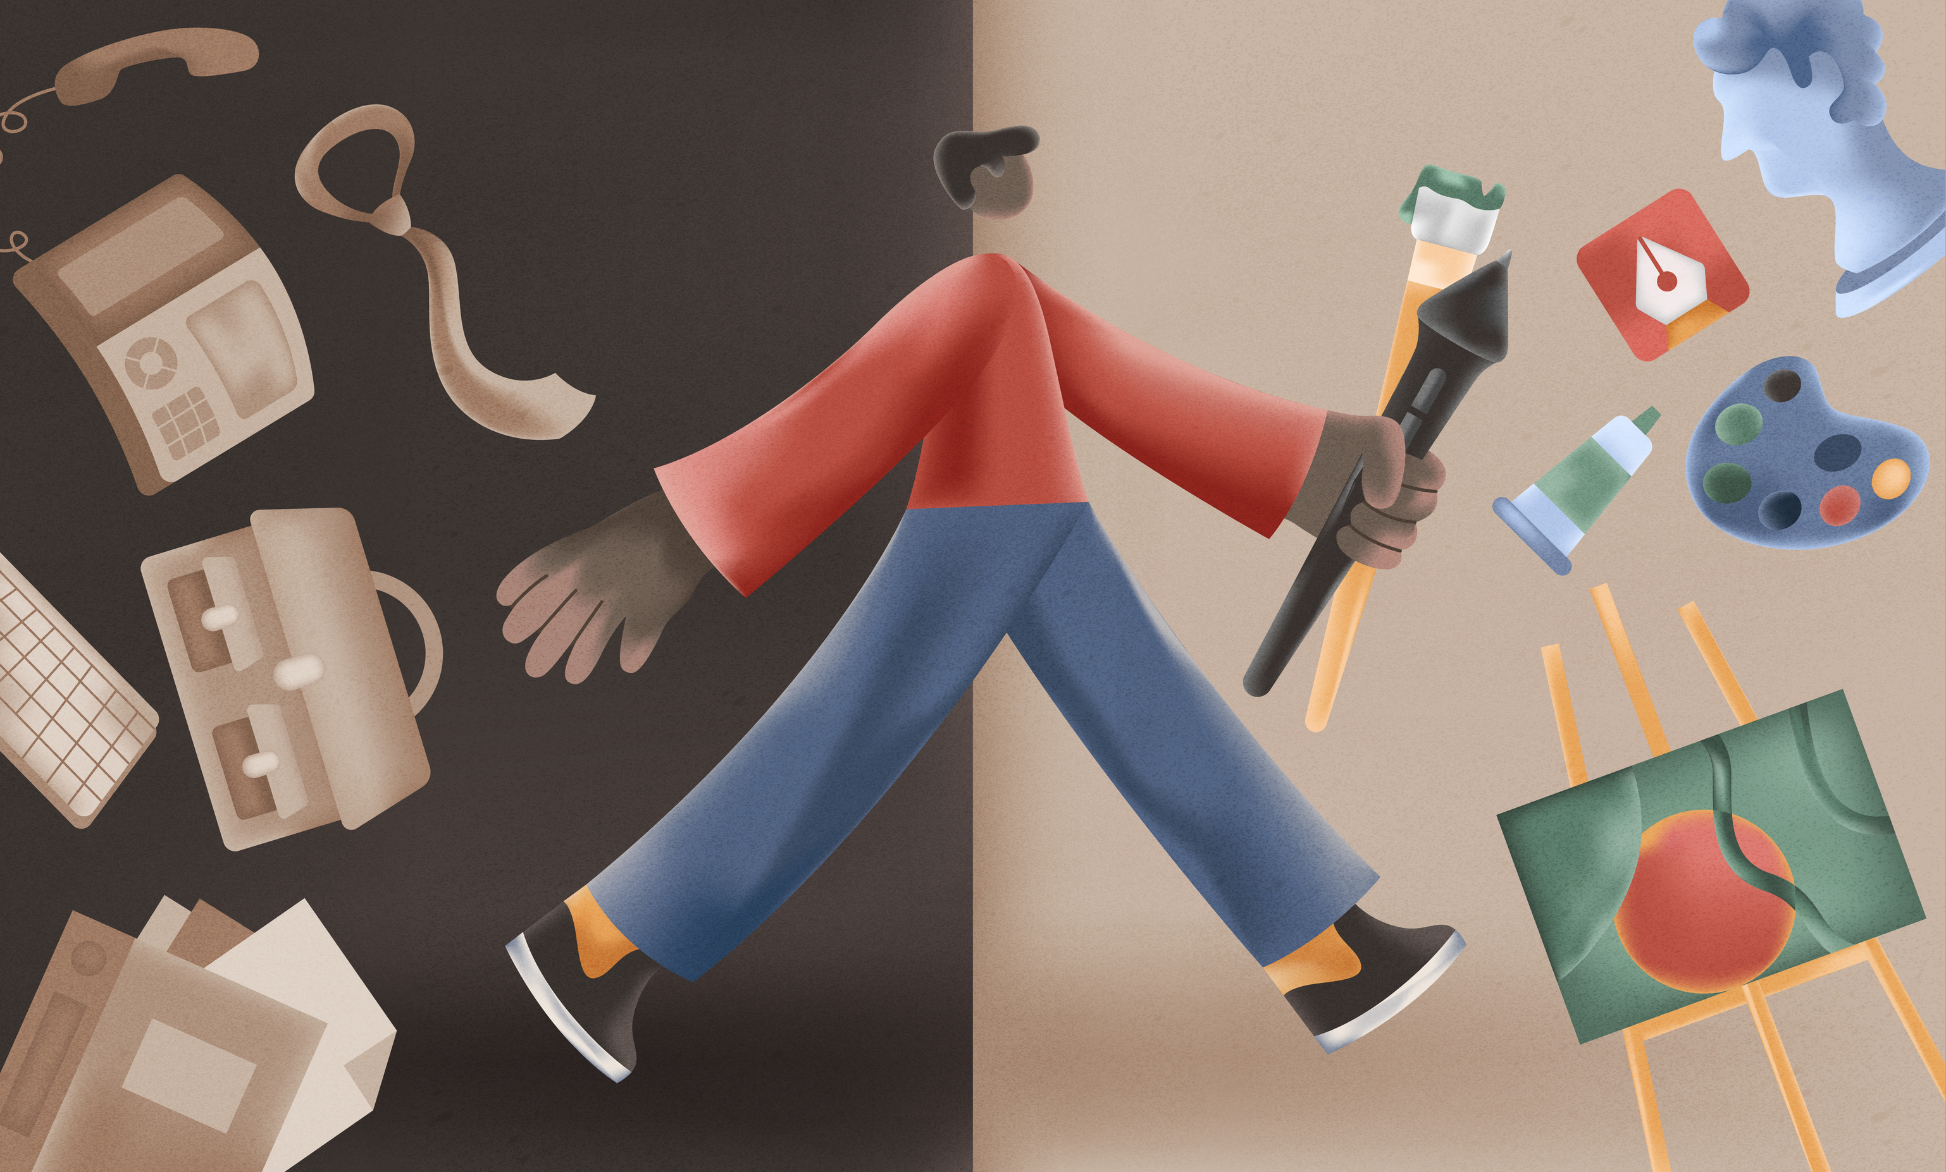
Mindfulness Walking

Slide 24
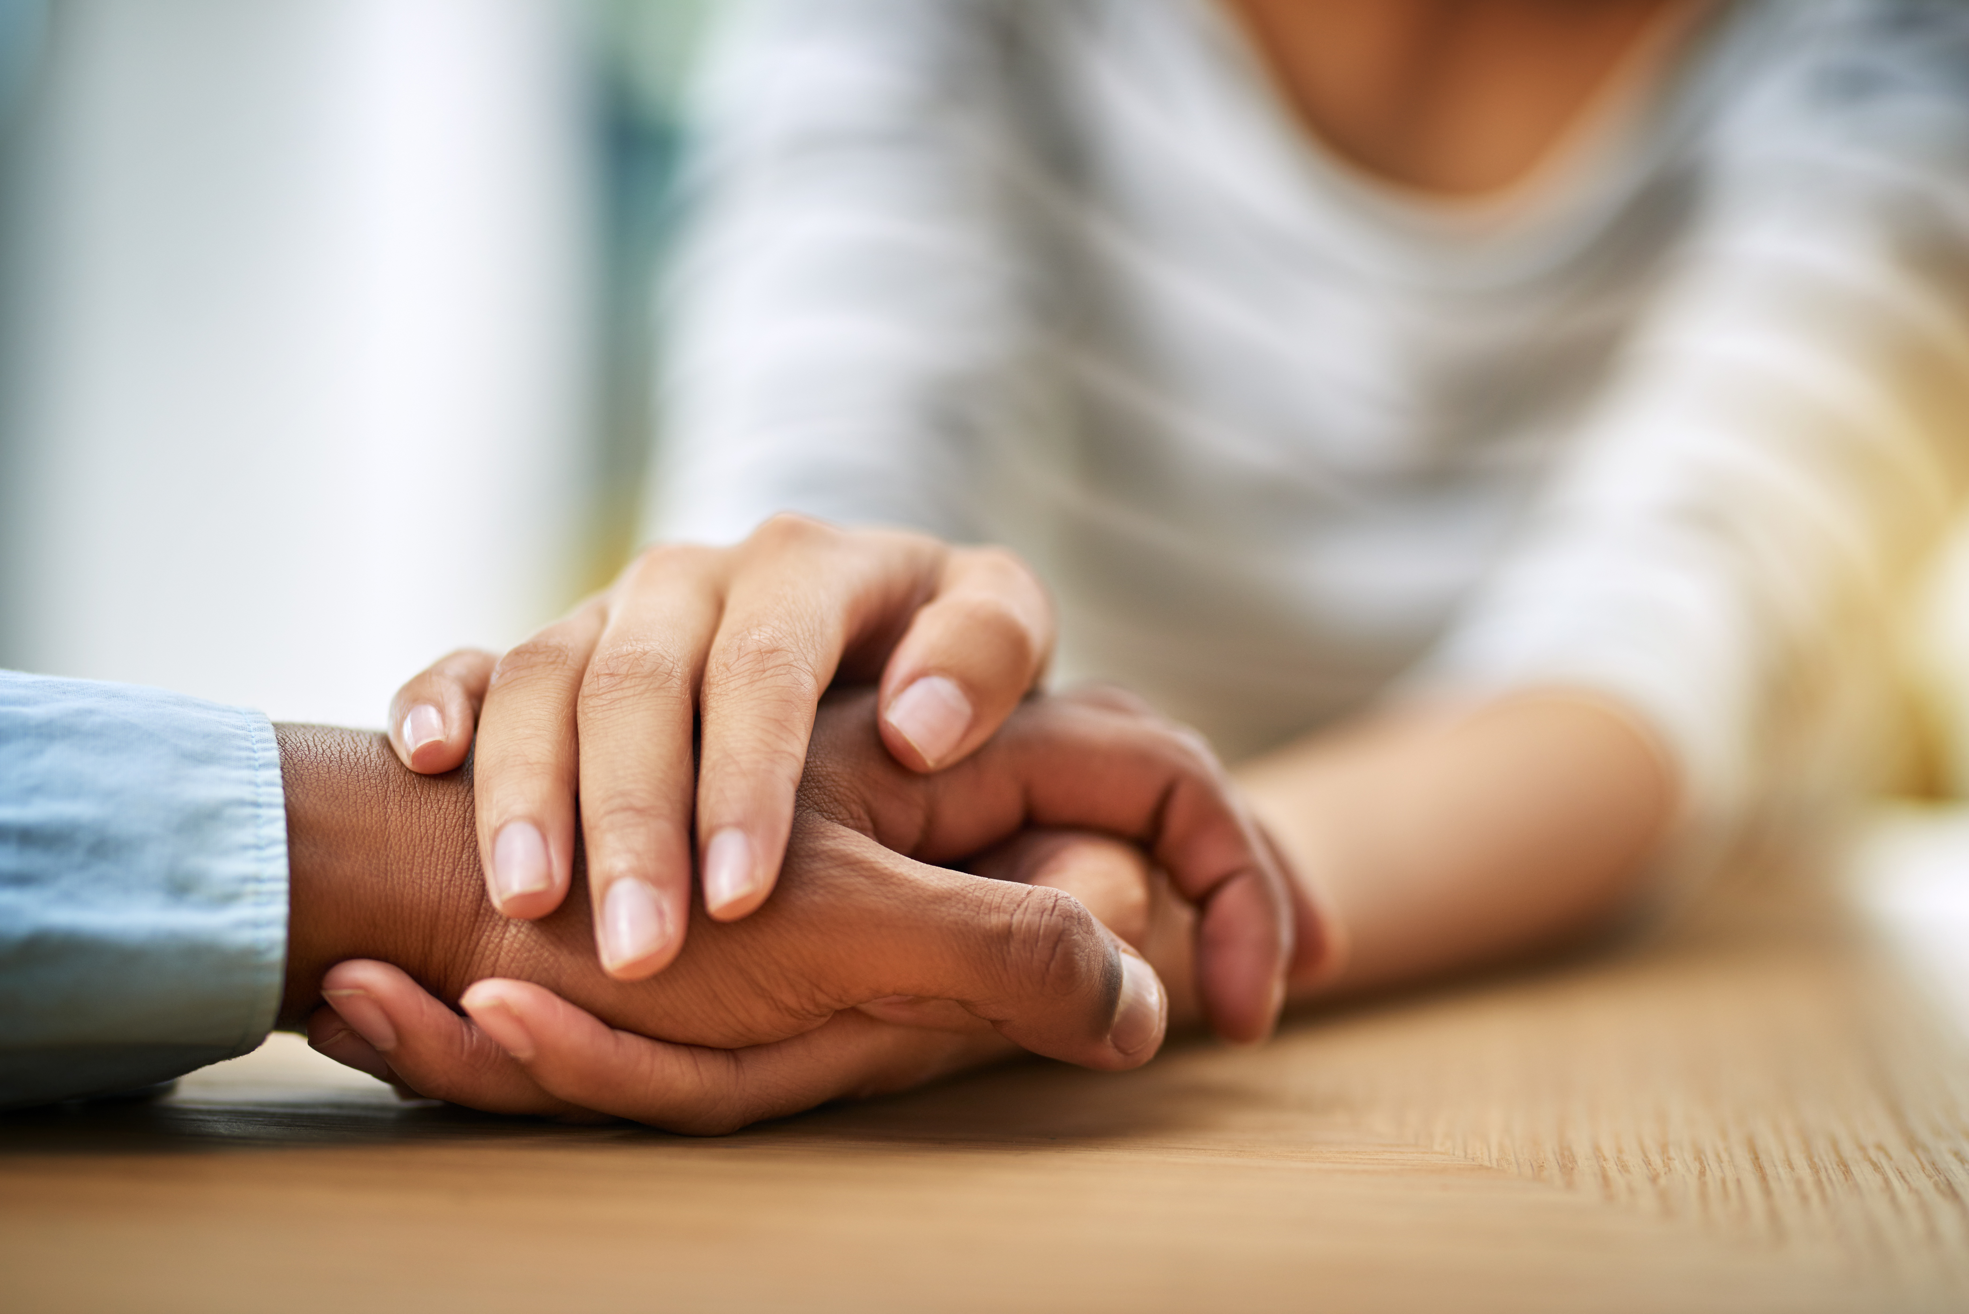
Pledge/Affirmations
"I can..."
"I am..."
"I will..."

Slide 25
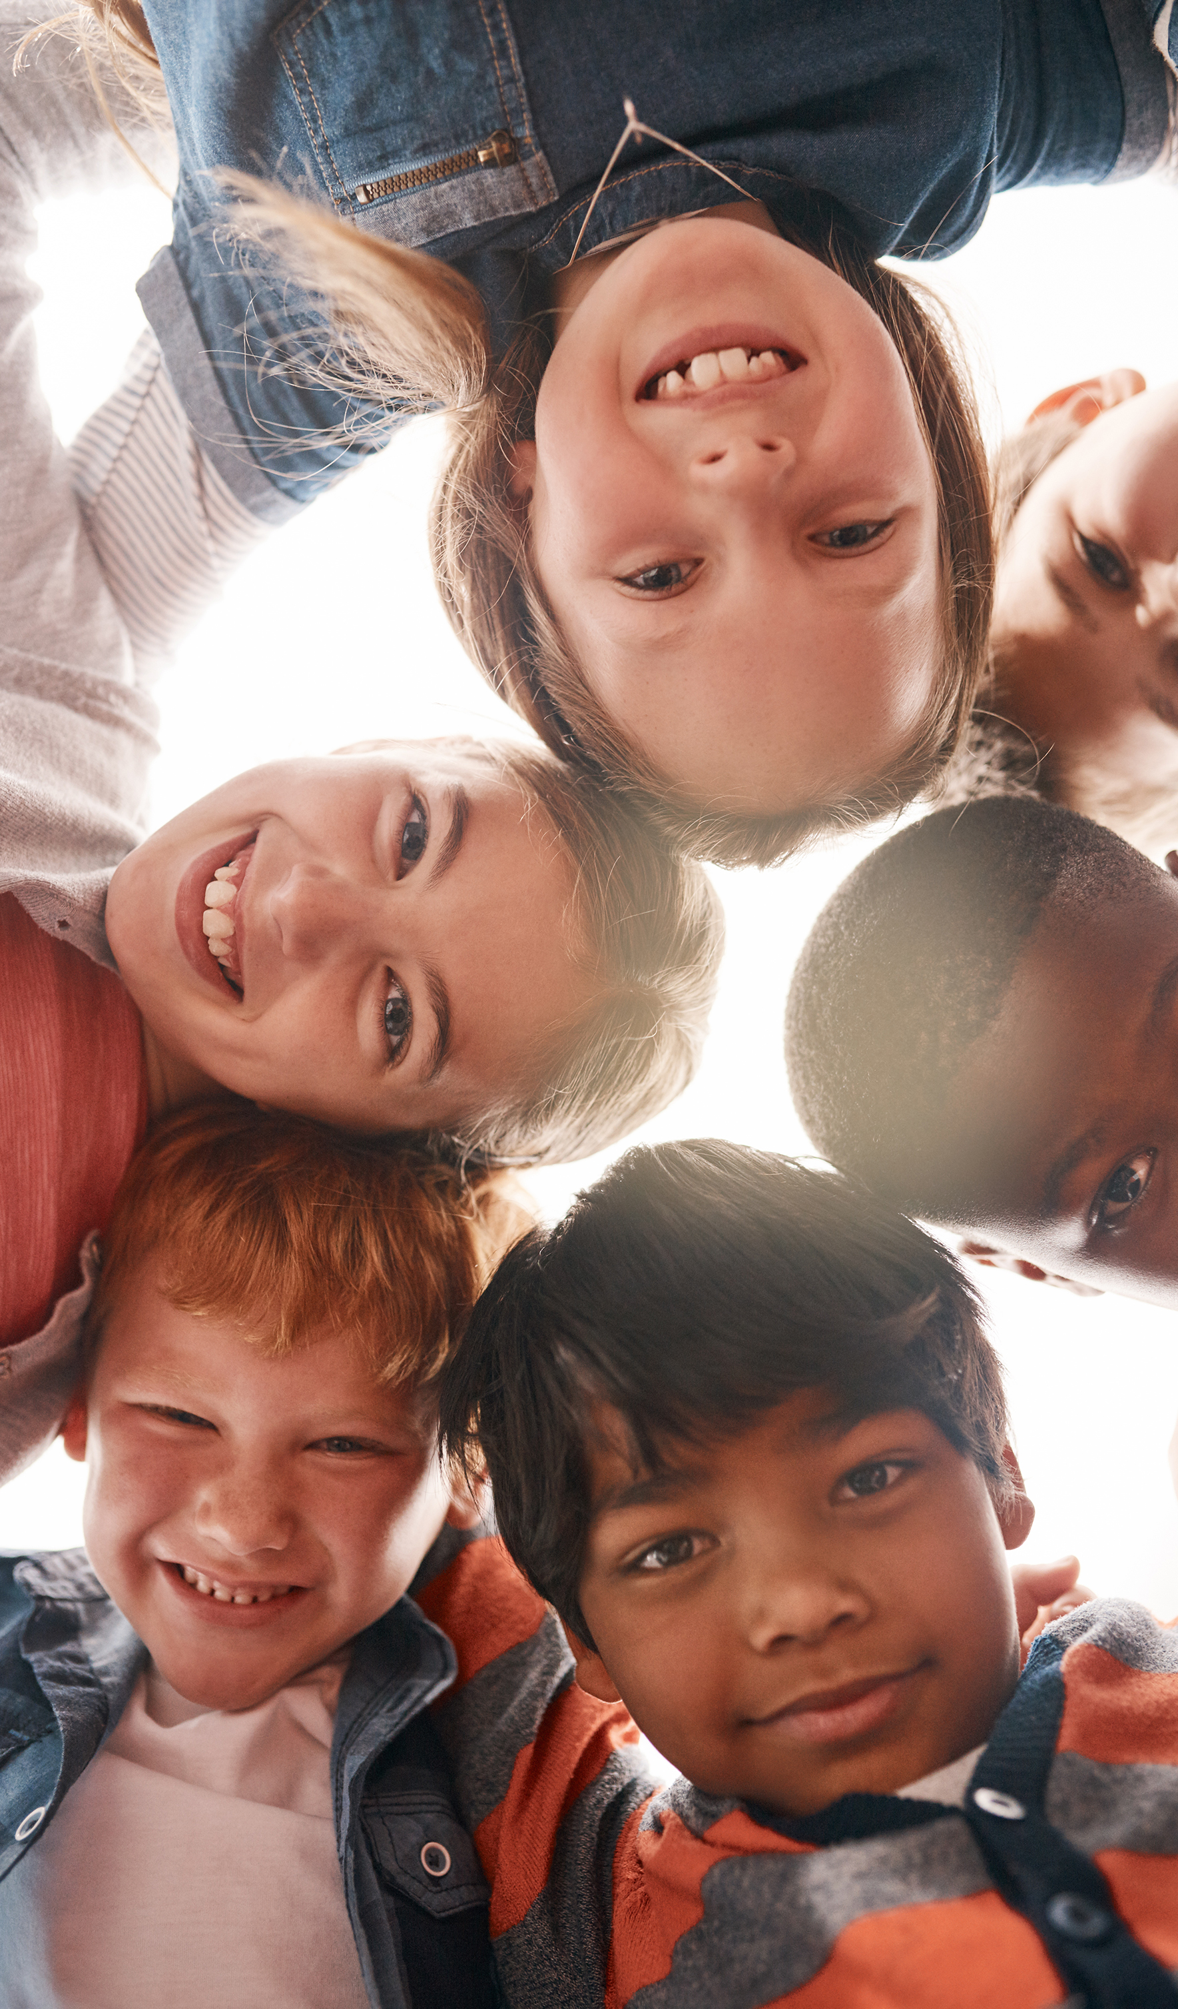
In our journey through life, there are moments when we encounter the darker sides of humanity. We see acts of unkindness, injustice, and harm that can leave us feeling disheartened and disillusioned. These experiences can challenge our faith in goodness and fairness.

Slide 26
Yet, it is precisely in these moments of darkness that our call to pursue justice becomes most vital. Justice is not about seeking revenge or holding onto anger. It is about striving to create a world where fairness, compassion, and respect prevail, even when we have witnessed the opposite.

Slide 27
In the face of darkness, let us be the light. In the presence of wrong, let us strive to be the right. And in a world that sometimes shows us its worst, let us respond with our best.
Amen.

Slide 28
Dear God,
Sometimes we see others in a way that we perhaps shouldn’t.
Remind us that we can make a difference by choosing to do what is right and just. Give us the strength and courage to stand up for justice, to speak out against wrongs, and to treat everyone with kindness and respect

Slide 29
Guide our hearts to seek fairness and to help those who are hurting or in need. Teach us to forgive, to heal, and to work together to make our world a better, more just place. Thank you for your love and guidance.
Amen

