Slide 3




Three habits
Community
Embrace
Power
Listen to others’ stories and see the world through their eyes.
Encounter others with authenticity and confidence.
Find hope and opportunity in the places where we long to see changes.

Slide 4
I wonder…
How can we define beauty?

Slide 5


Slide 6
‘all knew it was right.’

Slide 7
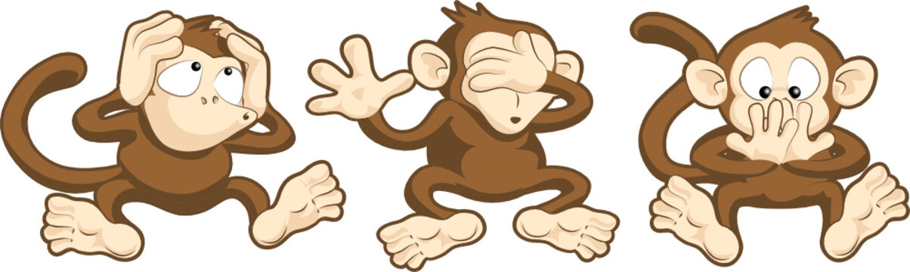
SEE
no evil
SPEAK
no evil
HEAR
no evil

Slide 8

"Ha! You’re ugly, you Rough-Face Girl!"

Slide 9

Right or Wrong?
"Ha! You’re ugly, you Rough-Face Girl!"

Slide 10
Right or Wrong?
The two sisters were proud and hard-hearted.

Slide 11
Right or Wrong?
The Rough-Face Girl had faith in herself and she had courage.

Slide 12
Right or Wrong?
The people took Wild Girl from the forest.

Slide 13
Right or Wrong?
During an art lesson, one child tells another that their drawing is not as good as another child’s.

Slide 14
Right or Wrong?
A child sees another child sitting alone at lunch and invites them to join their table.

Slide 15
Right or Wrong?
A child stands up for a friend who is being teased by others.

Slide 16
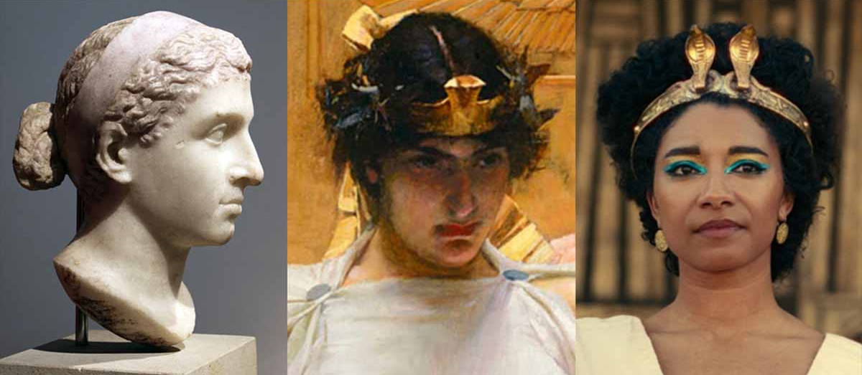
Depictions of Queen Cleopatra

Slide 17
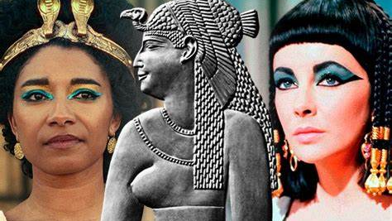

Slide 18
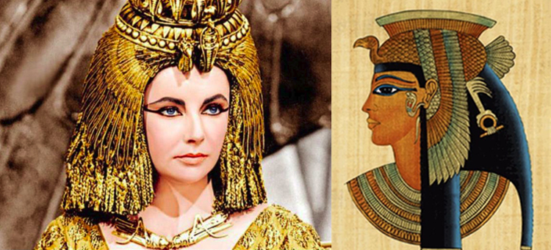
Which image is likely to be more accurate? Why?
How do we define beauty?

Slide 19
"Your outer beauty will capture the eyes. Your inner beauty will capture the heart.”
Steven Aitchison

Slide 20
"The most beautiful eyes are those that seek beauty in others."

Slide 21
Hebrews 12:14
"Make every effort to live in peace with everyone..."

Slide 22
Circle of Appreciation

Slide 23
Circle of Appreciation
Option 1:
In small groups, have each child write their name in the middle of a piece of paper (A4). Children move around writing on the sheets of every child why they are special or what they value about them. Do this until every child has had words of value written on their sheet by each child in the class.

Slide 24
Circle of Appreciation
Option 2:
In groups of 6, have 1 child sit in the centre of 5 other children in a circle on chairs. Each child must tell the child in the centre what it is they value about that child. Continue to rotate until every child has sat in the centre.

Slide 25
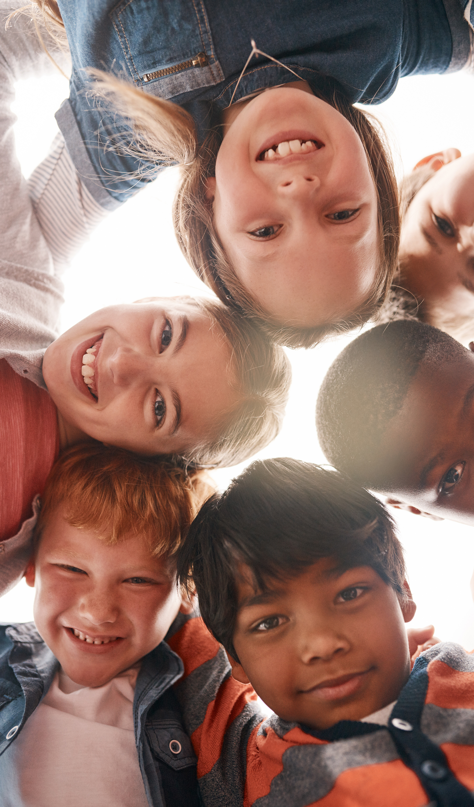
Forgiveness is when you decide to let go of the hurt or anger you feel towards someone who has done something wrong. It's like taking a deep breath and saying, "It's okay, I forgive you."

Slide 26
This doesn't mean you forget what happened or say that it was okay, but it means you're choosing to move on without holding a grudge.
Forgiveness is a powerful way to show kindness and keep our hearts light and happy. It helps us to be better friends and to create a more loving and peaceful world. So, the next time someone hurts your feelings, remember to take a deep breath, talk about it, and choose to forgive. You'll be glad you did!

Slide 27
Dear God,
Sometimes, people do things that hurt us and make us feel sad. It can be hard to forgive when we have been wronged.
Please help us to find it in our hearts to forgive others, just as You forgive us. Teach us to let go of anger and hurt and fill our hearts with kindness and understanding.

Slide 28
Help us to remember that everyone makes mistakes, and that forgiving others makes us strong and loving.
Thank you for always being there to guide us and help us do what is right.
Amen.

