Slide 3




Three habits
Community
Embrace
Power
Listen to others’ stories and see the world through their eyes.
Encounter others with authenticity and confidence.
Find hope and opportunity in the places where we long to see changes.

Slide 4
I wonder…
How can we define beauty?

Slide 5
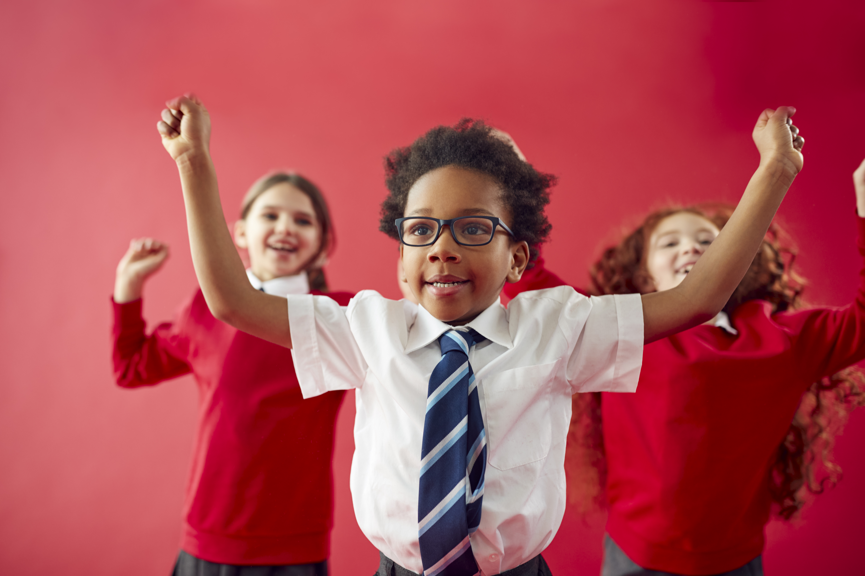

This is Our World by iSingPop

Slide 6
“even in the darkest place, whatever we may face, there is peace all over the world.”

Slide 7
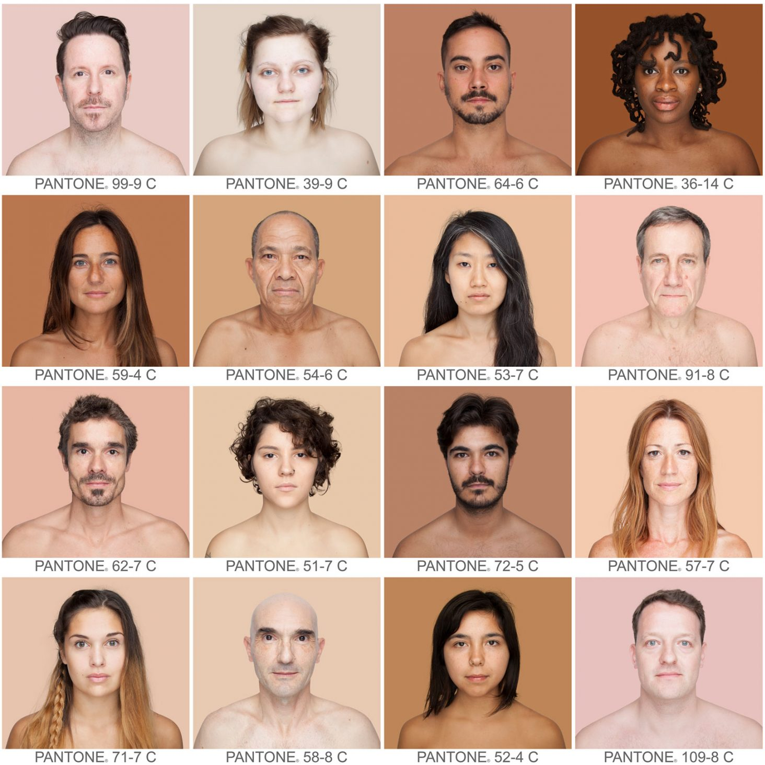
Who do you now think is most beautiful?
Do you still think anyone on here is not beautiful? (key question)
How would you define beauty now?

Slide 8
What do we consider to be beautiful?

Slide 9
Acts 17:26
“And he made from one man every nation of mankind to live on all the face of the earth…”

Slide 10
Self Portrait

Slide 11
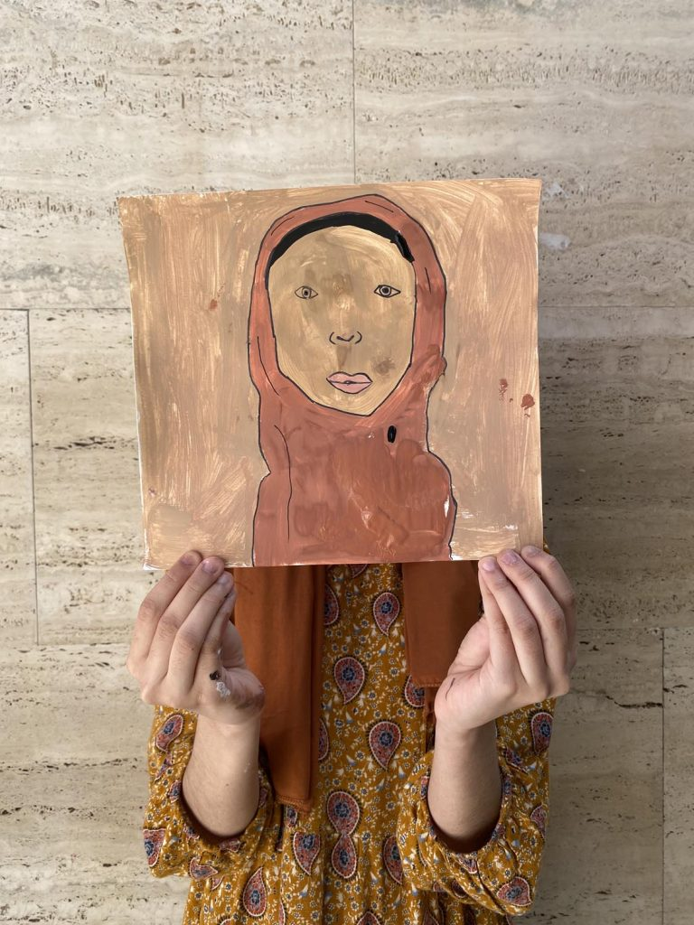

Slide 12
John 13:34
“Love each other. Just as I have loved you, you should love each other.”

Slide 13
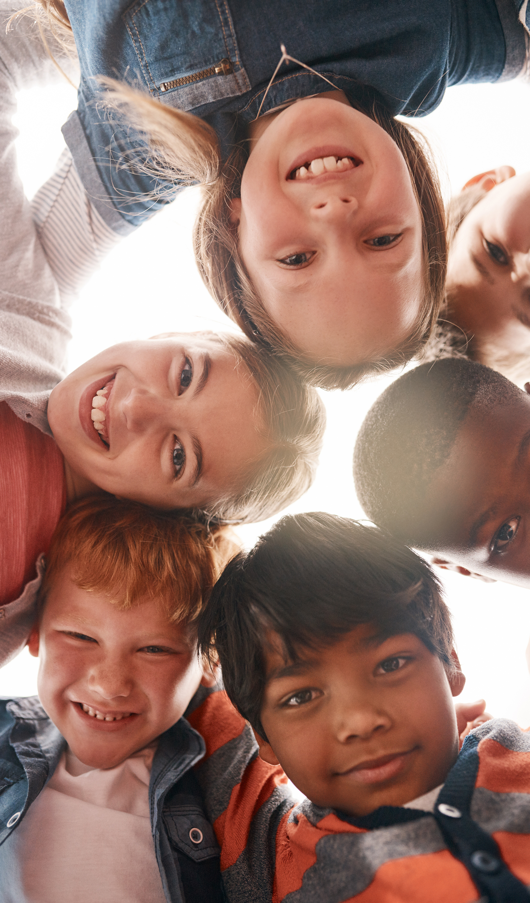
Let's think about how we are all connected, just like a big family. Imagine how important it is to be kind and caring to each other, just like how we would want others to treat us. When we help and share with others, we're making our community stronger and happier.

Slide 14
Even when we feel alone, it's important to remember that we always have friends and family with us. Each of us is special in our own way, and our differences make our world more beautiful. Let's be thankful for the love and friendship we have, and let's celebrate being part of a wonderful community.

Slide 15
Dear God,
Thank you for the people you put in our lives. Help us to remember that we are all connected, like a big family. Teach us to be kind and caring to one another, to share and to help each other. When we feel alone, remind us that we are never truly alone because we have friends, family, and you.

Slide 16
Help us to appreciate our differences and to celebrate the things that make each of us special. Thank you for the love and friendship we share, and for making us part of a wonderful community.
Amen

Slide 17
This is the Day (Difference song)

