Slide 3




Three habits
Community
Embrace
Power
Listen to others’ stories and see the world through their eyes.
Encounter others with authenticity and confidence.
Find hope and opportunity in the places where we long to see changes.

Slide 4
I wonder…
How can we lift up our voices?

Slide 5
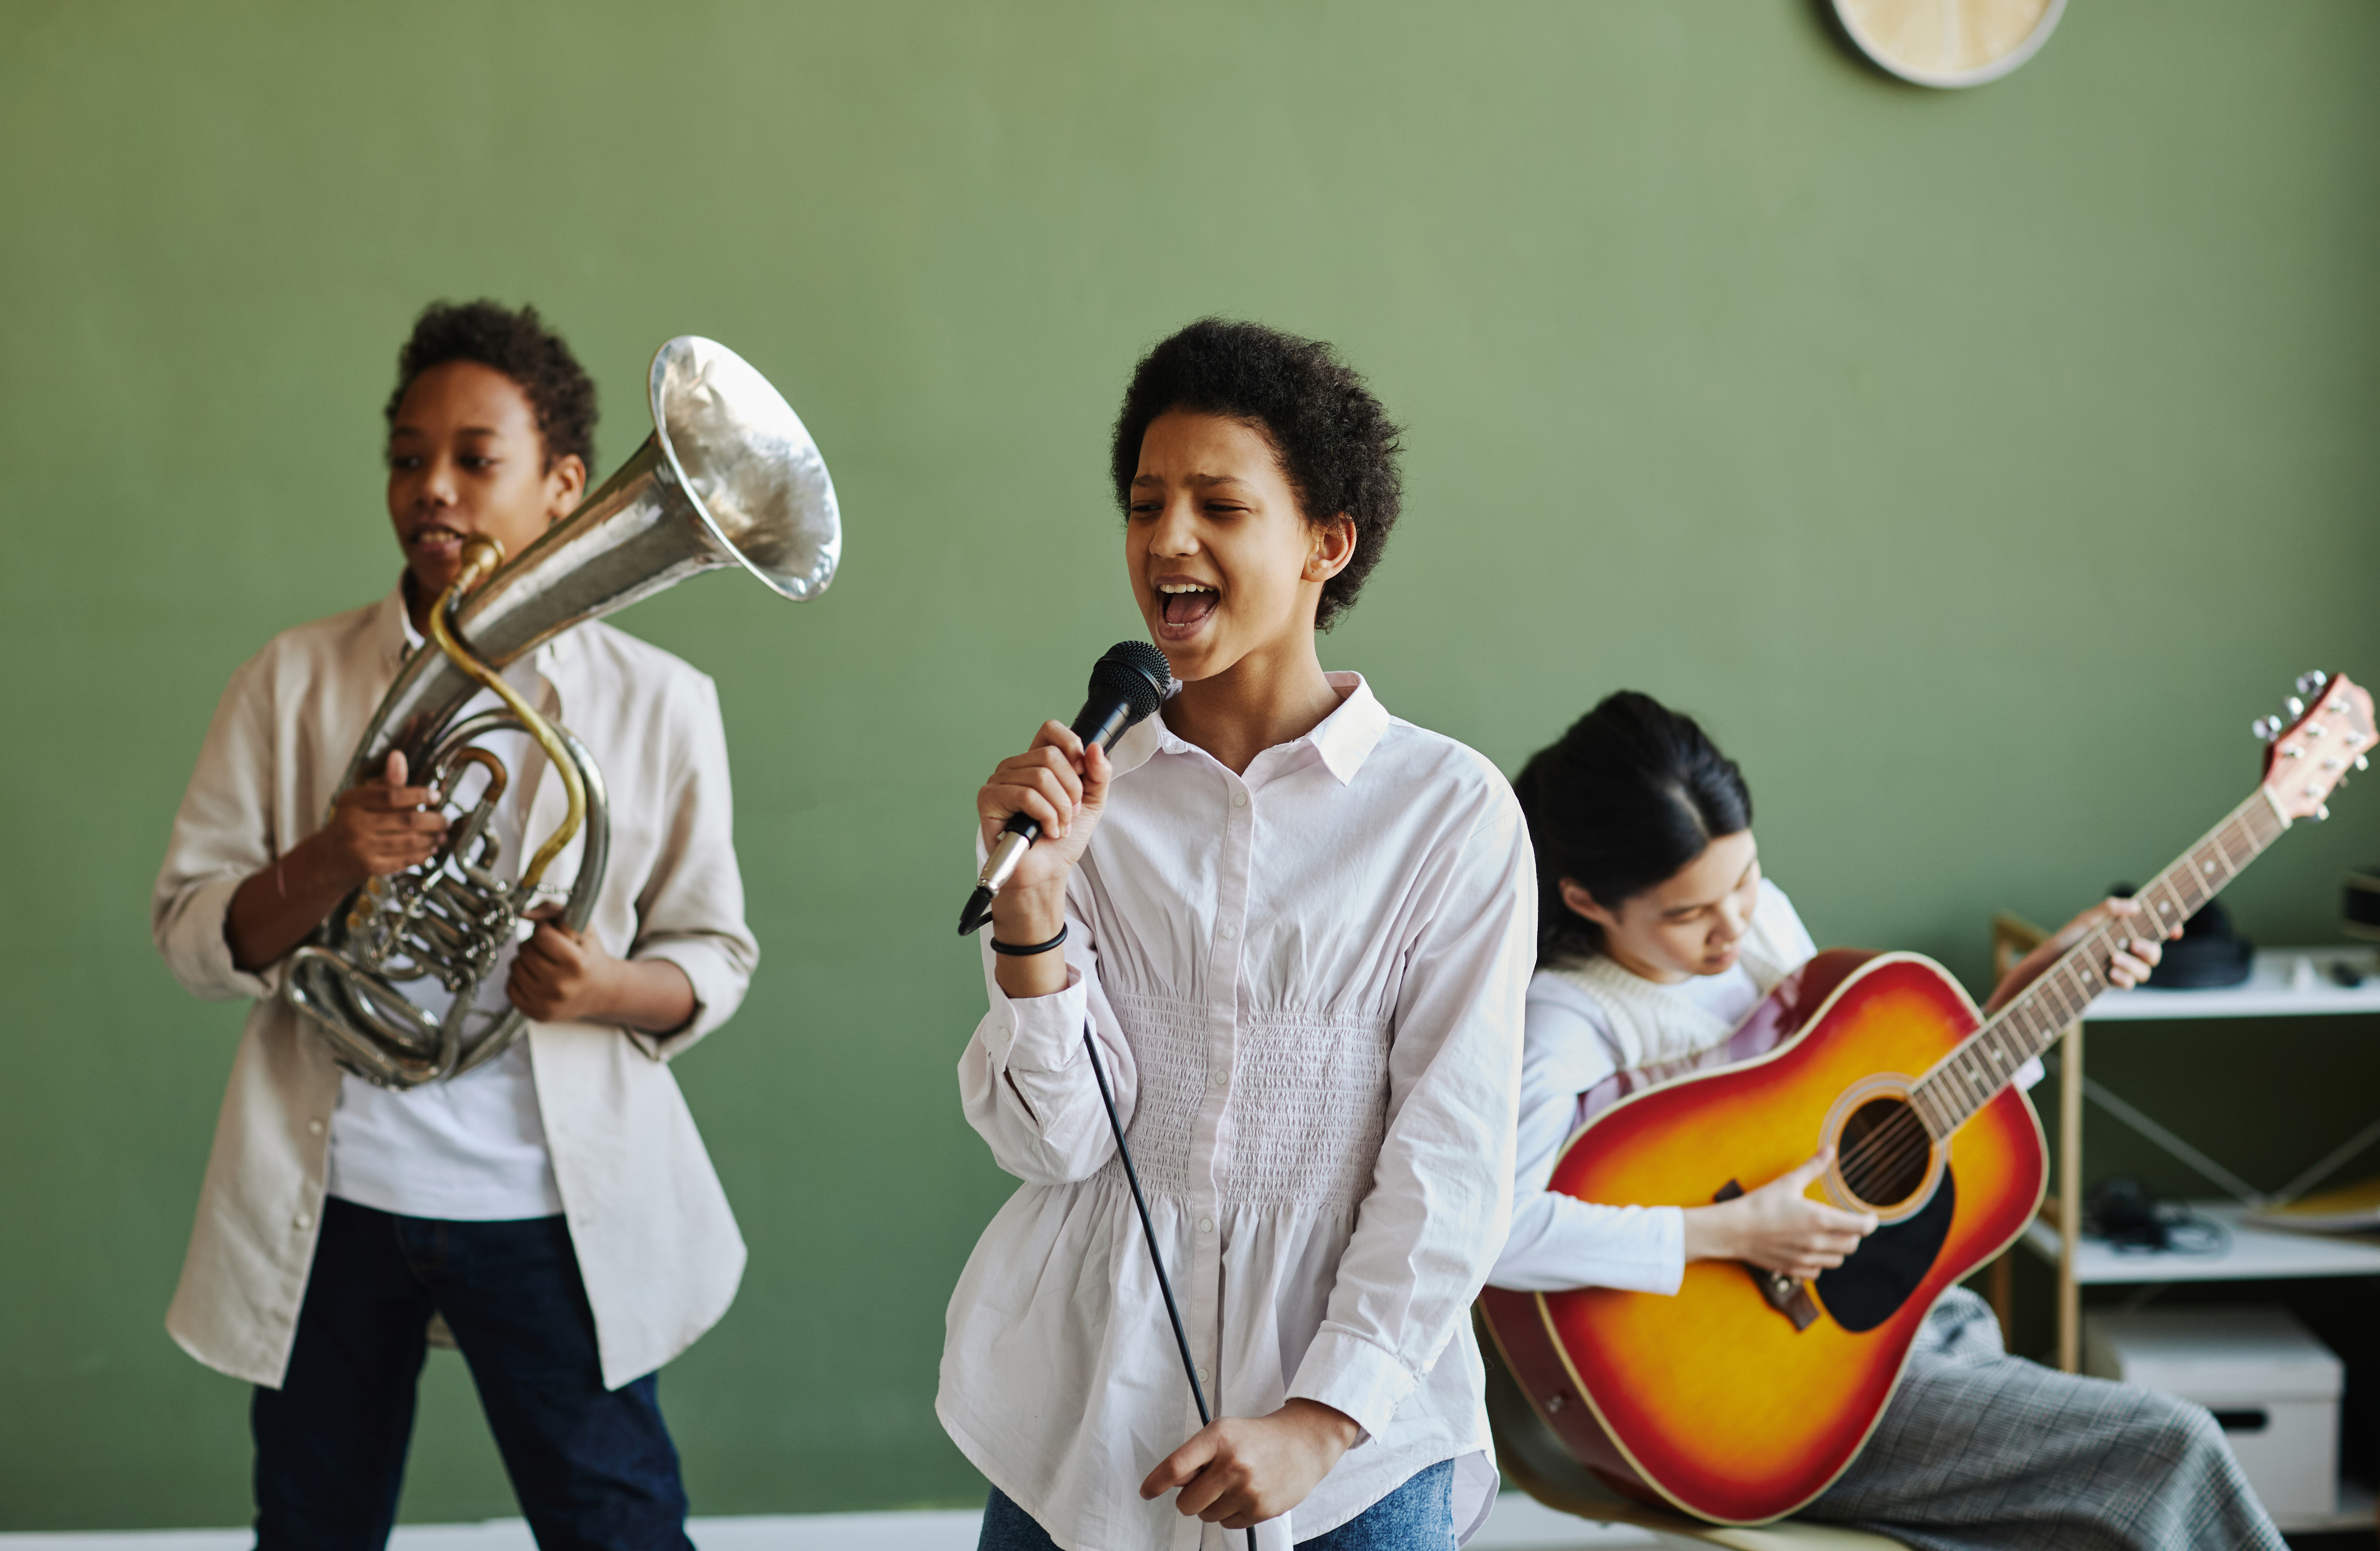

This is the day (The Difference Song)

Slide 6

Difference habits Transition
Coming soon…

Slide 7
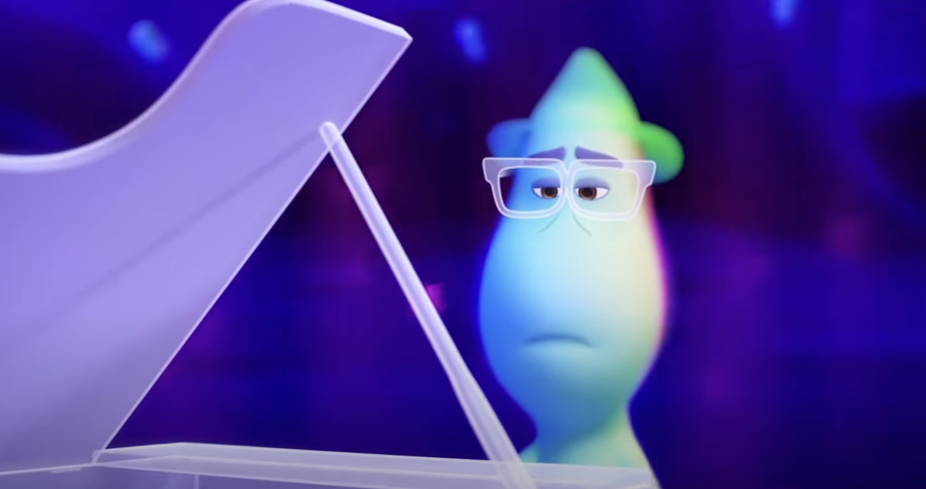
Soul by Disney Pixar

Slide 8

Memory sharing circle
Use a soft ball or object to indicate the speaker. The pupil holding it shares a short (1–2 minute) positive memory; perhaps involving a friend, a fun event, or a special moment at school. They then pass the object to someone else.

Slide 9
What’s a moment at school that made you smile?
Can you remember a time someone was kind to you?
What makes you feel like you belong somewhere –
at school, in a group, or with friends?

Slide 10
Have you ever helped someone else feel like they belonged?
What's a memory of a fun time with friends?

Slide 11

Were there any common themes?
What did you learn about each other?

Slide 12
Picture the Habit

Slide 13

What does it mean to Be Curious about others and the world?
How can we Be Present with someone; really listening to how they feel and understanding what they say?
ThePhoto by PhotoAuthor is licensed under CCYYSA.

Slide 14
What might it look like to Reimagine a better world or a kinder way to solve a problem?
ThePhoto by PhotoAuthor is licensed under CCYYSA.

Slide 15

Pupils create three mini artworks that illustrate what the habits mean to them (one for each habit). This can be done using A5 paper or three sections on a larger sheet. Pupils may choose any style: drawing, painting, collage, or mixed media.

Slide 16
Be Curious
Draw a time when you discovered something surprising about a person or place.
Show what curiosity looks like - maybe someone exploring, asking questions, or noticing something others missed.
Create an image of people learning from each other’s differences.

Slide 17
Be Present
Draw a picture of someone helping a friend feel calm, safe, or included.
What does it look like when people really listen and understand each other? Show that moment.
Show a time when it took courage for someone to share their perspective or story.
Illustrate a time when someone was kind and paid attention to how someone else felt.

Slide 18
Reimagine
If you could change one thing to make the world more kind or fair, what would it be? Show it in your drawing.
Imagine a school, town, or world where everyone feels they belong. What would that look like?
What inspired your picture?

Slide 19
1 Corinthians 12:25-26 (NIV)
“So that there should be no division in the body, but that its parts should have equal concern for each other. If one part suffers, every part suffers with it; if one part is honoured, every part rejoices with it.”

Slide 20
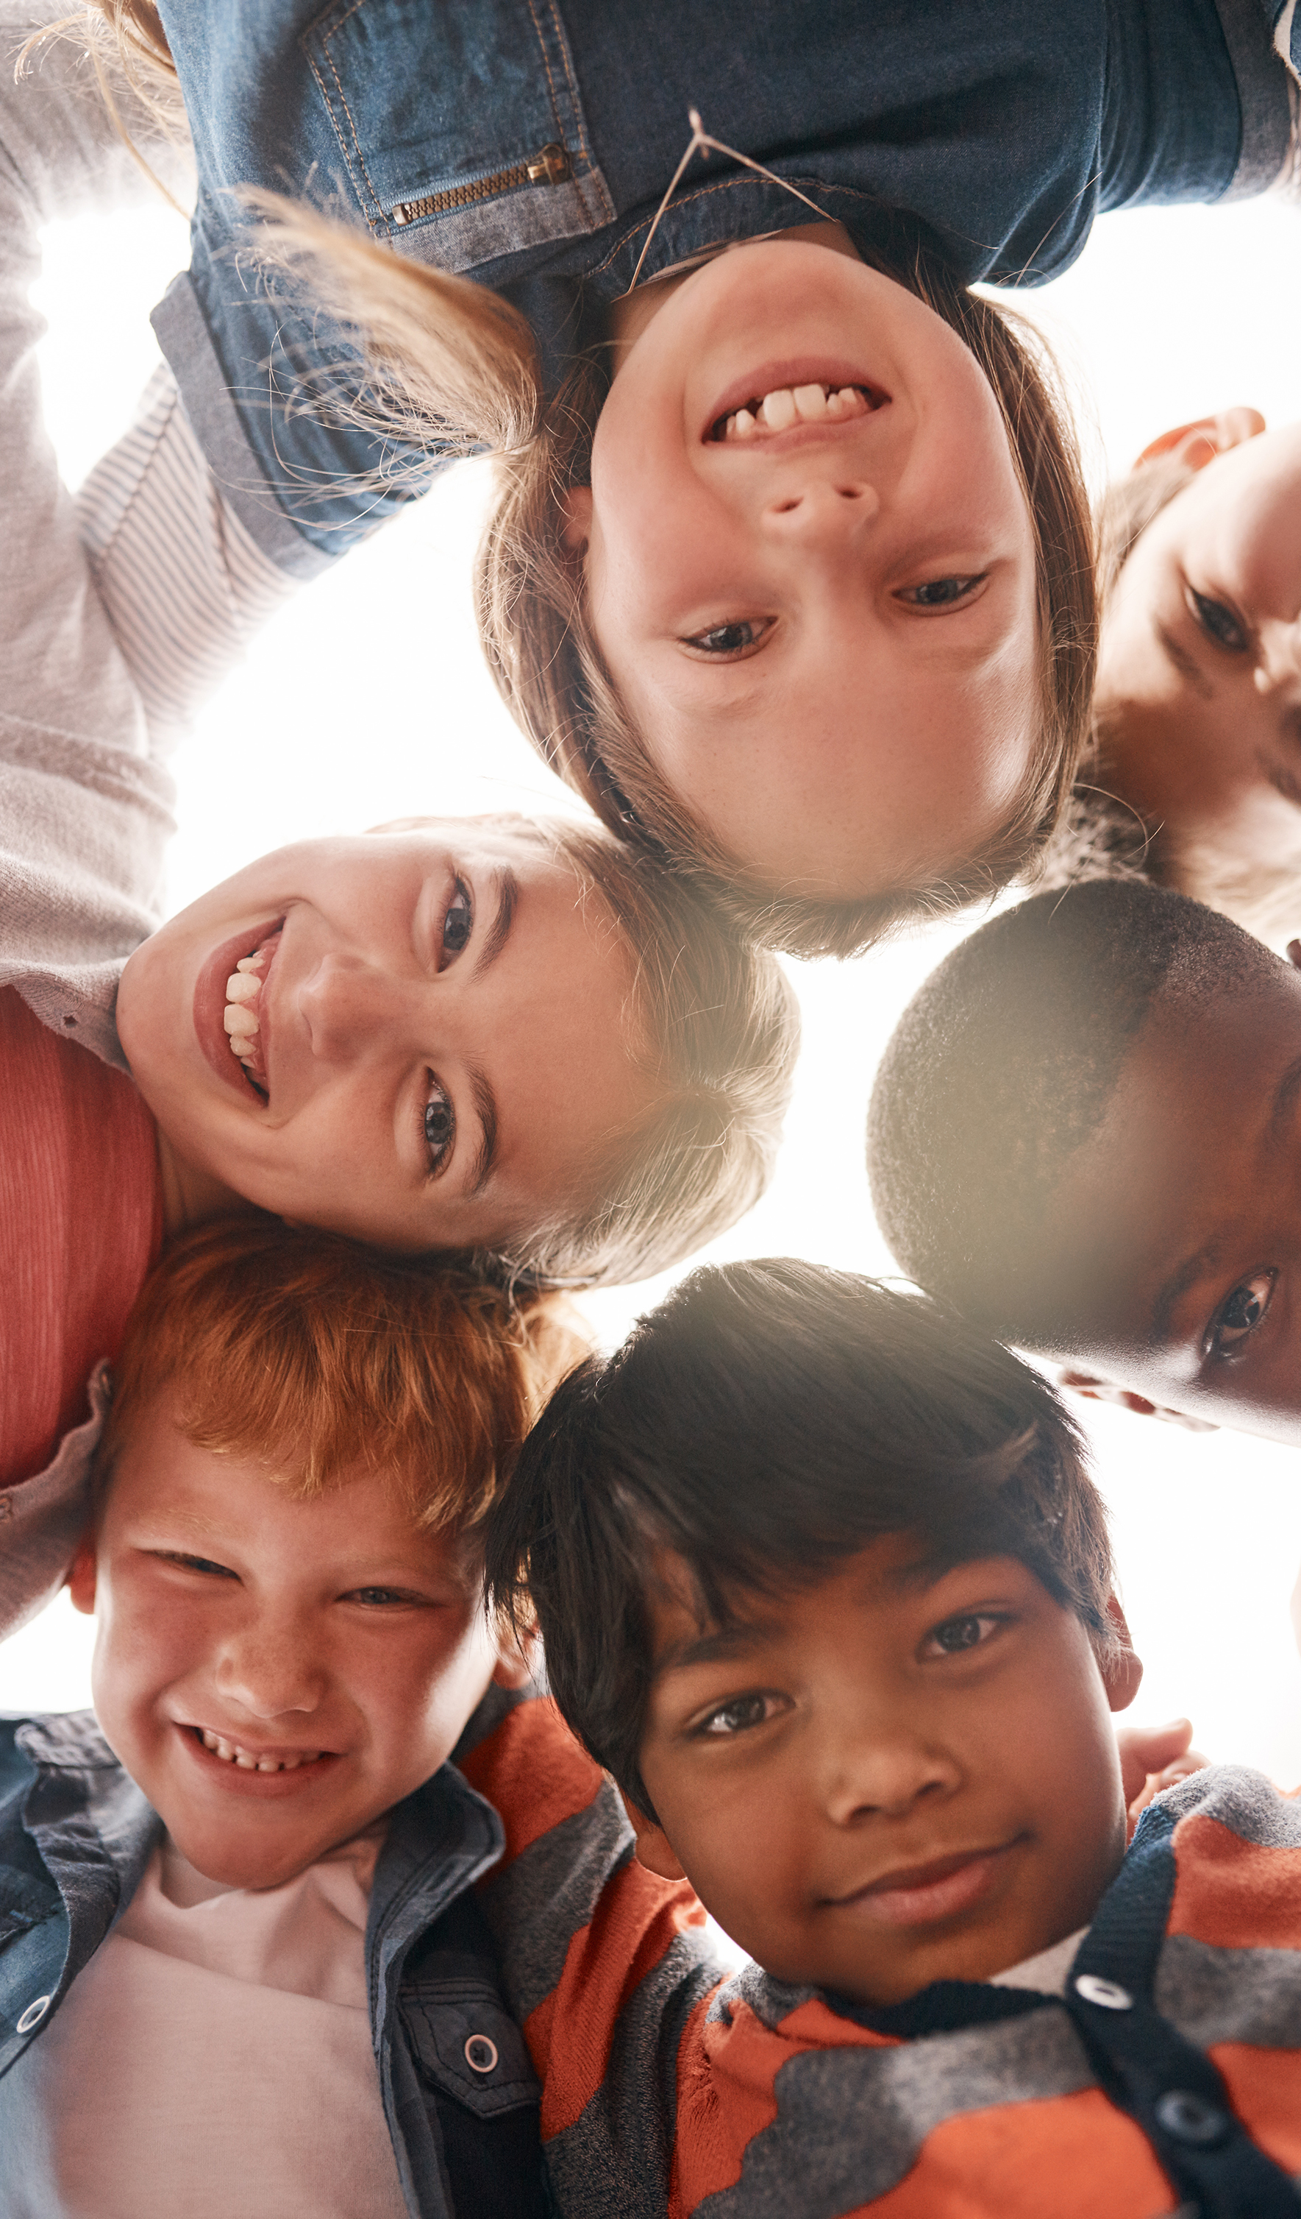
Friendship is a precious gift that brings joy, laughter, and comfort. True friends lift us up, walk beside us, and make life’s journey richer. They celebrate our successes, support us in struggles, and remind us that we are never alone.

Slide 21
Being a good friend is just as important as having good friends. It means listening, showing kindness, and being there through both the happy and difficult times. Friendship isn’t just about what we receive—it’s also about what we give.

Slide 22
Dear God,
Thank you for the friends who make us smile, For the laughter we share and the fun we have together. Thank you for the kind words, the happy moments, and the memories that make our hearts feel warm.
Help us to be good friends too — to listen, to share, and to care for one another. May our friendships be full of joy, kindness, and love, just as you love each of us.
Amen.

