Slide 3




Three habits
Community
Embrace
Power
Listen to others’ stories and see the world through their eyes.
Encounter others with authenticity and confidence.
Find hope and opportunity in the places where we long to see changes.

Slide 4
I wonder…
How can we lift up our voices?

Slide 5

Read A World of Your Own which highlights a journey of reflection and the value of diverse voices.

Slide 6

What did you notice about the world the character created? How was it similar or different to your own world?
Why do you think the character imagined a world of their own?

Slide 7
What parts of the story made you think about your own ideas or dreams?
What can we learn about someone by seeing the world through their eyes?
How might sharing our own ‘worlds’ help others understand us better?

Slide 8
Our own worlds – Identity and Belonging

Slide 9

Invite pupils to design their own personal world; a place where they feel safe, confident, and truly themselves. This can be drawn, painted, collaged, or written as a story or poem. Pupils are encouraged to include aspects of their identity (such as their interests, beliefs, family, culture, and values) as well as their hopes, dreams, and any feelings about the upcoming transition to secondary school.

Slide 10
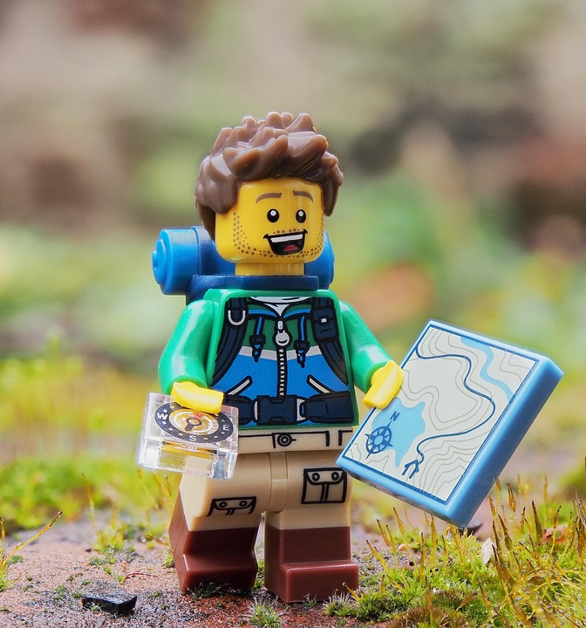
What does your world look like?
Who or what lives there?
What makes you feel at home and proud of who you are?

Slide 11
What do you hope for in your new school?
How does your world show what matters to you?

Slide 12

What makes each world unique and special?
How do our different worlds help us understand each other better?
What can we carry from our own worlds into our new school community?

Slide 13
1 Peter 4:10 (NIV)
“Each of you should use whatever gift you have received to serve others, as faithful stewards of God’s grace in its various forms.”

Slide 14

This verse encourages us to recognise our unique gifts and talents, understanding that they are given to them by God to share with others. It reminds them that our contributions, no matter how big or small, can make a positive impact on our community and help foster connections with our peers.

Slide 15
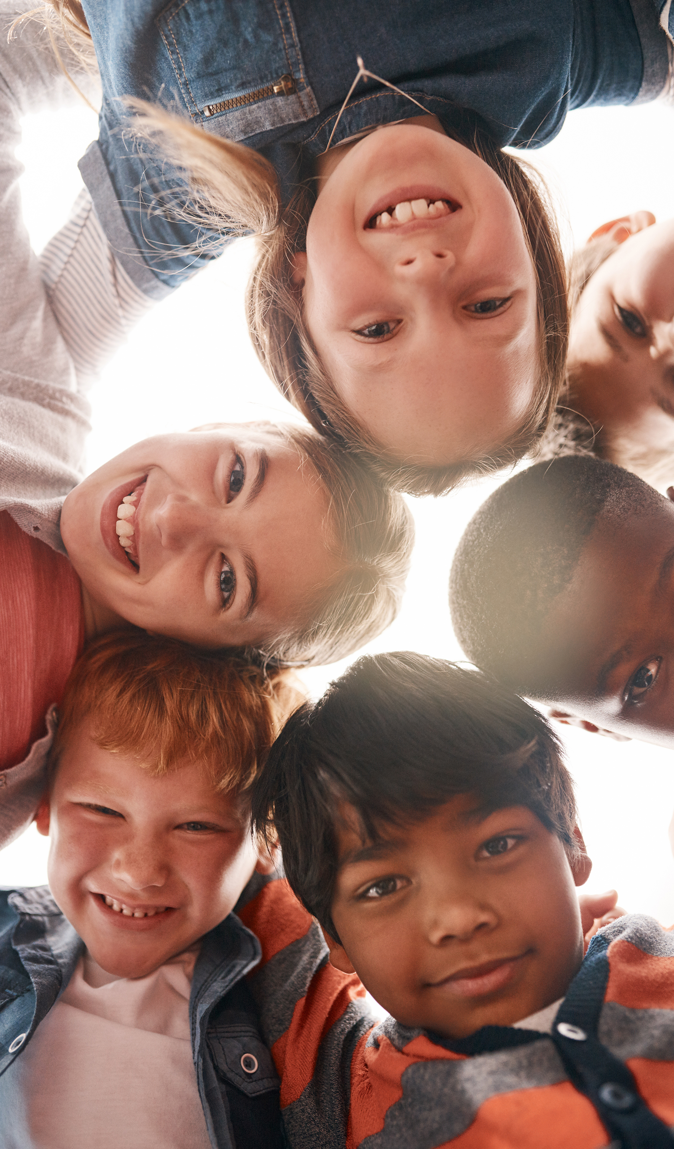
As you step into Year 7, remember how unique and special you are. Embrace your strengths and talents and celebrate what makes you different. This will not only help you face challenges with confidence but also enrich your school community.

Slide 16
Year 7 is a time to grow and learn about yourself and others. By respecting and supporting each other, you create a space where everyone feels valued. Your individuality makes the community stronger.
Focus on kindness, embrace who you are, and encourage others to do the same. Together, you can make Year 7 a year of growth, friendship, and success.

Slide 17
Dear God,
Thank you for making us unique. Help us embrace our strengths and differences as we step into Year 7. Guide us to be confident, kind, and respectful of others, knowing everyone has something valuable to offer.
Remind us that we don’t have to be the same to succeed and help us face challenges with courage. May we support and respect one another as we grow, learn, and make new friends.
Amen.

