Slide 3




Three habits
Community
Embrace
Power
Listen to others’ stories and see the world through their eyes.
Encounter others with authenticity and confidence.
Find hope and opportunity in the places where we long to see changes.

Slide 4
I wonder…
How can we lift up our voices?

Slide 5
Why do we disagree?
Notes:
Need bible story title page

Slide 6

Different opinions or beliefs
Wanting different things
Misunderstandings or not listening to each other
Different experiences
ThePhoto by PhotoAuthor is licensed under CCYYSA.

Slide 7

On a scale of 1-10 (one being small, 10 being big) think about a simple disagreement you've had this week that you'd consider a 1-3 on the scale.
For example: A simple disagreement you've had with someone such as a disagreement about what to watch on TV, what game to play, which sport team is better.
How did you resolve the disagreement?

Slide 8
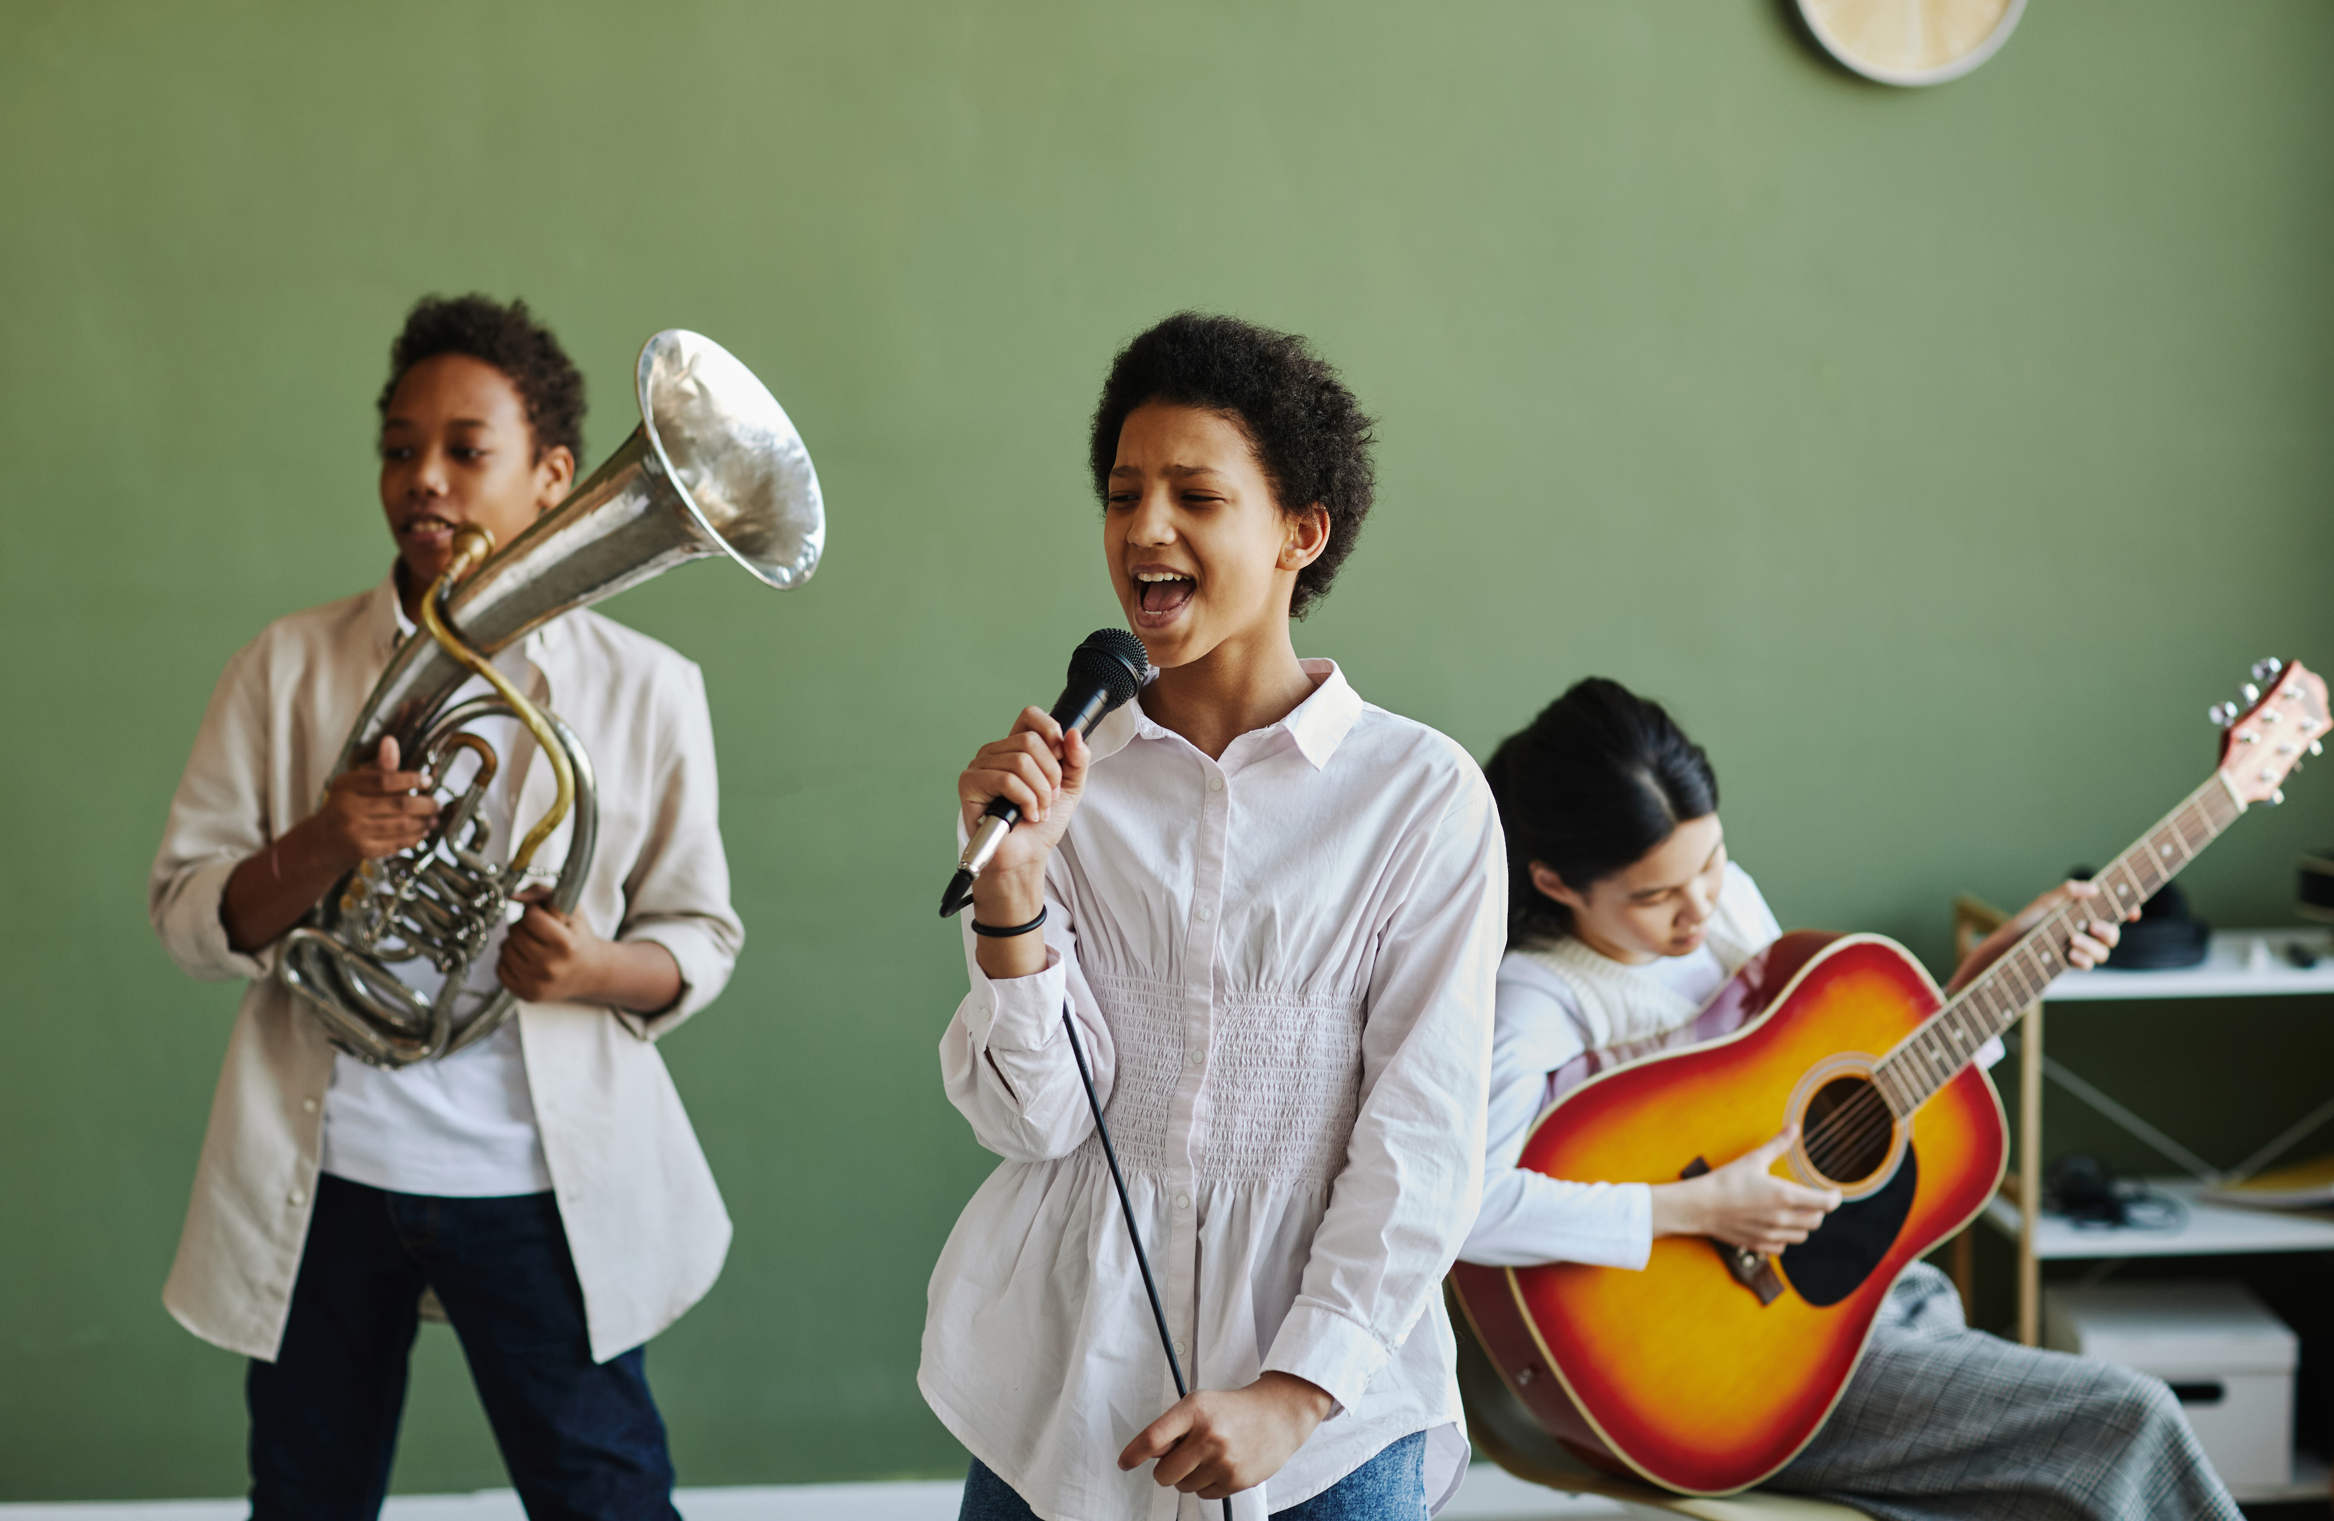

This is the day (The Difference Song)

Slide 9
Group Project Disagreement

Slide 10
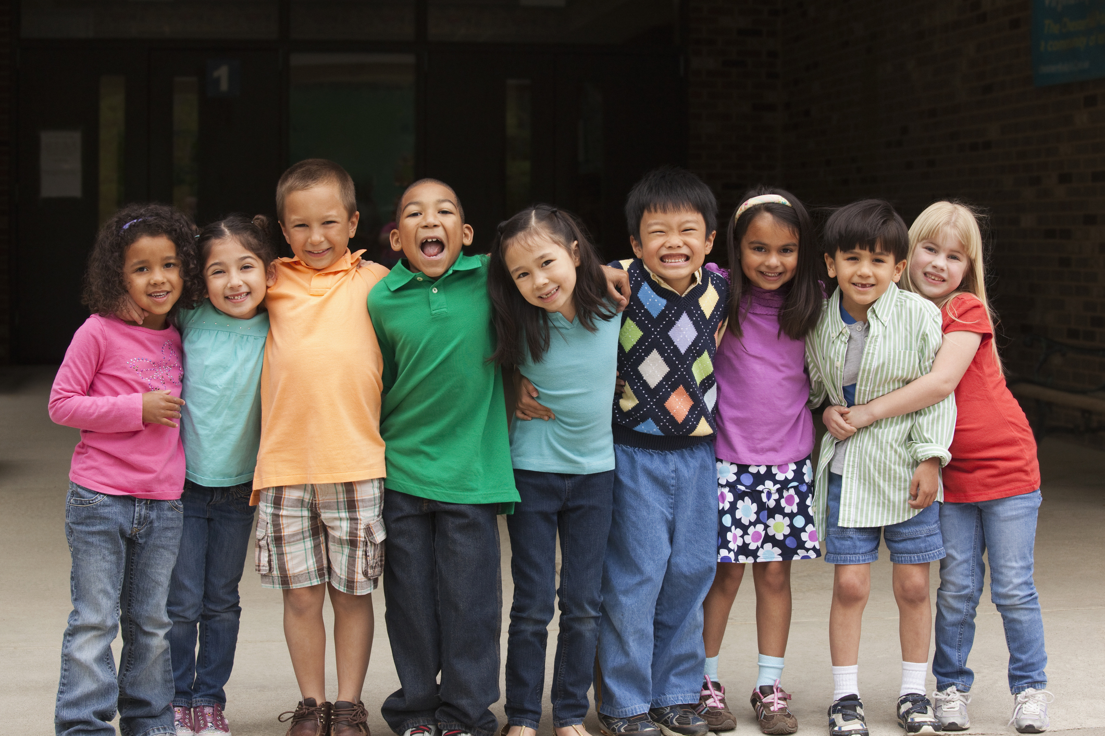
Group Project Disagreement
You and your classmates are working on a group project about animals. Everyone has different ideas about which animal to focus on.

Slide 11
How can you listen to everyone’s ideas without interrupting?
What questions could you ask to understand why your friend feels passionate about their choice?
How could you compromise?

Slide 12

Be Curious: What might we not yet understand about the other person’s feelings or perspective?
Be Present: How can we show we are really listening and caring?
Reimagine: What could a better outcome look like for everyone involved?

Slide 13
Scenarios
Disagreement about a game
A new friendship group
Compliment gone wrong
Friend wants to borrow something

Slide 14
James 1:19-20 (NIV)
“My dear brothers and sisters, take note of this: Everyone should be quick to listen, slow to speak and slow to become angry, because human anger does not produce the righteousness that God desires.”

Slide 15
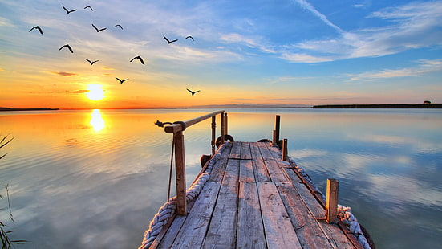
Why is it important to listen to others?
Do we always have to agree?
How can we respectfully disagree with someone?

Slide 16
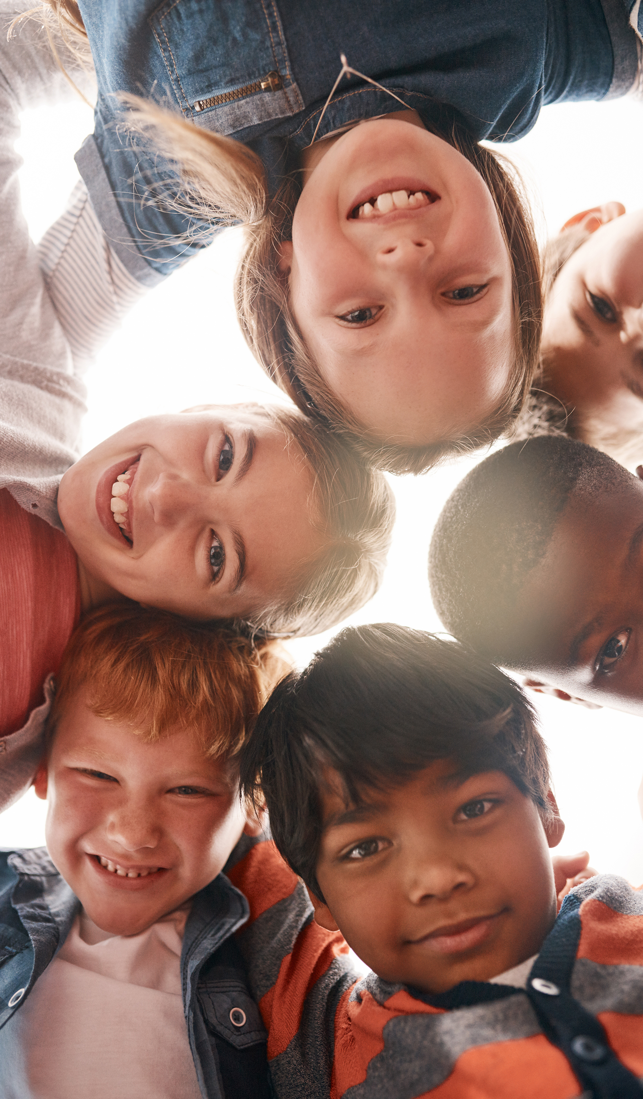
Disagreements are normal, especially in a new environment like secondary school. How we handle them matters. By approaching conflicts with empathy, we can better understand each other and strengthen friendships.

Slide 17
Listening, respecting others' feelings, and treating everyone with kindness, even when we disagree, helps our relationships grow. Practising skills of empathy and active listening doesn’t mean we need to agree, rather these skills help us share our opinions respectfully with greater understanding.

Slide 18
In secondary school, practicing empathy creates a supportive, respectful community where everyone feels heard and valued. This is the foundation of strong friendships and a positive school environment.

Slide 19
Dear God,
Thank you for the gift of friendship. Help us navigate disagreements with empathy and respect. Guide us to listen, understand, and approach conflicts with kindness.
Remind us that disagreements can strengthen friendships when we respond with patience. Teach us to be slow to anger, quick to listen, and always treat others with love.
Help us to build a community where everyone feels valued and supported.
Amen.

