Slide 3




Three habits
Community
Embrace
Power
Listen to others’ stories and see the world through their eyes.
Encounter others with authenticity and confidence.
Find hope and opportunity in the places where we long to see changes.

Slide 4
I wonder…
How can we lift up our voices?

Slide 5
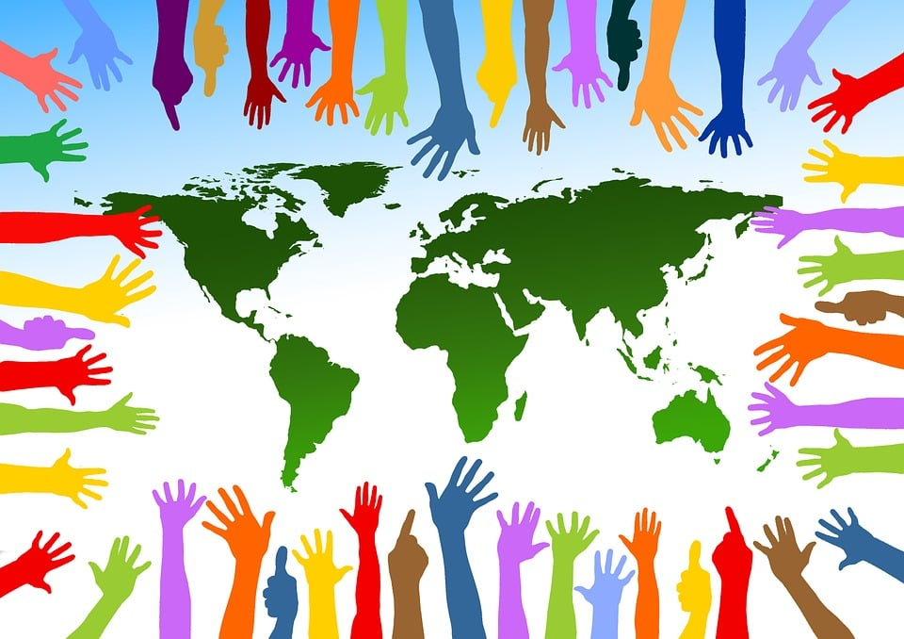
Getting to know ourselves and each other
What makes you feel seen?
What makes you feel cherished or valued?
What does it mean for you to be in a community with others?

Slide 6

What does justice look like in our school?
What does an unjust/unfair school or classroom look like?
What does a just/fair and flourishing classroom look like?

Slide 7
How can we show grace or mercy when someone makes a mistake?
What are small, everyday ways we can act fairly?

Slide 8

What Issues Matter?
In small groups, discuss some of the questions presented in the text and share your thoughts on how the world would change if racism were eliminated for a day, such as:
How do you like to wear your hair?

Slide 9
Why might some children feel uncomfortable wearing their hair the way they would like to?
What is important to you? Do you feel able to talk about these things?

Slide 10
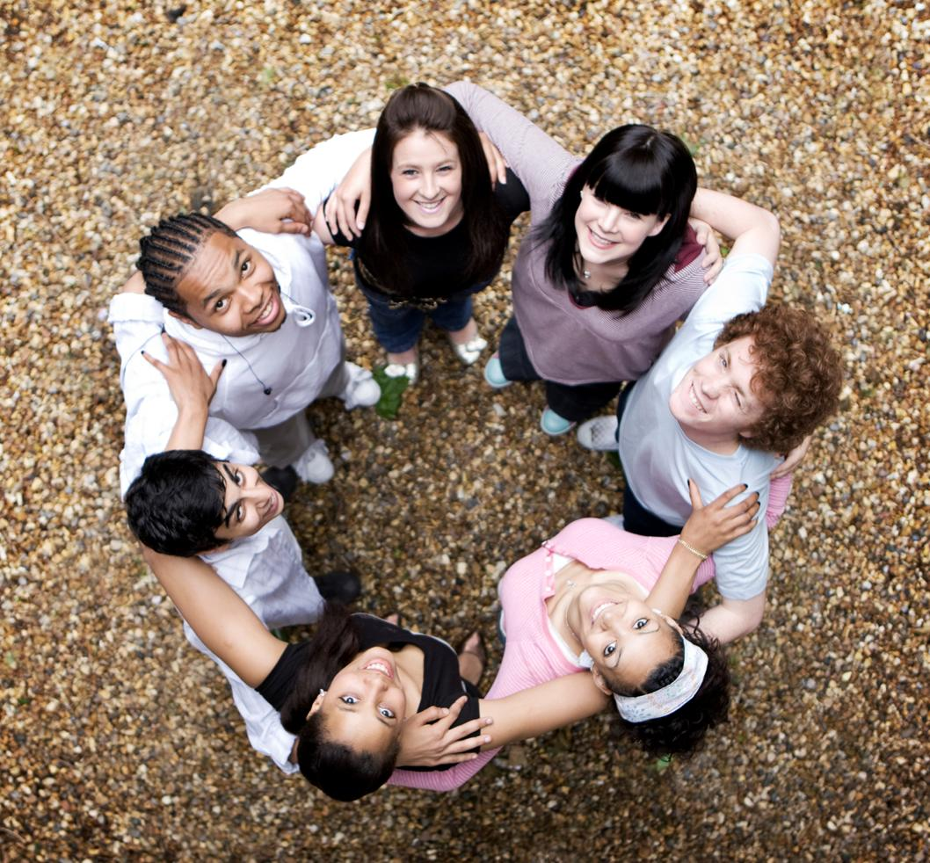
What does a world without these injustices look like?
How would you feel in that world?

Slide 11
Justice from the Future

Slide 12
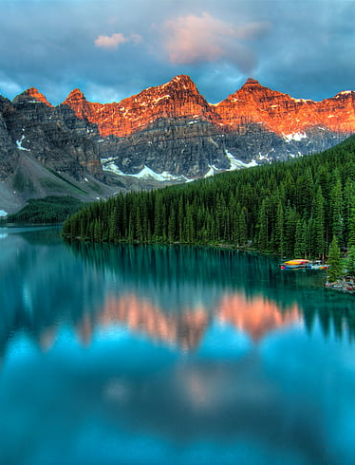
Imagine a future where the justice issue, you care about has been resolved. Create a message from that future; this could be a voice note, mini news report, time capsule leaflet, or short performance. Describe what the world looks like and how the change came about. Your message should inspire others by showing the steps that led to justice and encouraging action today.

Slide 13
Record (or script and perform) a voice note or video message from the future. Describe how a justice issue has been solved and what life is like in 2045

Slide 14
Voice Note from the Future
Steps:
Choose a justice issue.
Imagine it’s the year 2045 — the issue has been solved!
Record a 1–2 minute voice note or short video beginning with something similar to:
“Hi everyone, we’re sending this from the future to let you know what happened...”

Slide 15
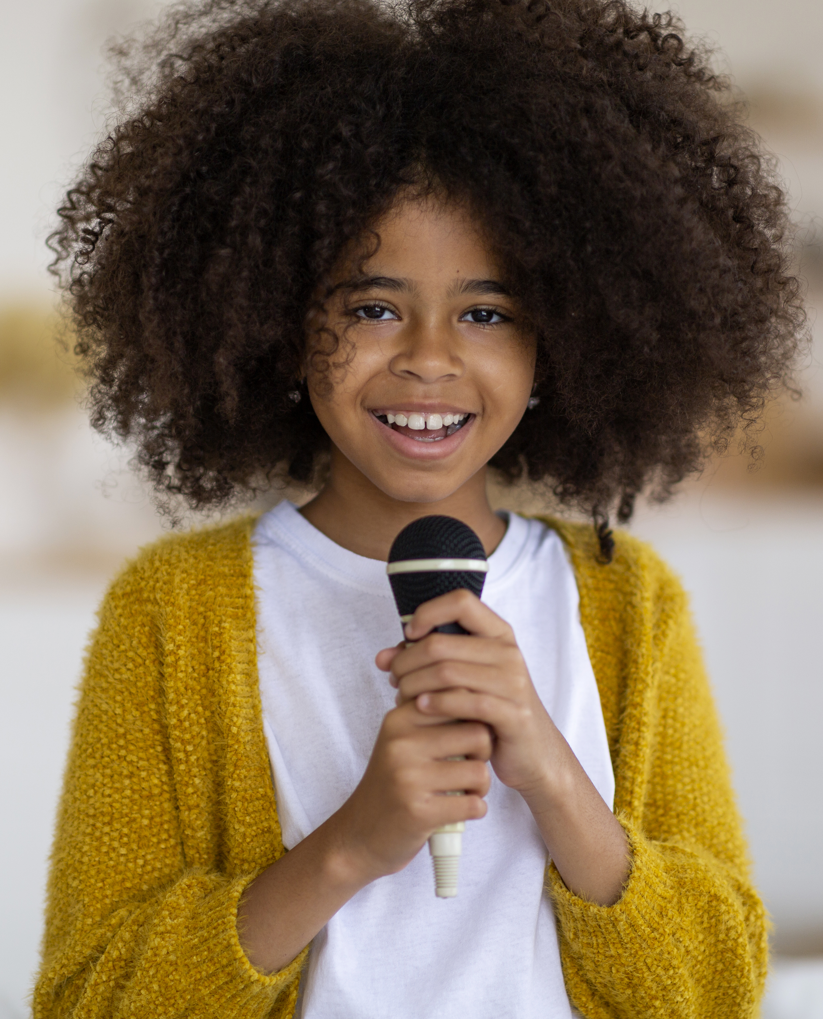
Voice Note from the Future
Include:
What’s changed.
What actions made it happen.
What people today can start doing.

Slide 16
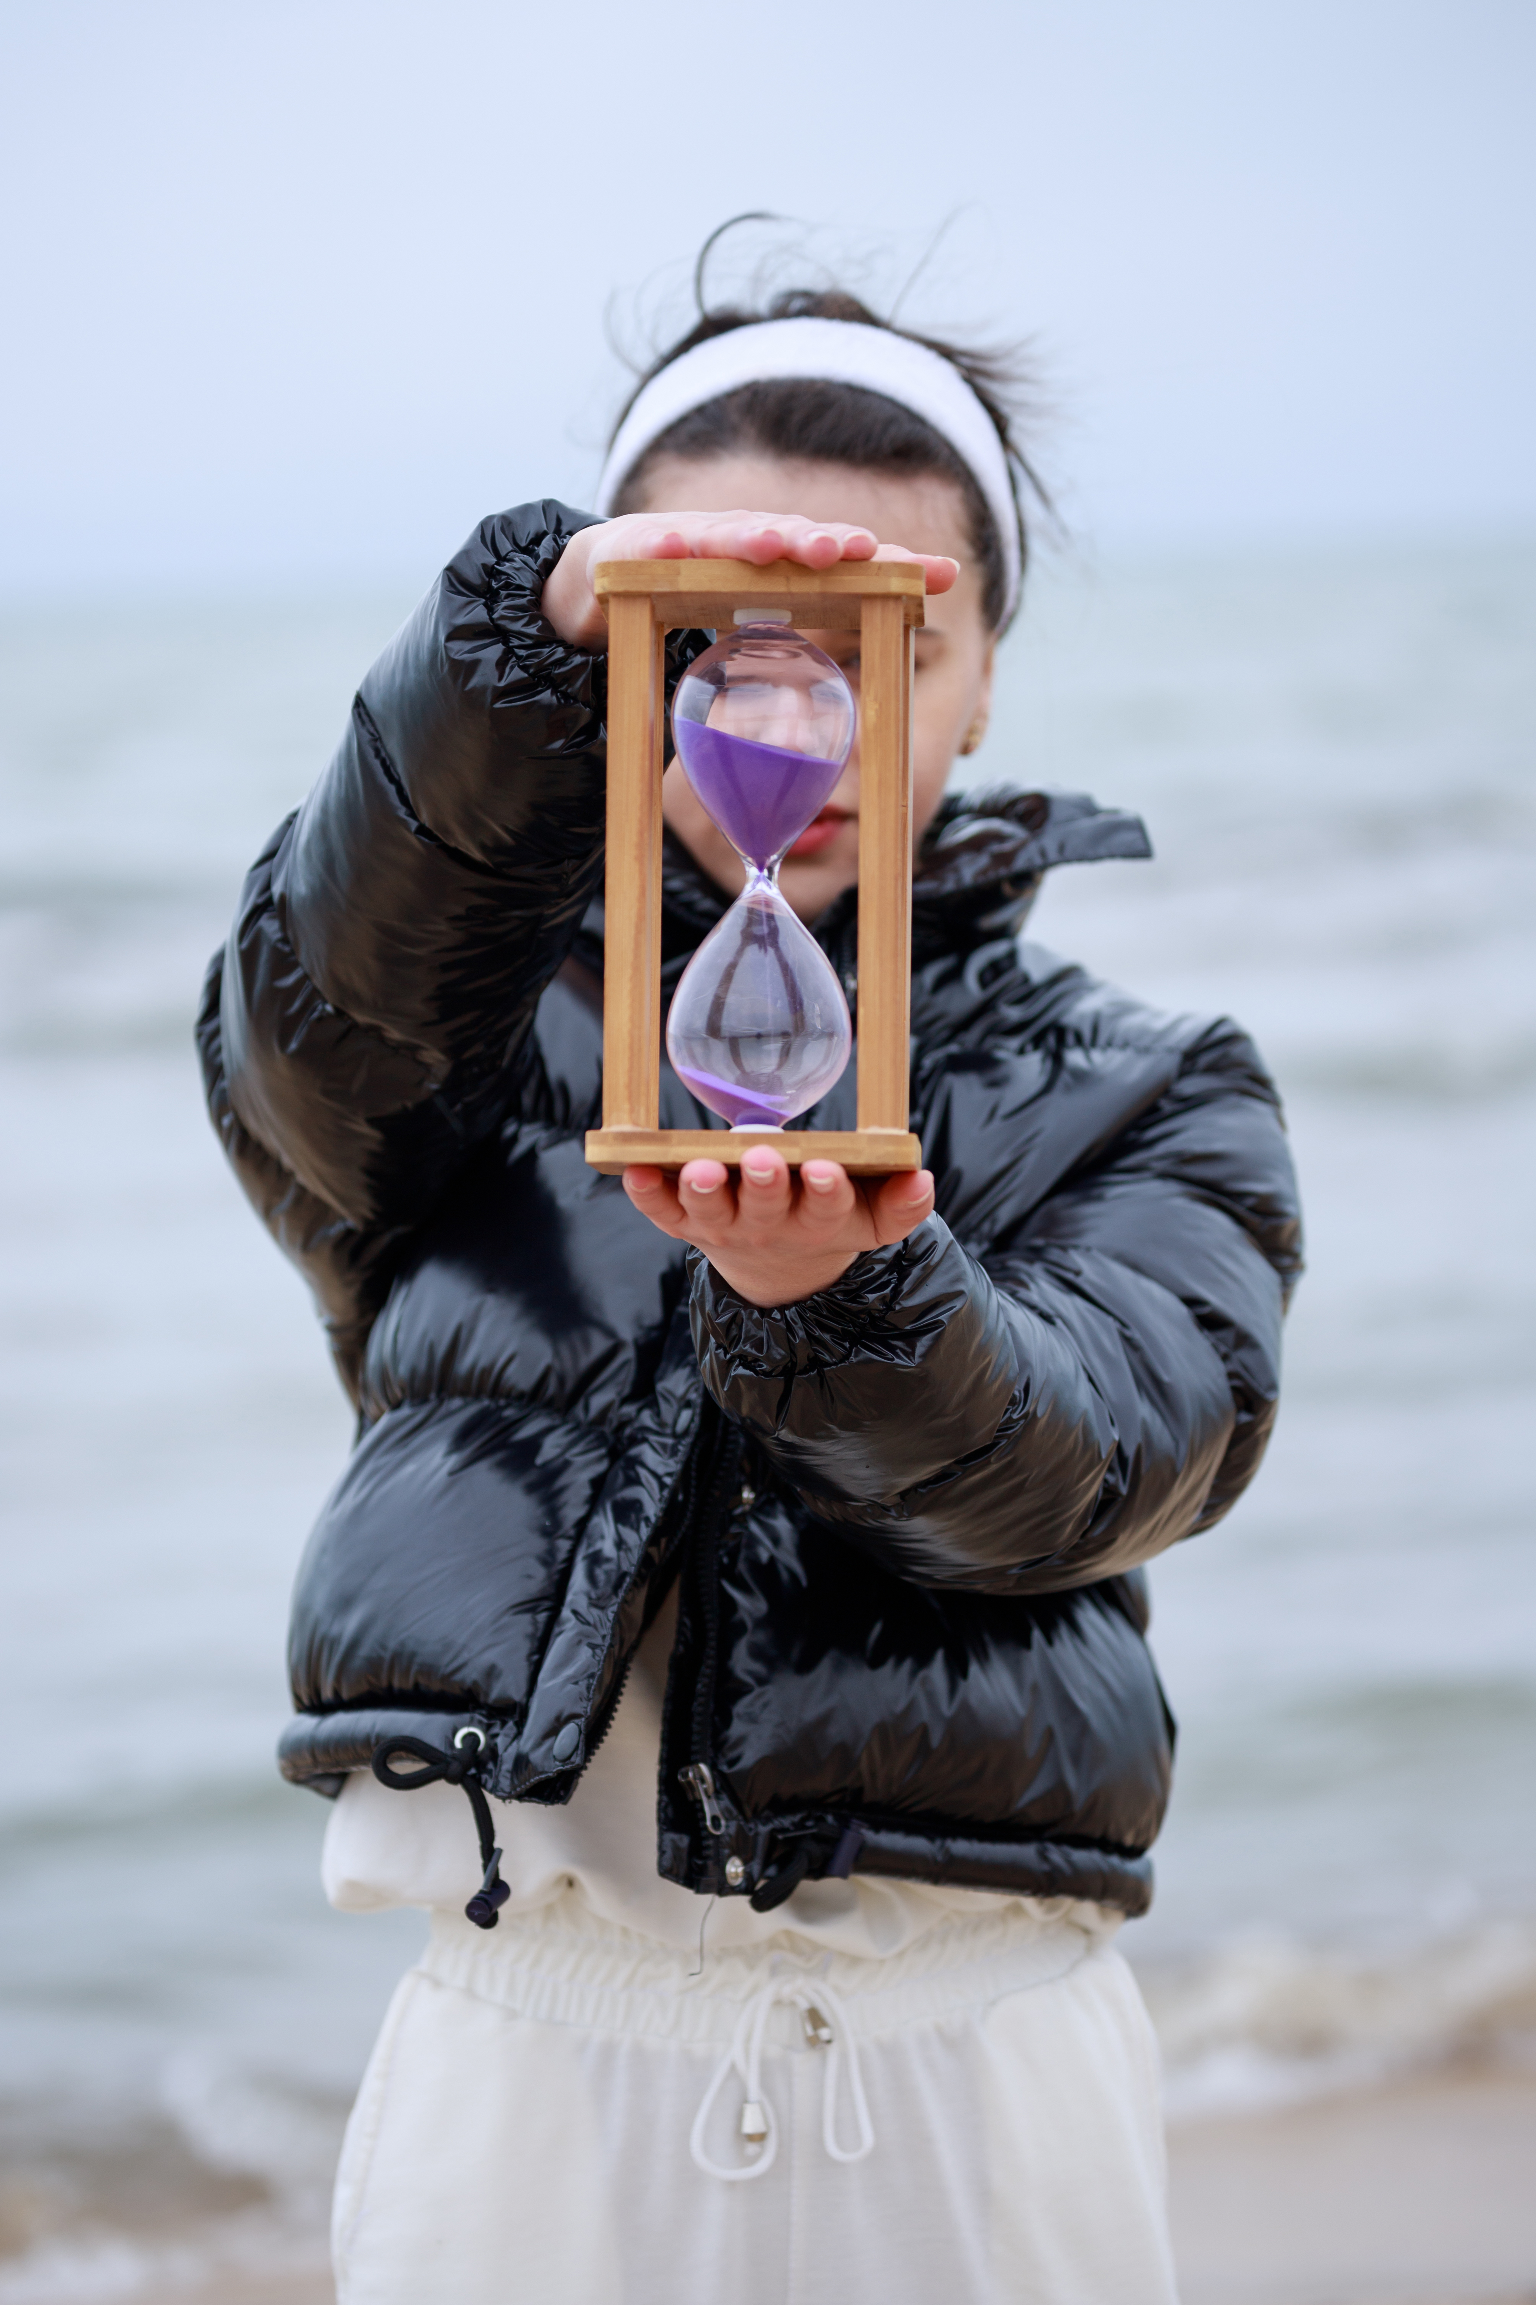
Time Capsule
Design a poster or leaflet that could be discovered in a time capsule. This should include a message to people living in the present, explaining how a better future was achieved.

Slide 17
This could Include:
A cover image of the future world
Headlines like “Justice Achieved!” or “How We Changed the World”
A section called “Steps We Took”
A call to action for today’s reader

Slide 18
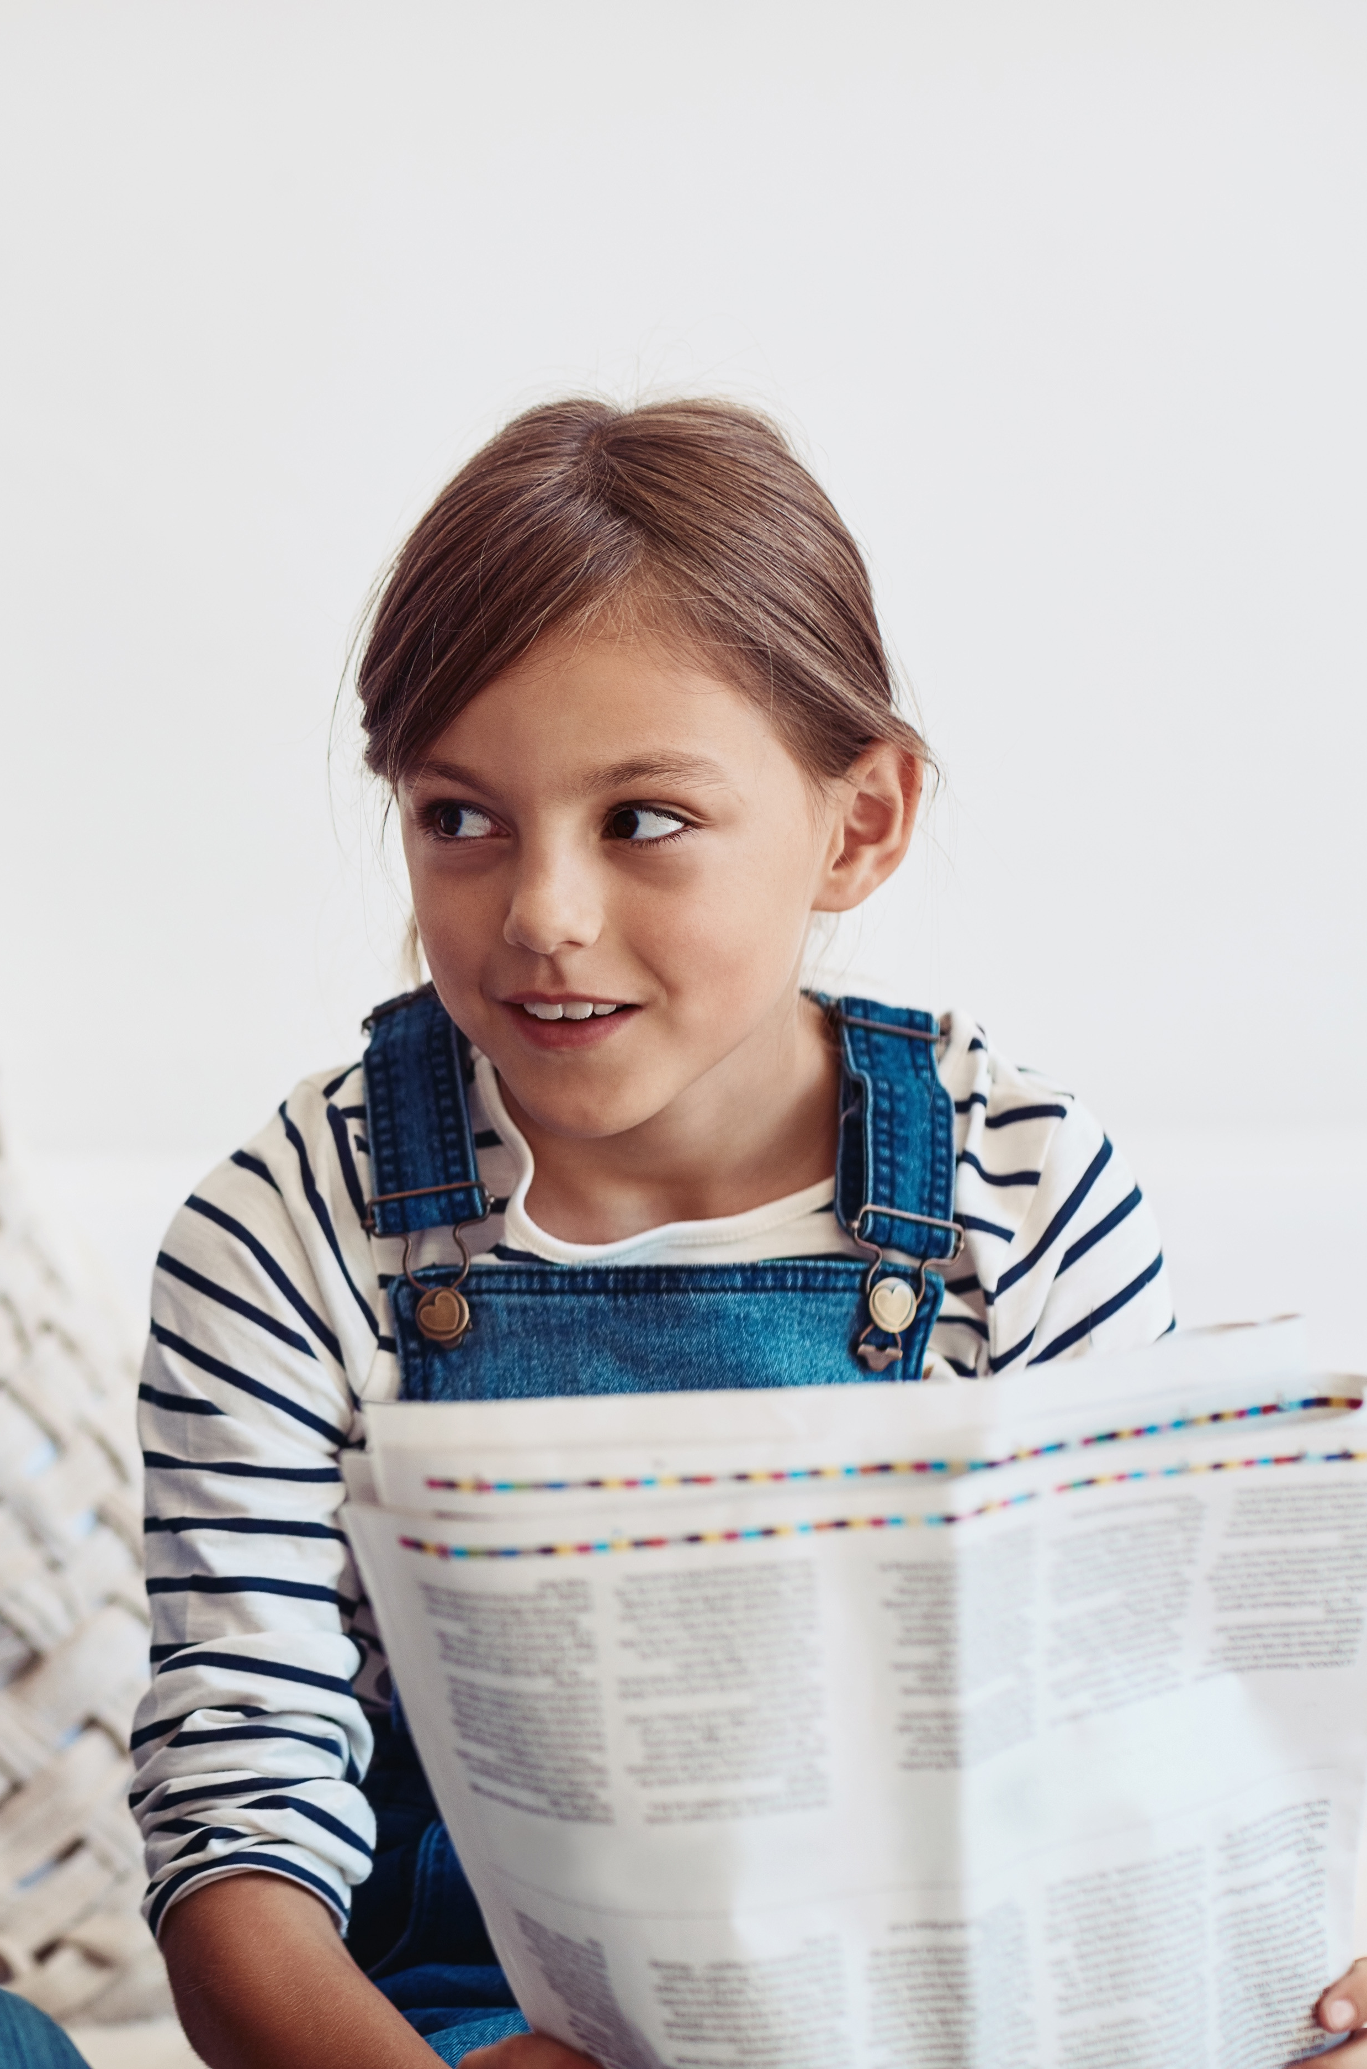
Newsflash from the Future
Create a mini-news broadcast (or written headline) as if you're reporting from the future where the issue has been solved.

Slide 19
Write a front-page news headline and story.
Film or perform a short news clip: “This just in — schools around the world are celebrating a decade without ...”
Add weather reports, interviews, or a “person on the street” segment for a fun element.

Slide 20
Micah 6:8 (NIV)
“He has shown you, O mortal, what is good. And what does the Lord require of you? To act justly and to love mercy and to walk humbly with your God.”

Slide 21
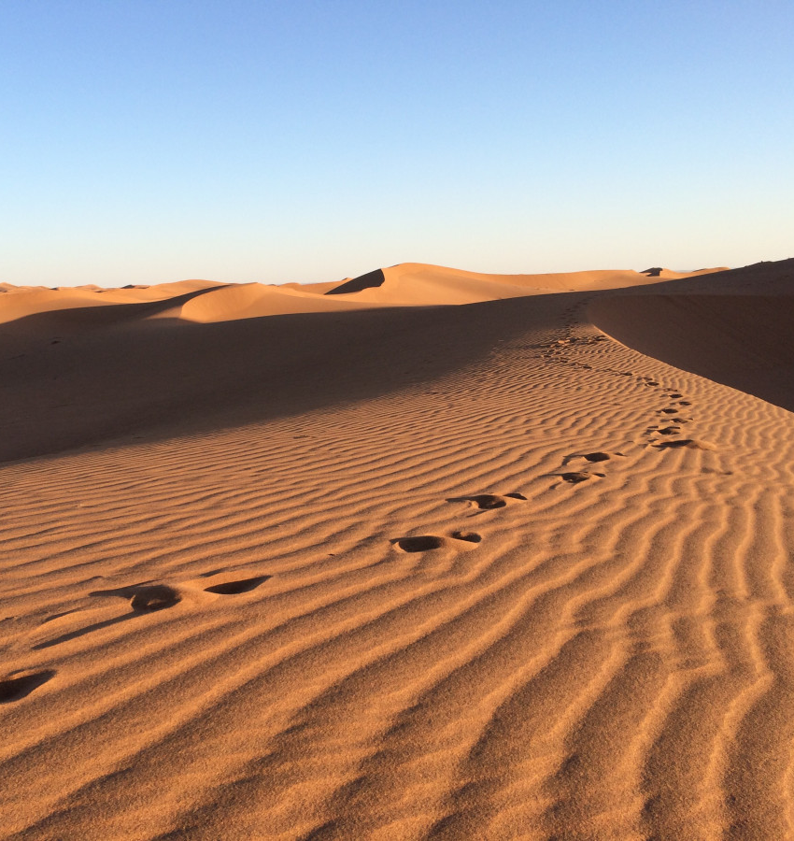
Act justly – Do what’s right and fair, not just for yourself, but for others too. Stand up when you see something wrong.
Love mercy – Be kind and forgiving. Show care, even when others make mistakes.
Walk humbly – Stay open to learning. Don’t think you have to have all the answers—be willing to listen and grow.

Slide 22
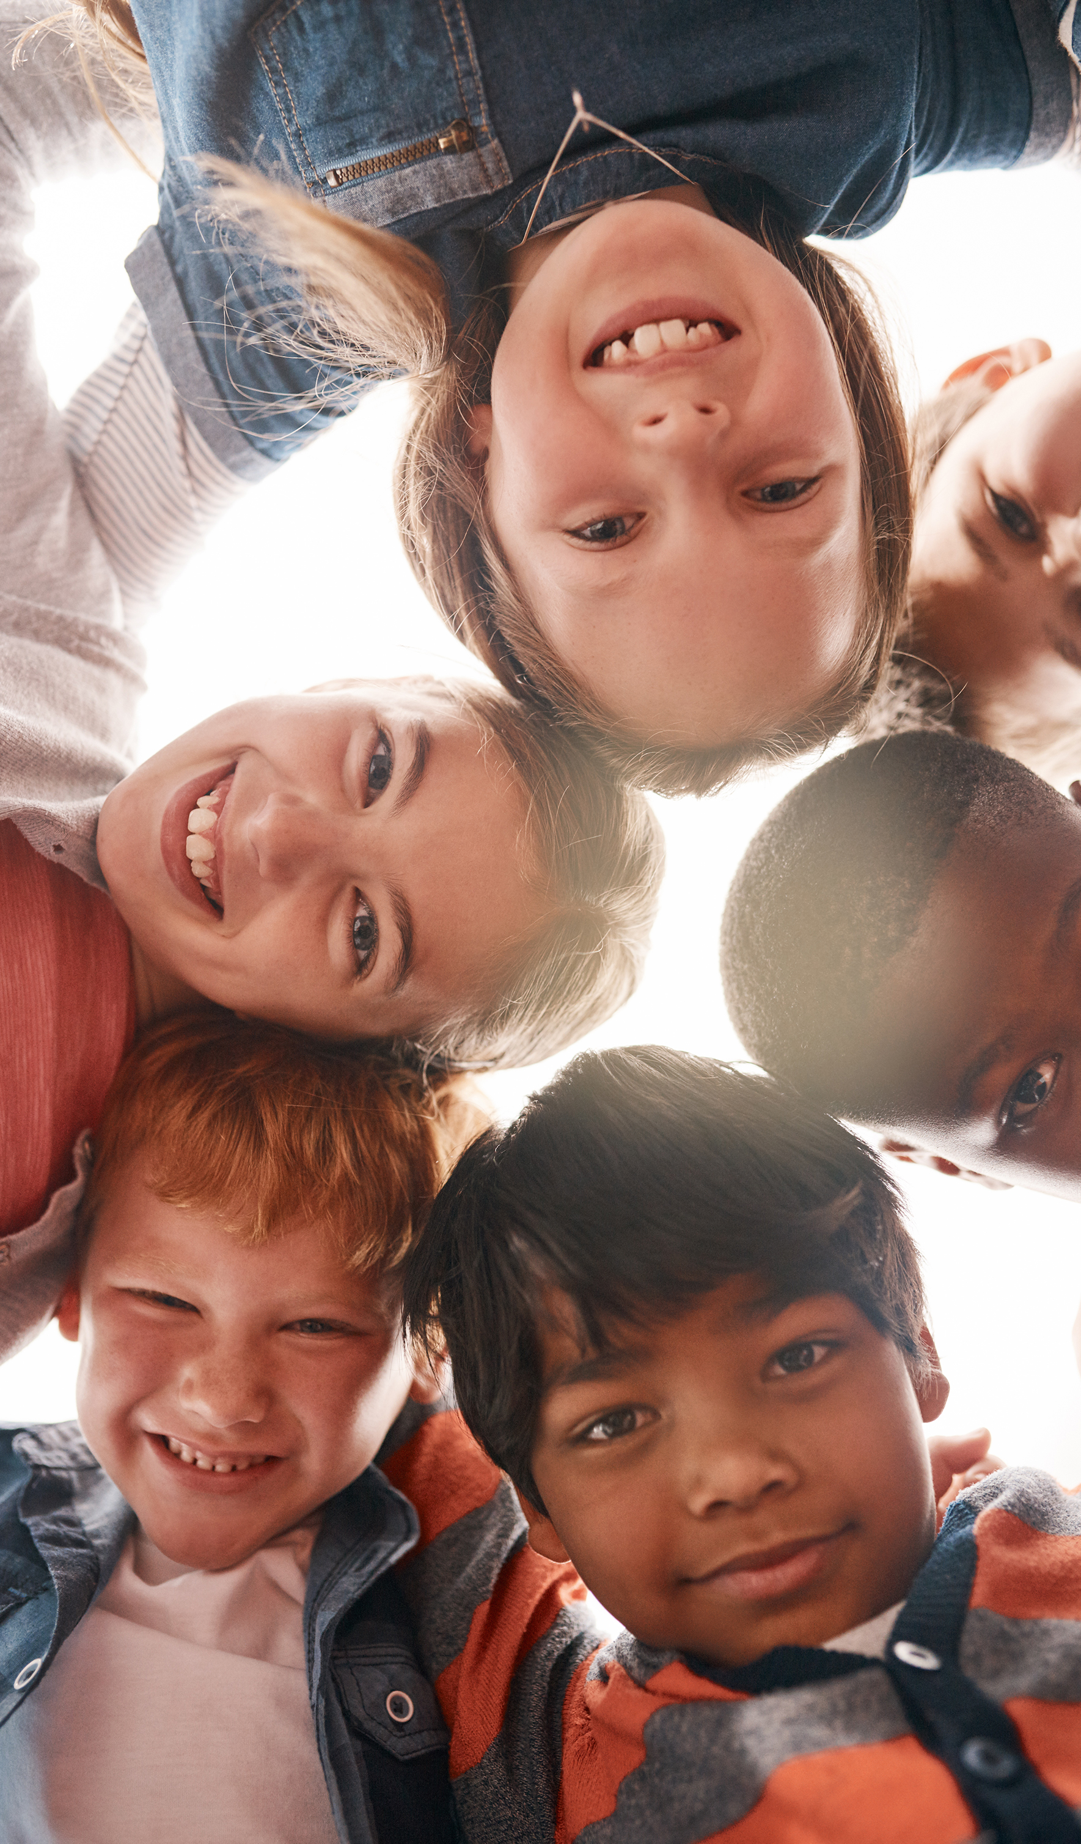
Sometimes it can feel like we don’t have much power – as if only adults or leaders are the ones who can create change. But that’s not true. Every small act of justice, kindness, or fairness matters.

Slide 23
We often talk about creating safe spaces – places where everyone feels protected and included. But to truly grow, we also need brave spaces – where we feel encouraged to speak honestly, listen deeply, and take risks for the sake of understanding and justice.

Slide 24
Moving from safe to brave means stepping into conversations and actions that might feel uncomfortable but that are necessary for real change. It means using our voices, even when it’s hard, and standing up for what’s right – not just for ourselves, but for others too.
No act is too small when it comes from a place of courage and care.

Slide 25
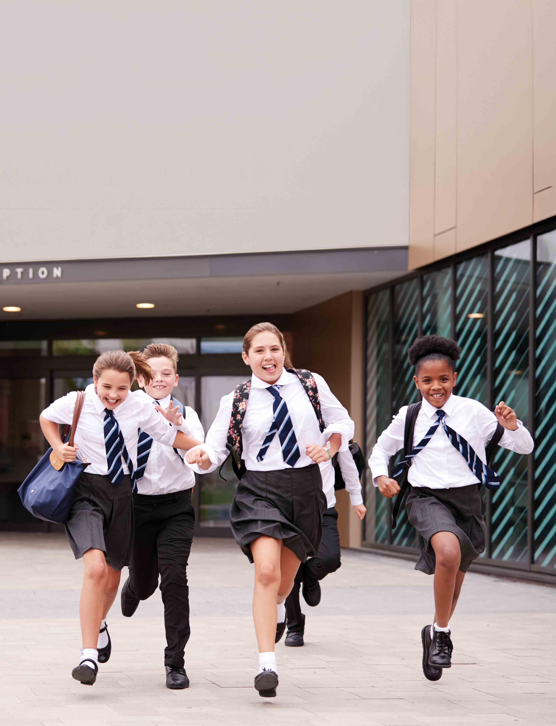
What kind of person do I want to be in secondary school?
What’s one way I could stand up for someone or do something fair?
How does walking humbly help us to listen and grow?

Slide 26
Dear God,
Thank You for showing us what is good – to act justly, love mercy, and walk humbly with You.
Help us to notice when things aren’t fair, and to have the courage to make a difference.
Show us how to be kind and to help others feel safe and included.

Slide 27
As we move into this new chapter of school, may we be people who help our community flourish.
Amen.

