Slide 3




Three habits
Community
Embrace
Power
Listen to others’ stories and see the world through their eyes.
Encounter others with authenticity and confidence.
Find hope and opportunity in the places where we long to see changes.

Slide 4
I wonder…
How can we lift up our voices?

Slide 5
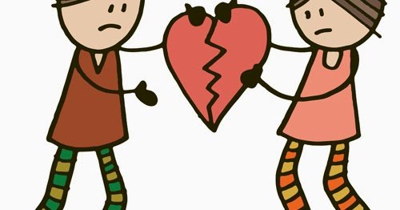
Have you ever
forgiven someone?
Is it easier to forgive or to ask for forgiveness?
What happens when we hurt others unintentionally? How can we ask for forgiveness?

Slide 6
How can we start to rebuild after something has been broken?

Slide 7
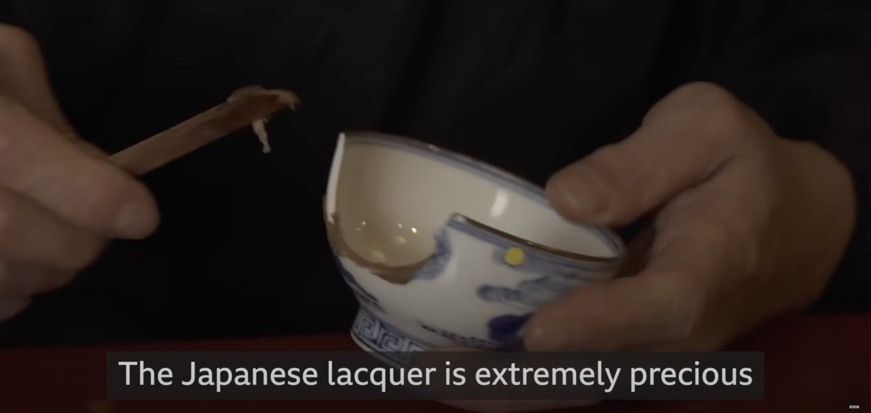

The Japanese art of fixing broken pottery

Slide 8
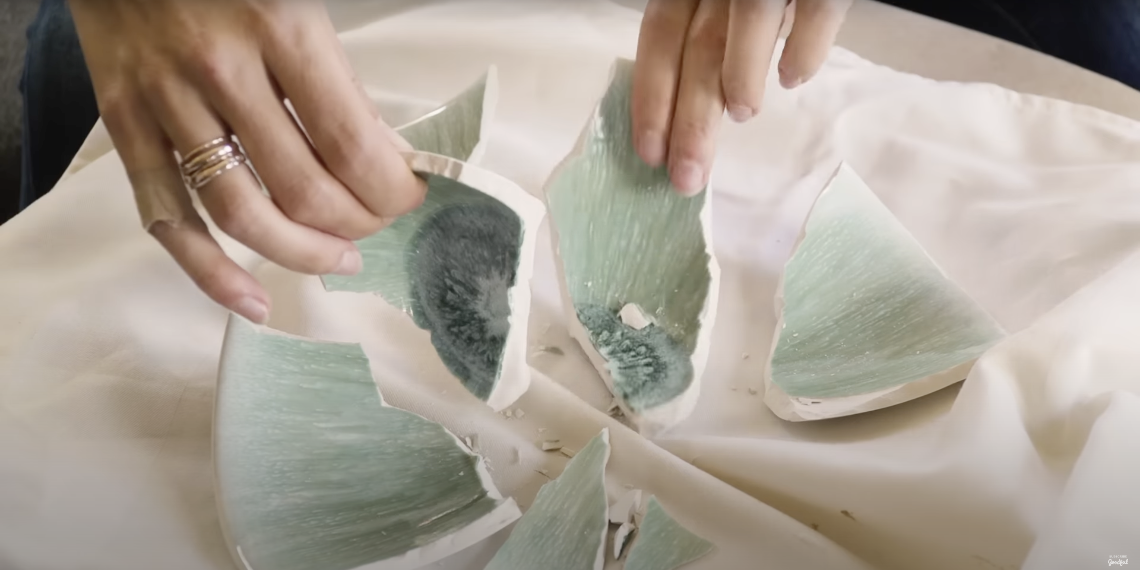
The Art of Kintsugi

Slide 9
Reflection
How might Kintsugi relate to our relationships?
Can we show kindness to ourselves and others, even when we’ve been hurt or made mistakes?
How can we celebrate who we are, even with our flaws?

Slide 10
Kintsugi-Inspired Artwork

Slide 11
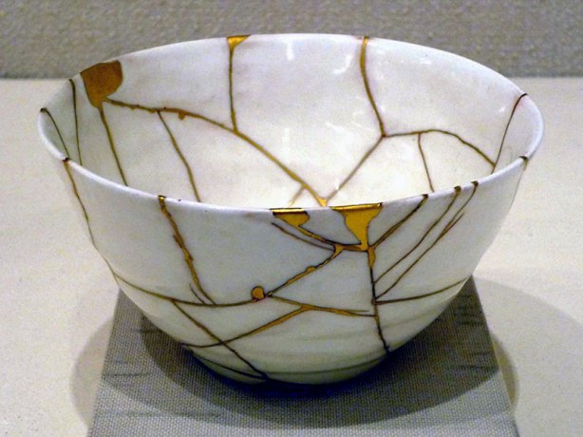
This creative activity is based on the Japanese art of Kintsugi. It symbolises the beauty of restoration and the strength found in healing. In this session, pupils are invited to create their own kintsugi-inspired artwork to explore ideas of forgiveness, acceptance, and restored relationships.

Slide 12
How might our past experiences shape our ability to forgive or reconnect with others?
How can art help us express feelings or experiences that are hard to put into words?
Why is it important to show care and attention to things or people that have been hurt?

Slide 13
What could be the “gold” in a relationship – the things that help rebuild trust or connection?
What does your artwork say about a part of yourself or a relationship that matters to you?
There may be times when the relationship is not restored or forgiven, are there still ways to find release from the hurt.

Slide 14
Ephesians 4:32 (NIV)
“Be kind and compassionate to one another, forgiving each other, just as in Christ God forgave you.”

Slide 15
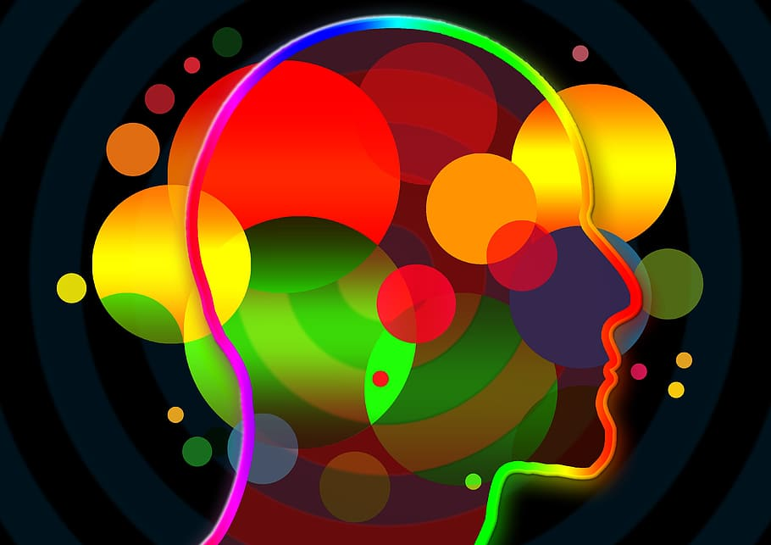
If we’ve been hurt deeply, it can be harder to trust again. Forgiveness does not mean that the wrongdoing doesn’t matter, the process of forgiveness recognises the wrong and hurt of what has happened, and forgiveness can take time– and that’s okay. Sometimes, our own healing can begin when we choose kindness and compassion for ourselves and others.

Slide 16
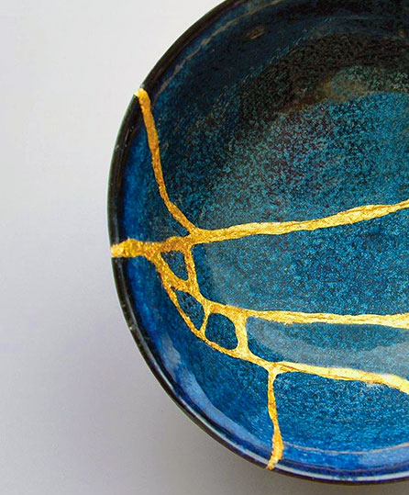
What might this passage teach us about forgiveness?
How can we use art to repair and re-establish relationships?
What could we use to bring a relationship back together?

Slide 17
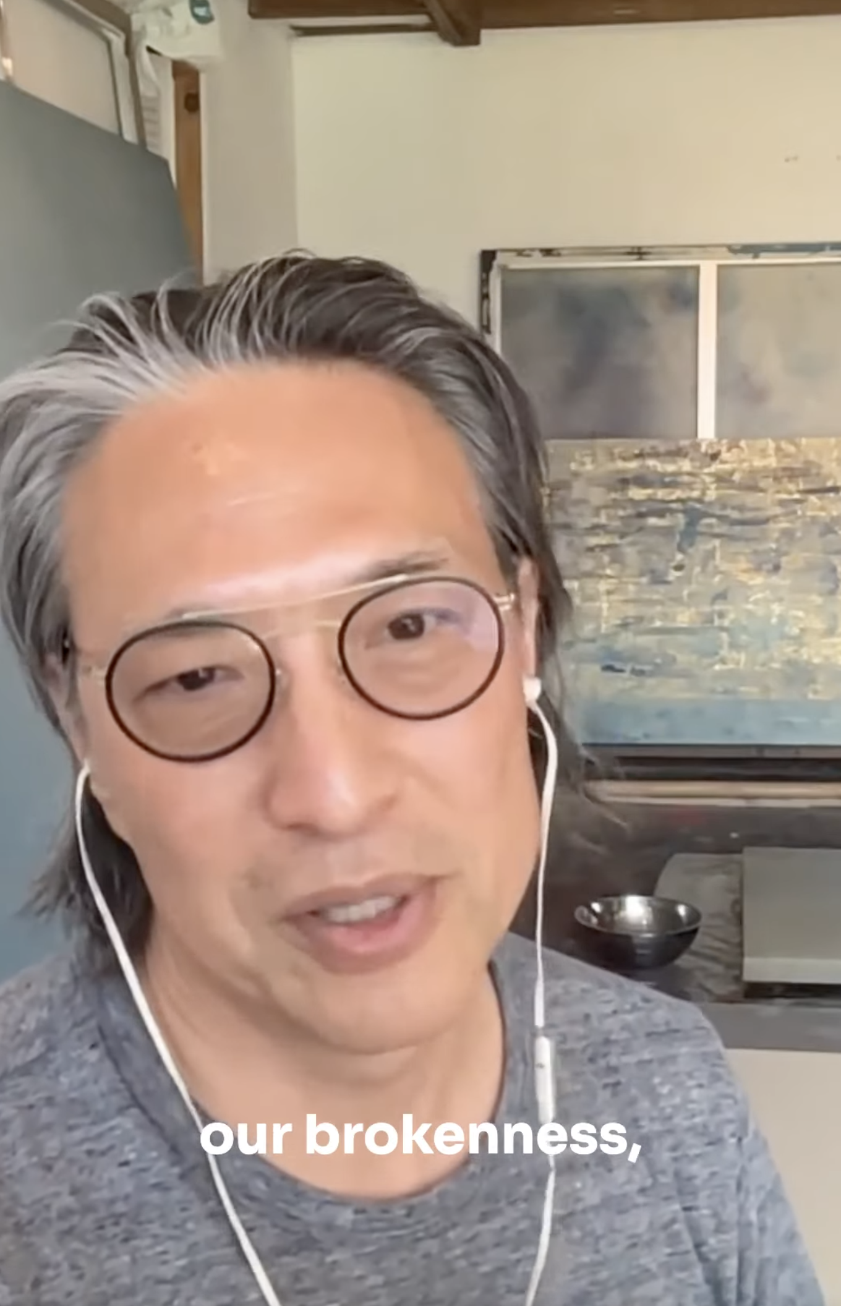
Makoto Fujimura film

Slide 18
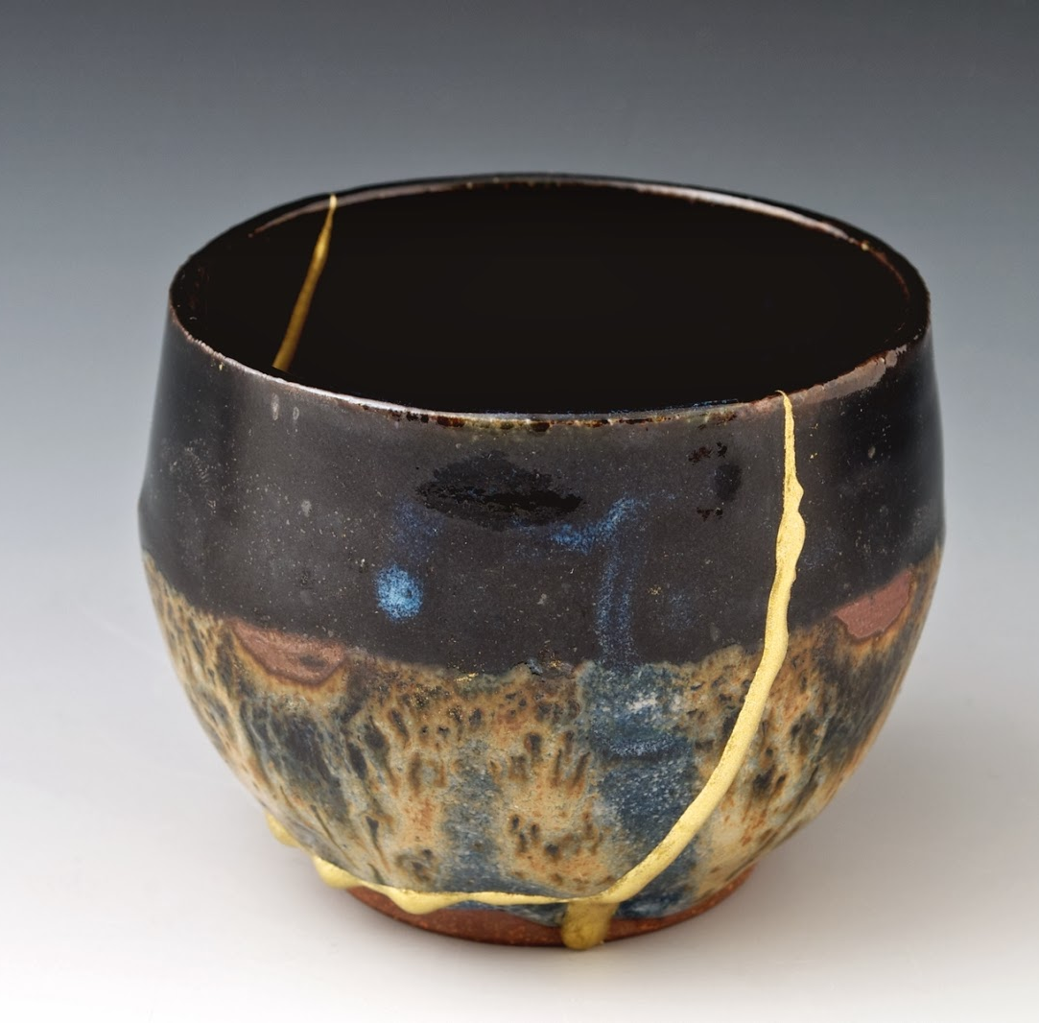
Have you ever found it hard to forgive because of something from the past?
What helps someone begin to forgive?
The Photo by Photo Author is licensed under CCYYSA.

Slide 19
How does it feel to be forgiven?
What might your "gold" be in a repaired relationship?
The Photo by Photo Author is licensed under CCYYSA.

Slide 20
Forgiveness is not always easy. It can be complicated, especially when we’ve been hurt or when trust has been broken. But forgiveness is powerful, it allows healing to begin, for others and for ourselves.

Slide 21
Like a piece of pottery that has been broken and then carefully repaired with gold in the Japanese art of Kintsugi, our relationships can become even more meaningful after pain, if we are willing to work through the hurt.
Kintsugi doesn’t try to hide the cracks. Instead, it highlights them, showing that what was once broken can become even more beautiful because of its history.

Slide 22
When we forgive, we aren’t saying that what happened was okay, but we are choosing not to carry the weight of anger or bitterness anymore. We are choosing to make space for peace, for growth, and for hope.
Forgiveness also means accepting that none of us are perfect. We all make mistakes. And just as we want others to forgive us when we fall short, we are called to offer that same grace to others.

Slide 23
Dear God,
Thank you for the gift of forgiveness – for second chances, and for the healing that follows.
Help us to let go of anger and hurt, and to be brave enough to forgive, even when it’s hard.
Teach us to see the beauty in broken things– just like the art of Kintsugi, where cracks are not hidden, but made golden. Help us to mend what’s been hurt, to restore what’s been lost, and to grow stronger through the process.

Slide 24
May we forgive others as you forgive us, and may we become people who bring peace in our words, our actions, and our hearts.
Amen.

