Slide 3




Three habits
Community
Embrace
Power
Listen to others’ stories and see the world through their eyes.
Encounter others with authenticity and confidence.
Find hope and opportunity in the places where we long to see changes.

Slide 4
I wonder…
How can we lift up our voices?

Slide 5
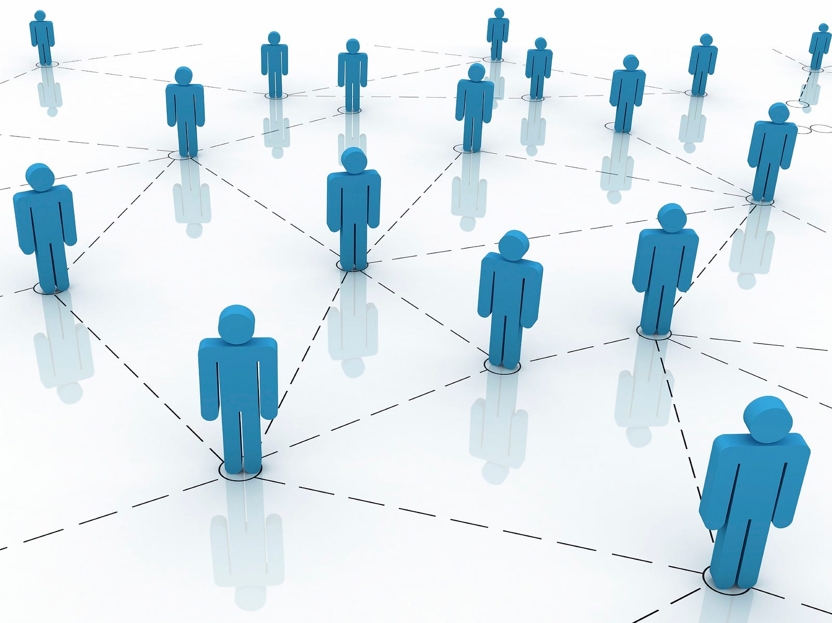
Web of Connection
Ask your group to sit in a circle. Using a ball of string or wool, one pupil begins by holding the string, sharing something about themselves (a hobby, something they like, or a strength).
They then pass the string to someone else across the circle, saying what they value or appreciate about that person or what they might have in common. The process continues until everyone is connected in a web.
The Photo by Photo Author is licensed under CCYYSA.

Slide 6
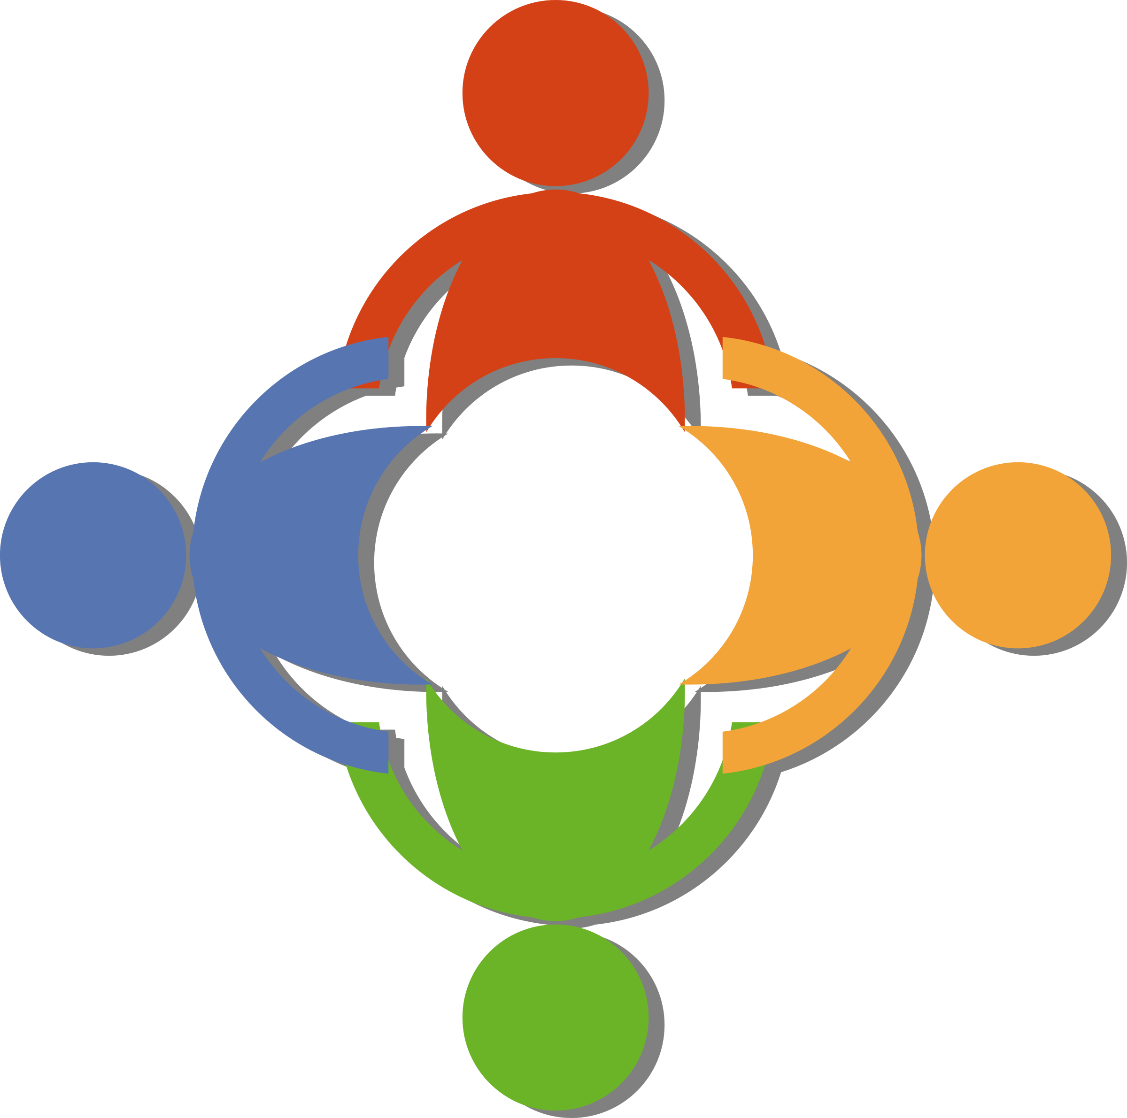
How did it feel to be connected by the web?
What did we learn about each other?
What does this show us about being part of a community?

Slide 7
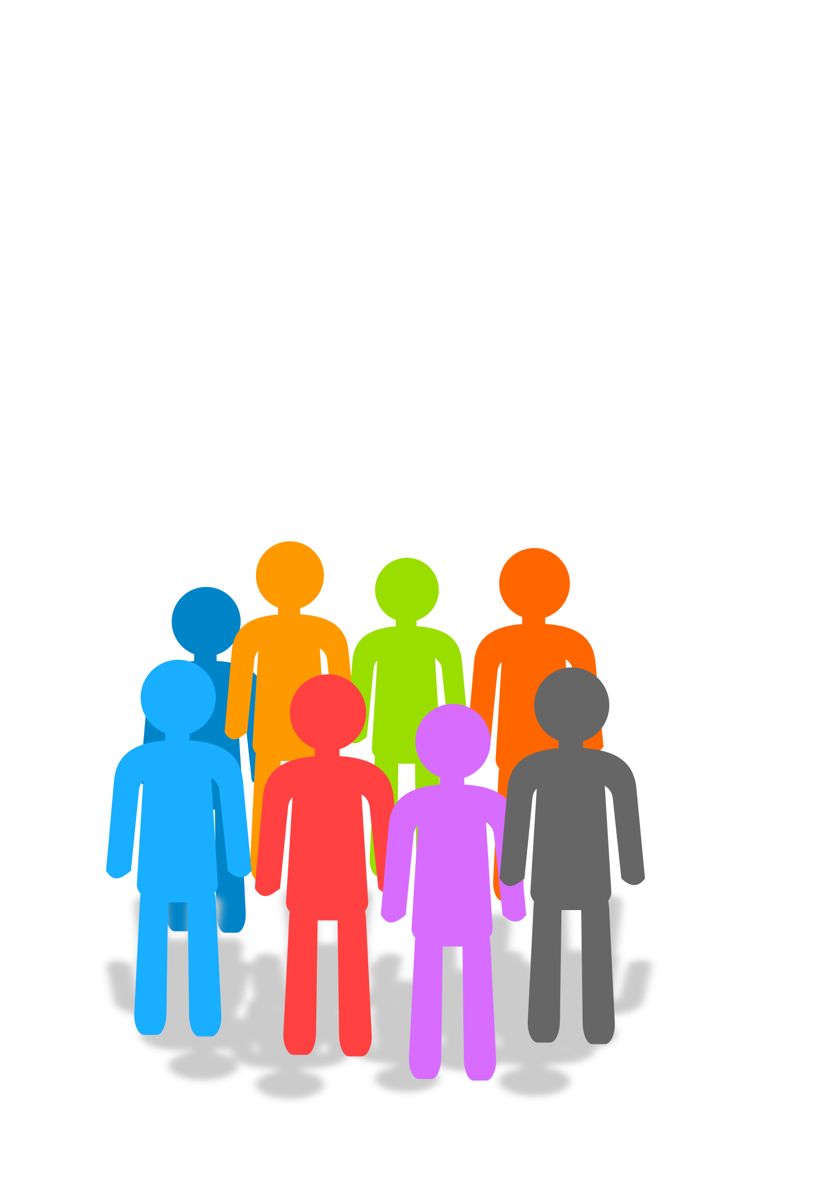
Umunthu…
“I belong, therefore I am.”

Slide 8
Celebrating Our Differences

Slide 9
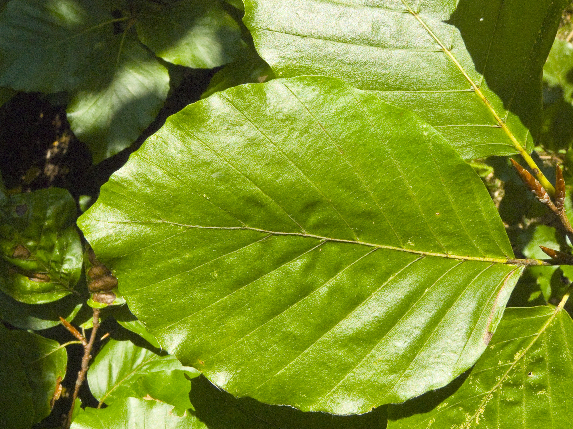
Celebrating Our Differences
Give each pupil a piece of leaf-shaped paper to decorate with symbols, colours, or words that represent who they are. These might include words like kind, curious, brave, creative, thoughtful, or joyful—qualities they see in themselves or value in others.
Collect all the leaves and attach them to a large paper tree displayed on a wall or board, creating a “Belonging Tree.”
The Photo by Photo Author is licensed under CCYYSA.

Slide 10

What do you notice when you see all the leaves on the tree?
Why is it important that every leaf looks different?
How does the tree show us the strength of our community when we come together?

Slide 11
We All Belong
Create a poster, short video, or digital presentation titled “We All Belong.” This should reflect your personal commitment to including everyone, and appreciation and respect in the school community.
Choose one meaningful action you will take to help someone feel included, valued, or supported.

Slide 12
What does it mean to belong?
How can we recognise when someone feels left out?
How does it feel when someone goes out of their way to include us?
What small actions can make a big difference?

Slide 13
Romans 12:5 (NIV)
“So in Christ we, though many, form one body, and each member belongs to all the others.”

Slide 14
This verse reminds us that even though we’re all different, we all belong to each other. Each of us has our own gifts, strengths, and personality—things that make us special and unique. And when we come together, we’re part of something bigger.

Slide 15
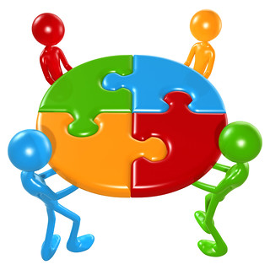
Think of it like a jigsaw puzzle: every piece is a different shape and colour, but each one matters. Even if some pieces look different or fit in unusual ways, they all help complete the picture. In the same way, we all belong and bring something important, just as we are.
The Photo by Photo Author
is licensed under CCYYSA.

Slide 16
Umunthu is a powerful word from the Chichewa language, spoken in parts of southern Africa, including Malawi. It means: "I belong, therefore I am."
That’s a big idea because it tells us that we become who we are through our connections with others. We’re not meant to journey through life alone. We’re shaped by how we treat people, and how they treat us. Umunthu reminds us that we are all deeply connected.

Slide 17
Some people think power means being in charge, being the loudest, or always being right. But Umunthu teaches us a different kind of strength. Real power comes from kindness, from lifting others up, and from choosing to treat people with respect, especially when it’s hard to do.
Every one of us has something special to bring. Each of us can help shape the kind of school we want to be part of, a place where everyone belongs, where differences are celebrated, and where no one is left out or left behind.

Slide 18
Just like a puzzle made up of different pieces, our community needs every one of us. When we choose to listen, to include others, and to show care, we help build a stronger, kinder school.
So today, think about this:
How can you use your words, actions, and choices to help someone else feel they belong?
That’s what Umunthu is all about, and it’s something we can all live out, together.

Slide 19
Dear God,
Thank you for making each one of us special. Thank you that we all belong – just like parts of one body.
Help us to see the value in others, to include, listen, and show kindness. May we work together to build a community of love, where everyone feels seen, heard, and important.
Amen

