Slide 3




Three habits
Community
Embrace
Power
Listen to others’ stories and see the world through their eyes.
Encounter others with authenticity and confidence.
Find hope and opportunity in the places where we long to see changes.

Slide 4
I wonder…
How can we intentionally flourish together?

Slide 5

Difference habits UKS2
Coming soon…

Slide 6


This is the Day (Difference Song)

Slide 7
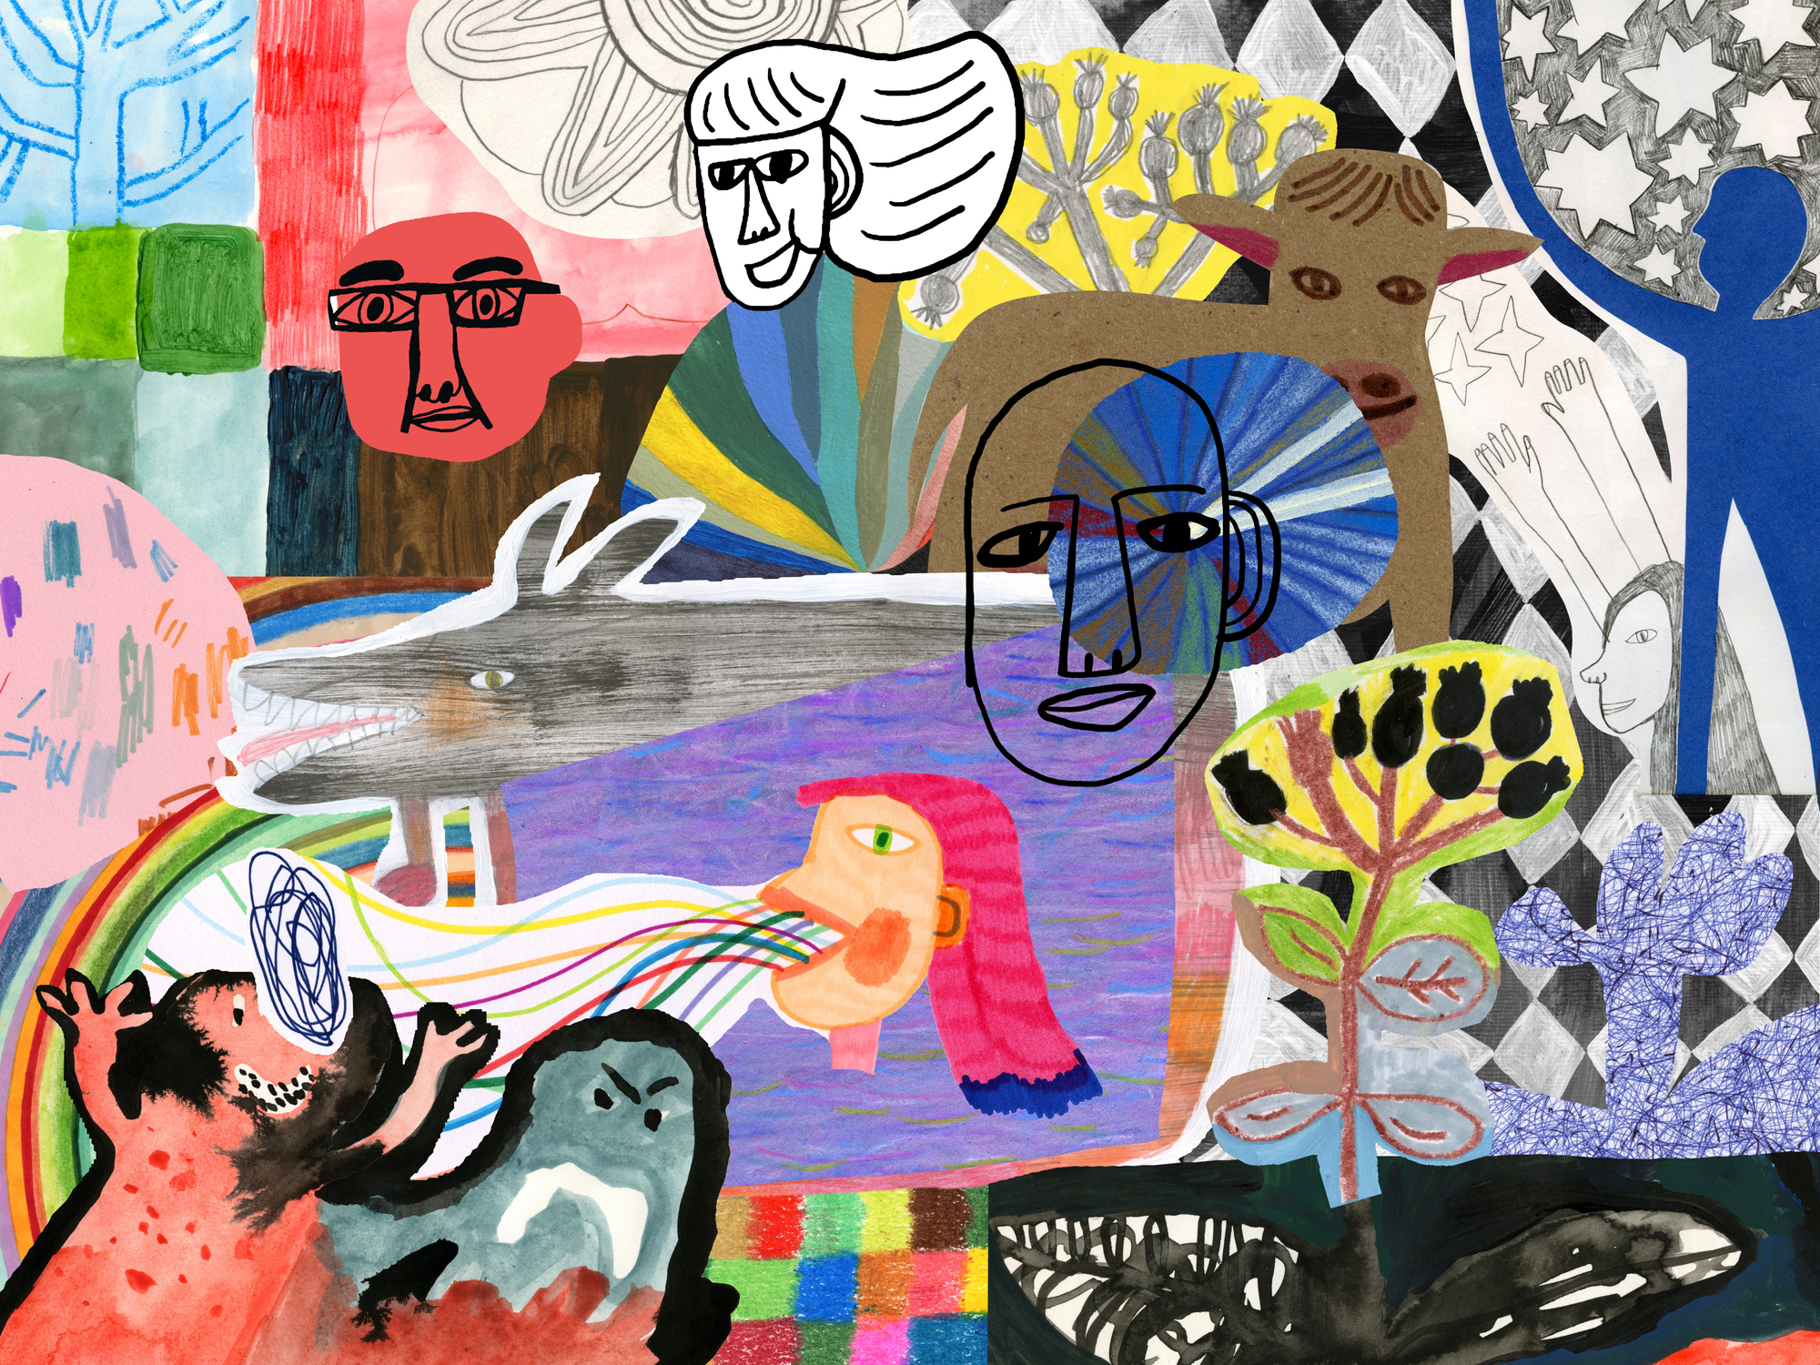
Nobody Stands Nowhere

Slide 8
Discussion

Slide 9
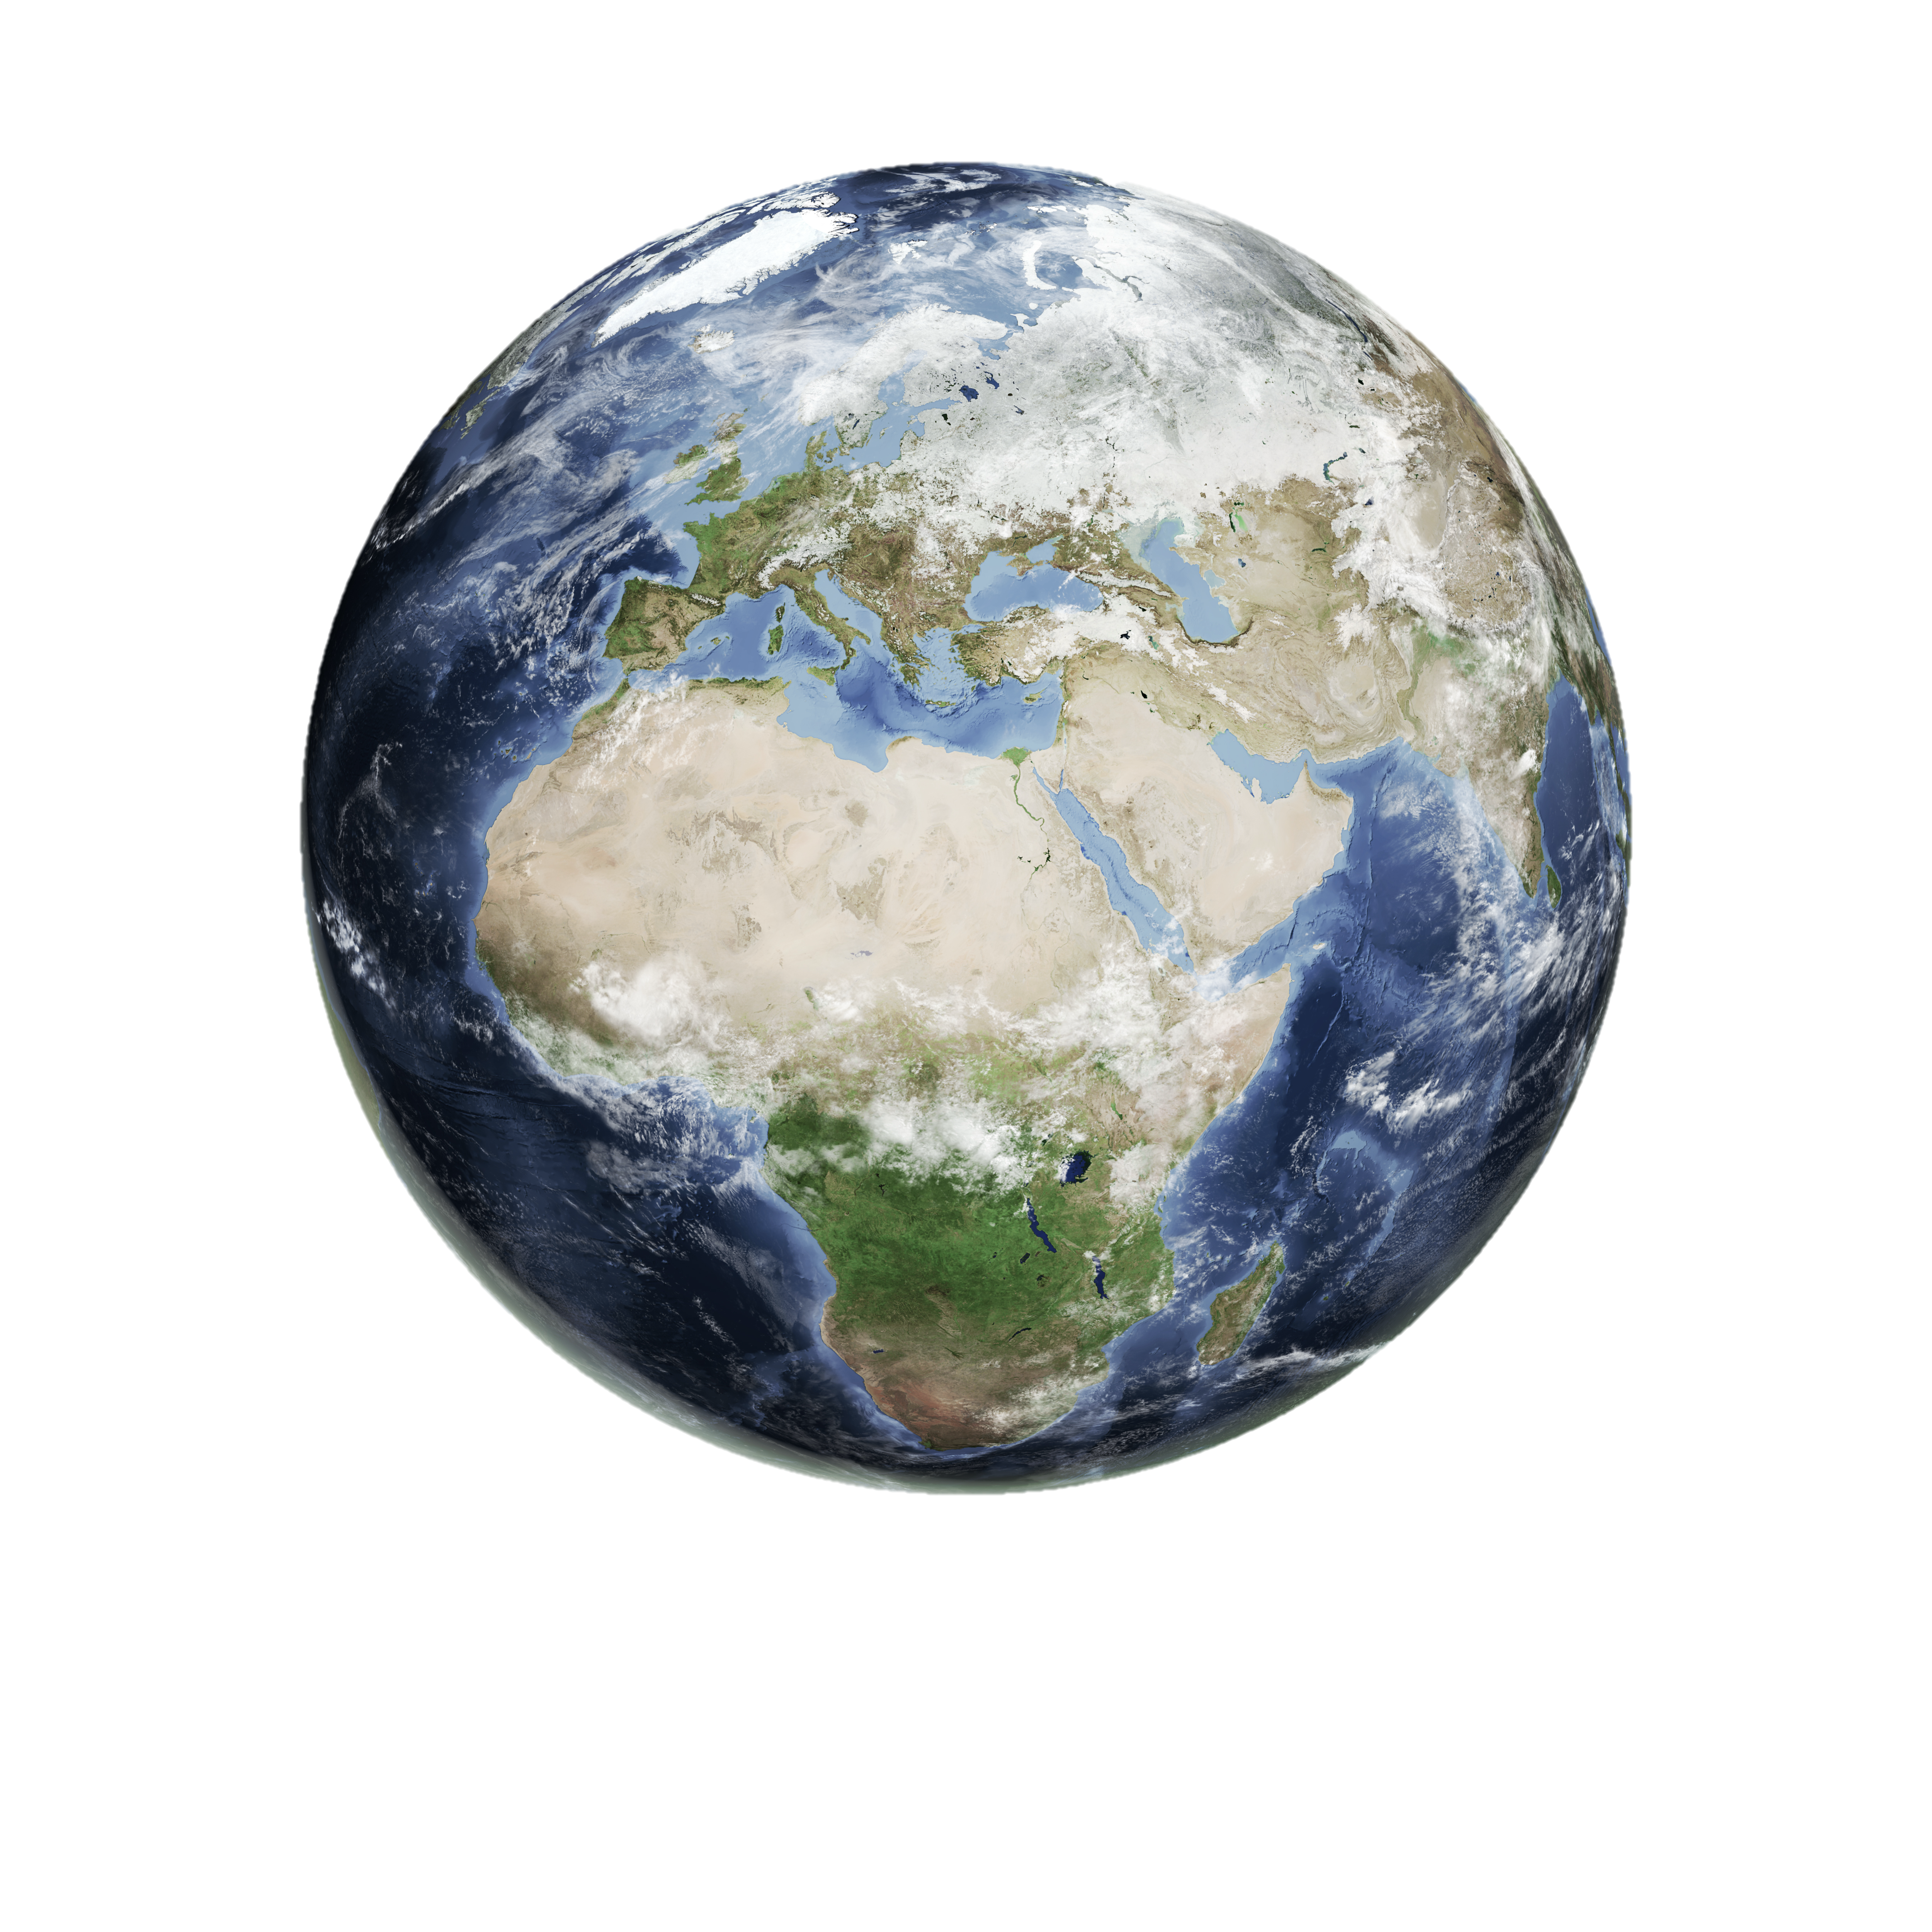
What is your view of the world?
How do you see things?
What makes you who you are?
On what do you base your decisions?

Slide 10
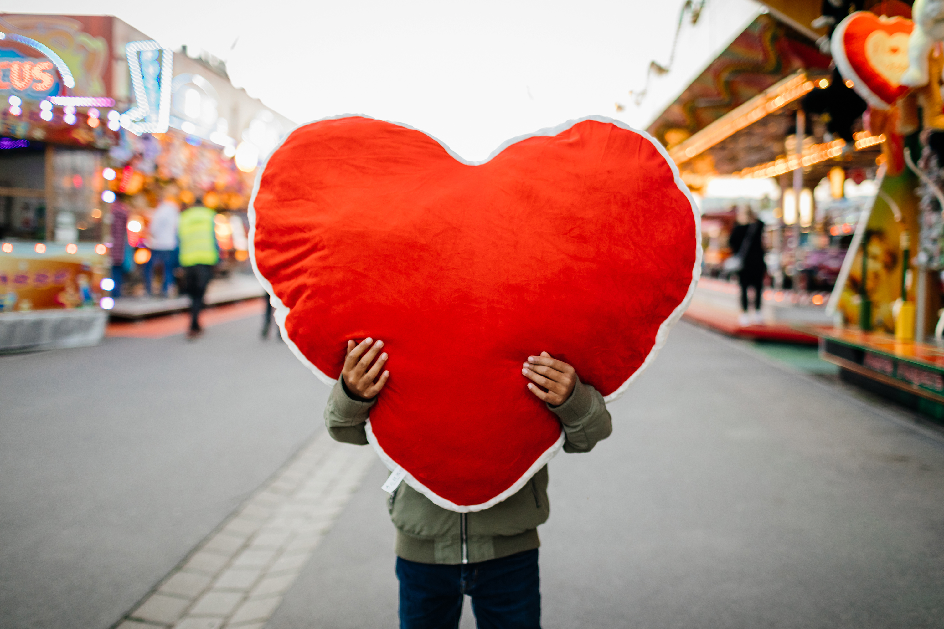
What makes you feel seen?
What makes you feel cherished?
What does it mean to be in a community with others?

Slide 11
Proverbs 23:7
"For as he thinks in his heart, so is he."

Slide 12
Hey, Hey, Hey!

Slide 13
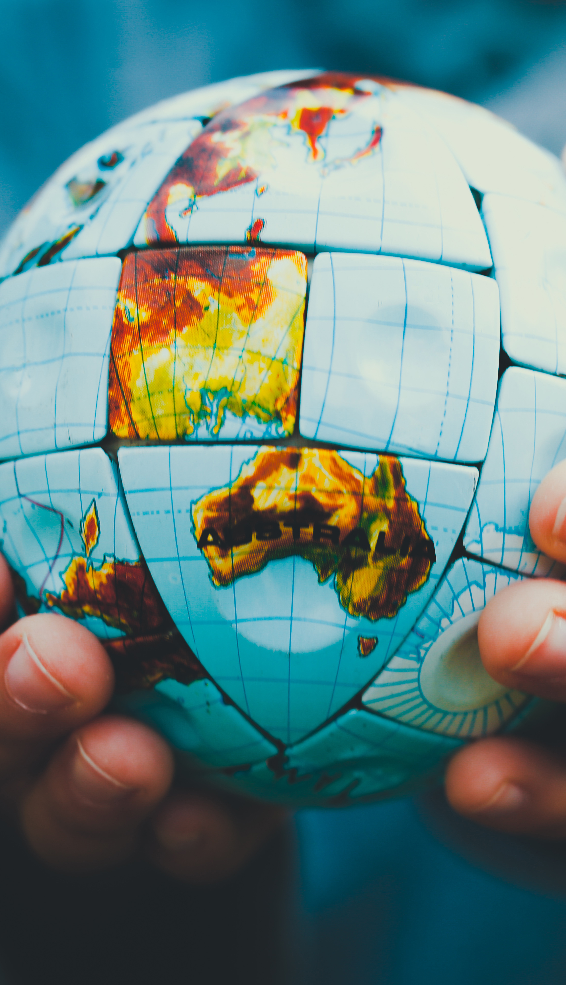
Imagine our world as a big, beautiful puzzle. Each of us is like a unique puzzle piece, with our own colours, shapes, and patterns. No two pieces are exactly the same, which makes the puzzle so amazing when it's all put together.

Slide 14
Some of us might love the bright blue sky and think it's the best part of the picture, while others might see the tall green trees and find them the most interesting. Our different views and experiences make the world richer and more exciting.

Slide 15
When we take time to listen and learn from each other, we can see the whole picture more clearly and appreciate the beauty of every piece.
So, let's celebrate our differences and remember that every perspective is important in creating the wonderful world we live in.

Slide 16
Dear God,
Thank You for making each of us unique and special. Help us to see the beauty in our differences and to appreciate the gifts that everyone brings.
Teach us to love and support each other, knowing that we are all important in Your eyes. May we work together in kindness and harmony, sharing Your love with everyone we meet.
Amen.

