Slide 3




Three habits
Community
Embrace
Power
Listen to others’ stories and see the world through their eyes.
Encounter others with authenticity and confidence.
Find hope and opportunity in the places where we long to see changes.

Slide 4
I wonder… How can we intentionally flourish together?

Slide 5


Hey, Hey, Hey!

Slide 6

What might a varmint be?
What might it
look like?

Slide 7
Definition
Var+mint… (‘va:mint) n. informal. An irritating or obnoxious person or animal.
How does this add to your original thoughts?

Slide 8
Draw your own picture of a varmint

Slide 9
What do the pictures show?
How does this help you learn more about varmints?

Slide 10

Conduct a gallery walk

Slide 11


National Outbreak of Varmints Reported!
In an unexpected development, a national outbreak of varmints has been reported, with sightings increasing across various regions. ​

Slide 12


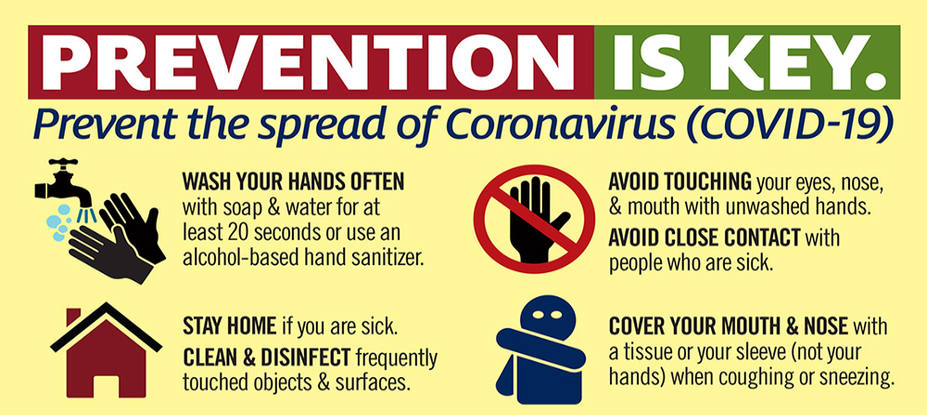
Public Awareness Campaigns

Slide 13

What could we do about the outbreak?
Public Awareness Campaigns

Slide 14
Create your own public awareness campaign

Slide 15

Clarity
Communication
impact

Slide 16
Philippians 2:4
"Let each of you look not only to his own interests but also to the interests of others."

Slide 17

It's important to stay curious about what's happening in our local community. When we take the time to learn about the events, people, and issues around us, we can better understand and appreciate our neighbours.

Slide 18
Being curious helps us see the challenges and opportunities that affect everyone. By asking questions and seeking to understand, we can find ways to contribute positively and make a difference in our community. Let's stay curious, engaged, and open to learning from those around us.

Slide 19
Dear God,
We thank You for the community we live in. Fill our hearts with curiosity and a desire to learn more about those around us.
Help us to see the needs and joys of our neighbours and to find ways to support and uplift one another.
Amen.

