Slide 3




Three habits
Community
Embrace
Power
Listen to others’ stories and see the world through their eyes.
Encounter others with authenticity and confidence.
Find hope and opportunity in the places where we long to see changes.

Slide 4
I wonder…
How can we intentionally flourish together?

Slide 5

What impact can the posters/placards have on managing the outbreak?
Review the gallery walk

Slide 6
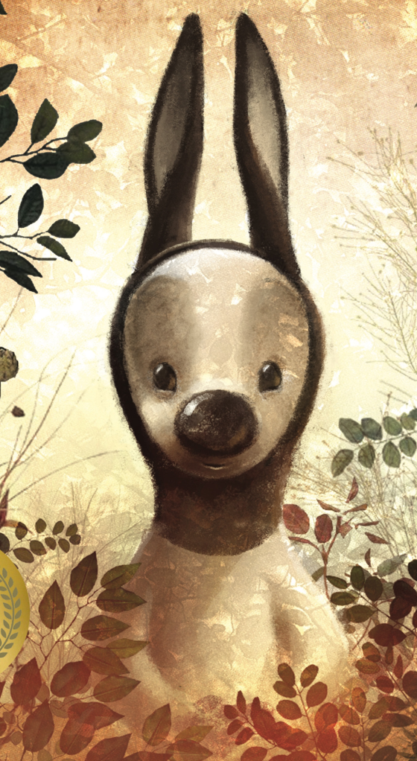
What do you see?
What do you think?
What do you know?

Slide 7
What do you want to know?
How does this creature compare with your drawings?

Slide 9


Slide 10
What did you notice?
What assumptions did you make?
How do you feel?

Slide 11
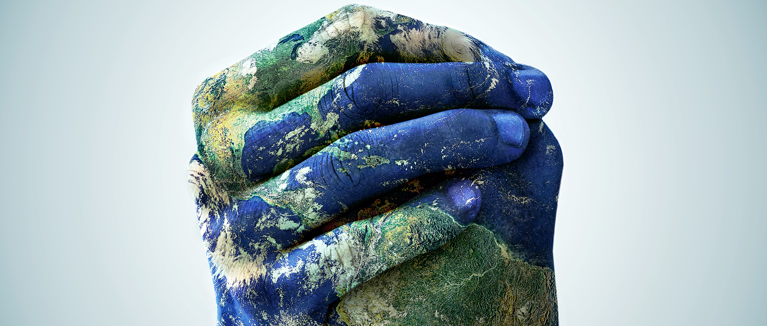

Thinking
beyond…
Does this remind you of any local, national, or global events, past or present?

Slide 12

Do you agree or disagree with what was said previously about varmints?
What can we do when we don’t agree with others?

Slide 13
What if they are older than us or have a position of power like a teacher?
How can you reframe or change your initial thoughts?

Slide 14
Luke 6:31
"Do to others as you would have them do to you."

Slide 15
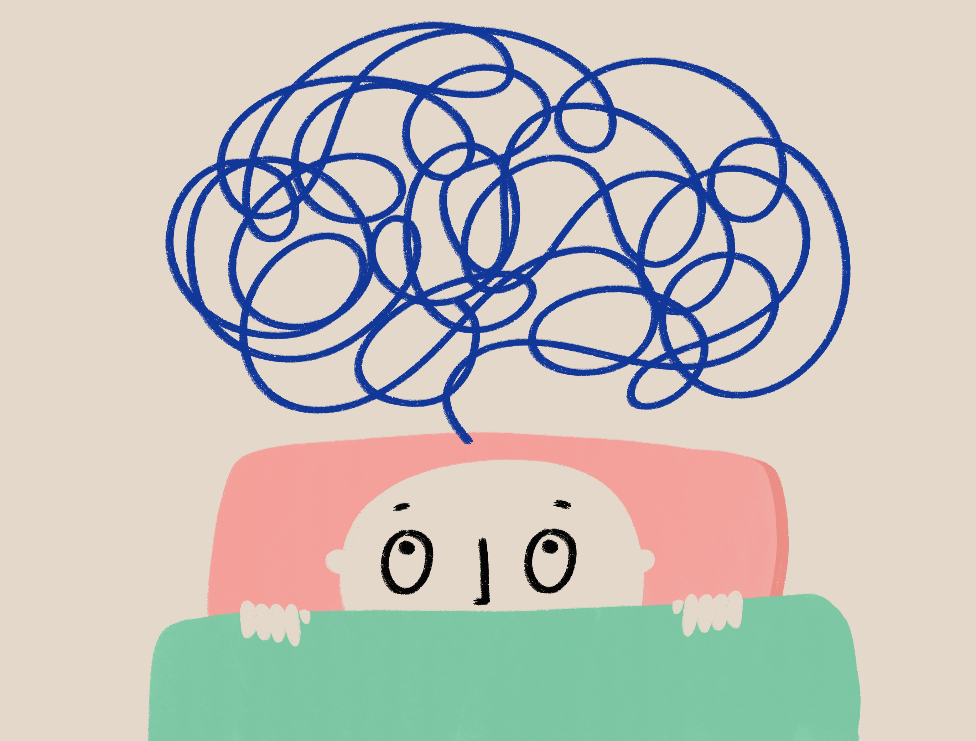
How can we be mindful of our assumptions?
How can we develop empathy for those who are different from us?

Slide 16
Listen carefully…
Let’s take a moment to unwind. Please fold your arms and rest them on the table, then lay your head down gently. Close your eyes and listen carefully to the sound clip. As you listen to the sound clip, focus on the different sounds and let them guide your thoughts.

Slide 17
Allow yourself to relax completely and just be present in this moment. When the sound clip finishes, we’ll come back together and talk about what you heard and how it made you feel.
Play the first 2 minutes and 50 seconds of VARMINTS

Slide 18

What did you hear?
How would you describe it?

Slide 19
What images come to mind?
How did it make you feel?

Slide 20

Soundscape artwork
Create artwork based on the mood presented by the soundscape.

Slide 21

Sometimes, we make assumptions about others without really knowing them. It's important to remember that everyone has their own story and experiences.

Slide 22
Just like we don’t want others to assume things about us, we should try to understand and be kind to those who are different from us.
By putting ourselves in someone else’s shoes, we can learn to be more caring and respectful.

Slide 23
Dear God,
Help us to see others through your eyes and not make assumptions.
Teach us to be kind and understanding to everyone, no matter how different they may seem.
Fill our hearts with empathy and love, so that we can treat others with respect, and make our world a better place.
Amen.

