Slide 3




Three habits
Community
Embrace
Power
Listen to others’ stories and see the world through their eyes.
Encounter others with authenticity and confidence.
Find hope and opportunity in the places where we long to see changes.

Slide 4
I wonder…
How can we intentionally flourish together?

Slide 5



Slide 6

Where are the moments of noise in our lives?
How do they relate to disagreements or conflict?

Slide 7
Why are moments of quiet or silence important in our lives?
What does this allow us to do?

Slide 8
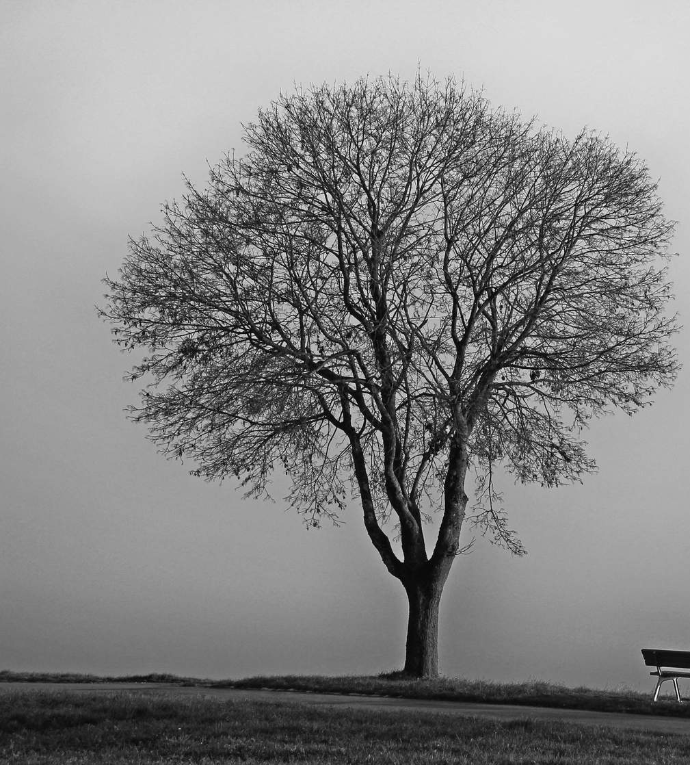
What happened to the creatures?
Does this remind you of anything from the past or present?

Slide 9

Dark and light elements
The authors use dark and light elements.
How does this affect the mood you feel as a reader or observer?

Slide 11
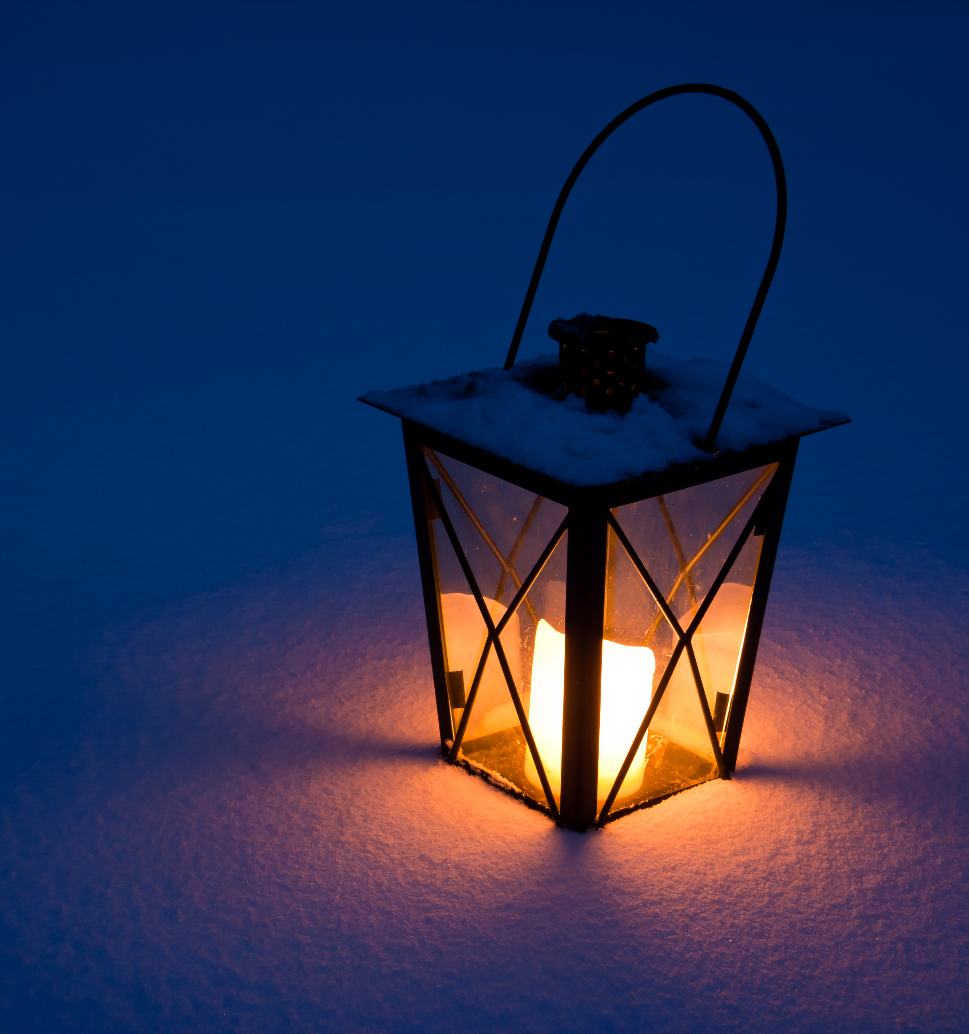
Why do you think people use the words ‘dark’ and ‘light’ to talk about hard times and hopeful times?
Have you ever had a time when you felt like you were in the ‘dark’ – maybe confused, sad, or worried?

Slide 12
What helped you feel better again?
What does ‘light’ mean to you when you’re going through something difficult?

Slide 13
Darkness leading to light
What challenges did the creature face?
How did they respond?

Slide 14
What do you think the ‘light’ was for the creature?
What helped keep them going?

Slide 15
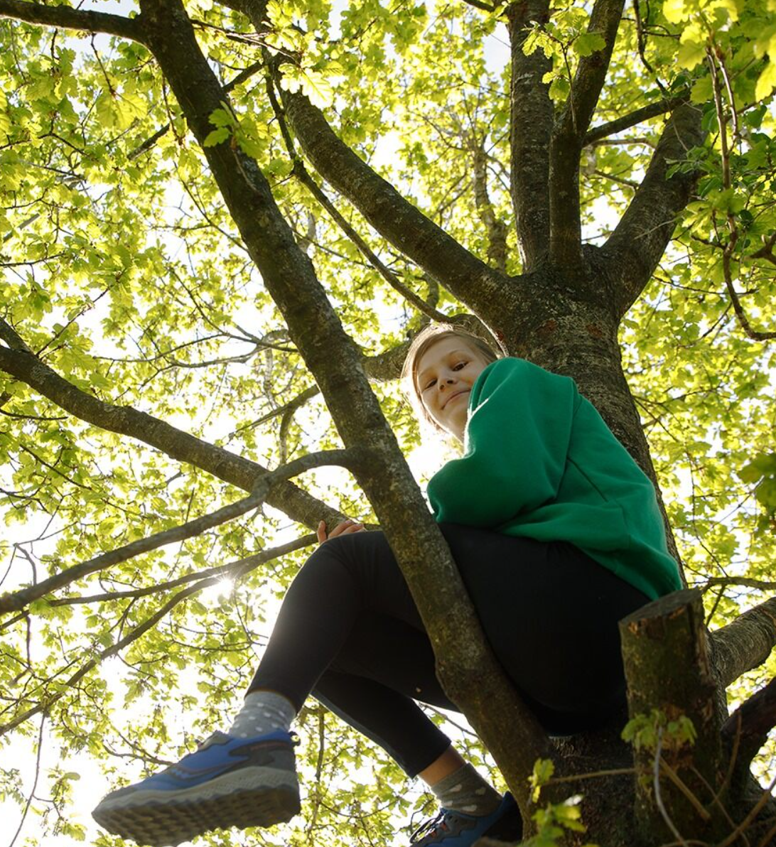
How can we be a ‘light’ for someone else when they’re going through a hard time?
What can we learn from hard times that can help us grow stronger or wiser?

Slide 16
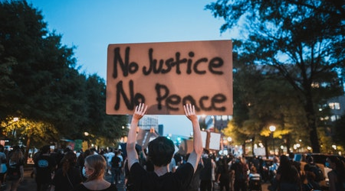
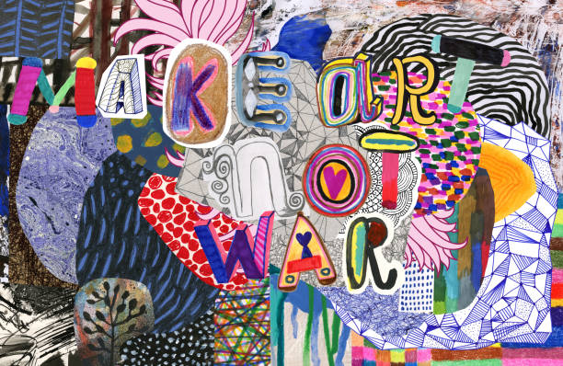
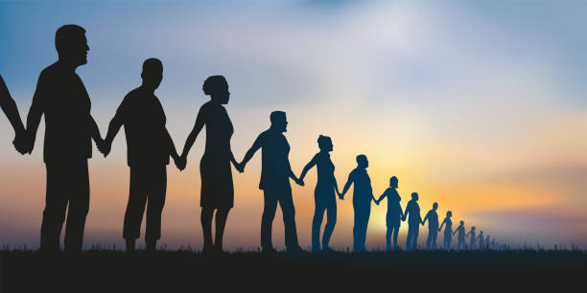
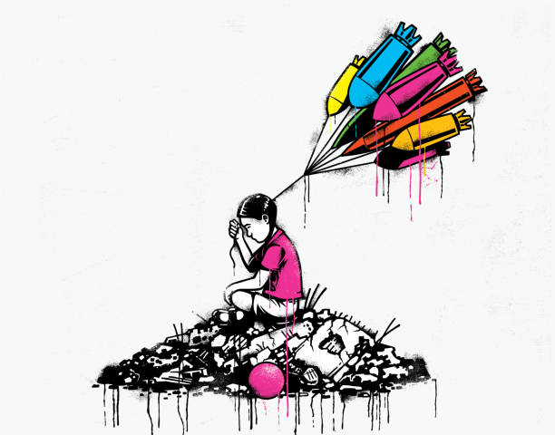
What do you see?
What do you think?
What do you know?
What do you want to know?

Slide 17
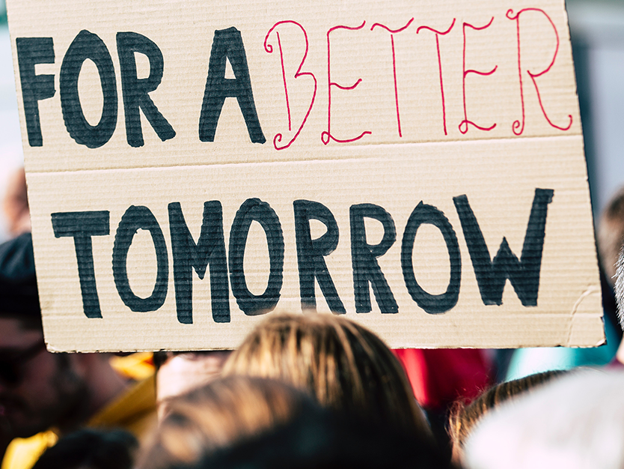
What are some ways people can express their opinions peacefully?
Why do people have peaceful protests?

Slide 18
How can peaceful protests help make changes in society?

Slide 19
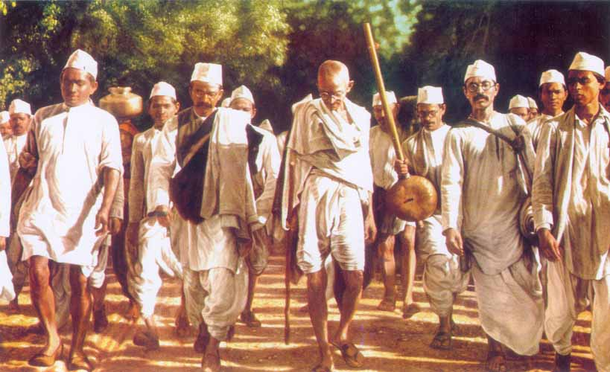
Gandhi’s Salt
March
Gandhi's Salt March was a peaceful protest in India in 1930. Mahatma Gandhi, a leader who believed in non-violence, wanted to show that the British laws were unfair. At that time, the British controlled India and made a law that Indians couldn't make their own salt—they had to buy it from the British and pay a tax.

Slide 20
Gandhi thought this was wrong because salt is something everyone needs. So, he and many followers walked 240 miles to the Arabian Sea, where they made their own salt from the seawater. This march of around 60,000 people showed the world that peaceful actions could help bring about change and fight injustice.

Slide 21
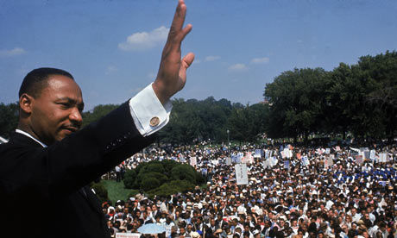
I Have a Dream
On 28th August 1963, more than 200,000 people gathered around the Lincoln Memorial in Washington, D.C. They were there to protest segregation and demand equal rights for all. Martin Luther King, Jr. made his famous "I have a dream" speech, and the peaceful protest, in large part, sparked a change in the nation, passionately reminding us that all people are created equal.

Slide 22
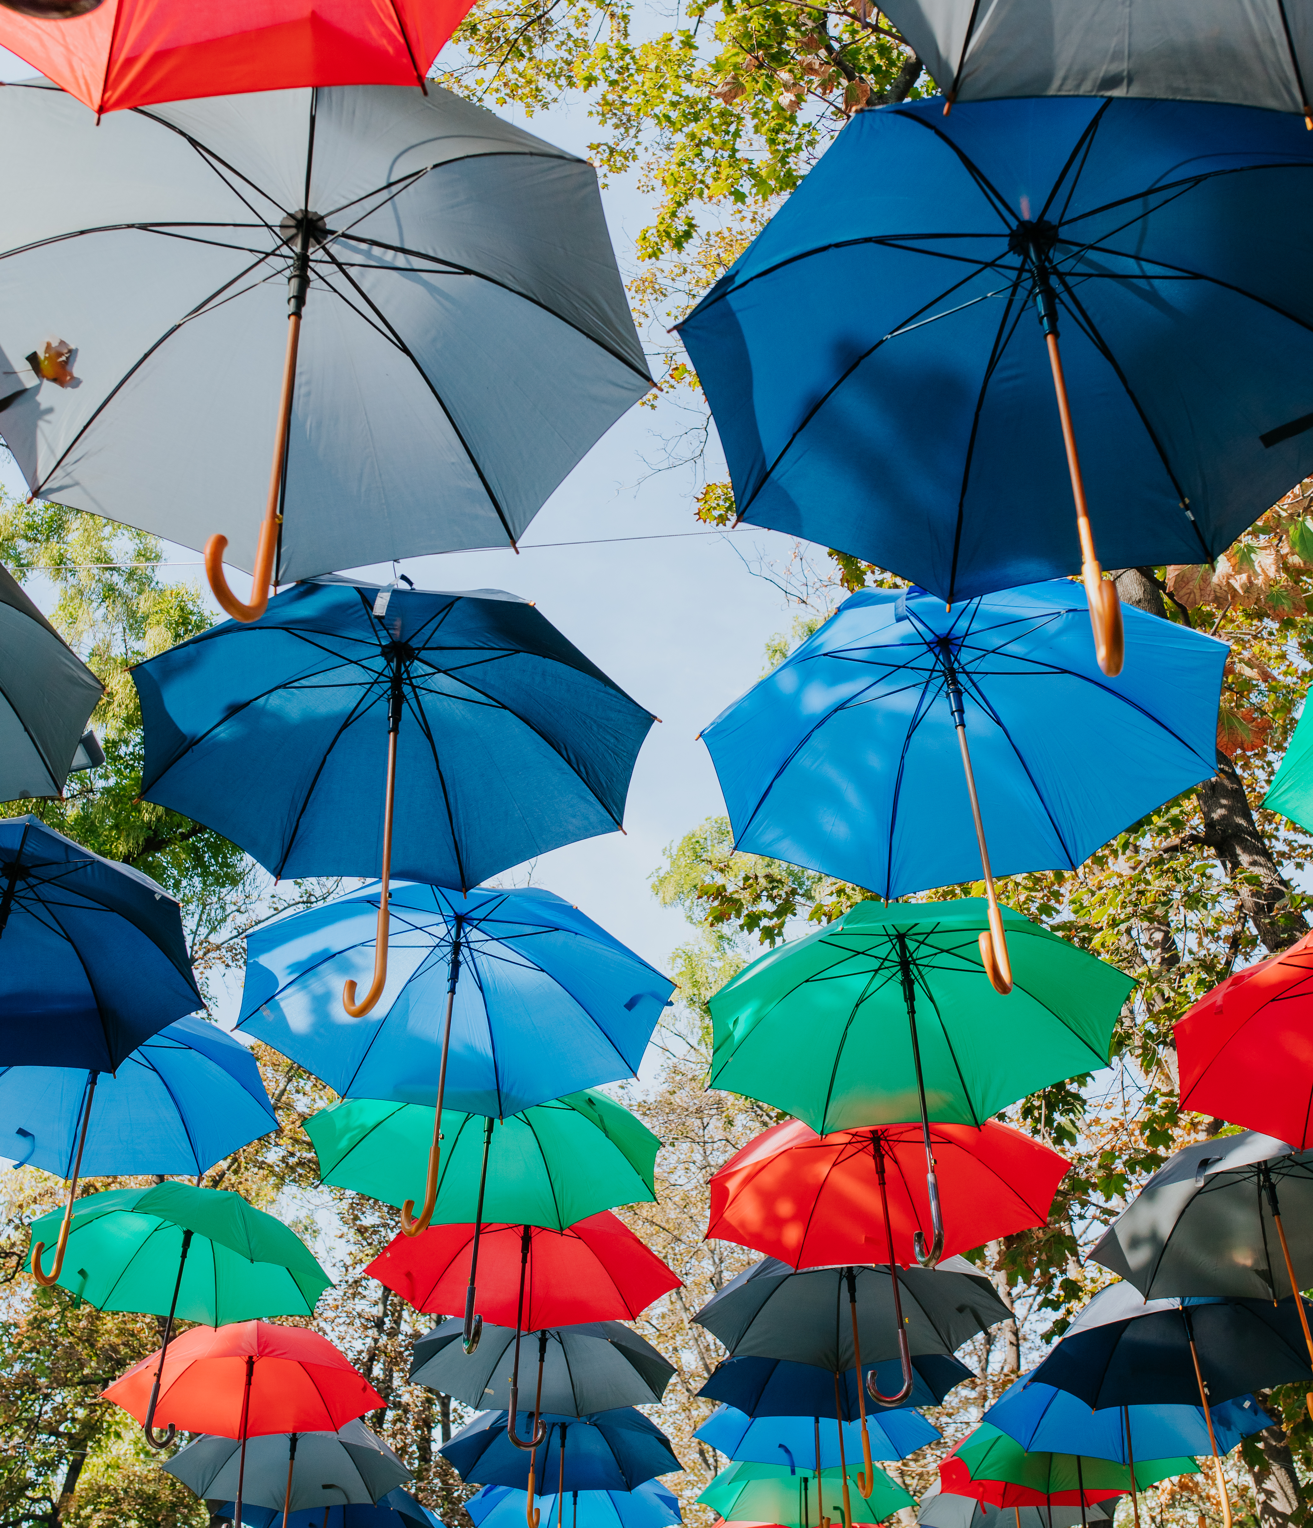
The Umbrella
Movement
The Umbrella Movement was a big protest in Hong Kong in 2014. Hundreds of thousands, especially students, wanted to have more freedom to choose their leaders. They were unhappy because they felt the government wasn't listening to them.

Slide 23
The name "Umbrella Movement" came from the umbrellas people used to protect themselves from tear gas and rain. For many weeks, they gathered peacefully in the streets, holding signs and speaking out for democracy. Although the movement didn’t immediately change the government’s decisions, it showed how important it is for people to stand up for what they believe in peacefully.

Slide 24
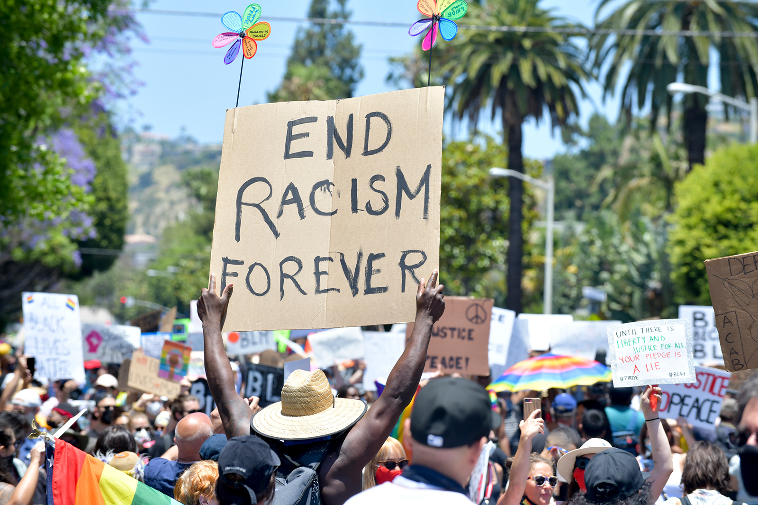
Black Lives Matter
Black Lives Matter is a movement that began in 2013 to make sure everyone is treated fairly and equally, no matter the colour of their skin. It began because millions of people around the world were deep troubled that Black individuals were being treated unfairly by the police and society.

Slide 25
The movement uses peaceful protests, signs, and social media to spread the message that everyone deserves respect and justice. By standing up for Black lives, people are working to make sure everyone has the same opportunities and is treated with kindness and fairness.

Slide 26
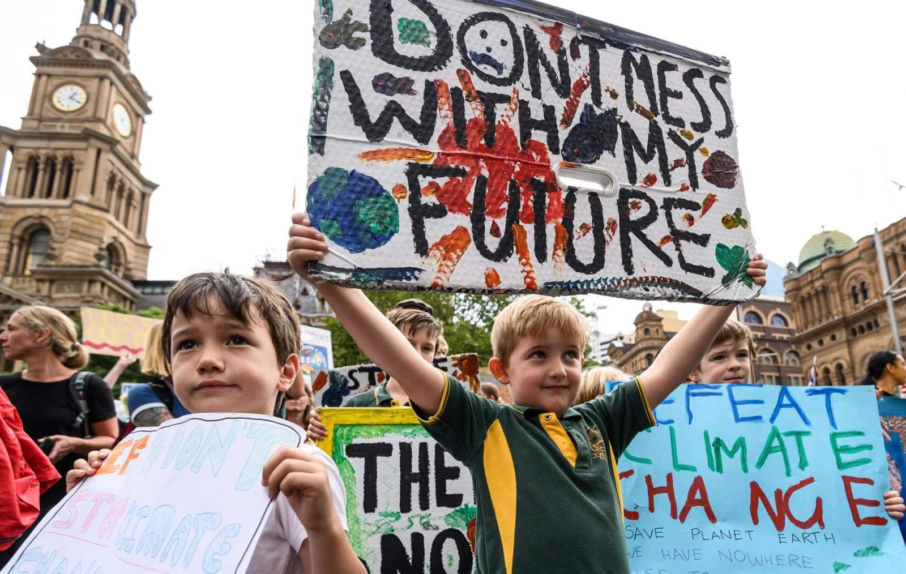
Climate Justice
Protests
Climate justice protests are when people come together to ask for help in protecting our planet from climate change. One big event was on 20th September 2019, when about 4 million people around the world took to the streets to show they care about the Earth. This was right before the UN Climate Action Summit, where leaders from many countries met to discuss ways to help our planet.

Slide 27
A young girl named Greta Thunberg started the Fridays for Future movement, which encouraged students to skip school and protest for the climate.
In March 2019, her movement helped 1.4 million people in over 2,000 cities join the fight for a healthier planet. These protests show how important it is for everyone to work together to protect the Earth for the future.

Slide 28
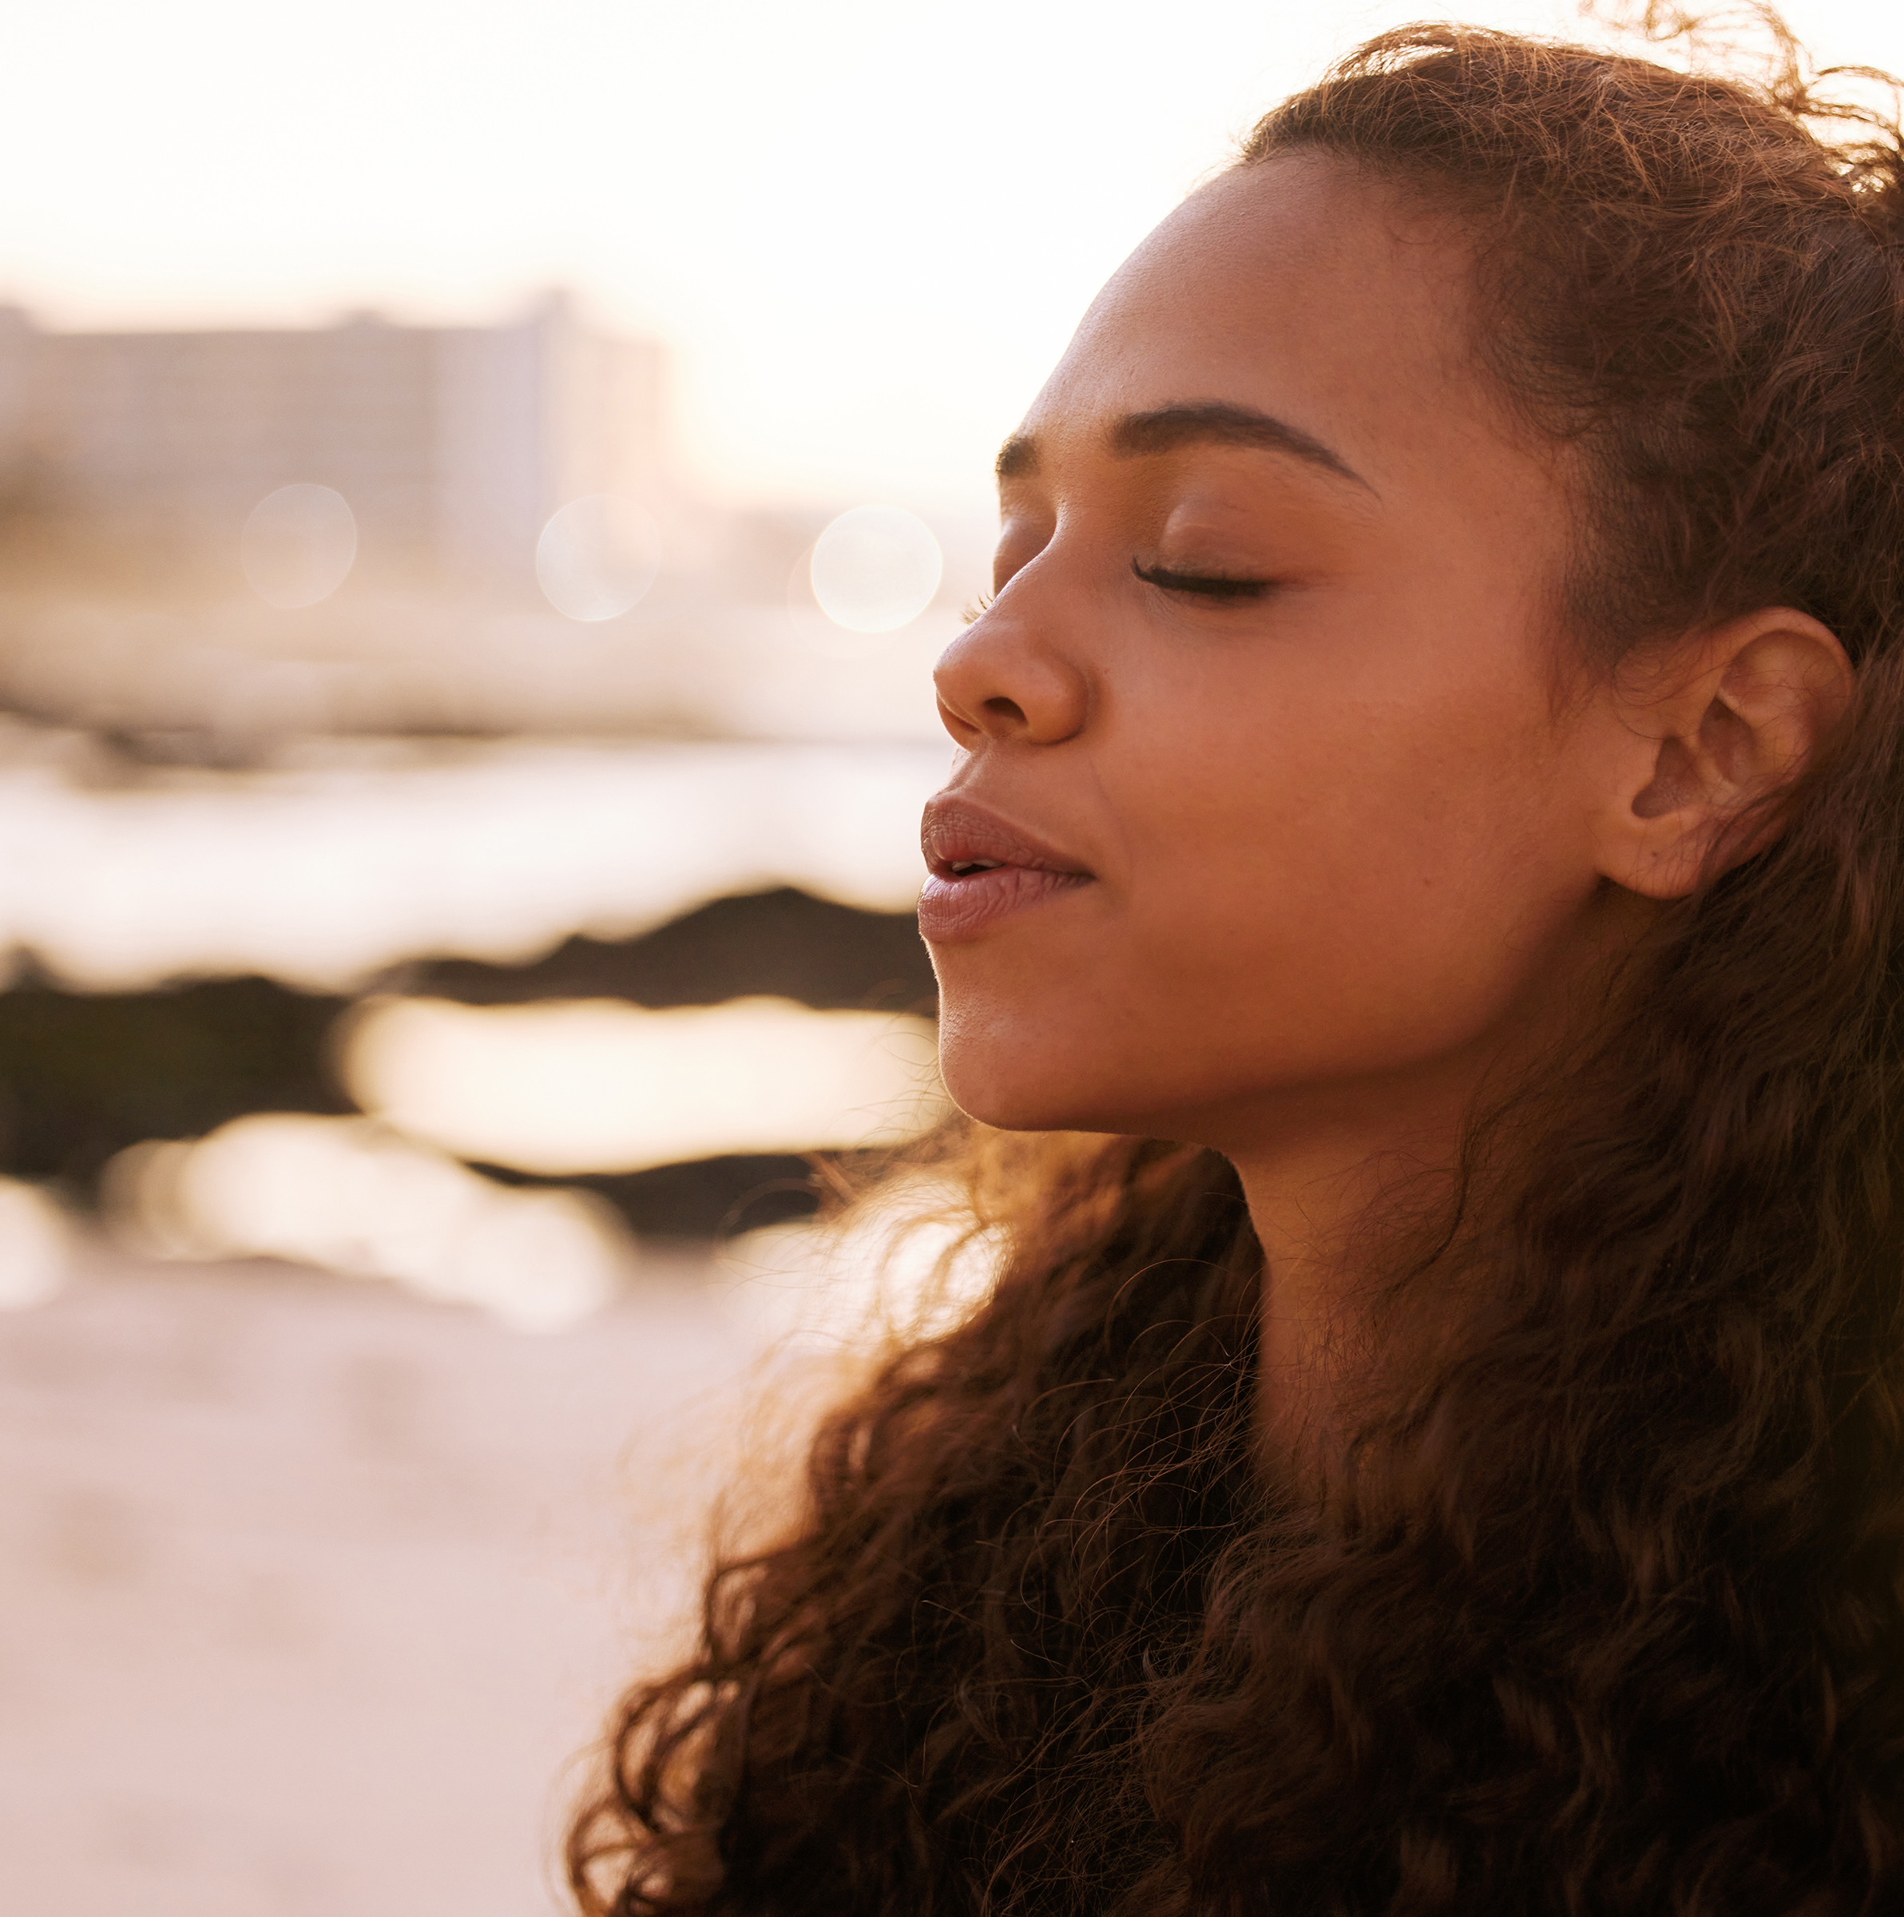
How can people express their opinions peacefully?
Why do people have peaceful protests?
How can peaceful protests help bring change in society?

Slide 29
John 1:5
"The light shines in the darkness, and the darkness has not overcome it."

Slide 30
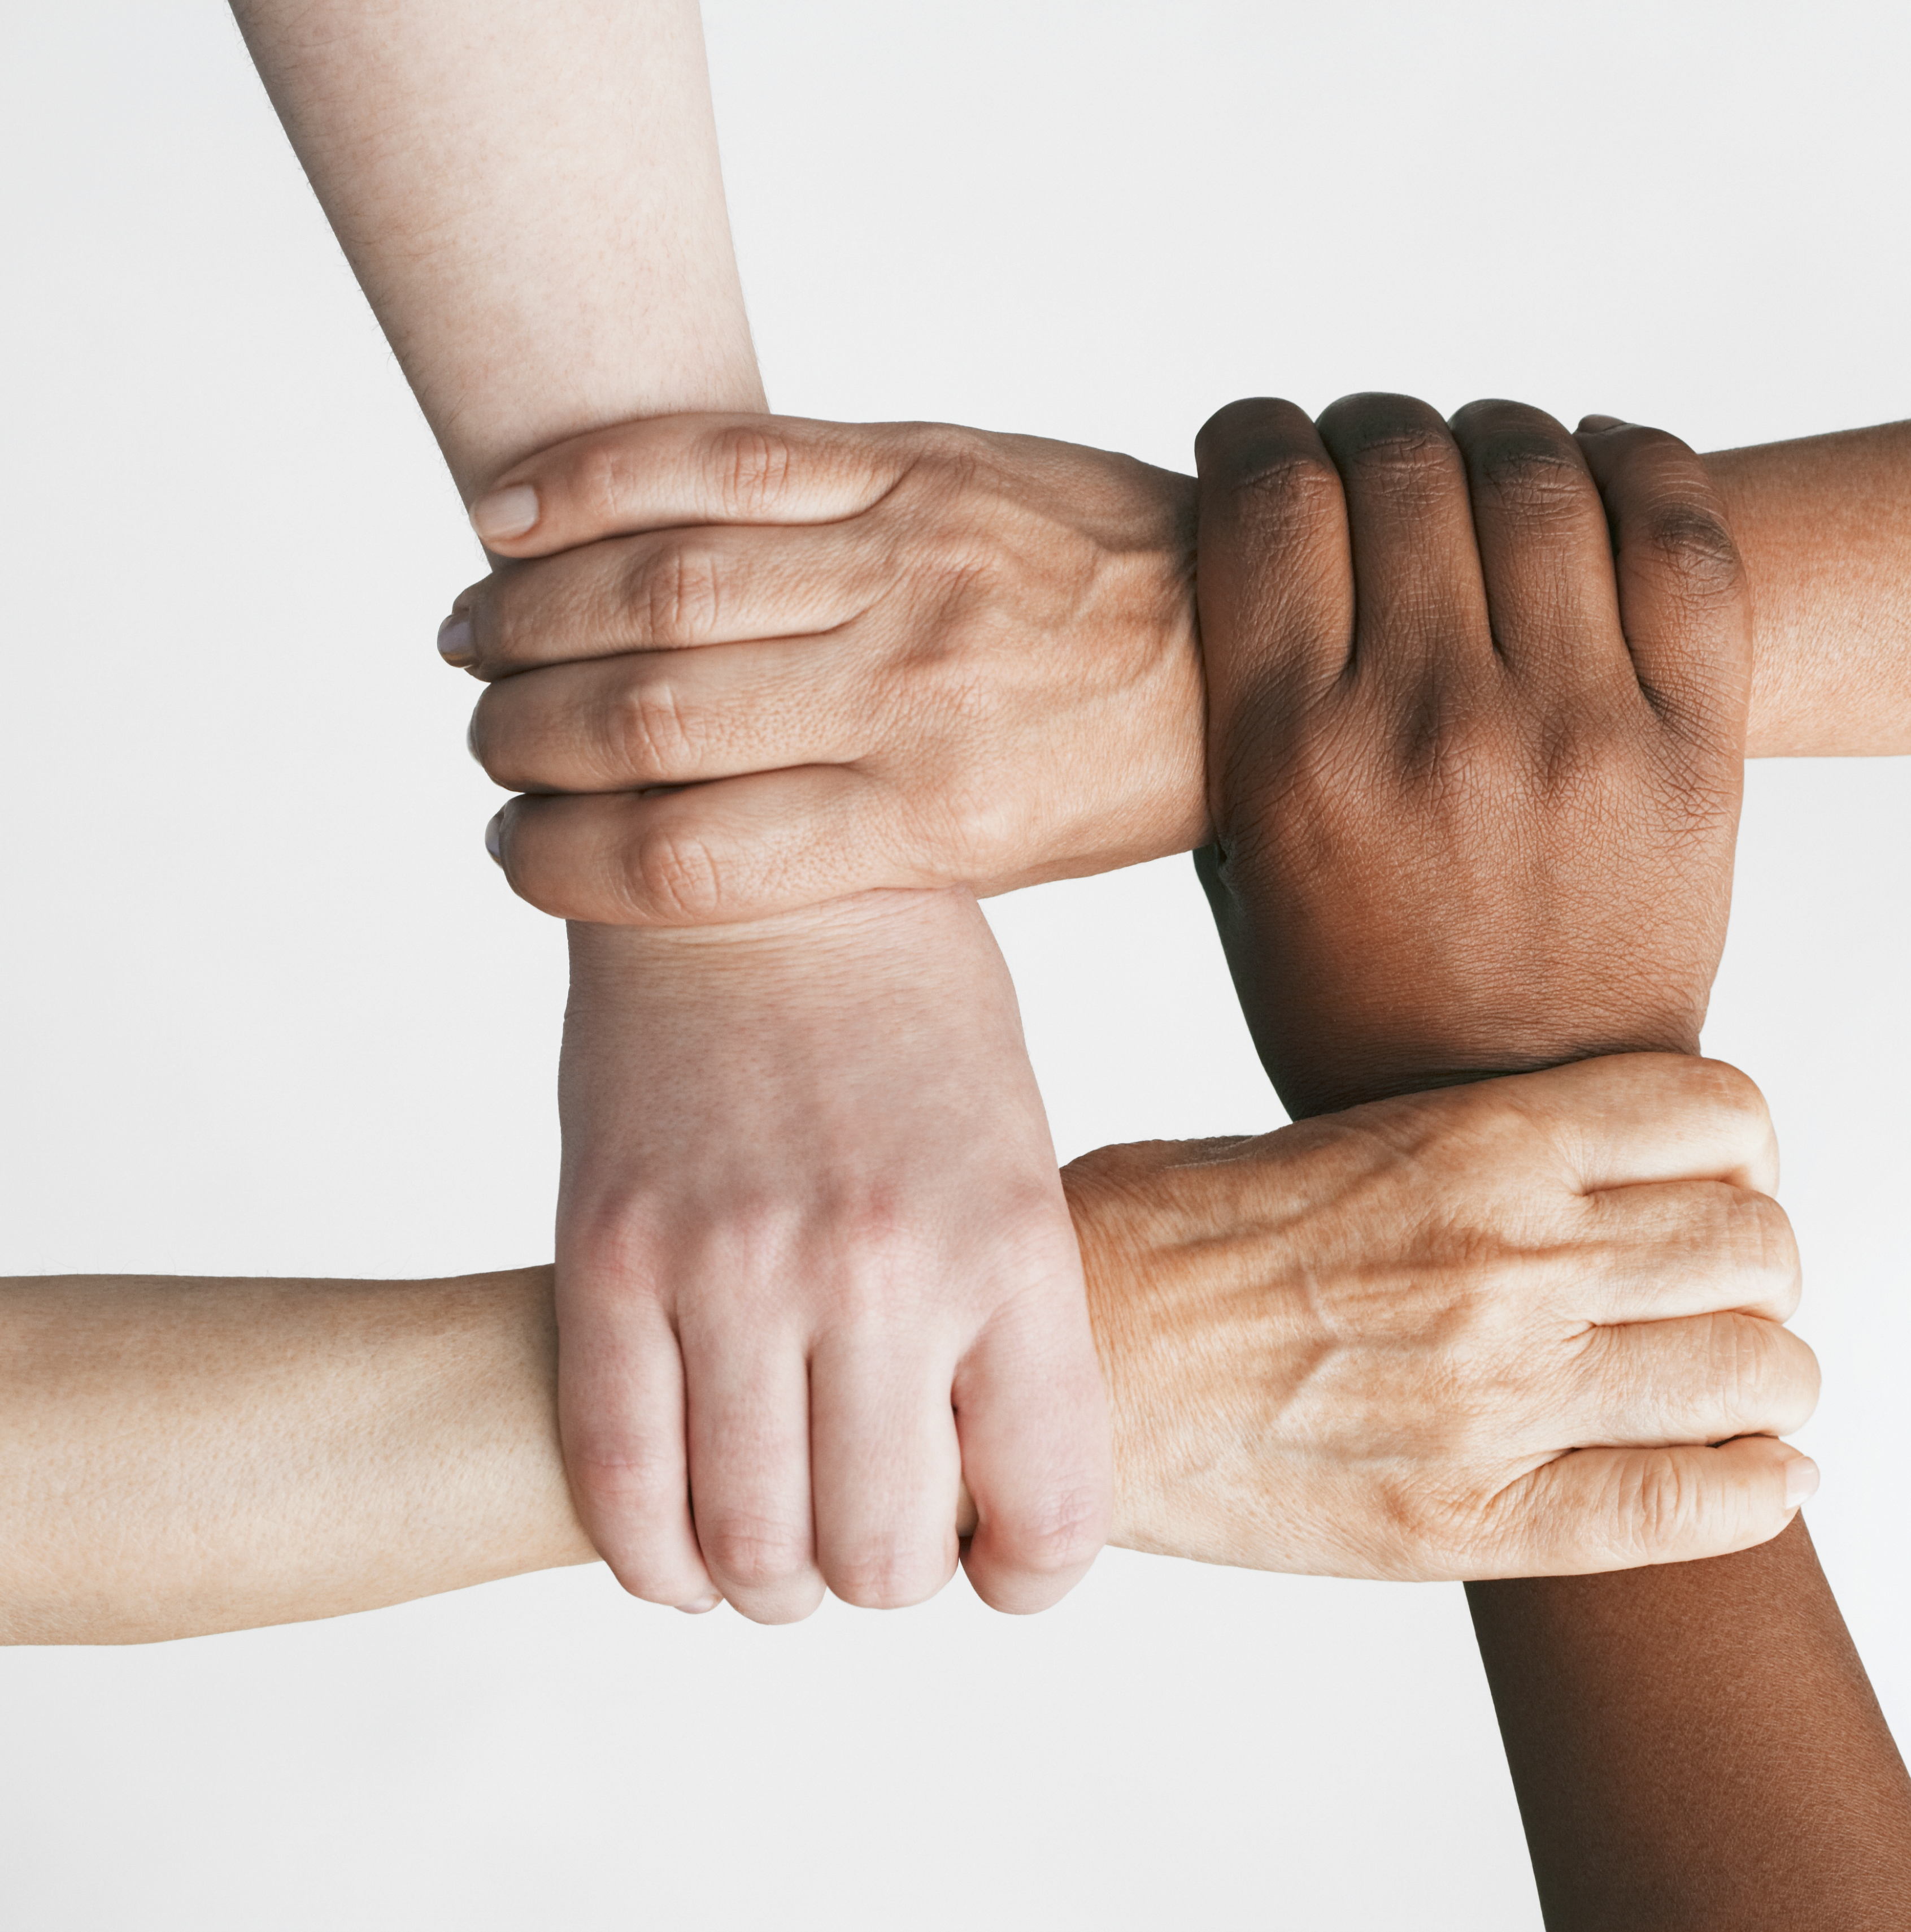
How much power do you think you have?
What influences this?
How can you use your position of power?

Slide 31
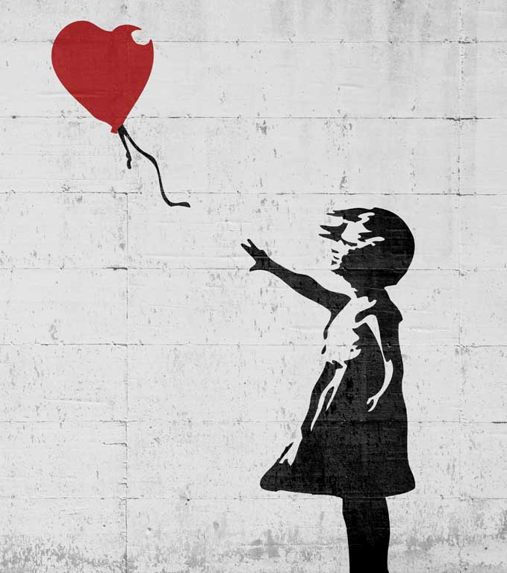
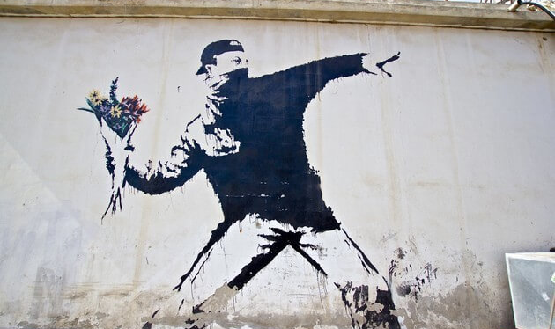
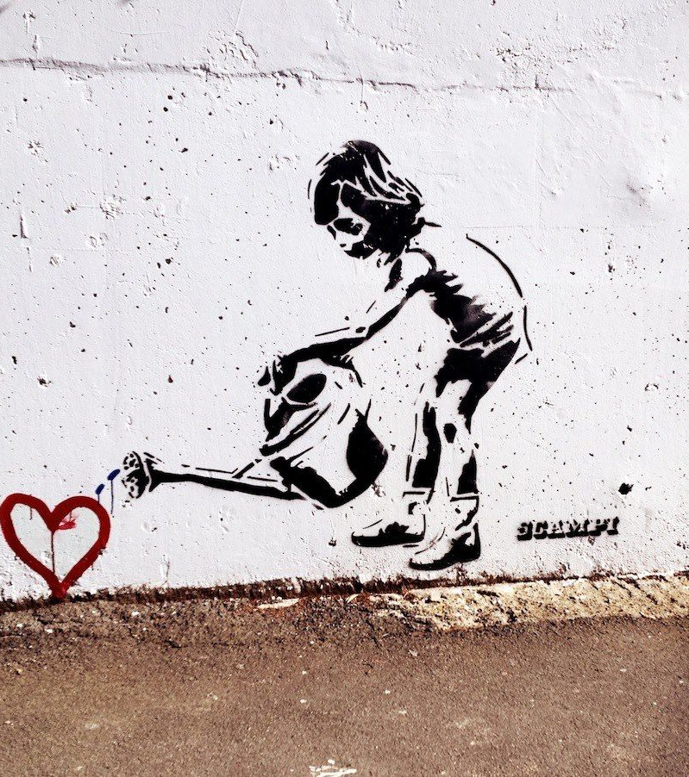
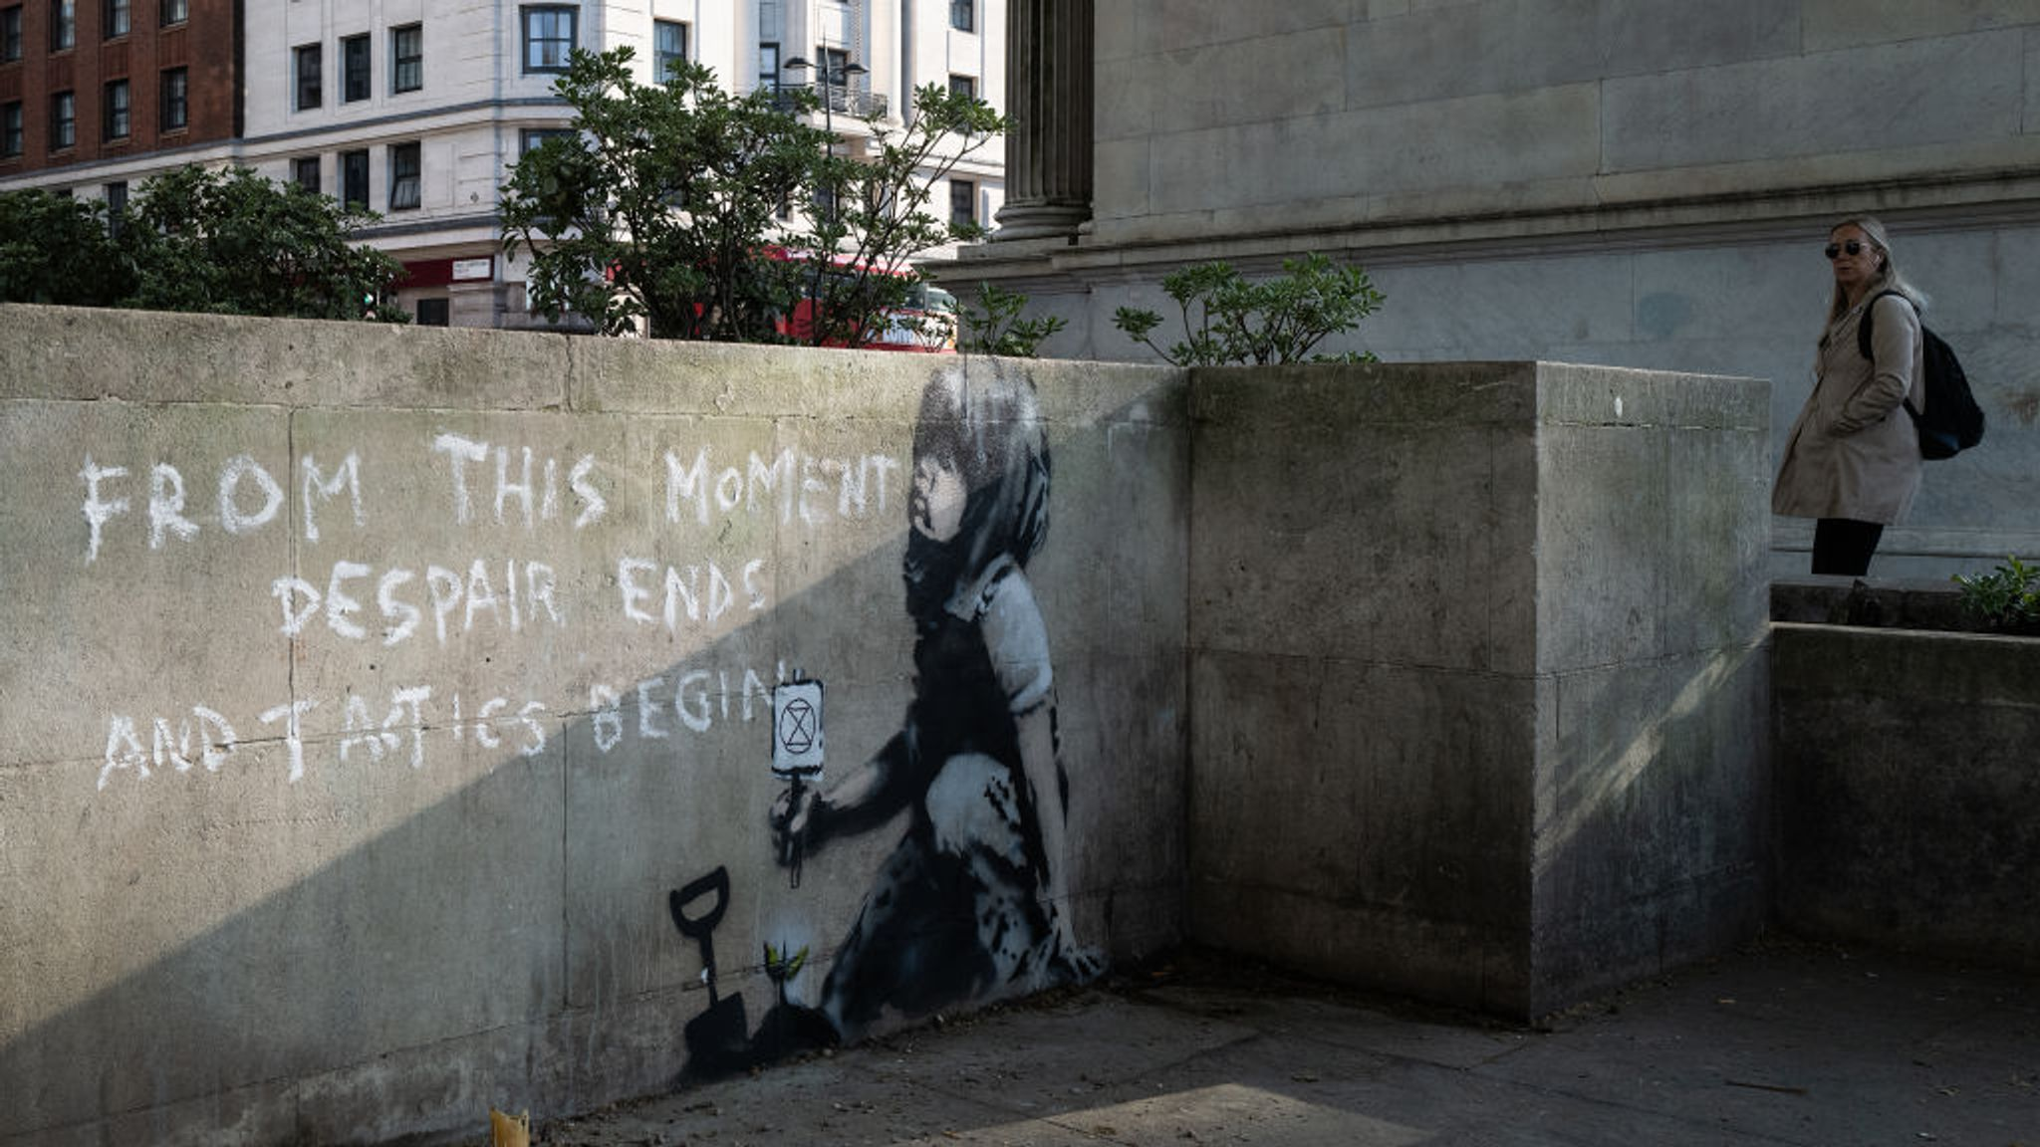
Banksy
Problems
Hopes

Slide 32
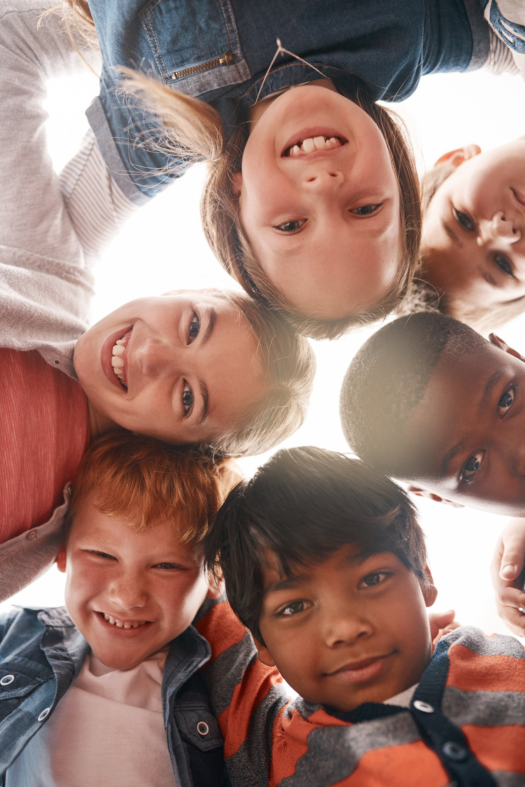
Sometimes, we see things that aren’t right, and it can be hard to know what to do. But standing up for what is wrong means being brave and speaking up or helping out when we see someone being treated unfairly.

Slide 33
It's important to remember that even though it might be difficult, standing up for what is right helps make things better and shows that we care about others. By doing this, we help make our world a kinder and fairer place for everyone.

Slide 34
Dear God,
Give us the courage to stand up for what is right and to speak out when we see something that isn’t fair or kind. Help us to be brave and loving, just as You are. Guide us to make choices that reflect Your love and justice. May we always act with compassion and make our world a better place for everyone.
Amen.

