Slide 3




Three habits
Community
Embrace
Power
Listen to others’ stories and see the world through their eyes.
Encounter others with authenticity and confidence.
Find hope and opportunity in the places where we long to see changes.

Slide 4
I wonder…
How can we intentionally flourish together?

Slide 5


Whose voice is heard?
Whose voice is missing?

Slide 6
How was forgiveness practised?
How was forgiveness practised? Was it linked to actions, or did the creature demonstrate forgiveness towards itself to move on?

Slide 7

"It is the heart that makes [someone] rich."
Henry Ward Beecher

Slide 8
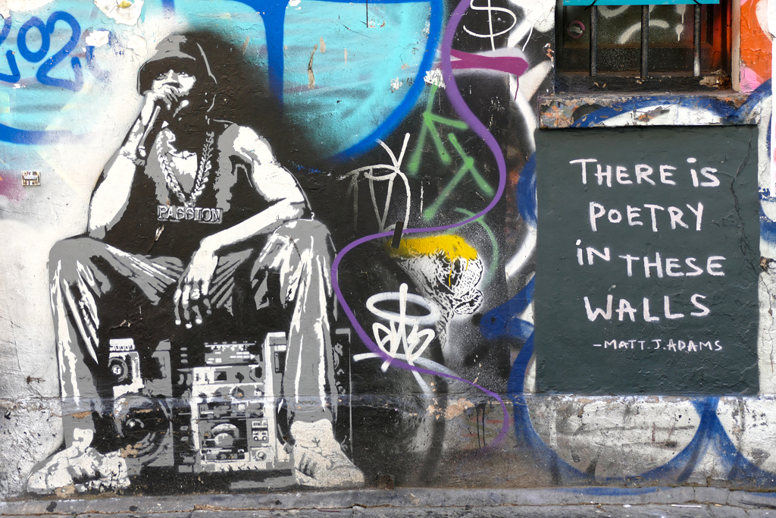
Think of an instance when you might not have recognised the richness of another person or their culture because you focused on material wealth, access to technology, or held an attitude of superiority.
How could you view things differently?

Slide 9
Ephesians 4:32
"Be kind and compassionate to one another, forgiving each other, just as in Christ God forgave you."

Slide 11
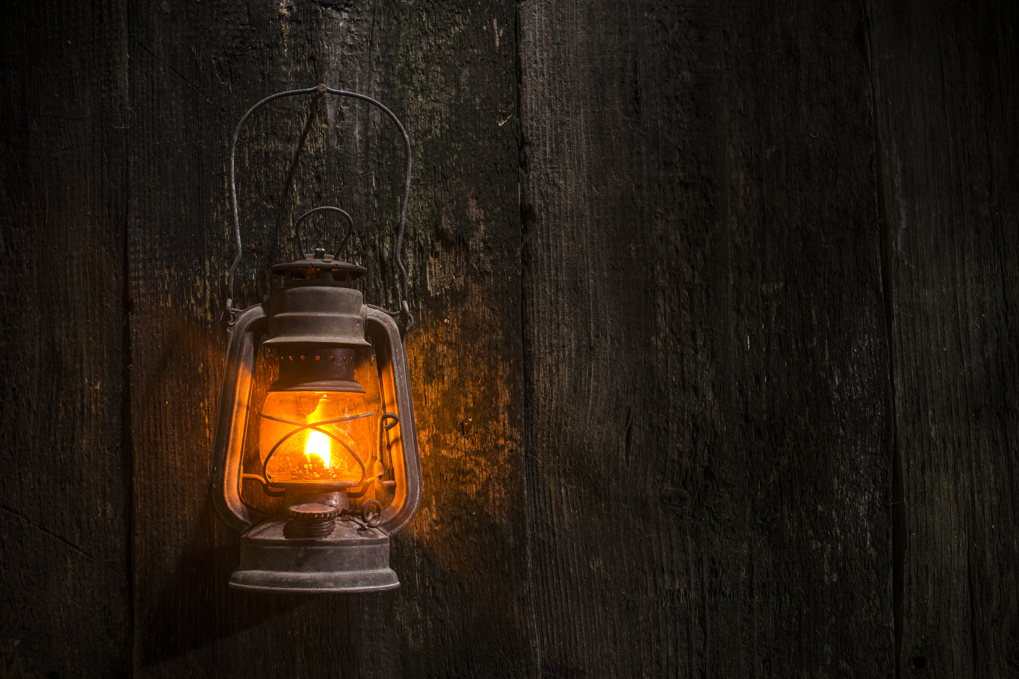
Role play or interview
Imagine how you would help the creature understand that forgiving itself is key to finding peace and moving forward.
What are your strengths?

Slide 12
How can you practise self-compassion when you face challenges?

Slide 13
Suggested questions
How did it feel when your home was taken away?
Was it hard to forgive yourself? Why or why not?
What do you wish others had understood about you?
What helped you find peace and move forward?
What do you wish others had understood about you?
What advice would you give to someone who feels like they’ve lost everything?

Slide 14
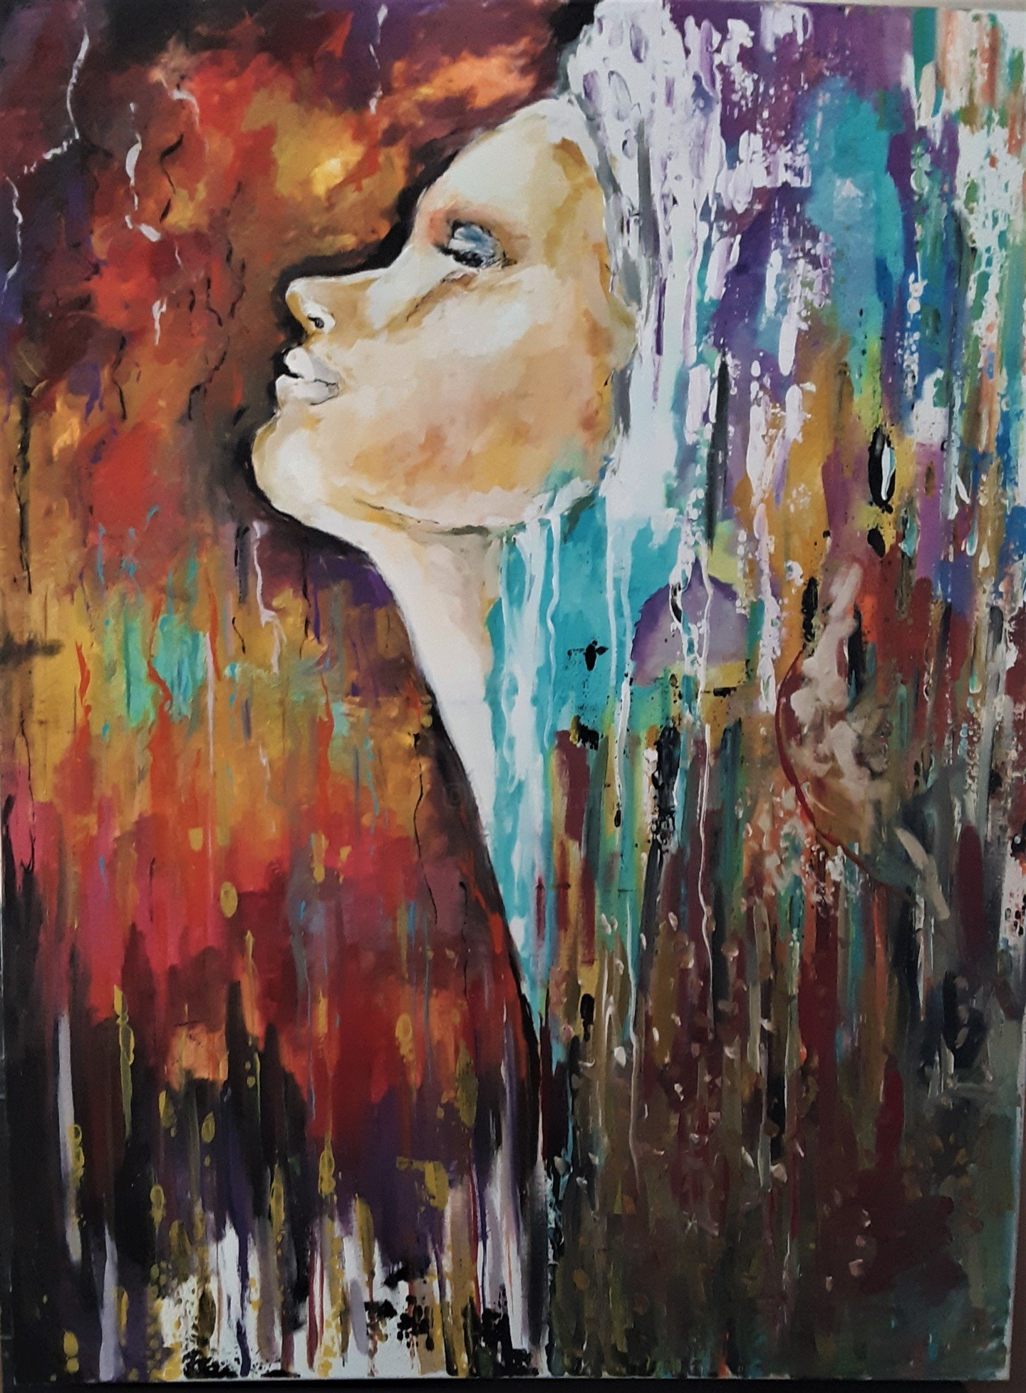
Places of peace
Peace map
Peace looks like...
Peace journal
"Do not let your hearts be troubled and do not be afraid."
John 14:27 (NIV)
Mindfulness reflection
Class discussion or circle time

Slide 15
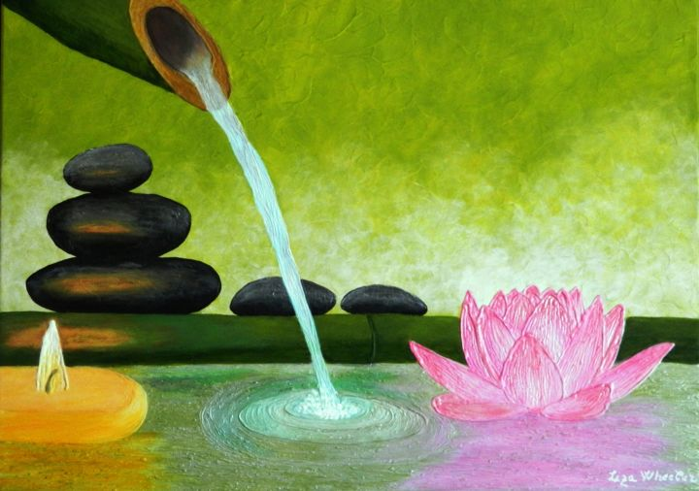
How and where can we find spaces of peace?
Why is this important?
What does peace look like for you?

Slide 16
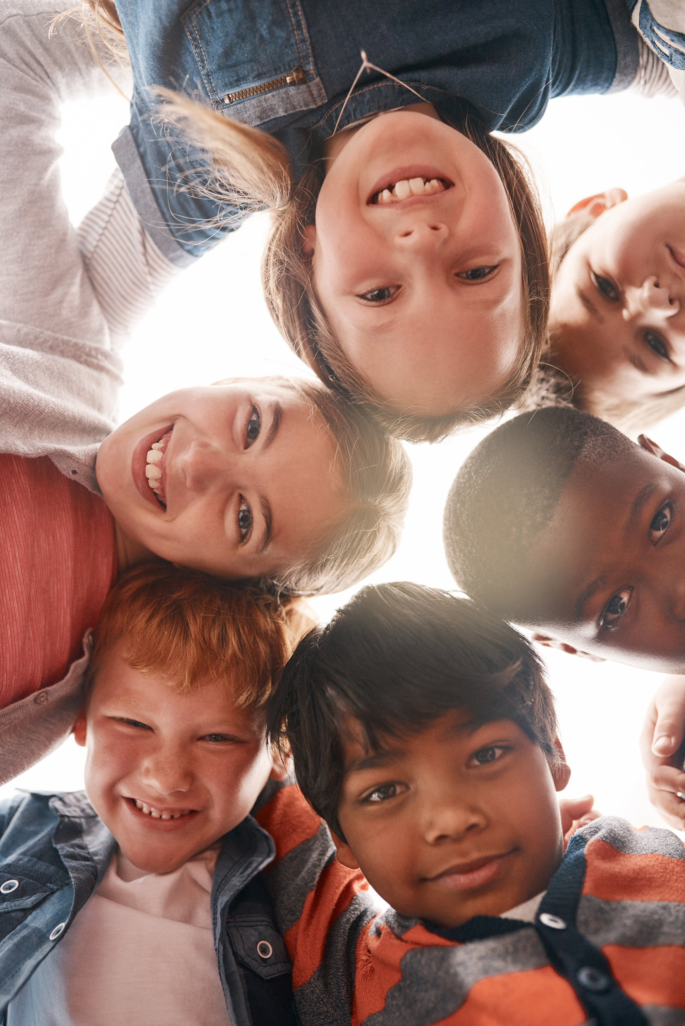
Finding places of peace is important for everyone. These are places where we feel calm and happy, like a cosy corner at home, a quiet spot in the park, or while reading a favourite book.

Slide 17
It's also important to be kind to ourselves, giving ourselves breaks when we need them and treating ourselves with gentle words.
By discovering our own peaceful places and practising self-kindness, we can bring more calm and happiness into our lives and the lives of those around us.

Slide 18
Dear God,
Thank you for the peaceful places in our lives where we can feel calm and happy. Help us to find and cherish these moments of tranquility, whether it's a cosy corner at home, a quiet spot in the park, or enjoying a favourite book. Teach us to be kind to ourselves, giving ourselves the breaks we need and treating ourselves with gentle words.
May we share this peace and kindness with those around us, spreading your love and serenity.
Amen.

