Slide 3




Three habits
Community
Embrace
Power
Listen to others’ stories and see the world through their eyes.
Encounter others with authenticity and confidence.
Find hope and opportunity in the places where we long to see changes.

Slide 4
I wonder…
How can we intentionally flourish together?

Slide 5


The story ends in an interesting way.
What could happen next?

Slide 6

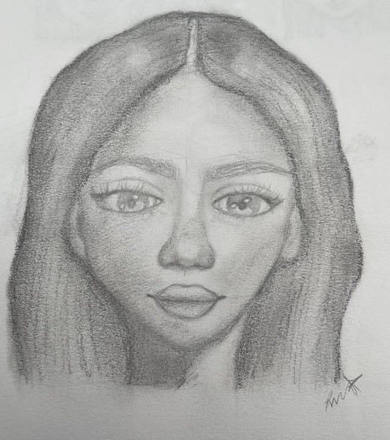
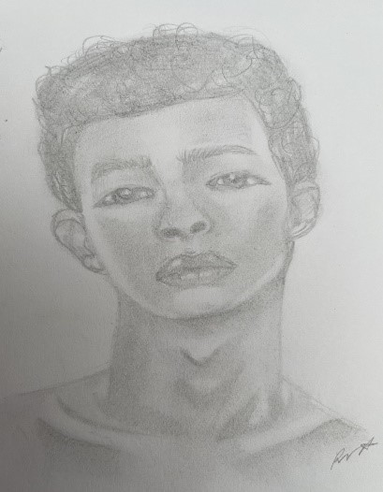
What is similar?
What is different?

Slide 7
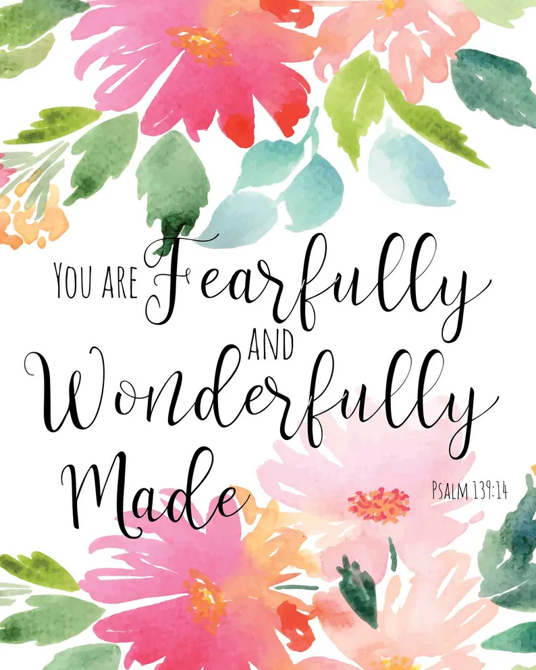
What can happen when we don’t see the value of others because they are different to us?
What can happen when we value the inherent worth and dignity of others?

Slide 9
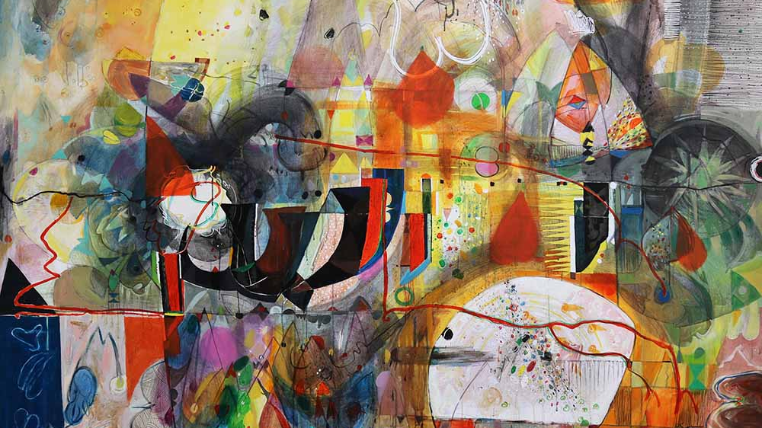
Ubuntu
"I am because we are"

Slide 10
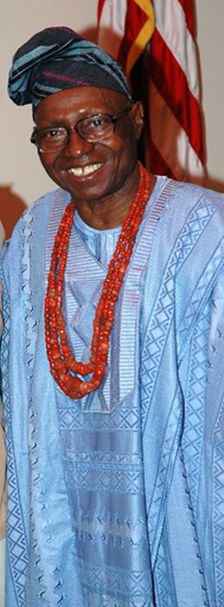
Chief Oloruntoba
Chief Zacheus Oloruntoba was a very talented person who was born on 1st October 1919 (Nigeria’s Independence Day). He was not only a leader in his community but also an artist, which means he created beautiful art, and he knew a lot about using herbs as medicine. He loved playing polo, and he could play the flute.

Slide 11
When Chief Oloruntoba created his artwork, he used special things like vegetable dyes, herbs, handmade papers, and silk thread. These made his paintings look really colourful and interesting! His art was incredible because you could feel it, not just see it.
People from all over the world loved his artwork and wanted to see them. He had shows in places like London, New York, and Nigeria.

Slide 12
Some really famous people, like Queen Elizabeth II and Muhammad Ali, loved his art and wanted to have it in their homes. Imagine having art made by someone who was also friends with a famous jazz musician like Ornette Coleman.
Chief Oloruntoba's life was full of adventure and creativity, and he shared that with people everywhere through his incredible art.

Slide 13
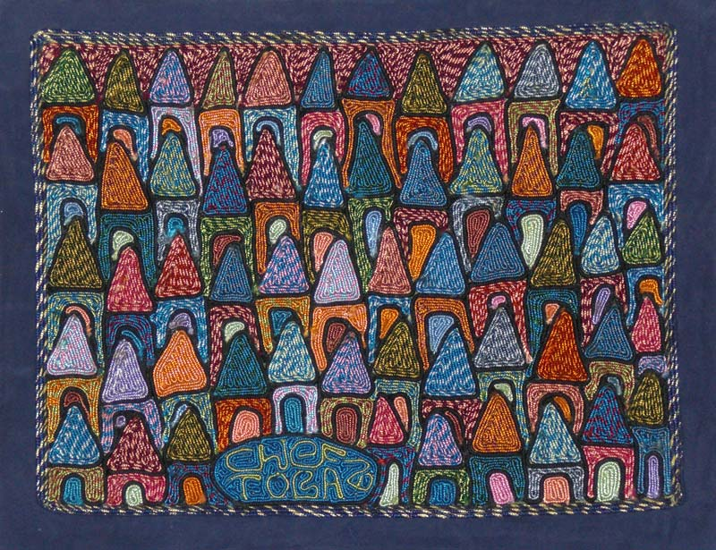
What do you see?
What do you think?
What do you know?
What do you want to know?

Slide 14
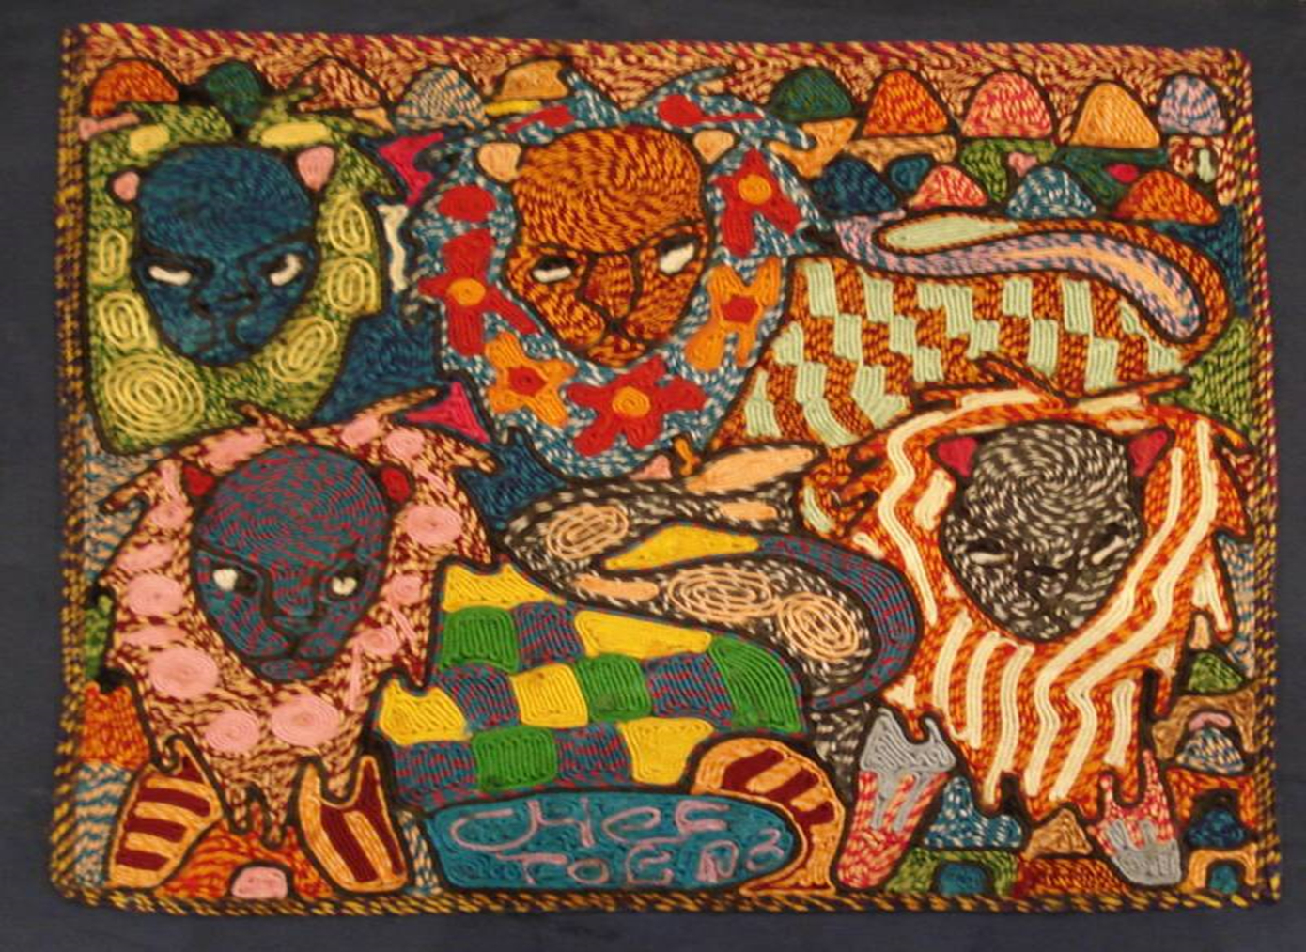
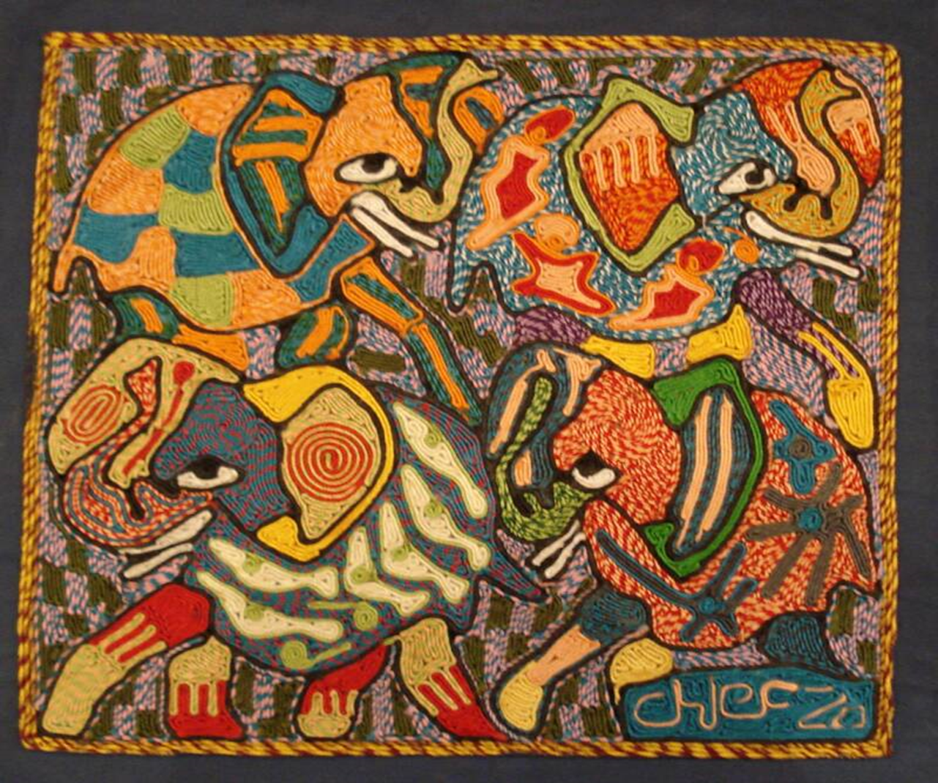
What do you see?
What do you think?
What do you know?
What do you want to know?

Slide 15
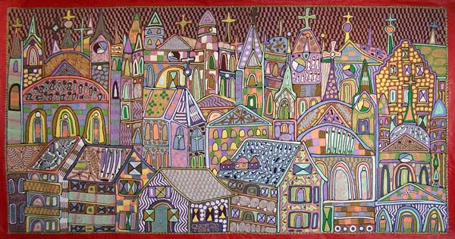
What do you see?
What do you think?
What do you know?
What do you want to know?

Slide 16
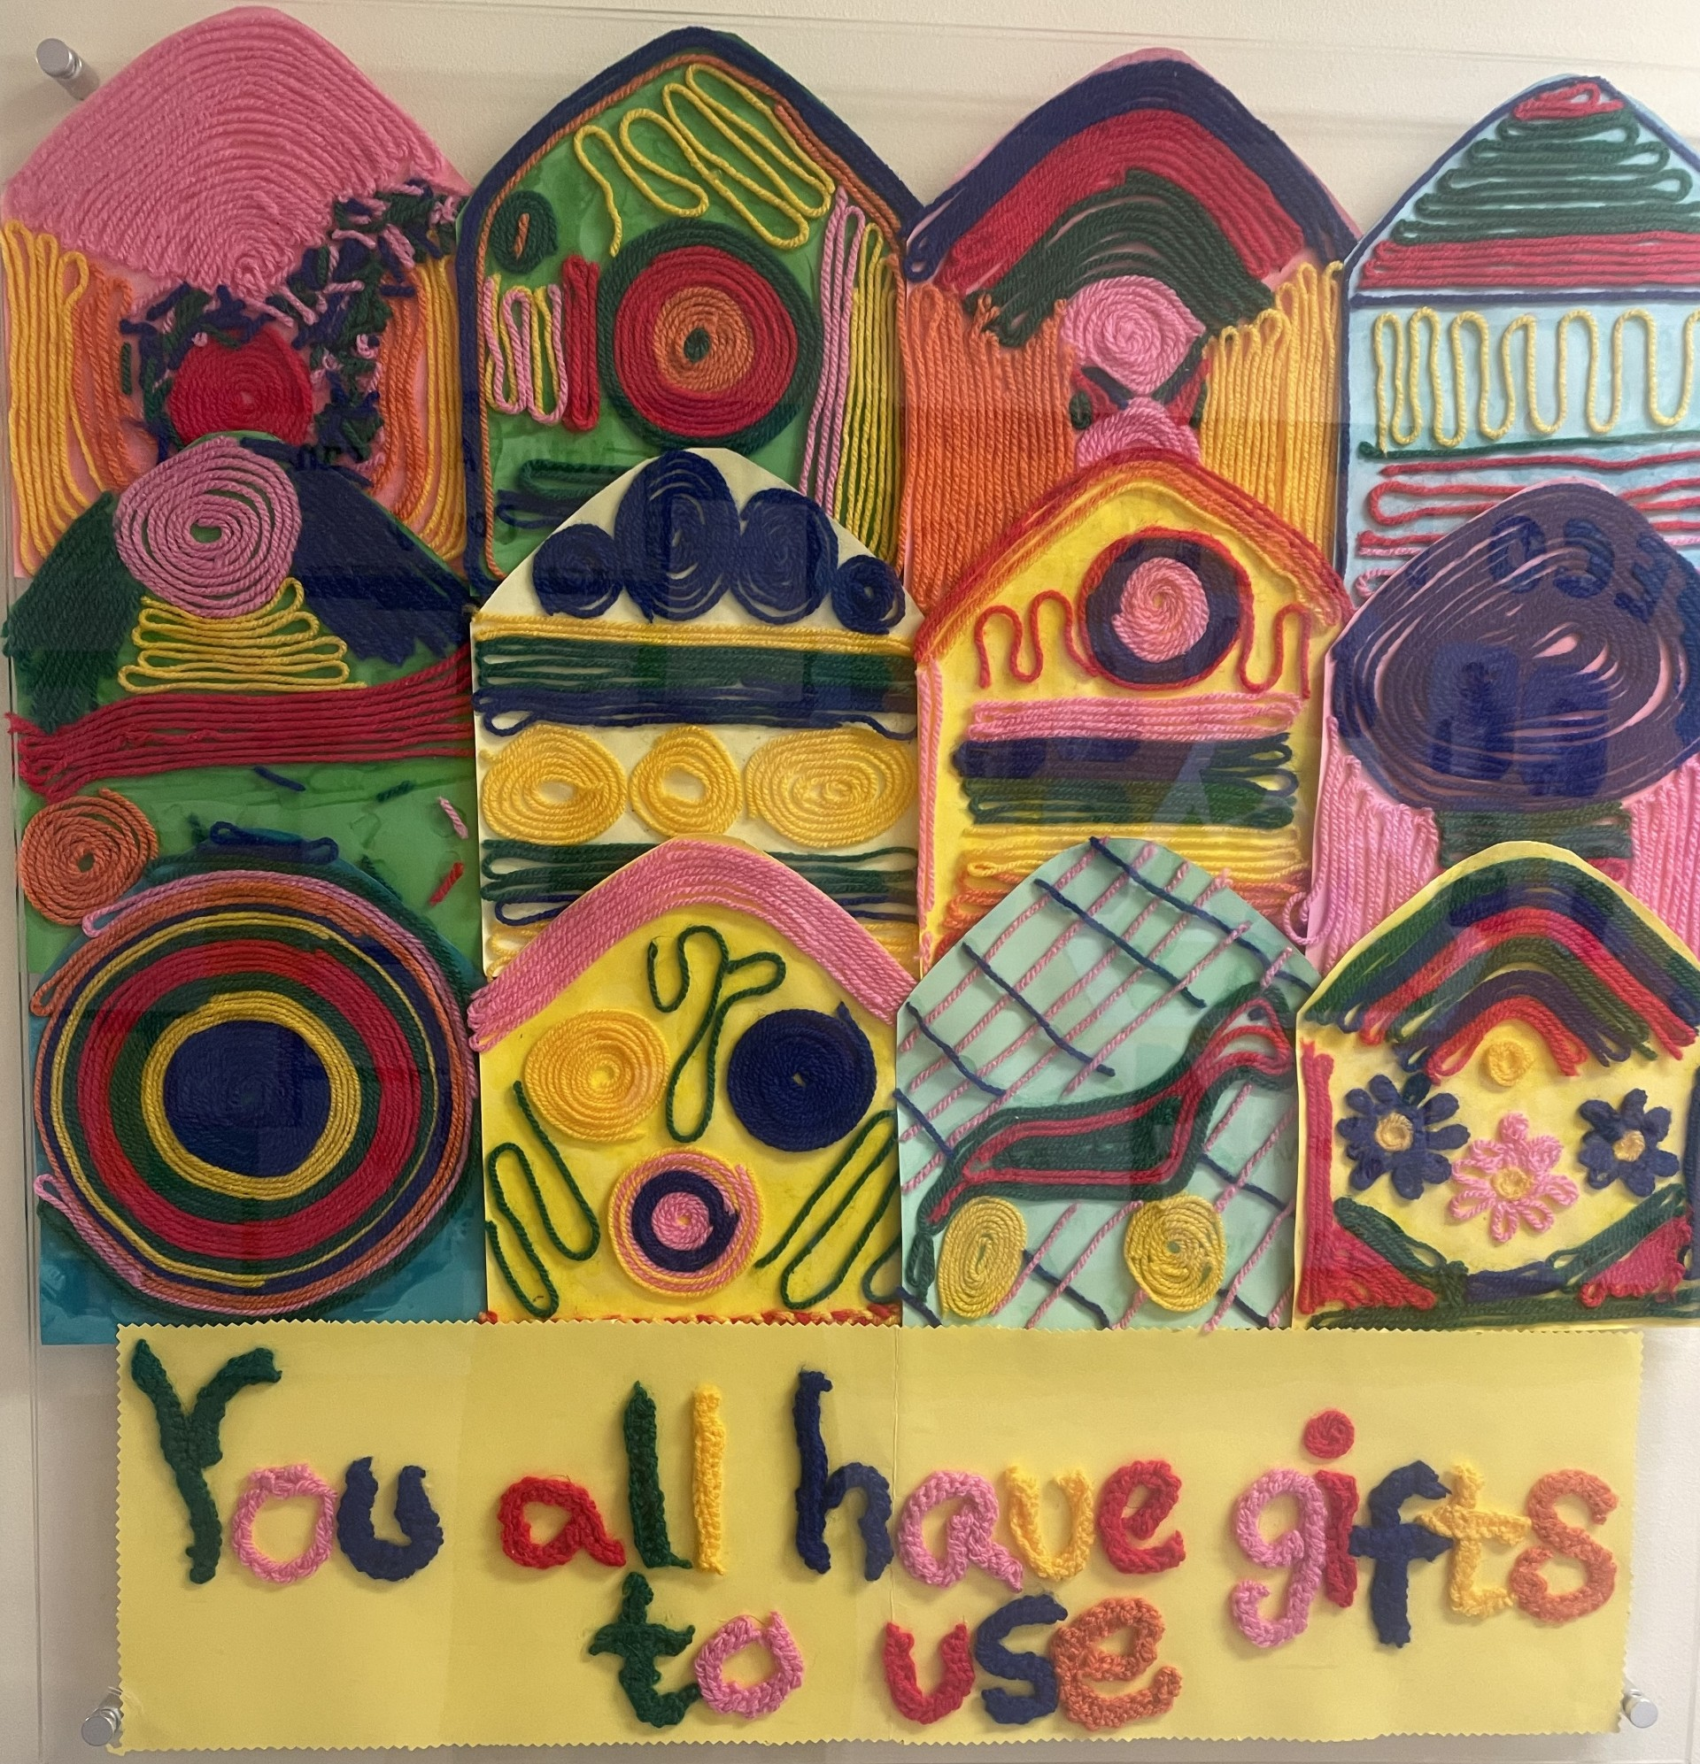
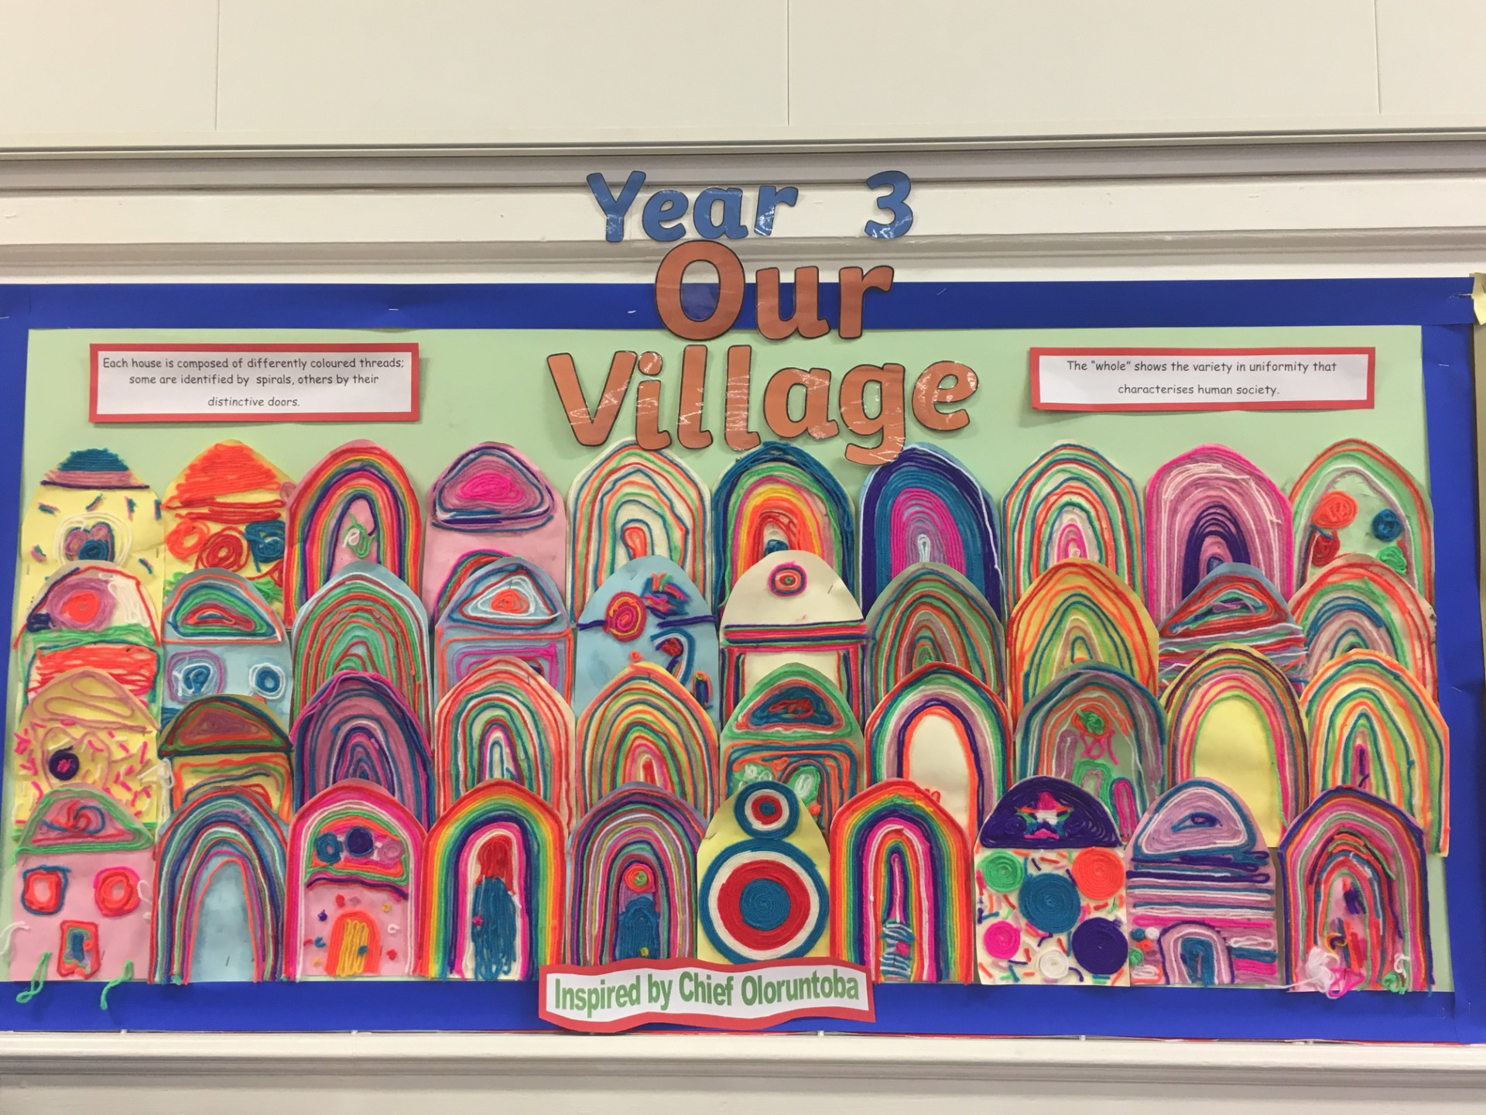
Time to work together to create your village

Slide 17
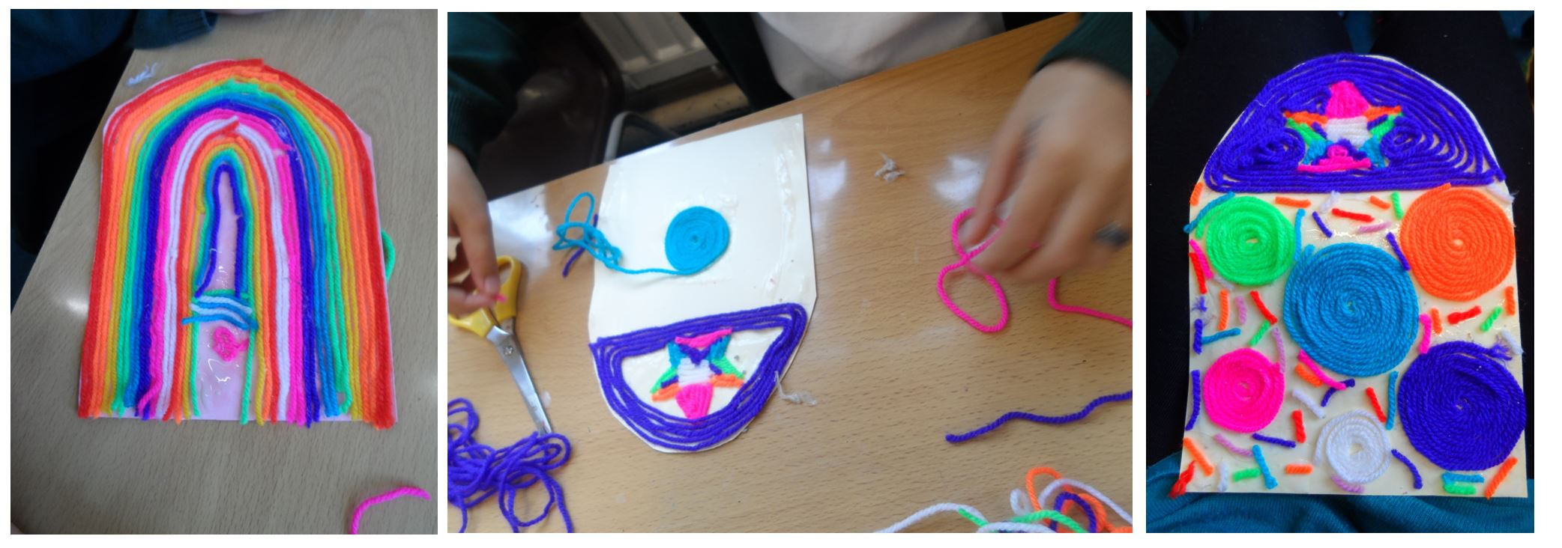

Slide 18
1 Corinthians 12:27
"Now you are the body of Christ, and each one of you is a part of it."

Slide 19
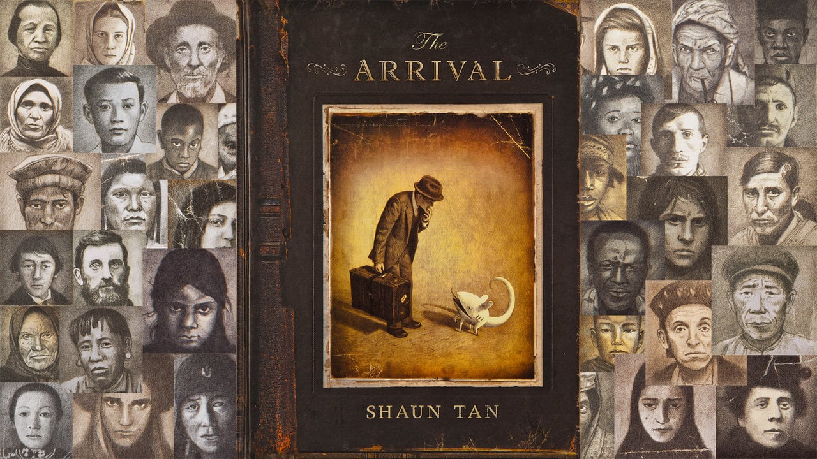
What do you see?
What do you think?
What do you know?
What do you want to know?

Slide 20
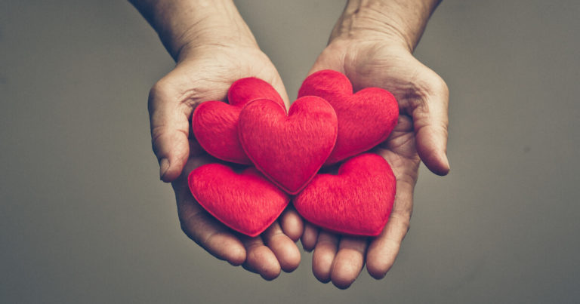
Compassion Bridges Hearts
Who is marginalised or excluded in our communities?
How can compassion bridge hearts to help our village/community grow?

Slide 21
Can our village grow by making others feel welcome?
What could this look like globally?

Slide 22
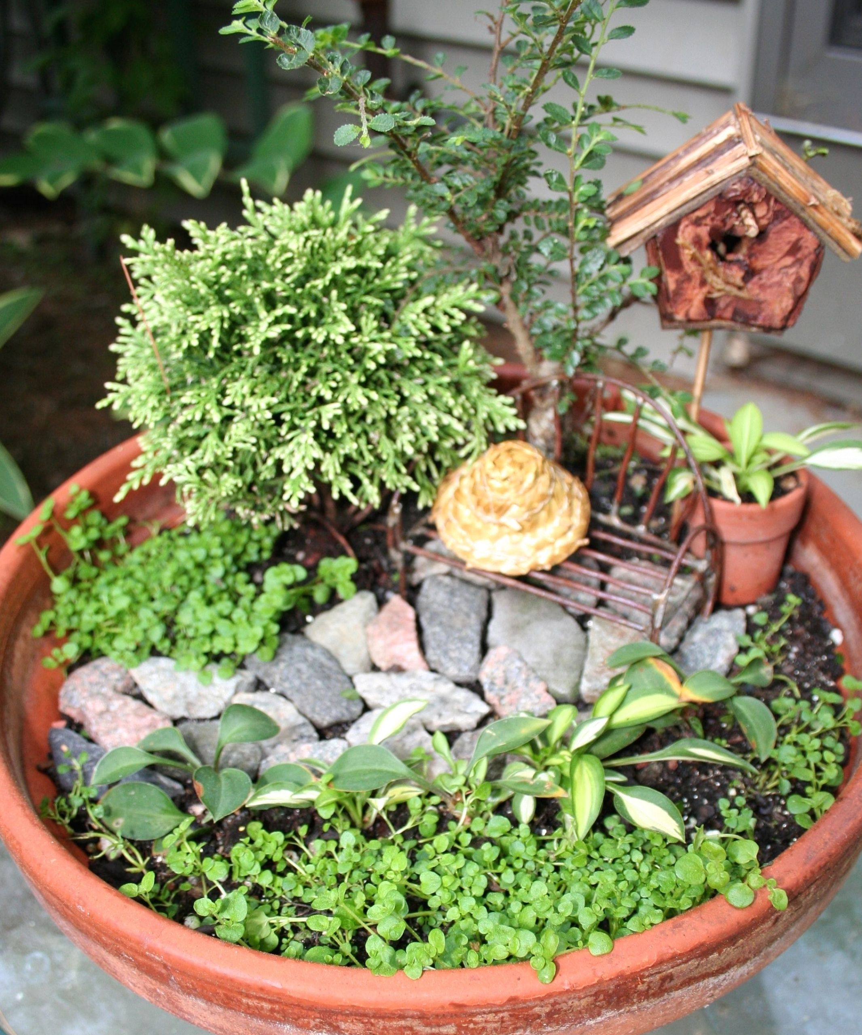
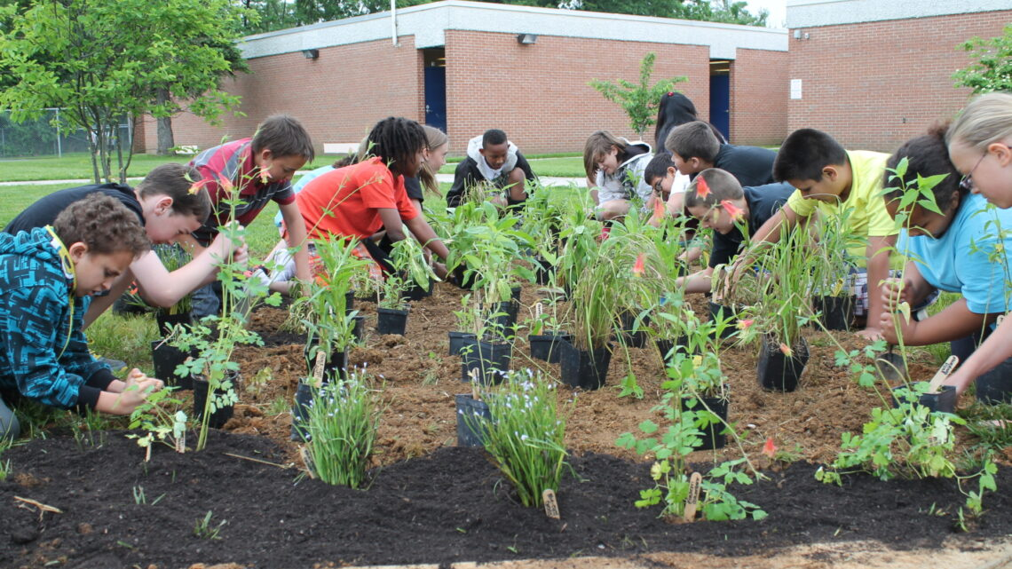
Community project
Community garden
Mini-garden project

Slide 23
I wonder…
How can we intentionally flourish together?

Slide 24
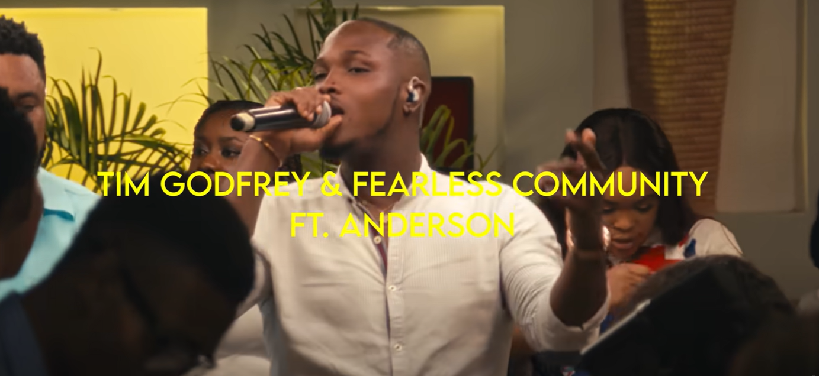

Big God – Tim Godfrey X Fearless Community ft. Anderson

Slide 25
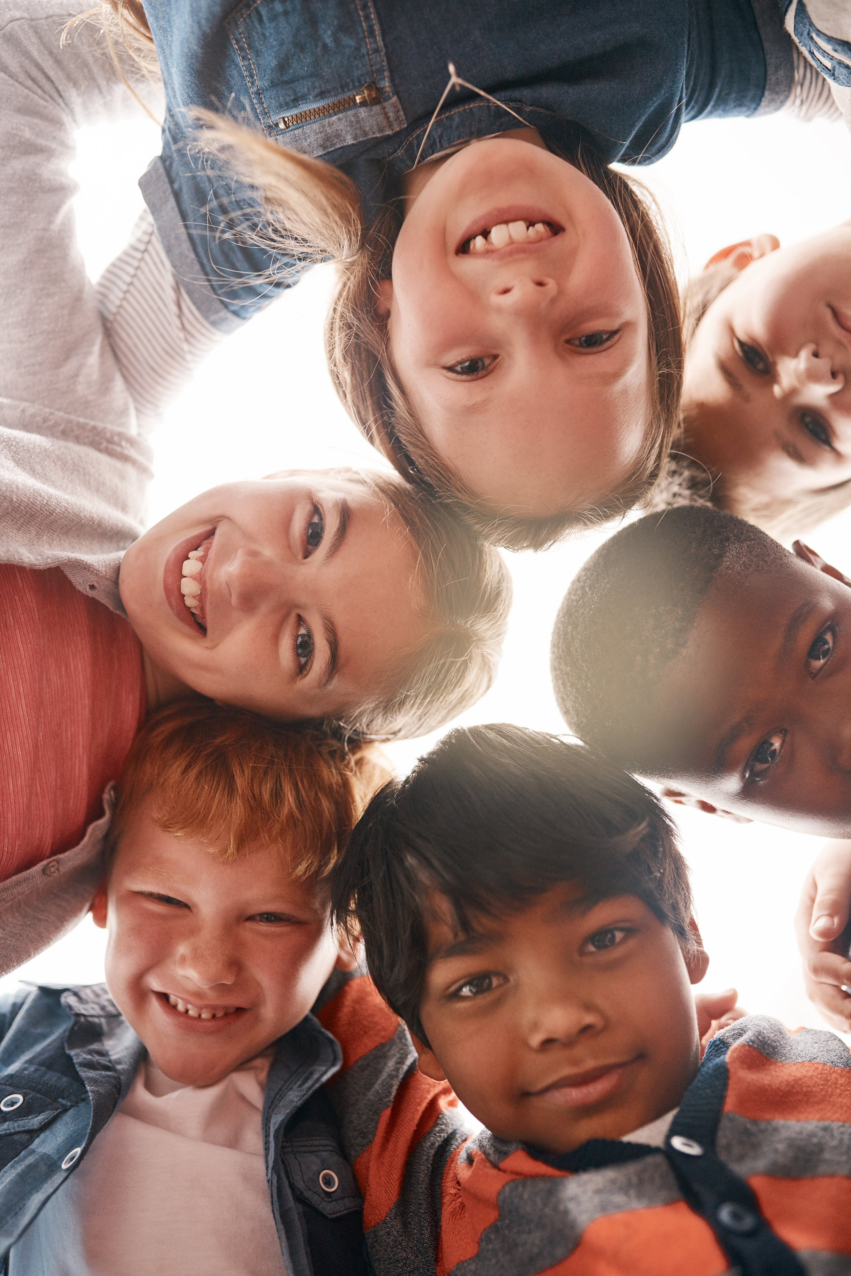
In our communities, it’s important to include everyone and make sure no one feels left out. The idea of Ubuntu means "I am, because we are," which reminds us that we are all connected and need each other.

Slide 26
When we include others and help everyone feel welcome, we make our community stronger and happier
By working together and supporting each other, we show that everyone matters and that we are all part of one big circle of compassion.

Slide 27
Dear God,
Help us to include everyone in our community and make sure no one feels left out. Teach us the spirit of Ubuntu, reminding us that we are all connected and that we need each other. Guide us to show kindness and compassion, making our community a place where everyone feels welcome and valued. May our actions reflect your love and create a circle of compassion that brings us all closer together.
Amen.

